Slide 1

IMPLEMENTING IOE
Week 5
Assist. Prof. Rassim Suliyev - SDU 2017

Slide 2
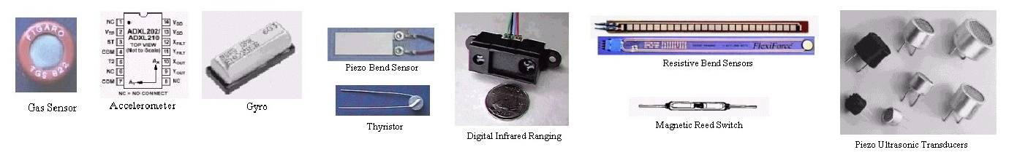
Getting Input from Sensors
Sensors give report on the world around it
Sensors convert physical input to an electrical signal
The electrical signal depends on the kind of sensor and how much information it needs to transmit
  Some use substance that alters their electrical properties in response to physical change
  Others are sophisticated electronic modules that use their own microcontroller to process information

Slide 3
Methods to provide information
Digital on/off - switch a voltage on and off
  Tilt sensor
  Motion sensor
Analog - provide an analog signal (voltage)
  Temperature sensor
  Light intensity sensor
Pulse width - measure the duration of a pulse
  Distance sensors

Slide 4
Methods to provide information
Serial - provide values using a serial protocol
  RFID reader
  GPS module
Synchronous protocols: I2C and SPI
  The I2C and SPI digital standards were created for microcontrollers to talk to external sensors and modules
  These protocols are used extensively for sensors, actuators, and peripherals
  E.g: compass module, LCD display

Slide 5
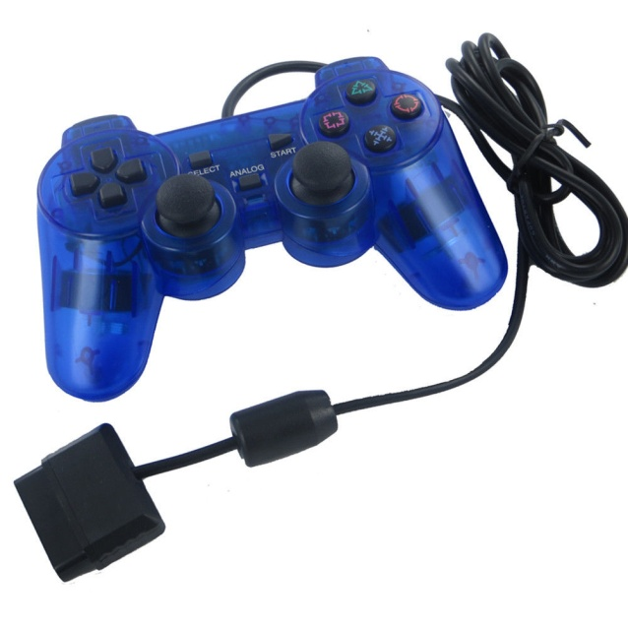
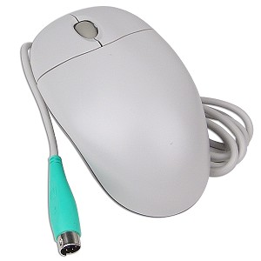
Consumer devices
Contain sensors but are sold as devices in their own right
Provide sensors already incorporated into robust and ergonomic devices
They are also inexpensive as they are mass-produced
  PS2 mouse
  PlayStation game controller

Slide 6
Data sheets
Contains information about a sensor’s output signal
Available from the company from which you bought the device
Google search of the device part number or description
Are aimed at engineers designing products to be manufactured
Usually provide more detail than you need
Information on output signal will usually be in a section:
  Data format, interface, output signal, or something similar
Check the maximum voltage!!!

Slide 7
Noises
Reading sensors from the messy analog world is a mixture of science, art, and perseverance
Use trial and error method to get a successful result
Common problem:
  Sensor just tells you a physical condition has occurred
  But not what caused it
Skills to acquire with experience:
  Putting the sensor in the right context
  Location, range, orientation
  Limiting its exposure to things that you don’t want to activate it
Separating the desired signal from background noise
  Use a threshold to detect when a signal is above a certain level
  Take the average of a number of readings to smooth out noise spikes

Slide 8
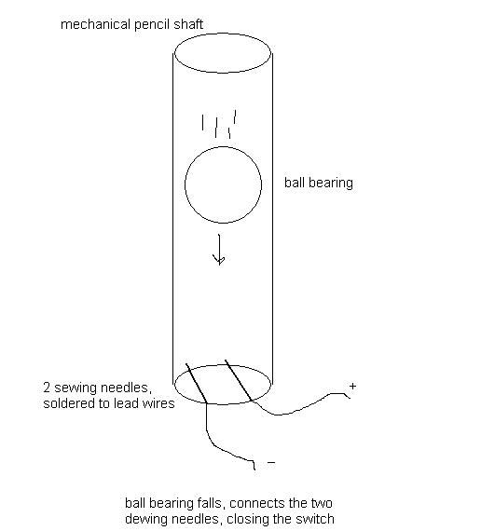
Detecting Movement
Detect when something is moved, tilted, or shaken
Tilt sensor - switch that closes a circuit when tilted
Ball bearing in a box with contacts at one end
Sensitive to small movements of around 5 to 10 degrees

Slide 9
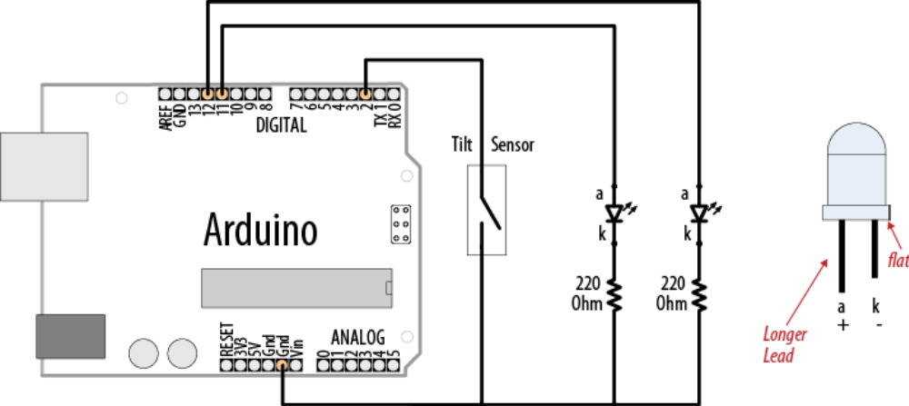
Detecting Movement
const int tiltSensorPin = 2; //pin the tilt sensor is connected to
const int firstLEDPin = 13; //pin for one LED
const int secondLEDPin = 12; //pin for the other
void setup(){
pinMode (tiltSensorPin, INPUT); //the code will read this pin
digitalWrite (tiltSensorPin, HIGH); // and use a pull-up resistor
pinMode (firstLEDPin, OUTPUT); //the code will control this pin
pinMode (secondLEDPin, OUTPUT); //and this one
}
void loop(){
if (digitalRead(tiltSensorPin)){ //check if the pin is high
digitalWrite(firstLEDPin, HIGH); //if it is high turn on firstLED
digitalWrite(secondLEDPin, LOW); //and turn off secondLED
} else{ //if it isn't do the opposite
digitalWrite(firstLEDPin, LOW);
digitalWrite(secondLEDPin, HIGH);
}
}

Slide 10
Shake detection
const int tiltSensorPin = 2;
const int ledPin = 13;
int tiltSensorPreviousValue = 0;
int tiltSensorCurrentValue = 0;
long lastTimeMoved = 0;
int shakeTime = 100;
void setup(){
pinMode (tiltSensorPin, INPUT);
digitalWrite (tiltSensorPin, HIGH);
pinMode (ledPin, OUTPUT);
}
void loop(){
tiltSensorCurrentValue=digitalRead(tiltSensorPin);
if (tiltSensorPreviousValue != tiltSensorCurrentValue){
lastTimeMoved = millis();
tiltSensorPreviousValue = tiltSensorCurrentValue;
}
if (millis() - lastTimeMoved < shakeTime){
digitalWrite(ledPin, HIGH);
} else{
digitalWrite(ledPin, LOW);
}
}

Slide 11
millis() function
Returns long type value - number of milliseconds since the current sketch started running
Will overflow (go back to zero) in approximately 50 days
Determine the duration of the event by subtracting the pre-stored start time from the current time
long startTime = millis();
…do something…
long duration = millis() - startTime;

Slide 12
Similar digital output sensors
Mechanical switch sensors can be used in similar ways
Float switch can turn on when the water level in a container rises to a certain level
The way a ball cock works in a toilet cistern
A pressure pad can be used to detect when someone stands on it

Slide 13
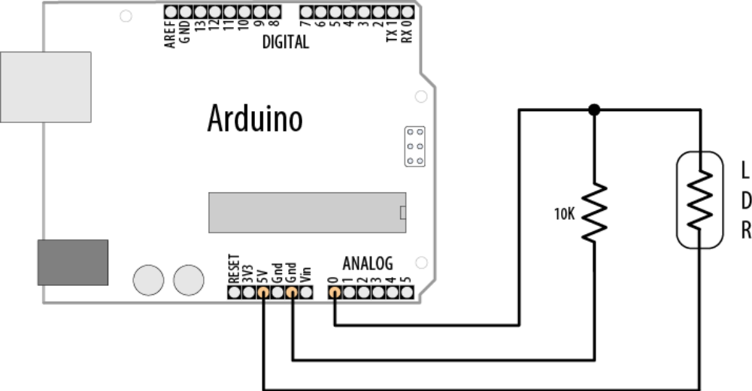
Detecting Light
Detect changes in light levels
  Something passes in front of a light detector
  Detecting when a room is getting too dark
Use a light dependent resistor (LDR)
  Changes resistance with changing light levels
  Produces a change in voltage
This circuit is the standard way to use any sensor that changes its resistance based on some physical phenomenon

Slide 14
Detecting Light
Not full range of possible values (0-1023)
  Since voltage will not be swinging between 0-5 V
LDR - simple kind of sensor called a resistive sensor
  Range of resistive sensors respond to changes in different physical characteristics
It is important to check the actual values the device returns in the situation you will be using it. Then you have to determine how to convert them to the values you need.

Slide 15
When a room is getting dark
const int ldrPin = A0;
const int ledPin = 13;
const int darknessThreshold = 500;
void setup(){
pinMode (ledPin, OUTPUT);
Serial.begin(9600);
}
void loop(){
if(analogRead(ldrPin) < darknessThreshold){
digitalWrite(ledPin, HIGH);
} else {
digitalWrite(ledPin, LOW);
}
}

Slide 16
Detecting motion
const int ldrPin = A0;
const int ledPin = 13;
const int movementThreshold = 20;
int previousReading = 0;
int currentReading = 0;
void setup(){
pinMode (ledPin, OUTPUT);
Serial.begin(9600);
previousReading = analogRead(ldrPin);
}
void loop(){
currentReading = analogRead(ldrPin);
if(abs(currentReading - previousReading) > movementThreshold){
previousReading = currentReading;
digitalWrite(ledPin, HIGH);
delay(1000);
digitalWrite(ledPin, LOW);
}
}

Slide 17
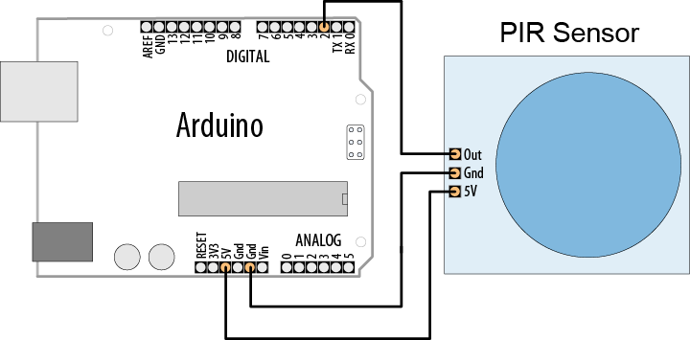
PIR motion detection
PIR - passive infrared sensor
  measures infrared light radiating from objects
Made from pyroelectric materials
  which generate energy when exposed to heat

Slide 18
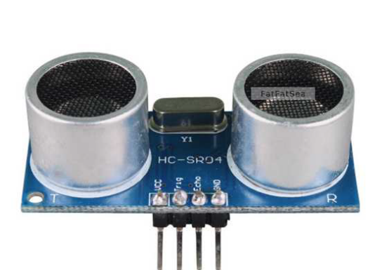
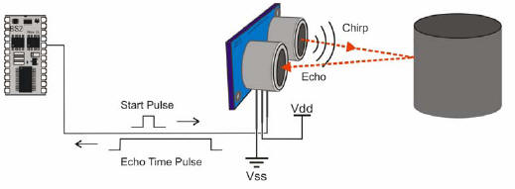
Measuring Distance
Ultrasonic distance sensor
  Measure the distance of an object (2 cm - 3 m)
  Modules includes ultrasonic transmitters, receiver and control circuit
Basic principle of work:
  Trigger trig pin for at least 10us with a high level signal
  The module automatically sends eight 40 kHz and detect whether there is a pulse signal back
  Time of high output duration at echo pin is the time from sending ultrasonic to returning.

Slide 19
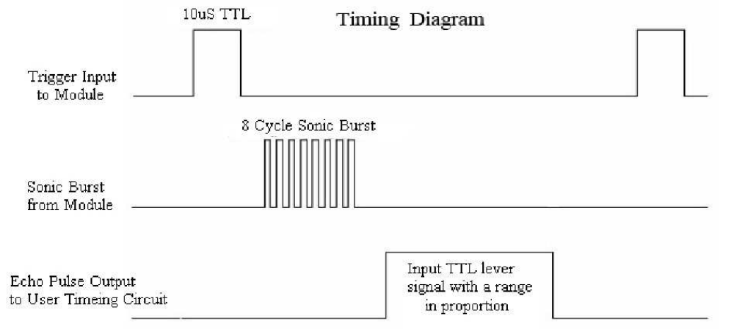
How it works
Ultrasonic sensors provide a measurement of the time it takes for sound to bounce off an object and return to the sensor
Pulse width is proportional to the distance the sound traveled
The speed of sound is 340 meters per second - 29 microseconds per centimeter
Roundtrip = microseconds / 29
Distance in centimeters is: microseconds / 29 / 2

Slide 20
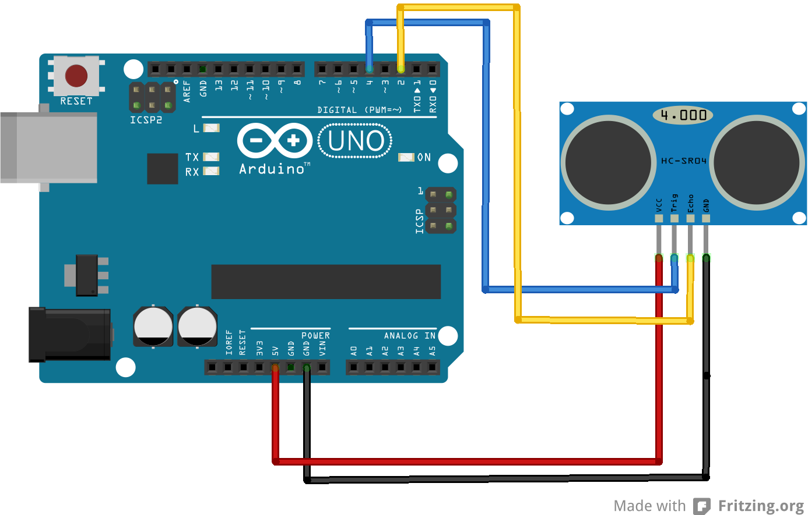
Measuring Distance
const int trigPin = 4;
const int echoPin = 2;
const int ledPin = 13;
long value = 0;
int cm = 0;
void setup(){
Serial.begin(9600);
pinMode(ledPin, OUTPUT);
pinMode(trigPin, OUTPUT);
pinMode(echoPin, INPUT);
digitalWrite(trigPin, LOW);
}
void loop(){
digitalWrite(trigPin, HIGH);
delayMicroseconds(10);
digitalWrite(trigPin, LOW);
value = pulseIn(echoPin, HIGH, 50000);
cm = value / 58; // pulse width is 58 microseconds per cm
Serial.print(value); Serial.print(" , "); Serial.println(cm);
digitalWrite(ledPin, HIGH);
delay(cm * 10 ); // each centimeter adds 10 milliseconds delay
digitalWrite(ledPin, LOW);
delay( cm * 10); delay(20);
}

Slide 21
pulseIn() and delayMicroseconds()
pulseIn(pin, value[, timeout])
  Reads a pulse (either HIGH or LOW) on a pin
  pin: the number of the pin on which to read the pulse
  value: type of pulse to read: either HIGH or LOW
  timeout (optional): the number of microseconds to wait for the pulse to be completed. Default is one second
  Returns the length of the pulse in microseconds or 0 if no complete pulse was received within the timeout
delayMicroseconds(us)
  Pauses the program for the us amount of time (in microseconds) specified as parameter

Slide 22
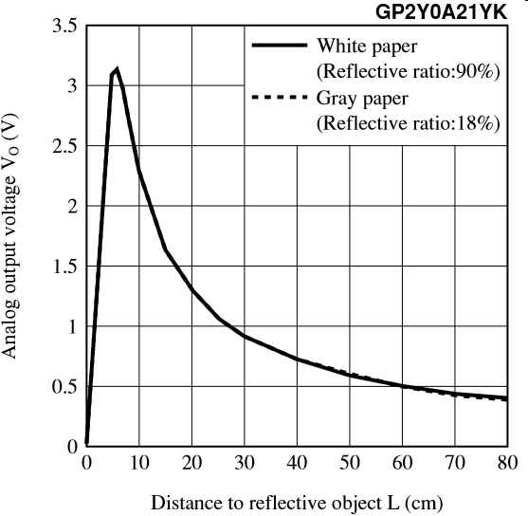
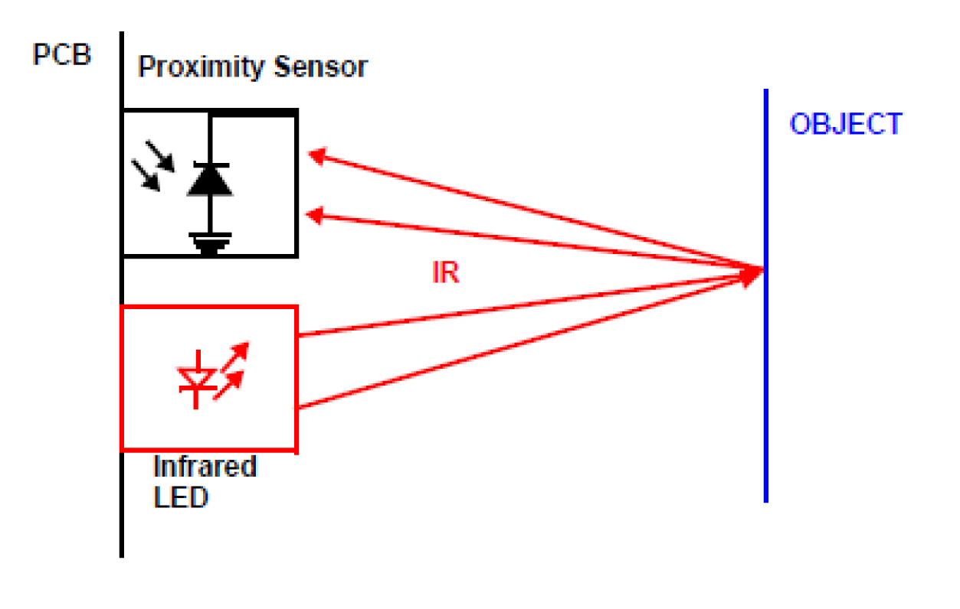
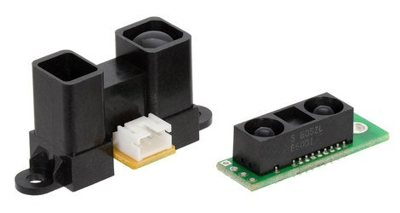
IR distance rangers
Generally provide an analog output
Have greater accuracy than ultrasonic sensors
Range of 10 cm to 1 m or 2 m
Output from the IR sensor is not linear (not proportional to distance)
Distance values can be found by trial and error

Slide 23
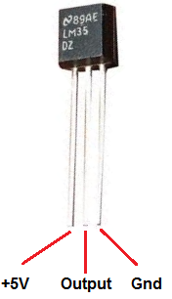
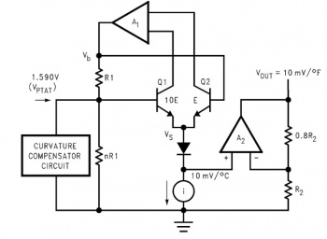
Measuring Temperature
LM35 heat detection sensor
  Produces an analog voltage directly proportional to temperature
  1 millivolt per 0.1°C (10mV per degree)
  The sensor accuracy is around 0.5°C,
  Functional range: from -40°C to 150°C

Slide 24
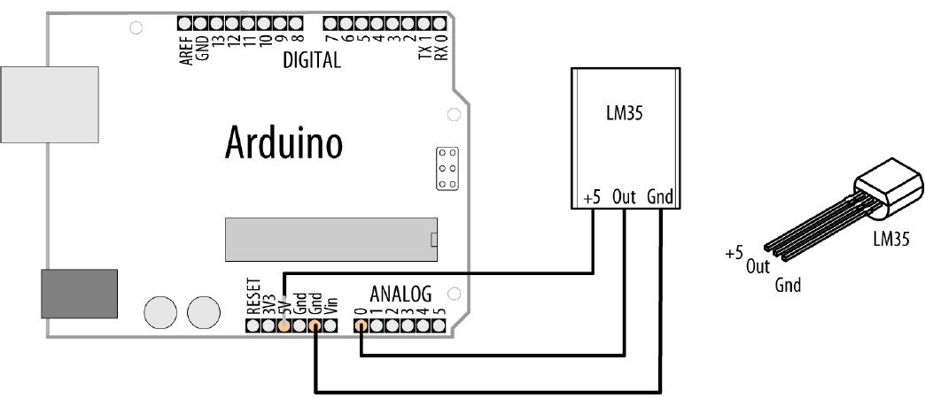
Measuring Temperature
const int inPin = A0; // analog pin
void setup() {
Serial.begin(9600);
}
void loop(){
int value = analogRead(inPin);
Serial.print(value); Serial.print(" => ");
float millivolts = (value / 1024.0) * 5000;
float celsius = millivolts / 10; // sensor output is 10mV per degree Celsius
Serial.print(celsius);
Serial.print(" degrees Celsius, ");
Serial.print( (celsius * 9)/ 5 + 32 ); // converts to fahrenheit
Serial.println(" degrees Fahrenheit");
delay(1000); // wait for one second
}

Slide 25
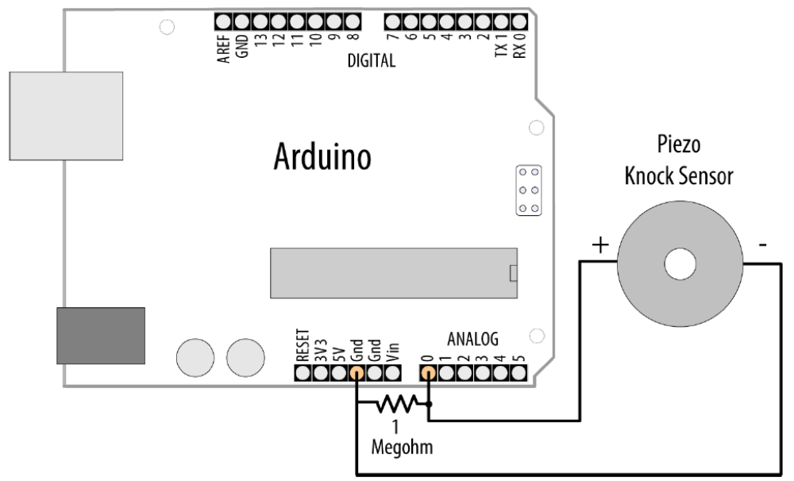
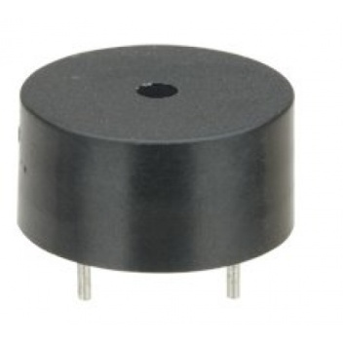
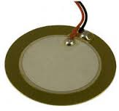
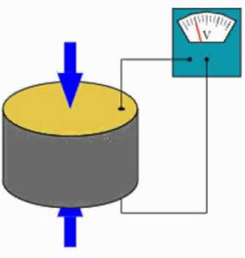
Detecting Vibration
Piezo sensor responds to vibration
Produces a voltage in response to physical stress
The more it is stressed, the higher the voltage
Piezo is polarized (has + and -)
A high-value resistor (1 megohm) is connected across the sensor

Slide 26
Detecting Vibration
const int sensorPin = A0; // the analog pin connected to the sensor
const int ledPin = 13; // pin connected to LED
const int THRESHOLD = 1;
void setup(){
pinMode(ledPin, OUTPUT);
Serial.begin(9600);
}
void loop(){
int val = analogRead(sensorPin);
Serial.println(val);
if (val >= THRESHOLD){
digitalWrite(ledPin, HIGH);
delay(100);
} else{
digitalWrite(ledPin, LOW);
}
}

