Slide 1

IMPLEMENTING IOE
Week 6
Assist. Prof. Rassim Suliyev - SDU 2017

Slide 2
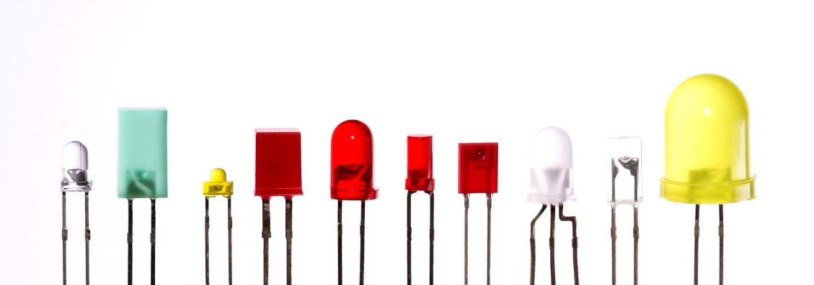
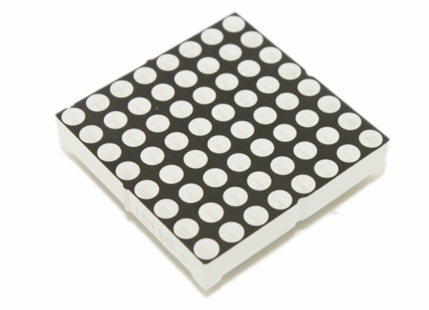
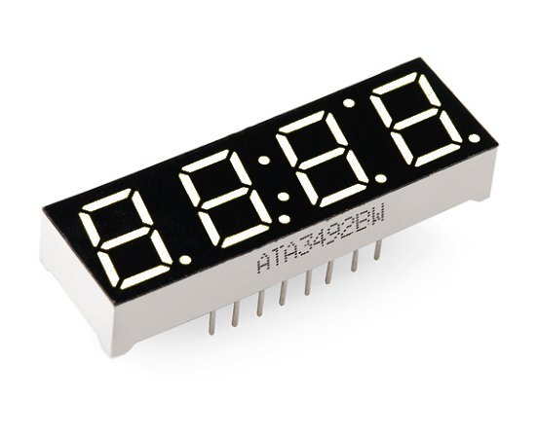
Visual Output
Lets the Arduino show off
Arduino supports a broad range of LED devices
Use digital and analog outputs for visualization
Digital output
  All pins that used for digital input can be used as output as well
  Digital output causes the voltage on a pin to be either high (5 volts) or low (0 volts)
  digitalWrite(outputPin, value)
  pinMode(outputPin, OUTPUT)

Slide 3
Analog Output
Refers to levels that can be gradually varied up to their maximum level
analogWrite(pin, val)
  Used to control such things as the intensity of an LED
  Is not truly analog, but behave like analog
  Uses a technique called Pulse Width Modulation (PWM)
  Emulates an analog signal using digital pulses
  Works by varying the proportion of the pulses’ on time to off time

Slide 4
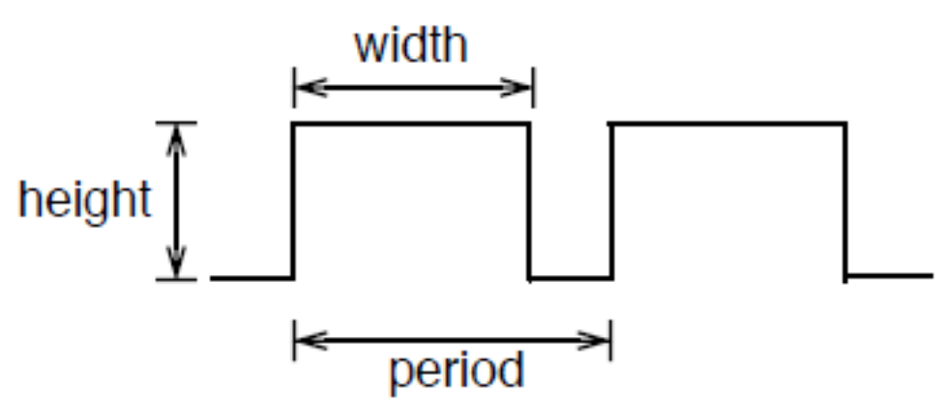
Pulse Width Modulation
More commonly called “PWM”
Computers can’t output analog voltages
  Only digital voltages (0 volts or 5 volts)
But you can fake it
  if you average a digital signal flipping between two voltages
For example...

Slide 5
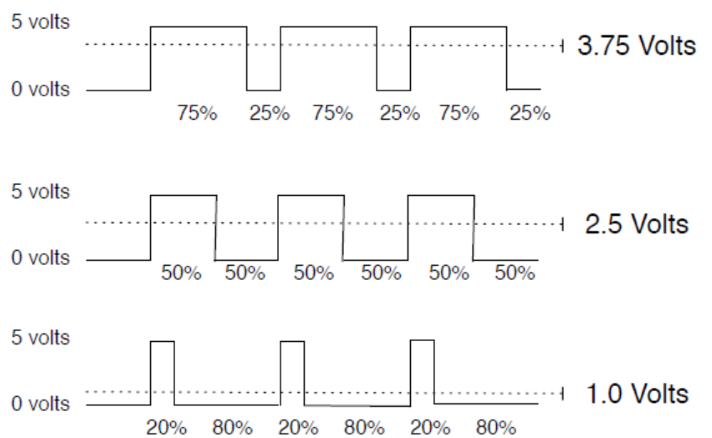
PWM
Output voltage is averaged from on vs. off time
  output_voltage = (on_time / off_time) * max_voltage

Slide 6
PWM
Used everywhere
  Lamp dimmers
  Motor speed control
  Power supplies
  Noise making
Three characteristics of PWM signals
  Pulse width range (min/max)
  Pulse period (= 1/pulses per second)
  Voltage levels (0-5V, for instance)

Slide 7
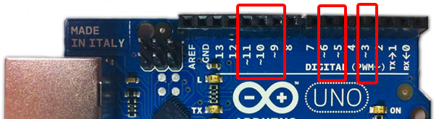
Arduino PWM
Arduino has built-in PWM
  On UNO they are pins 3, 5, 6, 9, 10, 11
Use analogWrite(pin,value)
  pin: the pin to write to.
  value: the duty cycle: between 0 (always off) and 255 (always on).
It operates at a high, fixed frequency
  490HZ for most pins (except pins 5 and 6 which run at 980HZ)
  Great for LEDs and motors
Uses built-in PWM circuits of the ATmega8 chip
  No software needed

Slide 8
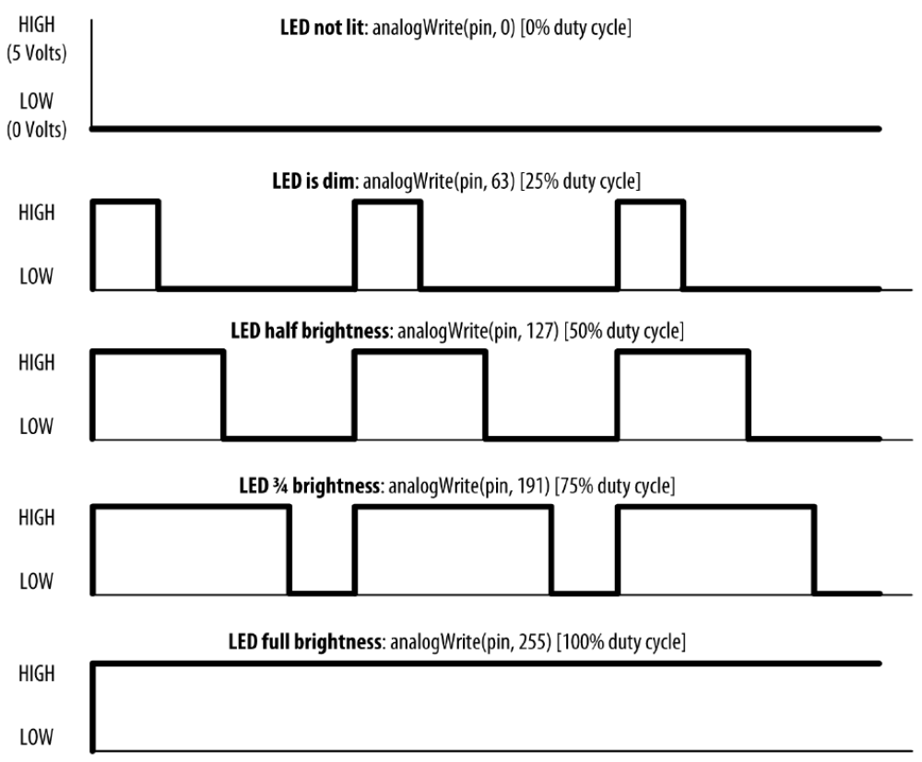
Arduino PWM
Higher level output is emulated with pulses that are on more than they are off
Pulses are repeated quickly enough
almost 500 times per second on Arduino
pulsing cannot be detected by human senses

Slide 9
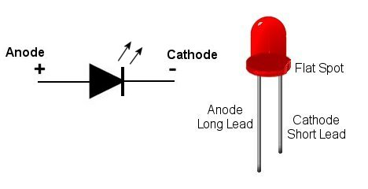
LED specifications
LED is a semiconductor device (diode)
  Two leads, an anode and a cathode
The device emits light (photons) when
  Vanode > Vcathode + forward voltage
Anode is usually the longer lead and flat spot on the housing indicates the cathode
LED color and forward voltage depend on the construction of the diode
Typical red LED has a forward voltage of around 1.8 volts
Limit the current with a resistor, or the LED will burn out

Slide 10
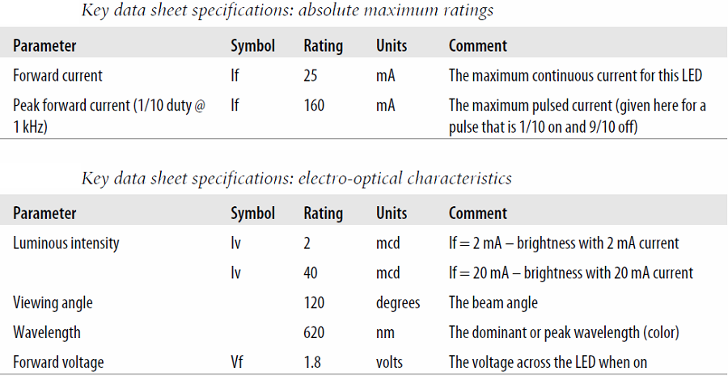
Consult an LED data sheet
Arduino pins can supply up to 40 mA of current
This is plenty for a typical medium intensity LED, but not enough to drive the higher brightness LEDs or multiple LEDs connected to a single pin

Slide 11
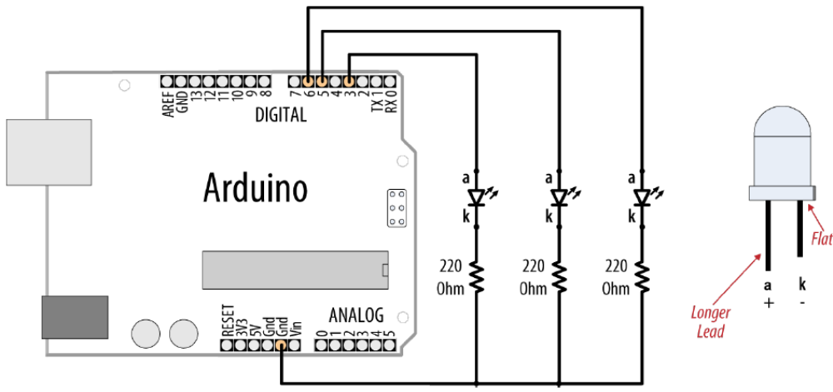
Adjusting the Brightness of an LED
Connect each LED to an analog (PWM) output
const int firstLed = 3;
const int secondLed = 5;
const int thirdLed = 6;
int brightness = 0;
int increment = 1;
void setup(){
//for analogWrite no need
//to declare as OUTPUT
}
void loop(){
if(brightness > 254){
increment = -1; // count down after reaching 254
}else if(brightness < 1){
increment = 1; // count up after dropping back down to 0
}
brightness = brightness + increment; // increment (or decrement sign is minus)
// write the brightness value to the LEDs
analogWrite(firstLed, brightness);
analogWrite(secondLed, brightness);
analogWrite(thirdLed, brightness );
delay(10); // 10ms for each step change means 2.55 secs to fade up or down
}

Slide 12
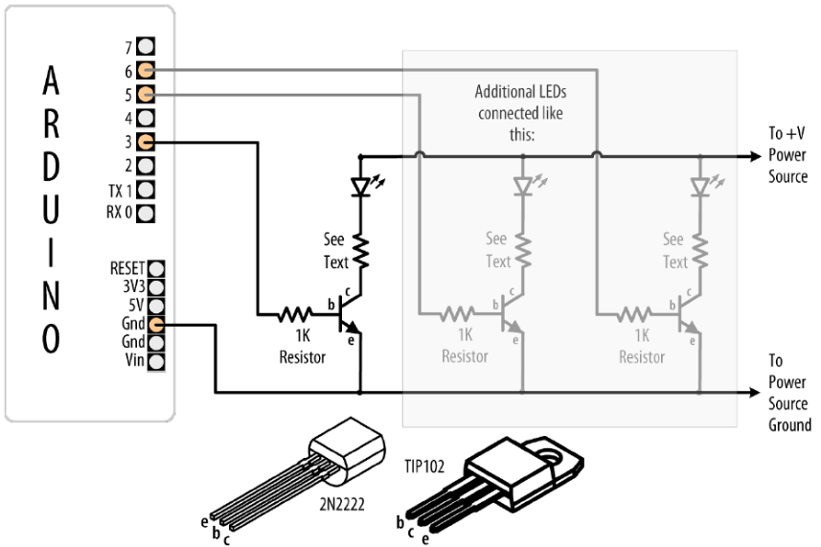
Driving High-Power LEDs
Arduino can handle current up to 40 mA per pin
Use a transistor to switch on and off the current
Arrow indicates a +V power source
  +5V power pin can supply up to 400 mA or so
If an external power supply is used, remember to connect the ground of the external supply to the Arduino ground
Current flows from collector to emitter when transistor is ON
Turn ON transistor by writing HIGH to appropriate pin
Resistor between the pin and the transistor base prevents huge current flow (1K-5mA)
Voltage drop of transistor ~ 0.7V (collector-emitter saturation voltage)

Slide 13
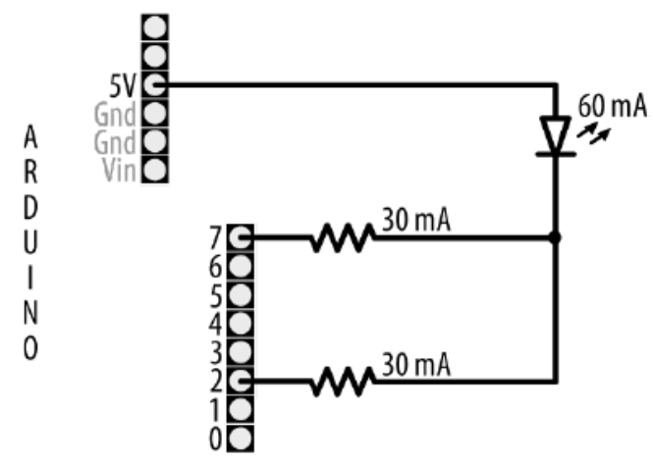
How to Exceed 40 mA per Pin
Connect multiple pins in parallel to increase current beyond the 40 mA
Don’t try to use a single resistor to connect the two pins
This technique can also be used to source current
It does not work with analogWrite

Slide 14
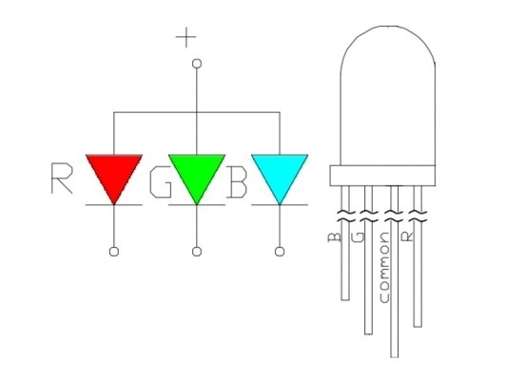
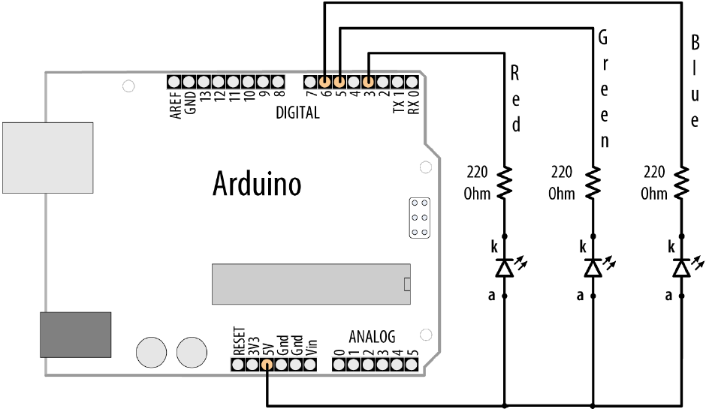
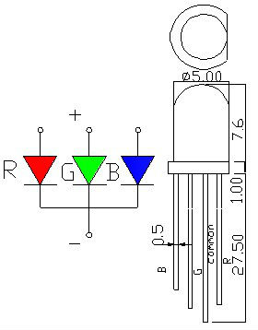
Adjusting the Color of an LED
RGB LEDs have red, green, and blue elements in a single package
  common anode or common cathode

Slide 15
Adjusting the Color of an LED
const int redPin = 3; // choose the pin for each of the LEDs
const int greenPin = 5;
const int bluePin = 6;
int R, G, B, seg, i; // the Red Green and Blue color components
void setup(){
R = G = B = seg = i = 0;
}
void loop(){
if(i > (255 * 8 - 1)) i = 0;
switch(i / 255){
case 0: R++; break;
case 1: G++; break;
case 2: R--; break;
case 3: B++; break;
case 4: R++; break;
case 5: G--; break;
case 6: R--; break;
case 7: B--; break;
}
analogWrite(redPin, 255 - R);
analogWrite(greenPin, 255 - G);
analogWrite(bluePin, 255 - B);
delay(3);
i++;
}

Slide 16
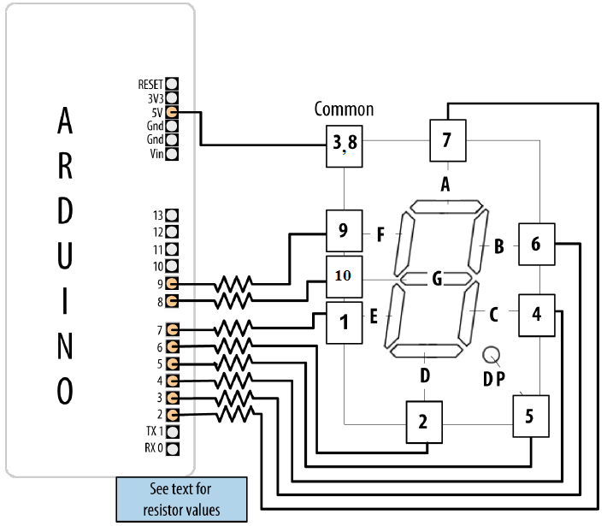
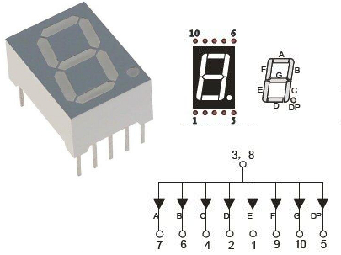
Driving a 7-Segment LED Display
Contains 8 LEDs (including Decimal Point indicator)
Common Anode & Common Cathode

Slide 17
Driving a 7-Segment LED Display
const byte numeral[10][8] = {
{1,1,1,1,1,1,0,0}, // 0
{0,1,1,0,0,0,0,0}, // 1
{1,1,0,1,1,0,1,0}, // 2
{1,1,1,1,0,0,1,0}, // 3
{0,1,1,0,0,1,1,0}, // 4
{1,0,1,1,0,1,1,0}, // 5
{0,0,1,1,1,1,1,0}, // 6
{1,1,1,0,0,0,0,0}, // 7
{1,1,1,1,1,1,1,0}, // 8
{1,1,1,0,0,1,1,0} // 9
}; //A,B,C,D,E,F,G,dp
const int segmentPins[8] = {2,3,4,6,7,8,9,5}; // A,B,C,D,E,F,G,dp
void setup(){
for(int i=0; i < 8; i++)
pinMode(segmentPins[i], OUTPUT); // set segment and DP pins to output
}
void loop(){
for(int i=0; i < 10; i++){
showDigit(i); delay(1000);
}
}
void showDigit(int number){
if( number >= 0 && number <= 9){
for(int segment = 0; segment < 8; segment++){
int isBitSet = ! numeral[number][segment];; // remove ! sign if common cathode display
digitalWrite(segmentPins[segment], isBitSet);
}
}
}

Slide 18
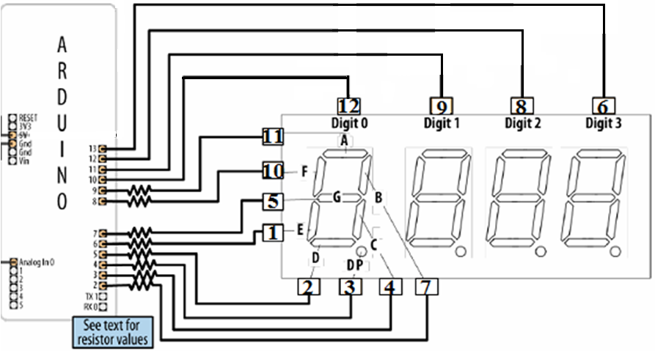
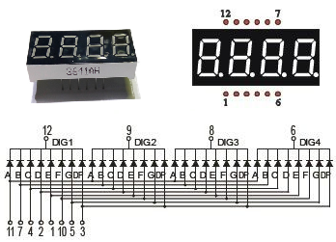
Multidigit, 7-Segment: Multiplexing
Corresponding segments from each digit are connected together

Slide 19
Multidigit, 7-Segment: Multiplexing
const byte numeral[10][8] = {
{1,1,1,1,1,1,0,0}, // 0
{0,1,1,0,0,0,0,0}, // 1
{1,1,0,1,1,0,1,0}, // 2
{1,1,1,1,0,0,1,0}, // 3
{0,1,1,0,0,1,1,0}, // 4
{1,0,1,1,0,1,1,0}, // 5
{0,0,1,1,1,1,1,0}, // 6
{1,1,1,0,0,0,0,0}, // 7
{1,1,1,1,1,1,1,0}, // 8
{1,1,1,0,0,1,1,0} // 9
}; //A,B,C,D,E,F,G,dp
const int segmentPins[8] = {9,2,3,5,6,8,7,4};
// A-11,B-7,C-4,D-2,E-1,F-10,G-5,dp-3
const int digitPins[4] = {13,12,11,10};
// DIG4-6,DIG3-8,DIG2-9,DIG1-12
unsigned long count = 0;
void setup(){
for(int i=0; i < 8; i++)
pinMode(segmentPins[i], OUTPUT);
for(int i=0; i < 4; i++)
pinMode(digitPins[i], OUTPUT);
}
void loop(){
if(millis()/1000 > count) count++;
showNumber(count);
}
void showNumber(int num){
for(int i = 0; i < 4; i++){
showDigit(num % 10, i);
num = num / 10;
}
}
void showDigit(int digit, int pos){
if( digit >= 0 && digit <= 9){
for(int segment = 0; segment < 8; segment++)
digitalWrite(segmentPins[segment], numeral[digit][segment]);
digitalWrite(digitPins[pos],LOW);
delayMicroseconds(300);
digitalWrite(digitPins[pos],HIGH);
}
}

Slide 20
Multiplexing
To control many LEDs use a technique called multiplexing
Multiplexing is switching groups of LEDs in sequence
  Usually arranged in rows or columns
Scanning through the LEDs quickly enough
  Creates the impression that the lights remain on
  Through the phenomenon of persistence of vision
Charlieplexing uses multiplexing along with the fact that LEDs have polarity
  They only illuminate when the anode is more positive than the cathode
  Switch between two LEDs by reversing the polarity

Slide 21
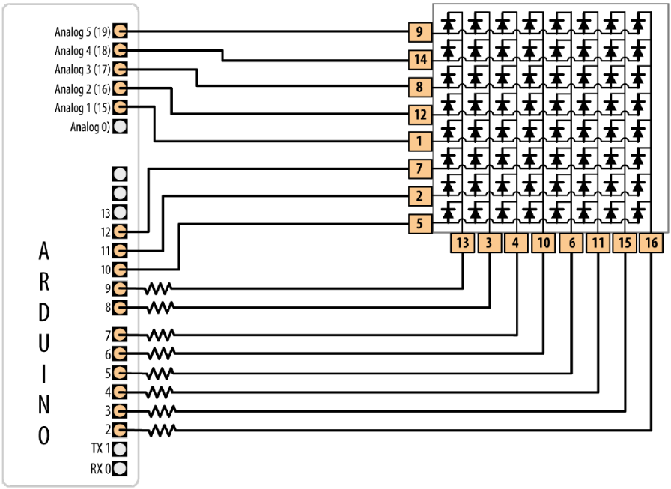
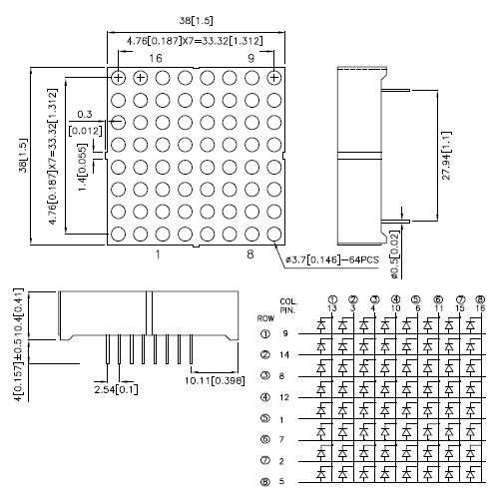
Controlling an LED Matrix
8X8 LED matrix contains 64 LEDs
Anodes connected in rows and cathodes in columns
Resistors must be chosen so that max. current through a pin does not exceed 40 mA
8 LEDs in column => 5mA for each => 680ohms

Slide 22
Lighting Each Pixel of LED Matrix
const int columnPins[] = { 2, 3, 4, 5, 6, 7, 8, 9};
const int rowPins[] = { 10,11,12,14,15,16,17,18};
int pixel = 0; // 0 to 63 LEDs in the matrix
int columnLevel = 0; // pixel value converted into LED column
int rowLevel = 0; // pixel value converted into LED row
void setup() {
for (int i = 0; i < 8; i++){
pinMode(columnPins[i], OUTPUT); // make all the LED pins outputs
digitalWrite(columnPins[i], HIGH);
pinMode(rowPins[i], OUTPUT);
digitalWrite(rowPins[i], LOW);
}
}
void loop() {
pixel = pixel + 1;
if(pixel > 63) pixel = 0;
columnLevel = pixel / 8; // map to the number of columns
rowLevel = pixel % 8; // get the fractional value
digitalWrite(columnPins[columnLevel], LOW); // connect this column to Ground
digitalWrite(rowPins[rowLevel], HIGH);
delay(100);
digitalWrite(rowPins[rowLevel], LOW); // turn off LED
digitalWrite(columnPins[columnLevel], HIGH);
}

Slide 23
Displaying Images on an LED Matrix
byte bigHeart[] = {
B01100110,
B11111111,
B11111111,
B11111111,
B01111110,
B00111100,
B00011000,
B00000000};
byte smallHeart[] = {
B00000000,
B00000000,
B00010100,
B00111110,
B00111110,
B00011100,
B00001000,
B00000000};
const int columnPins[] = { 2, 3, 4, 5, 6, 7, 8, 9};
const int rowPins[] = { 10,11,12,14,15,16,17,18};
void setup() {
for (int i = 0; i < 8; i++){
pinMode(rowPins[i], OUTPUT); // make all the LED pins outputs
pinMode(columnPins[i], OUTPUT);
digitalWrite(columnPins[i], HIGH); // disconnect column pins
}
}
void loop() {
show(smallHeart, 800); // show the small heart image for 100 ms
show(bigHeart, 800); // followed by the big heart for 200ms
delay(400); // show nothing between beats
}
void show( byte * image, unsigned long duration){
unsigned long start = millis(); // begin timing the animation
while (start + duration > millis()){ // loop until duration passed
for(int row = 0; row < 8; row++){
digitalWrite(rowPins[row], HIGH); // connect row to +5 volts
for(int column = 0; column < 8; column++){
boolean pixel = bitRead(image[row],column);
if(pixel == 1) digitalWrite(columnPins[column], LOW);
delayMicroseconds(300); // a small delay for each LED
digitalWrite(columnPins[column], HIGH);
}
digitalWrite(rowPins[row], LOW); // disconnect LEDs
}
}
}

Slide 24
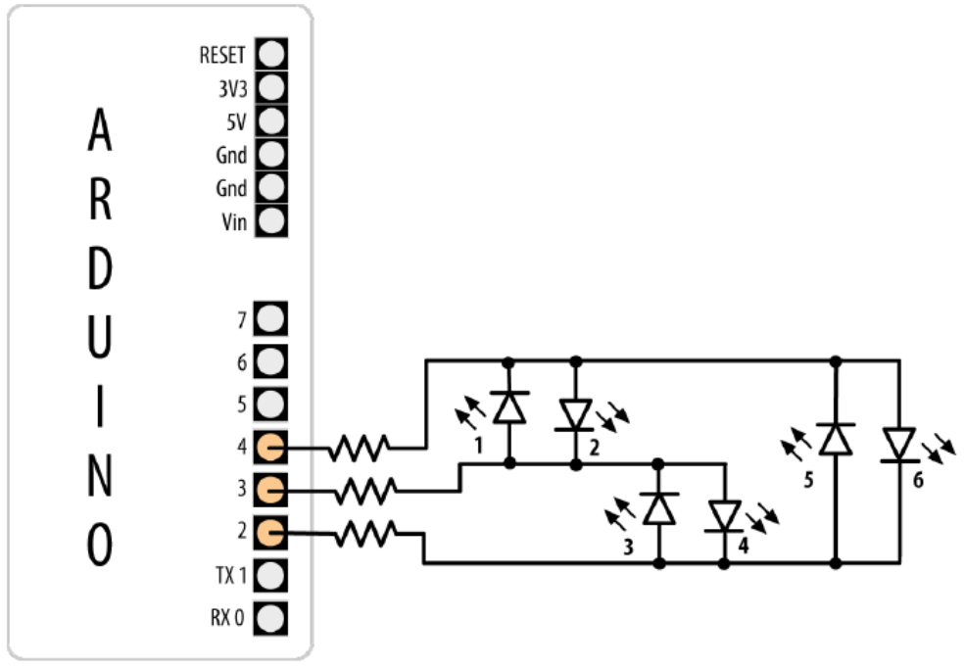
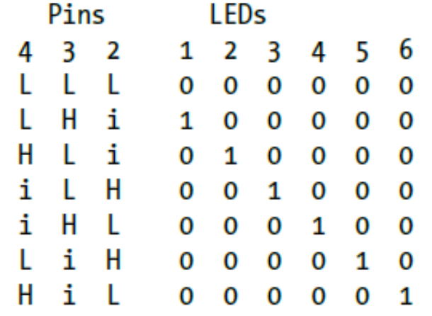
Controlling LEDs: Charlieplexing
Charlieplexing - increases the number of LEDs that can be driven by a group of pins
Based on the fact that LEDs only turn on when anode more positive than the cathode

Slide 25
Controlling LEDs: Charlieplexing
byte pins[] = {2,3,4}; // the pins that are connected to LEDs
const int NUMBER_OF_PINS = sizeof(pins)/ sizeof(pins[0]);
const int NUMBER_OF_LEDS = NUMBER_OF_PINS * (NUMBER_OF_PINS-1);
byte pairs[NUMBER_OF_LEDS/2][2] = { {0,1}, {1,2}, {0,2} }; // maps pins to LEDs
void setup(){
}
void loop(){
for(int i=0; i < NUMBER_OF_LEDS; i++){
lightLed(i); // light each LED in turn
delay(1000);
}
}
void lightLed(int led){
int indexA = pairs[led/2][0];
int indexB = pairs[led/2][1];
int pinA = pins[indexA];
int pinB = pins[indexB];
for(int i=0; i < NUMBER_OF_PINS; i++)
if( pins[i] != pinA && pins[i] != pinB){ // if this pin is not one of our pins
pinMode(pins[i], INPUT); // set the mode to input
digitalWrite(pins[i],LOW); // make sure pull-up is off
}
pinMode(pinA, OUTPUT); pinMode(pinB, OUTPUT);
if( led % 2 == 0){
digitalWrite(pinA,LOW); digitalWrite(pinB,HIGH);
}else{
digitalWrite(pinB,LOW); digitalWrite(pinA,HIGH);
}
}

