Slide 1

IMPLEMENTING IOE
Week 8
Assist. Prof. Rassim Suliyev - SDU 2017

Slide 2
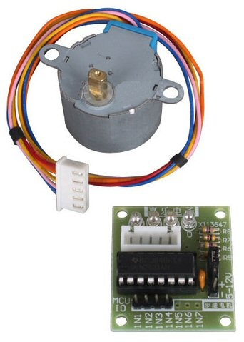
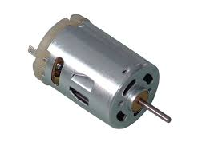
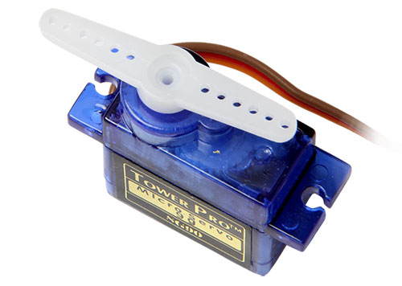
Physical Output
Make things move by controlling motors with Arduino
Servo-motors
  Rotary actuator that allows for precise control of angular position
DC-motors
  Converts direct current electrical power into mechanical power
Stepper-motors
  Divides a full rotation into a number of equal steps

Slide 3
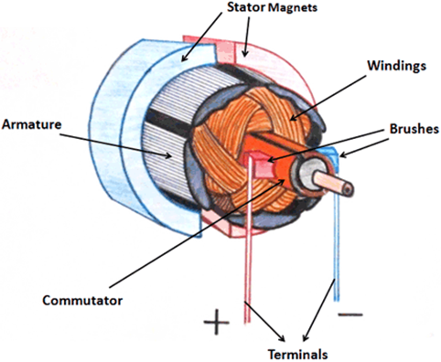
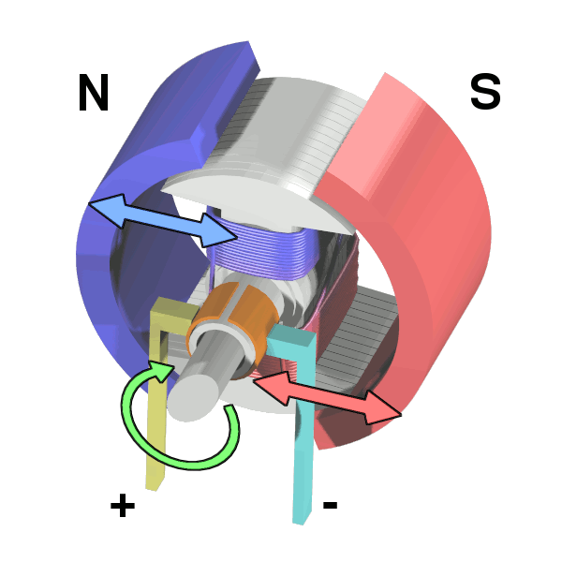
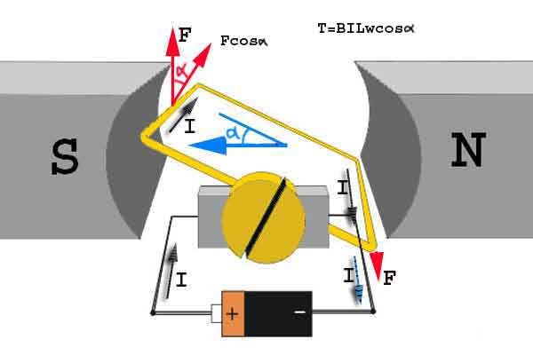
Brushed DC Motors
Simple devices with two leads connected to brushes (contacts)
  Control the magnetic field of the coils
  Drives a metallic core (armature)
Direction of rotation can be reversed by reversing the polarity
Require a transistor to provide adequate current
Primary characteristic in selecting a motor is torque
  How much work the motor can do

Slide 4
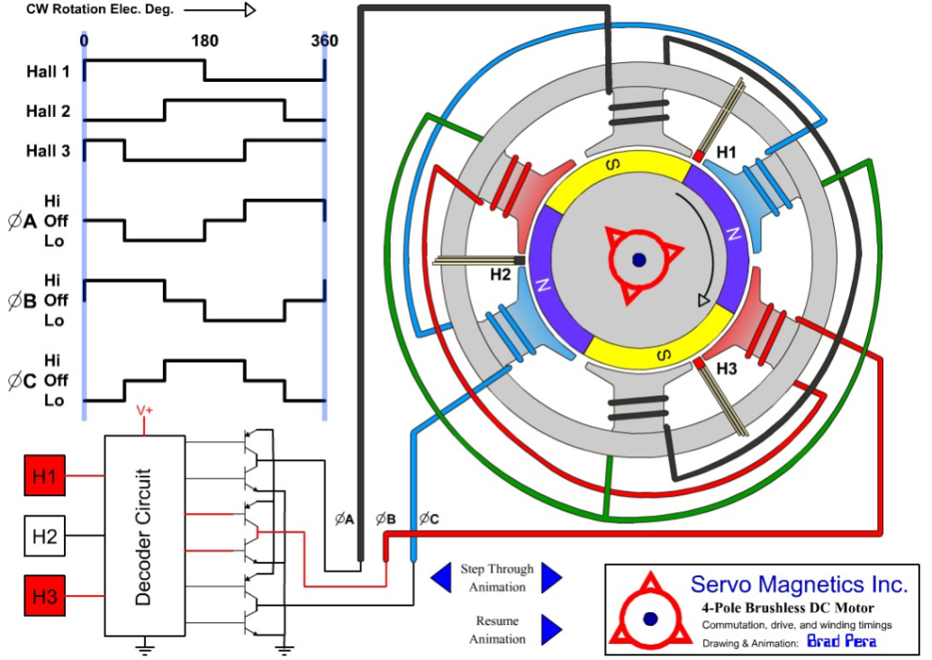
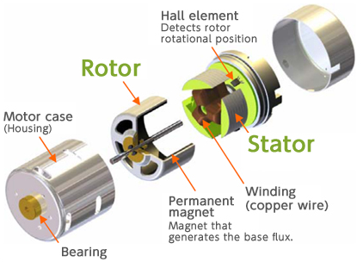
Brushless Motors
More powerful and efficient for a given size
Three phases of driving coils
Require more complicated electronic control
  Electronics speed controllers

Slide 5
DC Motor Parameters
Direct-drive vs. gearhead – built-in gears or not
Voltage – what voltage it best operates at
Current (efficiency) – how much current it needs to spin
Speed – how fast it spins
Torque – how strong it spins
Size, shaft diameter, shaft length

Slide 6
DC Motor Characteristics
When the first start up, they draw a lot more current, up to 10x more
If you “stall” them (make it so they can’t turn), they also draw a lot of current
They can operate in either direction, by switching voltage polarity
Usually spin very fast: >1000 RPM
To get slower spinning, need gearing

Slide 7
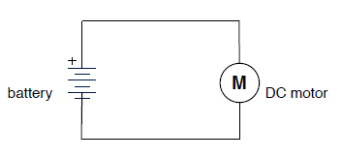
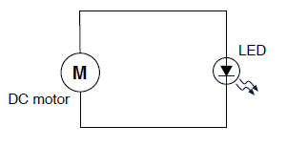
Driving DC Motor
To drive them, apply a voltage
The higher the voltage, the faster the spinning
Polarity determines which way it rotates
Can be used as voltage generators

Slide 8
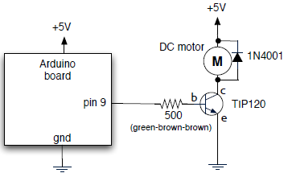
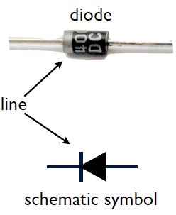
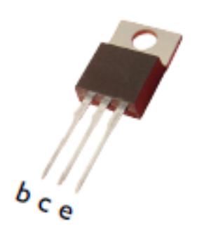
Switching Motors with Transistors
Transistors switch big signals with little signals
Since motors can act like generators,
Need to prevent them from generating “kickback” into the circuit
Can control speed of motor with analogWrite()

Slide 9
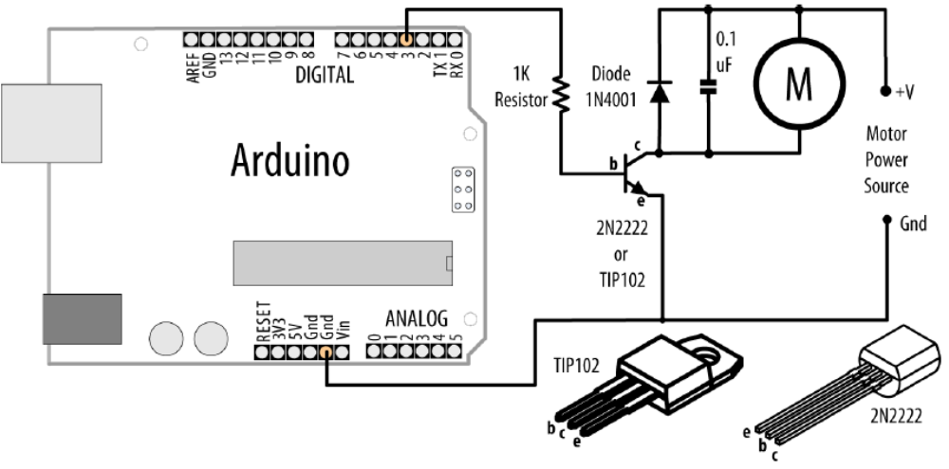
Driving a Brushed Motor
const int motorPin = 3;
const int switchPin = 2;
void setup() {
pinMode(switchPin, INPUT);
pinMode(motorPin, OUTPUT);
}
void loop() {
digitalWrite(motorPin, digitalRead(switchPin));
}

Slide 10
Controlling Speed of DC-Motor
const int motorPin = 3;
const int potPin = A0;
void setup() {
}
void loop() {
int spd = analogRead(potPin);
spd = map(spd, 0, 1023, 0, 255);
analogWrite(motorPin, spd);
}

Slide 11
Servo-Motors
Allow accurately control physical movement
Move to a position instead of continuously rotating
Rotate over a range of 0 to 180 degrees
Motor driver is built into the servo
  Small motor connected through gears
  Output shaft drives a servo arm
  Connected to a potentiometer to provide position feedback
Continuous rotation servos
  Positional feedback disconnected
  Rotate continuously clockwise and counter clockwise with some control over the speed

Slide 12
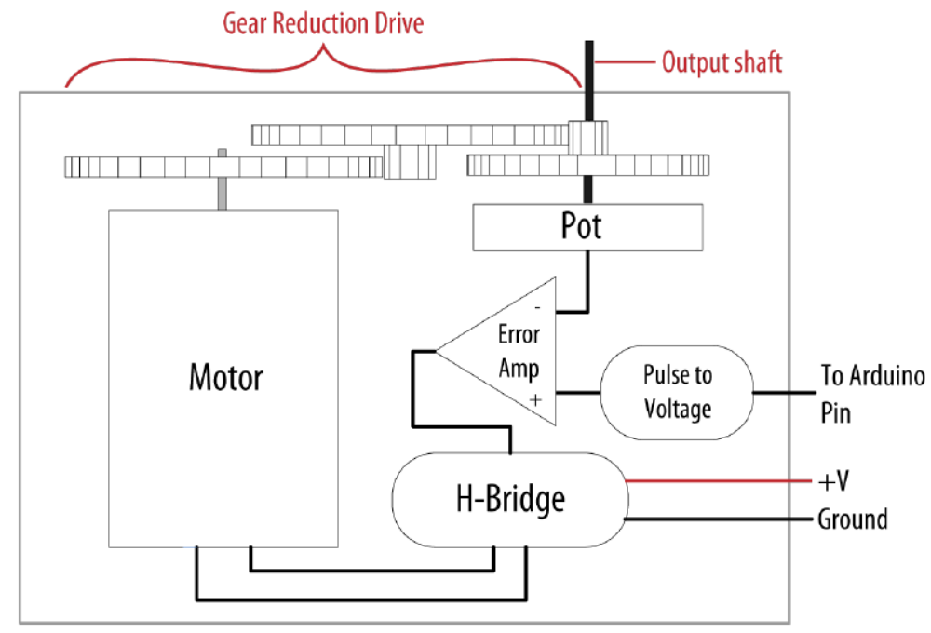
Servo-Motors

Slide 13
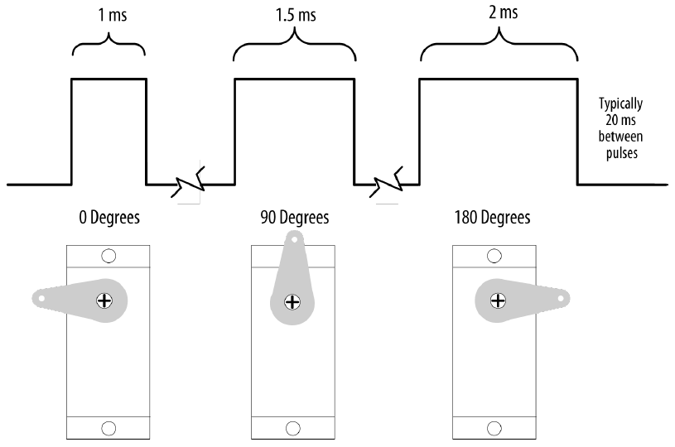
Servo-Motors
Respond to changes in the duration of a pulse
  Short pulse of 1 ms will cause to rotate to one extreme
  Pulse of 2 ms will rotate the servo to the other extreme
Servos require pulses different from the PWM output from analogWrite

Slide 14
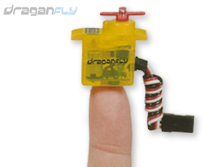
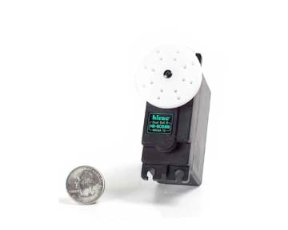
Servo-Motors
Come in all sizes
  from super-tiny
  to drive-your-car
All have same 3-wire interface
Servos are spec’d by:
  weight: 9g
  speed: .12s/60deg @ 6V
  torque: 22oz/1.5kg @ 6V
  voltage: 4.6~6V
  size: 21x11x28 mm

Slide 15
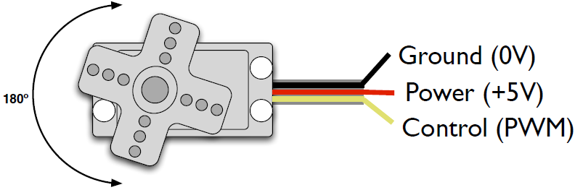
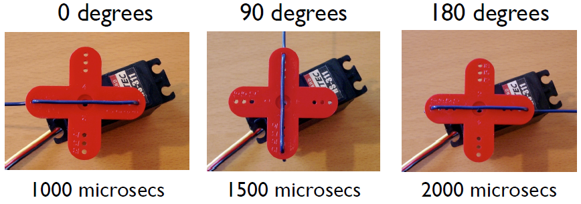
Servo Control
PWM freq is 50 Hz (i.e. every 20 millisecs)
Pulse width ranges from 1 to 2 millisecs
In practice, pulse range can range from 500 to 2500 microsecs

Slide 16
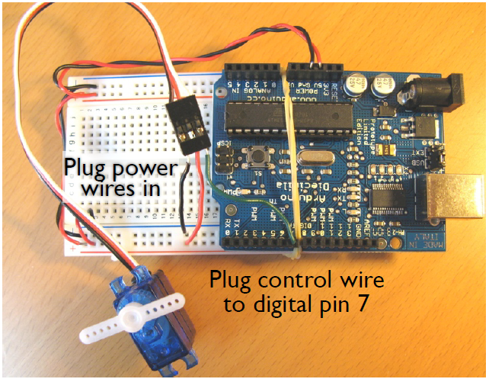
Servo and Arduino
const int servoPin = 7;
const int potPin = A0;
const int pulsePeriod = 20000; //us
void setup() {
pinMode(servoPin, OUTPUT);
}
void loop() {
int hiTime = map(analogRead(potPin), 0, 1023, 600, 2500);
int loTime = pulsePeriod - hiTime;
digitalWrite(servoPin, HIGH); delayMicroseconds(hiTime);
digitalWrite(servoPin, LOW); delayMicroseconds(loTime);
}

Slide 17
Use the Servo library
servo.attach(pin[, min][, max]) – attach the servo
  pin- the pin number that the servo is attached to
  min (optional) - the pulse width, in microseconds, corresponding to the minimum (0-degree) angle on the servo (defaults to 544)
  max (optional) - the pulse width, in microseconds, corresponding to the maximum (180-degree) angle on the servo (defaults to 2,400)
servo.write(angle) – turn the servo arm
  angle – the degree value to write to the servo (from 0 to 180)

Slide 18
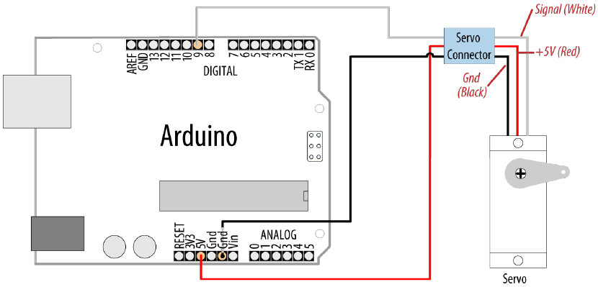
Servo sweeper
#include <Servo.h>
Servo myservo; // create servo object to control a servo
int angle = 0; // variable to store the servo position
void setup(){
myservo.attach(9); // attaches the servo on pin 9 to the servo object
}
void loop(){
for(angle = 0; angle < 180; angle += 1){ // goes from 0 degrees to 180
myservo.write(angle); //tell servo to go to position in variable 'angle'
delay(20); // waits 20ms between servo commands
}
for(angle = 180; angle >= 1; angle -= 1){ // goes from 180 degrees to 0
myservo.write(angle);
delay(20);
}
}

Slide 19
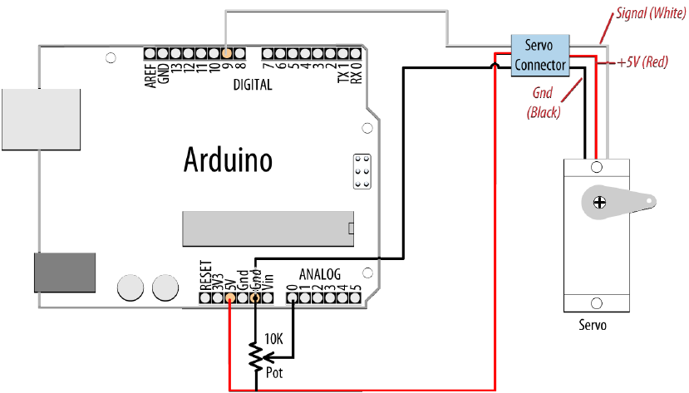
Controlling angle with pot
#include <Servo.h>
Servo myservo; // create servo object to control a servo
int potpin = 0; // analog pin used to connect the potentiometer
int val; // variable to read the value from the analog pin
void setup(){
myservo.attach(9); // attaches the servo on pin 9 to the servo object
}
void loop(){
val = analogRead(potpin); // reads the value of the potentiometer
val = map(val, 0, 1023, 0, 180); // scale it to use it with the servo
myservo.write(val); // sets position
delay(15);
}

Slide 20
Stepper Motors
Rotate a specific number of degrees in response to control pulses
Number of degrees for a step is motor-dependent
  Ranging from one or two degrees per step to 30 degrees or more
Two types of steppers
  Bipolar - typically with four leads attached to two coils
  Unipolar - five or six leads attached to two coils
Additional wires in a unipolar stepper are internally connected to the center of the coils

Slide 21
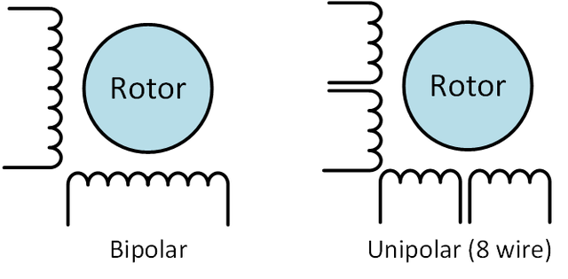
Stepper Motors
Unipolar drivers always energize the phases in the same way
  Single "common" lead, will always be negative.
  The other lead will always be positive
  Disadvantage - less available torque, because only half of the coils can be energized at a time
Bipolar drivers work by alternating the polarity to phases
  All the coils can be put to work

Slide 22
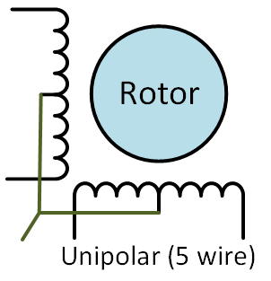
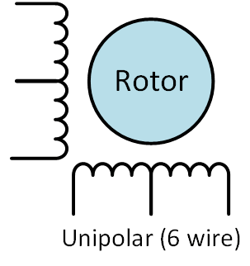
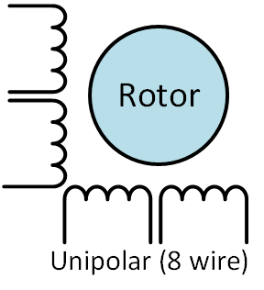
Stepper Motors
This motor only joins the common wires of 2 paired phases. These two wires can be joined to create a 5-wire unipolar motor. Or you just can ignore them and treat it like a bipolar motor!
All of the common coil wires are tied together internally and brought out as a 5th wire. This motor can only be driven as a unipolar motor.
It can be driven in several ways:
4-phase unipolar - All the common wires are connected together - just like a 5-wire motor.
2-phase series bipolar - The phases are connected in series - just like a 6-wire motor.
2-phase parallel bipolar - The phases are connected in parallel. This results in half the resistance and inductance - but requires twice the current to drive. The advantage of this wiring is higher torque and top speed.

Slide 23
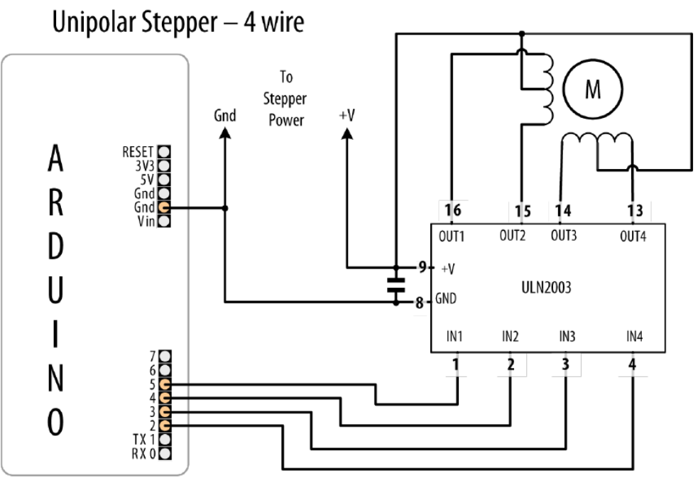
Driving a Unipolar Stepper Motor
const int stepperPins[4] = {2, 3, 4, 5};
int delayTime = 5;
void setup() {
for(int i=0; i<4; i++)
pinMode(stepperPins[i], OUTPUT);
}
void loop() {
digitalWrite(stepperPins[0], HIGH);
digitalWrite(stepperPins[1], LOW);
digitalWrite(stepperPins[2], LOW);
digitalWrite(stepperPins[3], LOW);
delay(delayTime);
digitalWrite(stepperPins[0], LOW);
digitalWrite(stepperPins[1], HIGH);
digitalWrite(stepperPins[2], LOW);
digitalWrite(stepperPins[3], LOW);
delay(delayTime);
digitalWrite(stepperPins[0], LOW);
digitalWrite(stepperPins[1], LOW);
digitalWrite(stepperPins[2], HIGH);
digitalWrite(stepperPins[3], LOW);
delay(delayTime);
digitalWrite(stepperPins[0], LOW);
digitalWrite(stepperPins[1], LOW);
digitalWrite(stepperPins[2], LOW);
digitalWrite(stepperPins[3], HIGH);
delay(delayTime);
}

Slide 24
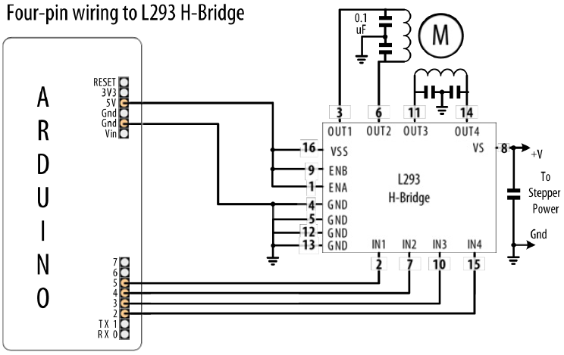
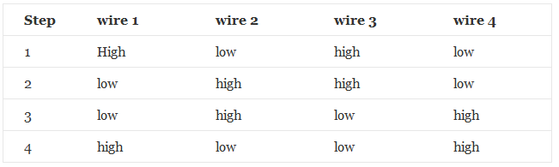
Driving a Bipolar Stepper Motor
const int stepperPins[4] = {2, 3, 4, 5};
int delayTime = 5;
void setup() {
for(int i=0; i<4; i++)
pinMode(stepperPins[i], OUTPUT);
}
void loop() {
digitalWrite(stepperPins[0], LOW);
digitalWrite(stepperPins[1], HIGH);
digitalWrite(stepperPins[2], HIGH);
digitalWrite(stepperPins[3], LOW);
delay(delayTime);
digitalWrite(stepperPins[0], LOW);
digitalWrite(stepperPins[1], HIGH);
digitalWrite(stepperPins[2], LOW);
digitalWrite(stepperPins[3], HIGH);
delay(delayTime);
digitalWrite(stepperPins[0], HIGH);
digitalWrite(stepperPins[1], LOW);
digitalWrite(stepperPins[2], LOW);
digitalWrite(stepperPins[3], HIGH);
delay(delayTime);
digitalWrite(stepperPins[0], HIGH);
digitalWrite(stepperPins[1], LOW);
digitalWrite(stepperPins[2], HIGH);
digitalWrite(stepperPins[3], LOW);
delay(delayTime);
}

Slide 25
Arduino Stepper Library
Allows to control unipolar or bipolar stepper motors
stepper(steps, pin1, pin2, pin3, pin4) – attach and initialize stepper
  steps: number of steps in one revolution of motor
  pin1, pin2, pin3, pin4: 4 pins attached to the motor
setSpeed(rpms) - Sets the motor speed in rotations per minute (RPMs)
step(steps) - Turns the motor a specific number of steps, positive to turn one direction, negative to turn the other
  This function is blocking
  wait until the motor has finished moving before passing control to the next line in sketch

Slide 26
Arduino Stepper Library
#include <Stepper.h>
const int stepsPerRevolution = 200; // change this to fit the number of steps
Stepper myStepper(stepsPerRevolution, 2, 3, 4, 5);
void setup() {
myStepper.setSpeed(60);
Serial.begin(9600);
}
void loop() {
Serial.println("clockwise");
myStepper.step(stepsPerRevolution);
delay(5);
Serial.println("counterclockwise");
myStepper.step(-stepsPerRevolution);
delay(5);
}

