Slide 1

S I N G A P O R E J O B S A N A LY T I C S
Before You Post
Benchmark the offer · test the ask · set realistic response expectations
1.04M postings
Mar 2023 – May 2024
Streamlit + DuckDB
Notes:
[SEGMENT 1 - Business case, budget 2:00] [~15s] Singapore Jobs Analytics: Before You Post - a decision tool for the hiring side of the market. Built on 1.04 million postings, March 2023 to May 2024, on Streamlit and DuckDB.

Slide 2
T H E U S E R
A hirer has three knobs — and no reliable benchmark
THEY SET
THEY DECIDE FROM
AND IT COSTS
Pay range
What they paid last time
30%
Minimum years of experience
A colleague's guess
under-filled
17.8%
Position level
— no reference point —
reposted
Before I post: is my offer competitive — and what response should I realistically expect?
2
Notes:
[~30s] The hirer sets three things - pay range, minimum years, position level - with no reliable benchmark. Today they decide from what they paid last time, or a colleague's guess - no reference point. That costs real money: 30% of postings end up under-filled, 17.8% get reposted. The question this tool answers: before I post, is my offer competitive, and what response should I realistically expect?

Slide 3
T H E C O N S T R A I N T
1.04M rows benchmark the market. Only a subset can measure response.
What a posting SAYS
What a posting GOT
Pay · level · years · dates
Views · applications · reposts
Fixed the moment it goes up.
vs
Accumulates after it goes up.
1.04M
? ? ?
POSTINGS · 15 MONTHS
NEEDS A VALID COHORT
Same dataset. Different questions. Different evidentiary limits.
3
Notes:
[~25s] What a posting SAYS - pay, level, years, dates - is fixed the moment it goes live; we have all 1.04 million rows of it. What it GOT - views, applications, reposts - only accumulates afterward, and only a subset can measure it reliably. Same dataset, different evidentiary limits - that split shapes everything from here on.

Slide 4
C L E A N I N G
We removed 0.38% — and imputed nothing.
ROWS REMOVED
CELLS IMPUTED
SALARY COVERAGE
REPORT
3,998
0
99.0%
auto
0.38% — ghost rows +
Salary is what we measure
Quoted alongside every
Generated from the live run
RANDOM_JOB_
tests
figure
When salary is the variable being measured, inventing one would contaminate the answer.
4
Notes:
[SEGMENT 2 - Process & data handling, budget 3:00] [~15s] Cleaning removed just 0.38% of rows - ghost rows and synthetic test IDs - and zero cells were imputed, because inventing a salary would contaminate the thing we're measuring. Salary coverage: 99.0%.

Slide 5
DECISION 1
Flag uncertainty. Don't invent salary.
salary_flag → undisclosed · outlier · low_stipend · ok
$1 – $1
$150,000 / month
Required-field placeholder
Outlier, but potentially real
1,804 postings. There is no real salary number to preserve at any resolution.
269 postings. Real C-suite role, or a missing decimal? That depends on the question being asked.
NULLED
9,577 rows · under 1%
FLAGGED, KEPT
analysis filters in 1 line
Same rule at the low end: keep the row, remove only the unusable salary value.
The number stays available for analyses that need it; filters decide when to exclude it.
5
Notes:
[~25s] Two edge cases, same rule. $1-to-$1 postings - 1,804 of them - are placeholder junk, so they're nulled. $150,000-a-month postings - 269 of them - might be real, might be a typo, so they're flagged and kept, filterable in one line depending on the question being asked.

Slide 6
DECISION 2
Four 'cleaning' choices that change the answer
DATES
TEXT
Parse → format back → compare
Normalize invisible characters
One mismatch and we refuse the conversion. A wrong date is a wrong cohort.
Titles carried zero-width characters. \s does not match them. 184 rows: one title can silently become two.
DUPLICATES
CATEGORIES
Flag, don't drop
JSON array → explode, not first value
16,990 of 21,344 same-day groups had different view counts. They are real listings, not duplicates to delete.
43 categories; 37% of postings carry more than one. Keeping only the first would discard 723,000 assignments.
Cleaning is part of the analysis: bad normalization changes cohorts, duplicates and market size.
6
Notes:
[~30s] Four fixes that change the answer, not just the format. Dates: parsed, reformatted, and compared - any mismatch refuses the conversion. Text: invisible zero-width characters split 184 titles in two. Duplicates: 16,990 of 21,344 same-day groups had different view counts - real listings, so flagged, not dropped. Categories: exploding the JSON array instead of keeping just the first value preserved 723,000 category assignments.

Slide 7
D E C I S I O N 3 · T H E F I N D I N G T H A T S H A P E D T H E P R O D U C T
Post-June engagement is unmeasured — not low
MEDIAN VIEWS BY POSTING MONTH
THE INTERPRETATION
100
crawl boundary
Unmeasured ≠ low response
75
51
After the crawl boundary, counters are effectively frozen at day zero. Those postings cannot be compared with the earlier cohort.
50
25
2
0
Mar 23
Jun
Jul
Dec
May 24
WHY THIS MATTERS
July had ten extra months to accumulate views — and still had fewer. The defensible response cohort must end before the crawl boundary.
EDA SCOPE · 1,044,587 cleaned postings · Mar 2023–May 2024
7
Notes:
[~30s] The finding that shaped the product. Median views collapse from 51 in June 2023 to just 2 in July - and a July posting has had ten extra months to accumulate views, yet has fewer. That only makes sense if counters freeze at day zero after a crawl boundary. Those postings aren't low-response - they're unmeasured. That's why the response cohort has to end before the boundary.

Slide 8
THE COHORT
Response metrics require two defensible cohorts
1,044,587
CLEANED POSTINGS
TWO LAYERS
1,009,709
DEDUPLICATED
Layer 1 — what the market offers
All 1.04M rows · posting-time columns only
118,749
COUNTERS COMPLETE
96,028
30-DAY LISTINGS ONLY
Layer 2 — what response it got
96,028 30-day listings → repost risk 78,942 first-cycle listings → views & applications
78,942
FIRST CYCLE ONLY
Same Mar–Jun 2023 window. Each outcome uses the smallest cohort that makes the comparison defensible.
8
Notes:
[~25s] The funnel: 1,044,587 cleaned, 1,009,709 deduplicated - that's Layer 1, the whole market. Then 118,749 with complete counters, 96,028 thirty-day listings for repost risk, and 78,942 first-cycle listings for views and applications - that's Layer 2. Each metric uses the smallest cohort that's still defensible.

Slide 9
IMPLEMENTATION
One pipeline. One source of truth.
SGJobData.csv
→
clean
→
enrich
→
DuckDB
→
Streamlit
1.05M rows
flag · null · convert
derive features
columnar analytics
4 boards
ONE IMPLEMENTATION
WHY DUCKDB
Cleaning and enrichment live in tested modules under src/pipeline/.
Aggregate a million postings inside a click.
Notebook and dashboard import the same pipeline — so the analysis and product cannot drift apart.
No 400 MB CSV re-read on every filter change.
9
Notes:
[~20s] One pipeline: CSV, clean, enrich, DuckDB, Streamlit, four boards. Notebook and dashboard import the same tested pipeline code, so they can't drift apart. DuckDB is what makes a million-row aggregation happen inside a click.

Slide 10
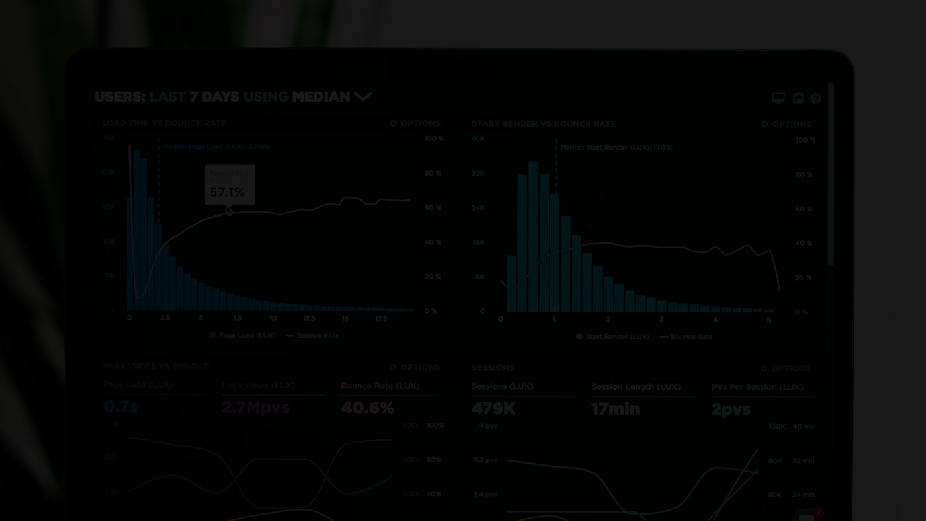
Live Demo
Five decisions in one hirer workflow
Salary benchmark
Experience norms
Applicant response
Reach vs conversion
Repost risk
Notes:
[SEGMENT 3 - Dashboard walkthrough, budget 3:45] [~20s script + ~85s live demo = ~105s block] That's the foundation - now the live app. Five tabs, five decisions in one hirer workflow: salary benchmark, experience norms, applicant response, reach vs conversion, repost risk. SWITCH TO LIVE DEMO HERE - budget about 85 seconds. Prioritize the Repost Risk tab since slide 12 is its payoff; move quickly through the other four.

Slide 11
P A Y & R E S P O N S E
Low-pay postings lose twice: less reach, weaker conversion
Entry roles draw just 2 median applications and show a 43.3% application-shortfall rate.
APPLICATIONS · UNDER-FILLED
MEDIAN
UNDER-FILLED
REACH × CONVERSION
Entry < $3k
2
43.3%
Entry roles get roughly
½ the views ⅓ the conversion
EXEC 116 views · 8.9%
Mid $3–5k
3
31.3%
Senior $5–8k
5
18.5%
ENTRY 53 views · 3.2%
Exec > $8k
10
12.6%
The gap compounds across both stages — this is not a visibility-only problem.
Median 3 applications vs mean 9.6 — averages set expectations about 3× too high.
SCOPE · pay-band subset of first-cycle 30-day postings · N = 78,430 · Mar–Jun 2023
11
Notes:
[~40s] Low pay costs twice. Entry roles draw a median of 2 applications and a 43.3% under-fill rate; by executive, that's 10 applications and 12.6%. Worth saying out loud: median is 3, but the mean is 9.6 - quoting averages would set expectations three times too high. And entry roles get about half the views of exec roles - 53 versus 116 - and convert at about a third the rate - 3.2% versus 8.9%. Two problems compounding, not one. Based on 78,430 postings with a valid pay band, Mar-Jun 2023.

Slide 12
THE HEADLINE FINDING
Aggregate data hides a reversal at entry pay
WHAT THE WHOLE MARKET SHOWS
18.7%
→
16.2%
Reads as: raise the experience bar, get fewer reposts.
True number. Wrong advice.
< 3 years
3+ years
It compares ~$3,000 roles with ~$5,400 roles. The higher-experience group is simply better paid.
COMPARE WITHIN PAY BANDS — THE HIRER'S ACTUAL DECISION
Entry < $3k
19.4%
→
24.6%
+5.3 pts
THE REVERSAL
Mid $3–5k
18.4%
→
18.1%
−0.3
+5.3 pts
Senior $5–8k
17.9%
→
15.5%
−2.4
reposting when Entry roles (<$3k) ask for 3+ years
Exec > $8k
15.0%
→
12.1%
−2.9
OR 1.36 · 95% CI 1.23–1.51
Heterogeneity is real: Breslow–Day p ≈ 6×10⁻¹². The un-split view does not ship.
SCOPE · 30-day postings with a pay band · N = 95,289 · Mar–Jun 2023 · association, not causation
12
Notes:
[~75s - the payoff slide, do not rush] Aggregate data lies here. Market-wide, reposting falls from 18.7% to 16.2% as the experience ask rises past 3 years - reads as 'raise the bar, get fewer reposts.' True number, wrong advice: it's comparing $3,000 roles to $5,400 roles - pay is doing the work. Split by pay band instead: at Entry, under $3k, asking 3-plus years actually raises reposting by 5.3 points, 19.4% to 24.6%. Every other band goes the other way - Mid roughly flat, Senior down 2.4 points, Exec down 2.9. This isn't noise - Breslow-Day p is about 6 times ten-to-the-minus-12, odds ratio 1.36, 95% CI 1.23 to 1.51, on 95,289 postings with a valid pay band. That's why the board never shows the unstratified view.

Slide 13
CHALLENGES & LEARNINGS
Three rules that kept the board honest
01
Know what the data cannot answer
Layer two uses 78,942 rows instead of a million because engagement counters must be comparable. That is the difference between a number and a trustworthy one.
02
Delete weak proxies
skill_count relies on job titles, not descriptions. competitiveness_score barely tracks applications, views or vacancies. A weak proxy is worse than no proxy.
03
Ship the caveat with the chart
Every chart carries its cohort, sample size and window. The board does not imply causation or claim that a role actually filled.
NOT ESTABLISHED — causation, seasonality (one 4-month window), or whether a role actually filled.
NEXT — high-volume employers get markedly less engagement per posting (ρ = −0.53).
13
Notes:
[SEGMENT 4 - Challenges & learnings, budget 1:00 for slides 13+14] [~35s] Three fast lessons. Earning the right to use 78,942 rows instead of a million was the hard part - that's the difference between a number and a trustworthy one. Two features got built and deleted along the way - skill_count and competitiveness_score - a weak proxy is worse than no proxy. And nothing here claims causation or that a role actually filled - one open thread: high-volume employers see markedly less engagement per posting, rho about minus 0.53.

Slide 14

B U S I N E S S T A K E A W A Y
Before you post, answer three questions.
01
02
03
Is the pay competitive?
Is the experience ask normal?
What response should I expect?
Benchmark against comparable roles — not the whole market.
Check what similar employers actually request.
Use only fully observed, comparable postings.
Clearest measurable risk zone in this dataset: low pay + high experience.
One board. One vacancy. Three checks before you post.
THANK YOU — QUESTIONS?
14
Notes:
[~25s] So: three checks before you post. Is the pay competitive against comparable roles, not the whole market? Is the experience ask normal? And what response should you realistically expect, from fully observed postings only? The clearest risk zone here is low pay paired with a high experience ask. One board, one vacancy, three checks before you post. Thank you.

