Slide 1

DevOps Tools
Present By: Bom bahadur BK & Umesh paneru
Level: Master of Computer Engineering
Nepal College of information Technology(NCIT)
Balkumari, lalitpur

Slide 2
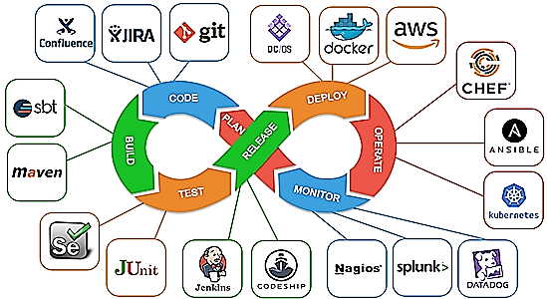
What is DevOps?
DevOps is a set of practices, principles, and cultural philosophies that aim to improve collaboration between software development (Dev) and IT operations (Ops) teams.
The goal of DevOps is to automate and streamline the software development lifecycle (CI/CD), from coding and testing to deployment and monitoring, ensuring faster and more reliable software delivery.

Slide 3
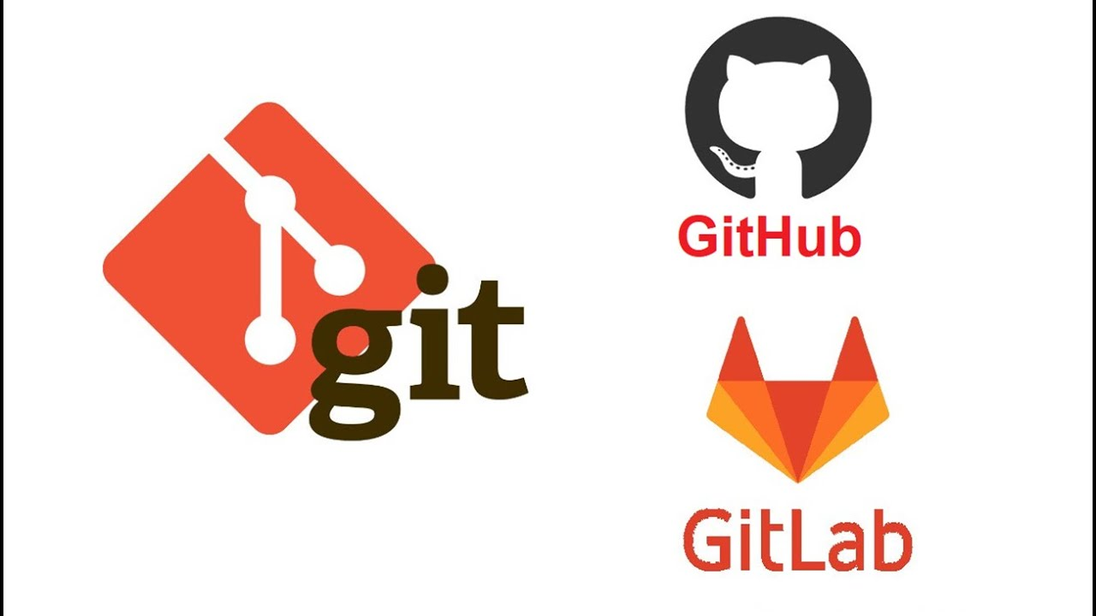
What is Git?
Git is a distributed version control system (VCS) that allows developers to track changes in code, collaborate on projects, and manage the history of their work.
Git repository: GitHub, GitLab

Slide 4
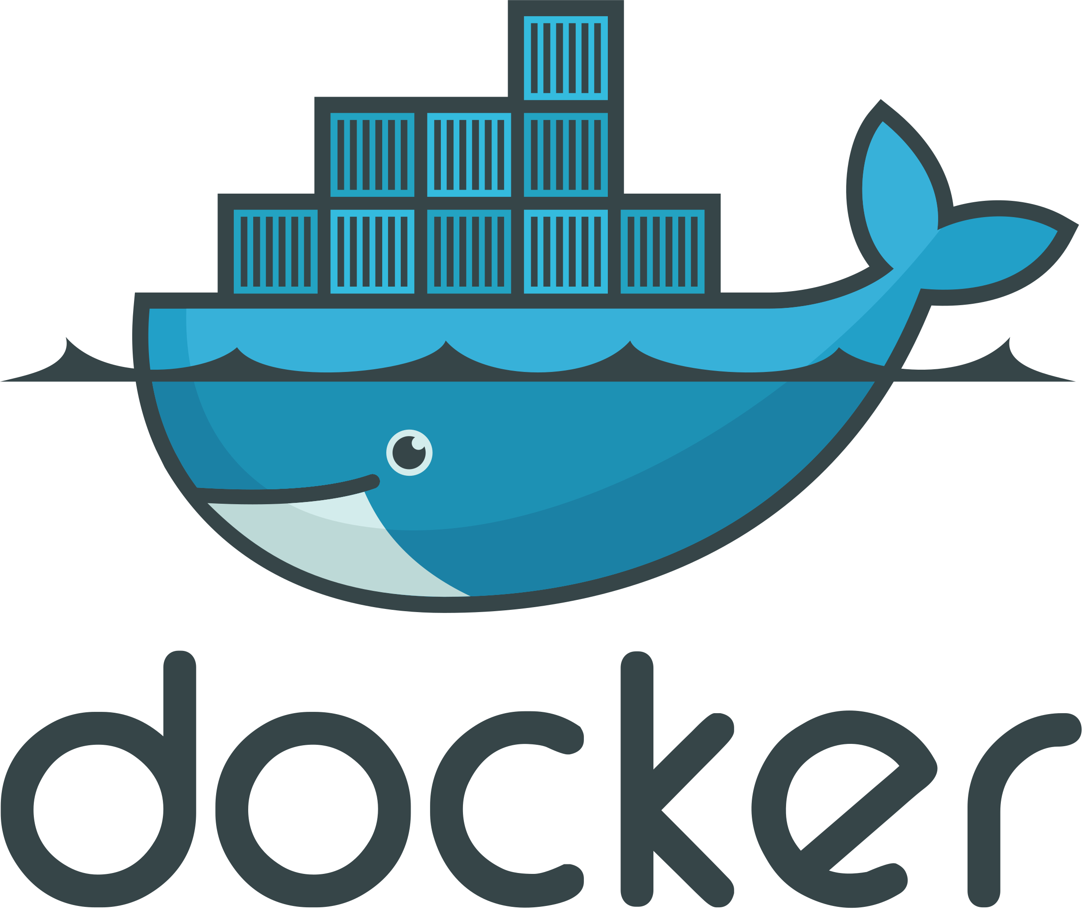
What is docker
Docker is a platform for developing, shipping, and running applications inside lightweight, portable, and isolated containers.
Containers allow developers to package applications with all their dependencies (libraries, tools, configuration files) so they can run consistently across different environments, such as development, testing, and production.

Slide 5
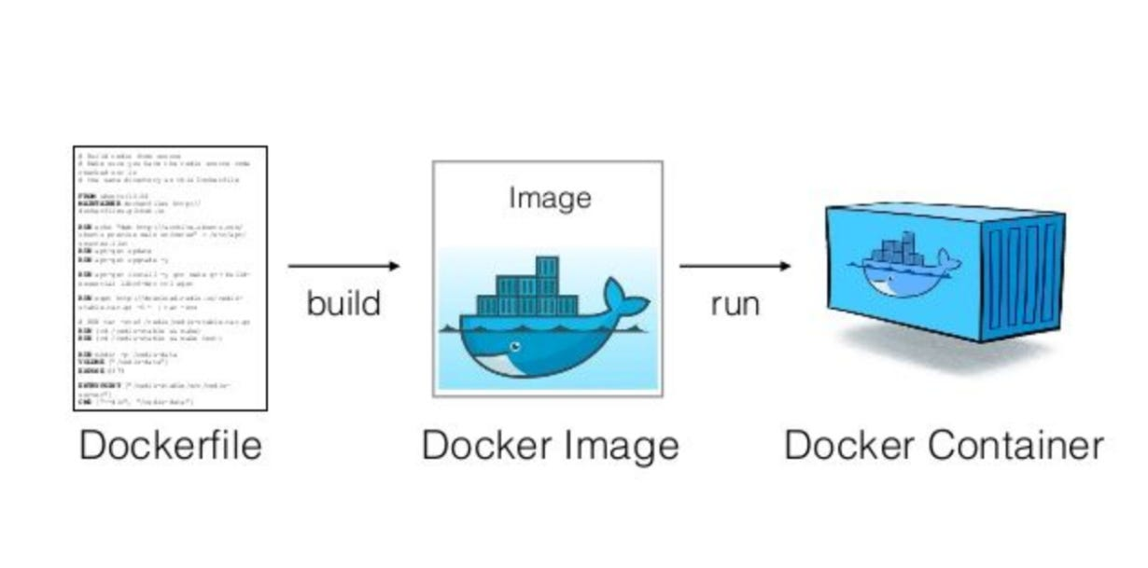
Docker Component
Docker engine
Docker file
Docker image
Docker container

Slide 6
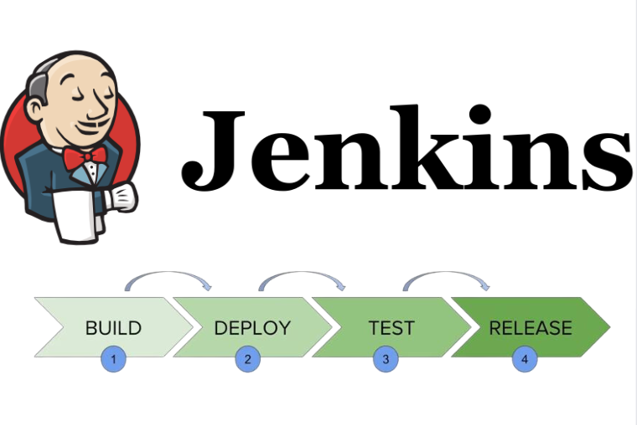
Jenkins
Jenkins is an open-source automation server that is widely used for Continuous Integration (CI) and Continuous Delivery/Deployment (CD) in software development.
It helps automate repetitive tasks such as building, testing, and deploying code, ensuring faster and more reliable software delivery.

Slide 7
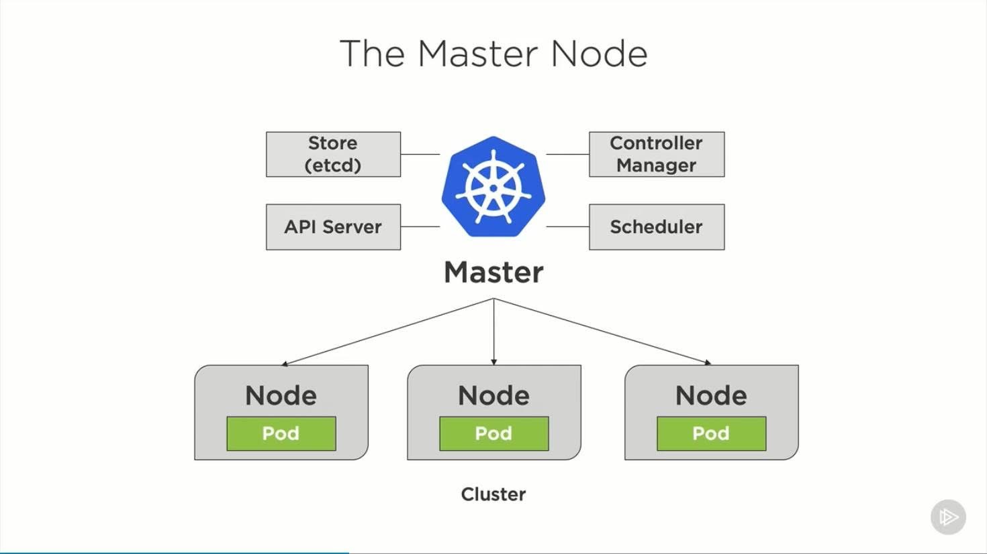
Kubernetes
Kubernetes (K8s) is an open-source container orchestration platform that automates the deployment, scaling, and management of containerized applications.
Originally developed by Google, it is now maintained by the Cloud Native Computing Foundation (CNCF).
Minikube is a lightweight, open-source tool that allows developers to run and test Kubernetes clusters on their local machines

Slide 8
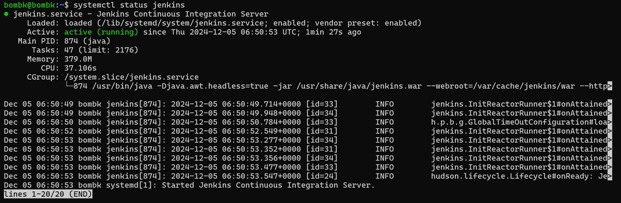
CICD Steps 1. Install jenkins

Slide 9
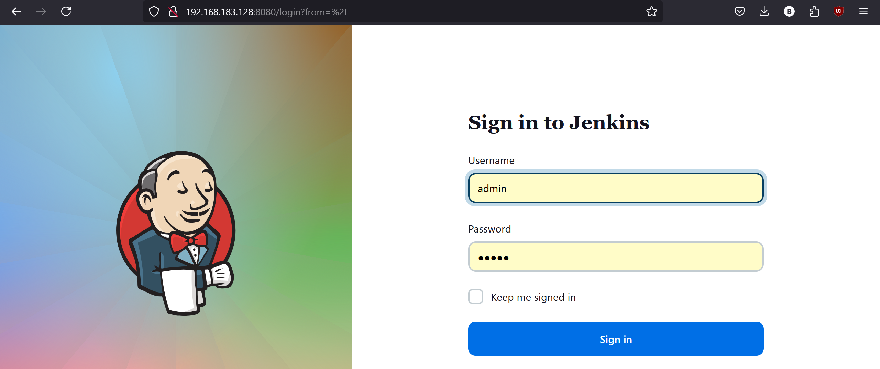
Jenkins weblogin

Slide 10
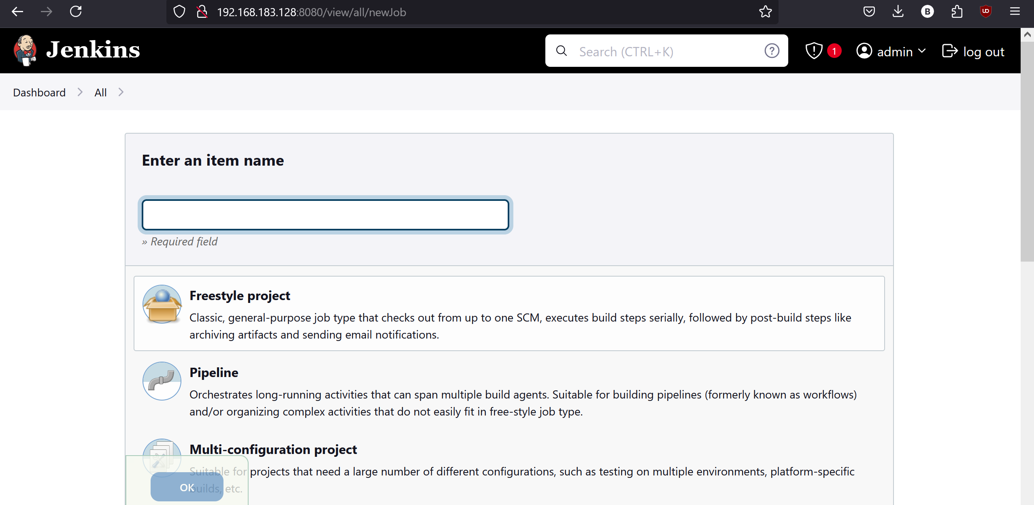
Create pipeline in jenkins

Slide 11
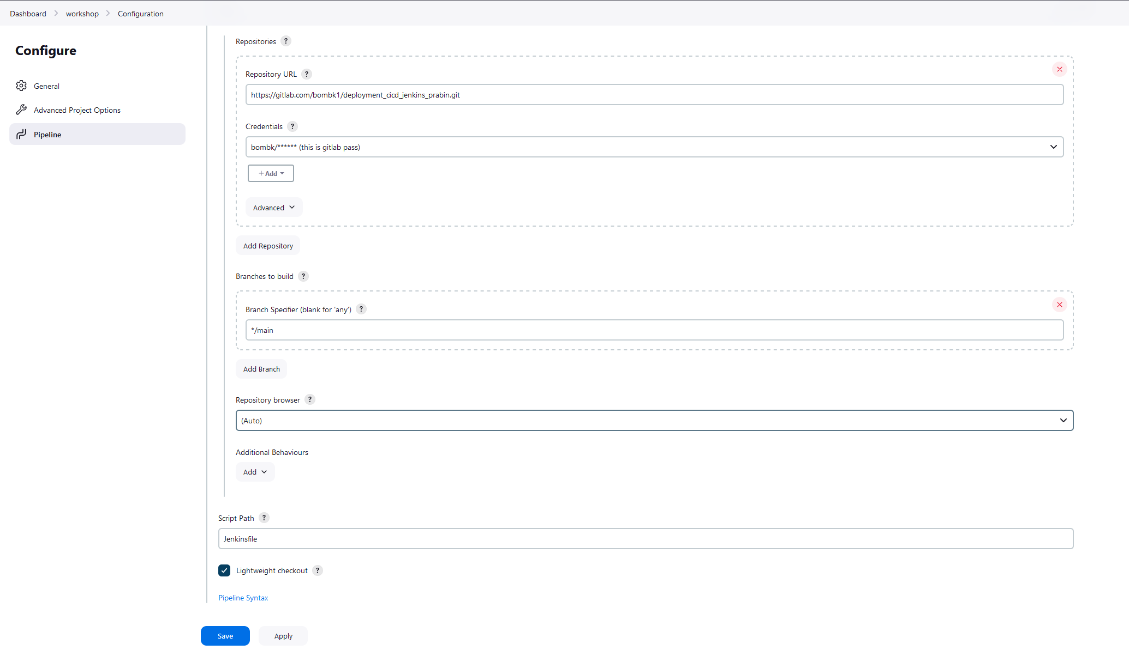
Pipeline configuration

Slide 12
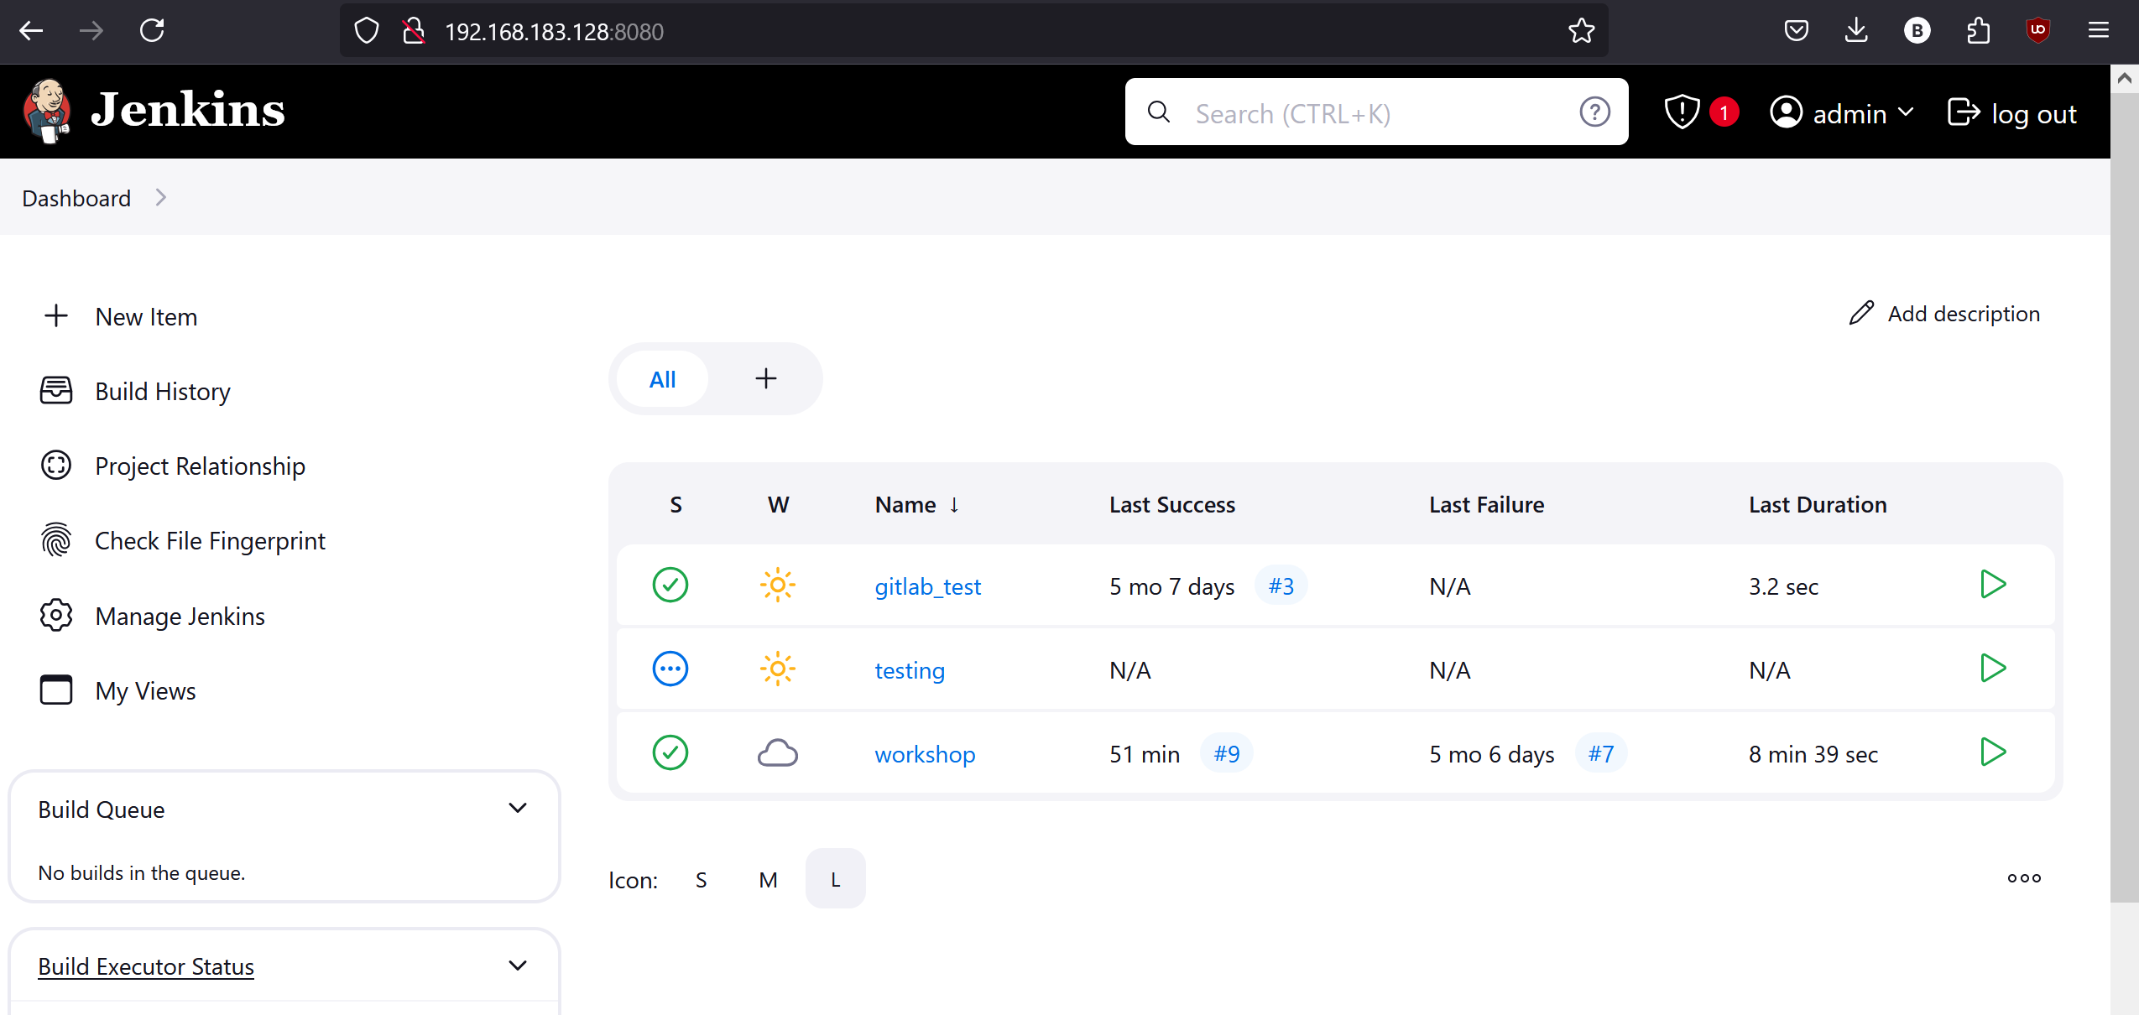
Pipeline list

Slide 13
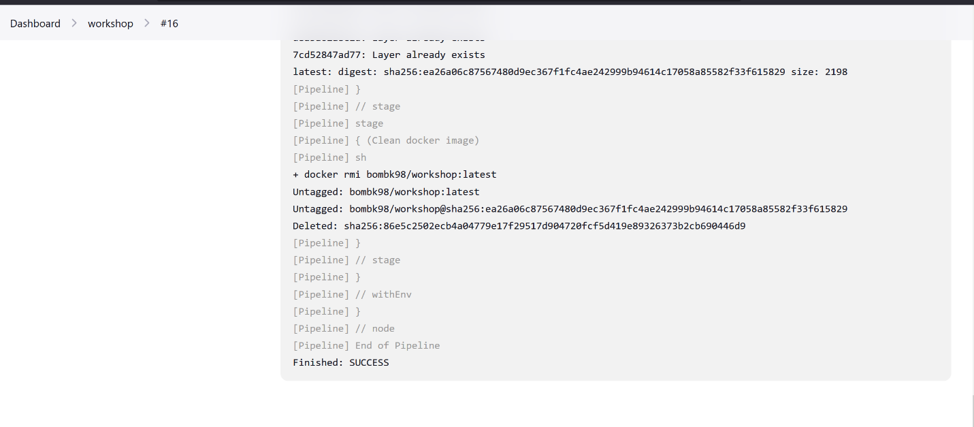
Pipeline running outpu

Slide 14
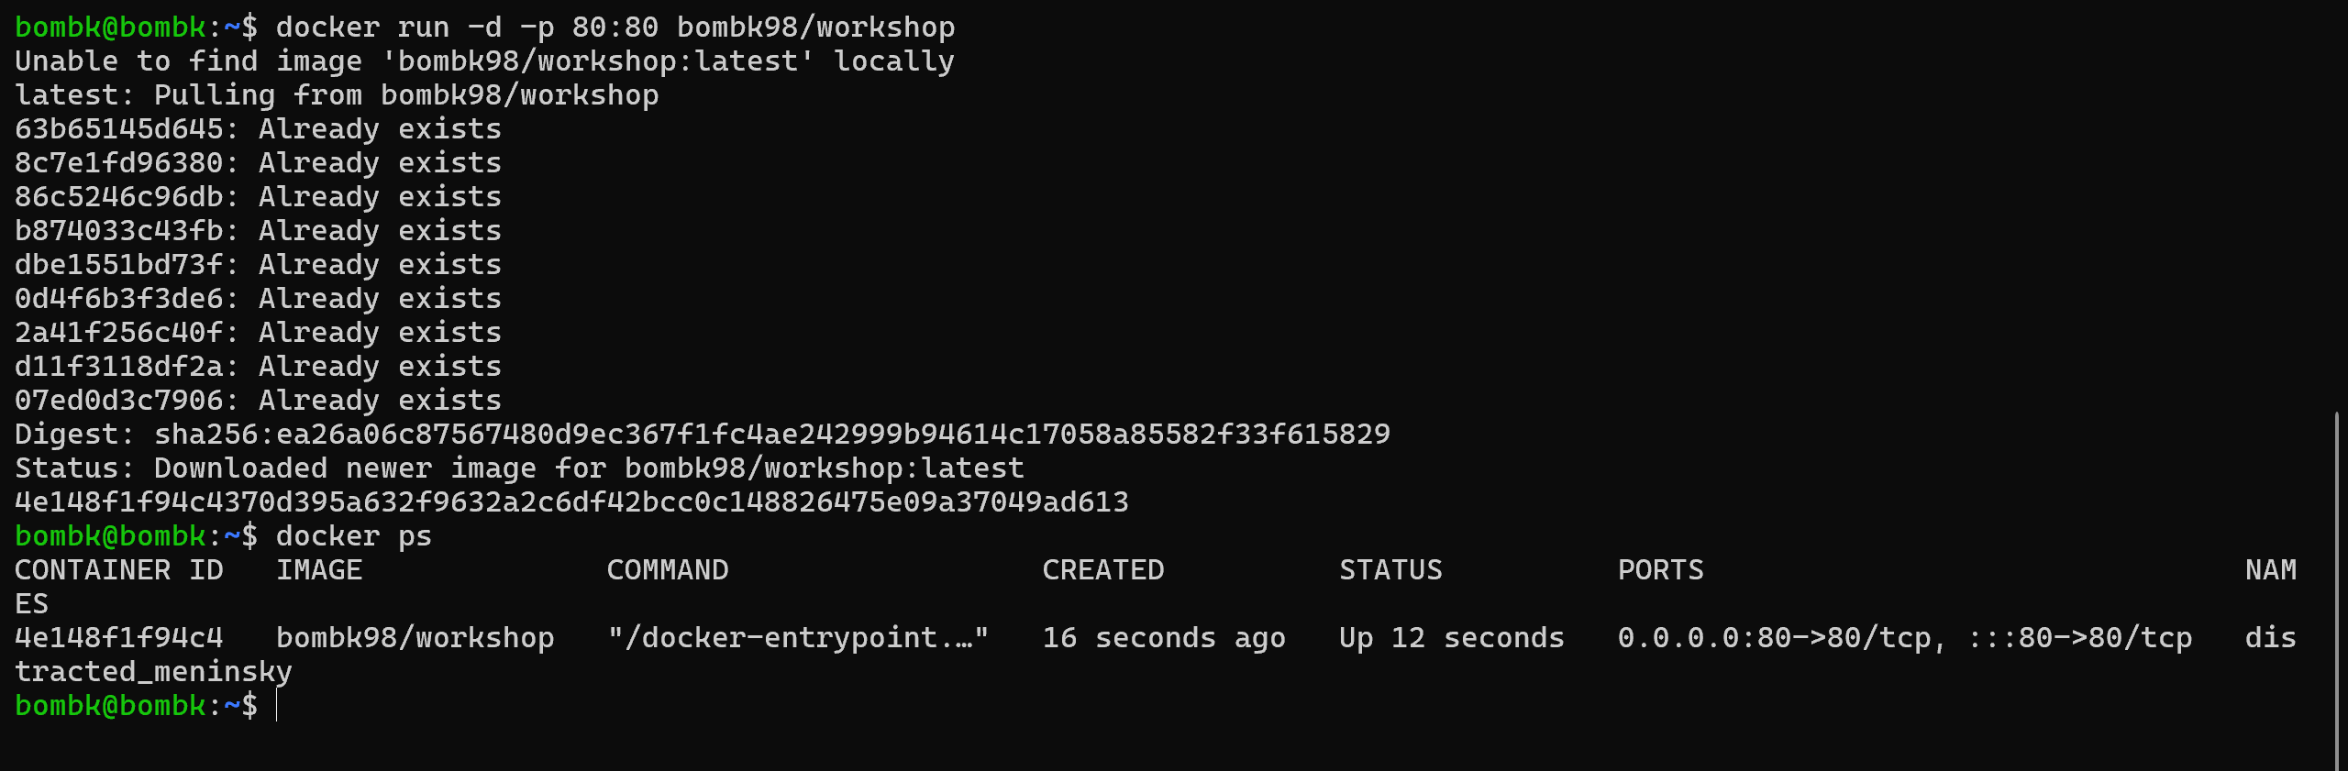
Run docker image

Slide 15
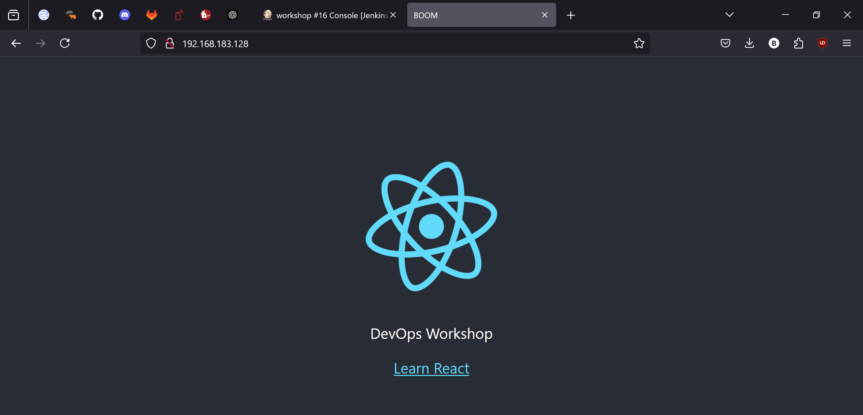
Deployment

Slide 16
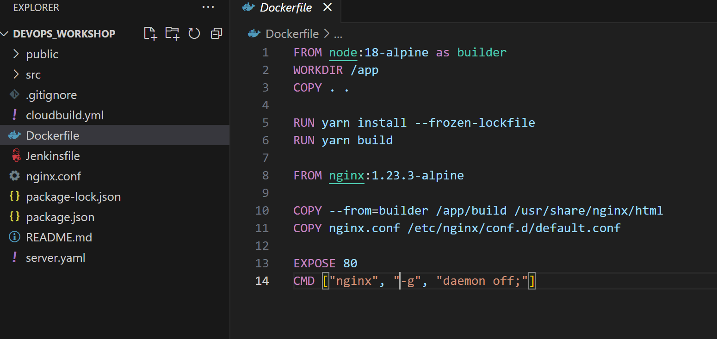
Dockerfile

Slide 17
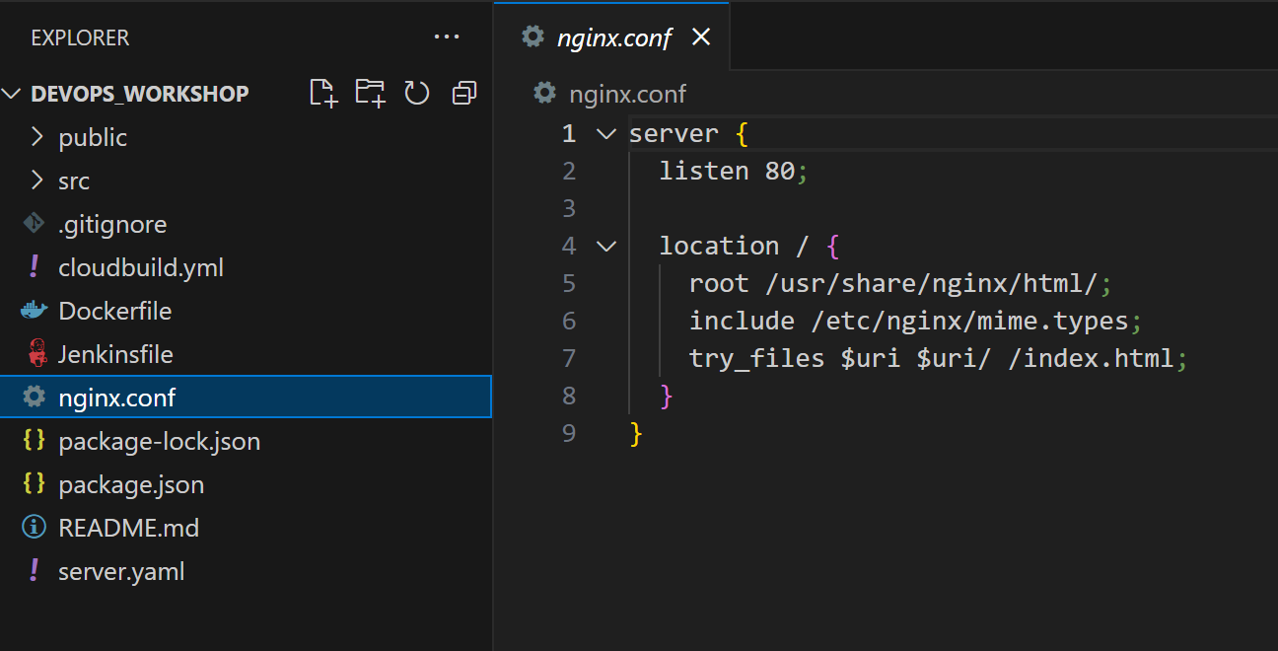
Nginx configuration file

Slide 18
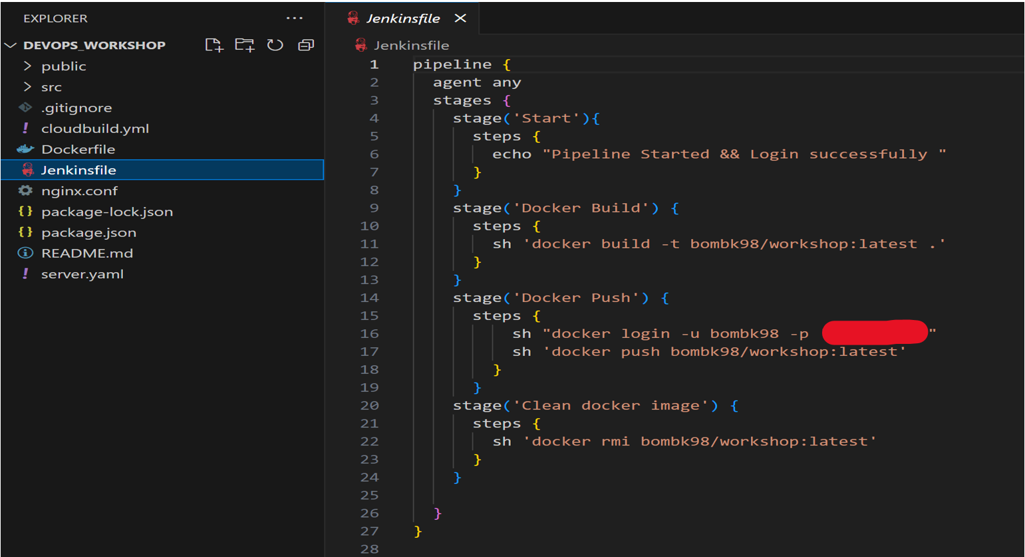
Jenkins file for CICD

Slide 19
Thank You So Much!
Have a great time…

