Slide 1

Distributed File Systems & Emerging Storage Technologies
Present By: Bom bahadur BK
Level: Master
Nepal College of information Technology(NCIT)
Balkumari, lalitpur

Slide 2
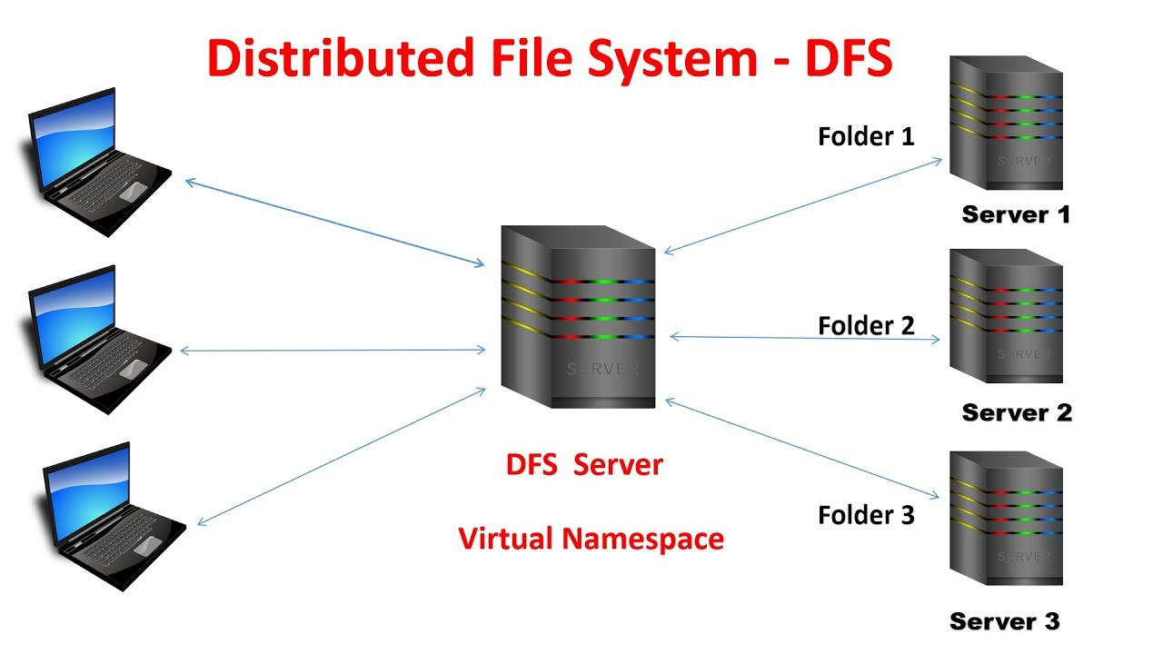
Introduction
What is a Distributed File System?
A file system that allows storing and accessing files across multiple servers.
Designed for scalability, fault tolerance, and high availability.
Emerging Storage Technologies:
Innovations like DNA, holographic, and quantum storage aim to revolutionize data storage for the future.

Slide 3
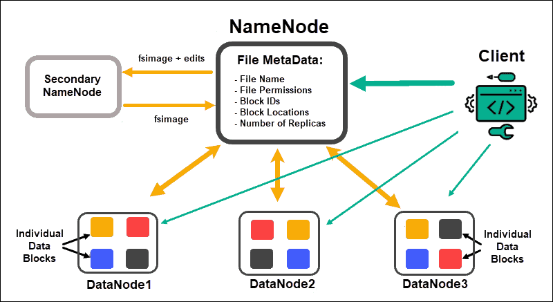
Hadoop Distributed File System (HDFS)
Overview:
Designed for big data processing using Hadoop.
Stores large files across multiple machines.
Key Features:
Fault tolerance (replication of data blocks).
Scalability (handles petabytes of data).
High throughput for large datasets.
Use Cases:
Big data analytics, log processing, and data warehousing.

Slide 4
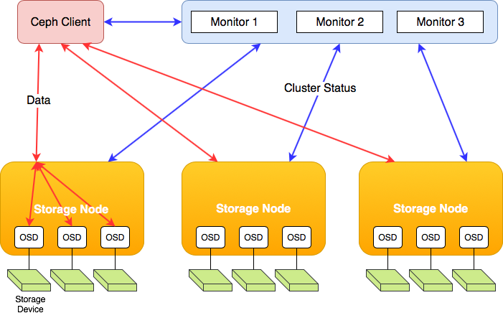
Ceph
Overview:
A unified distributed storage system providing object, block, and file storage.
Open-source and highly scalable.
Key Features:
Decentralized architecture (no single point of failure).
Self-healing and self-managing.
Supports petabytes of data.
Use Cases:
Cloud storage, virtualization, and backup systems.

Slide 5
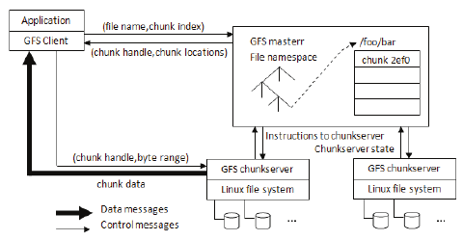
Google File System (GFS)
Overview:
Proprietary distributed file system developed by Google.
Designed for large-scale data processing.
Key Features:
Master-slave architecture.
High fault tolerance through replication.
Optimized for large files and sequential reads/writes.
Use Cases:
Google Search, YouTube, and other Google services.

Slide 6
Comparison of HDFS, Ceph, and GFS
Feature | HDFS | Ceph | GFS
Architecture | Master-Slave | Decentralized | Master-Slave
Scalability | High | Very High | Very High
Fault Tolerance | Replication | Self-Healing | Replication
Use Case | Big Data Analytics | Cloud Storage | Google Services

Slide 7
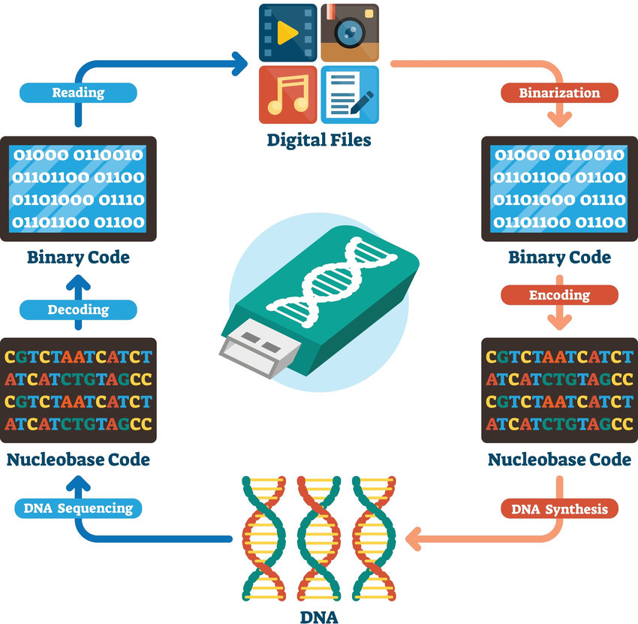
DNA Storage
Overview:
Uses synthetic DNA molecules to store digital data.
Extremely high density and longevity (thousands of years).
Key Features:
1 gram of DNA can store ~215 petabytes of data.
Energy-efficient and compact.
Challenges:
High cost and slow read/write speeds.
Use Cases:
Long-term archival storage, scientific research.

Slide 8
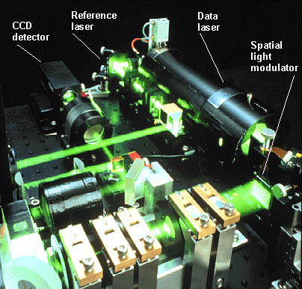
Holographic Storage
Overview:
Uses lasers to store data in 3D holograms within a photosensitive medium.
Key Features:
High storage density and fast data access.
Potential for terabytes of data in a single disc.
Challenges:
Expensive and complex technology.
Use Cases:
Data archiving, medical imaging, and multimedia storage.

Slide 9
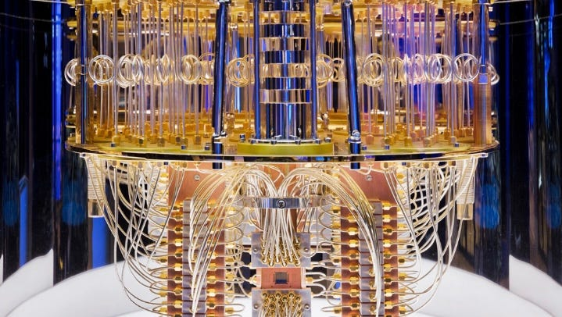
Quantum Storage
Overview:
Uses quantum mechanics principles to store and process data.
Quantum bits (qubits) enable superposition and entanglement.
Key Features:
Potential for exponentially higher storage capacity.
Enables quantum computing and secure data transmission.
Challenges:
Requires extremely low temperatures and is still in experimental stages.
Use Cases:
Quantum computing, cryptography, and advanced research.

Slide 10
Comparison of Emerging Storage Technologies
Feature | DNA Storage | Holographic Storage | Quantum Storage
Capacity | Extremely High | High | Exponentially High
Speed | Slow | Fast | Ultra-Fast (theoretical)
Cost | High | High | Very High
Maturity | Experimental | Developing | Experimental

Slide 11
Thank You So Much!
Have a great time…

