Slide 1
Gomore Runner Data Dump from server
Scott

Slide 2
Basic Structure
Module
(Data Processing: parsing / calculation)
request
Control
(Handling main process / directory / file access)
result
request
Plot
(Generate figures)
result

Slide 3
Gomore runner server download modules
Parse HTML page and download jsons
Gomore runner server download control
Data parsing modules
Init settings &
main flow
Pasre data lists from json
Single workout plot
Generate fig objects
Data analysis modules
Do extra data analysis or processing (filtering…)

Slide 4
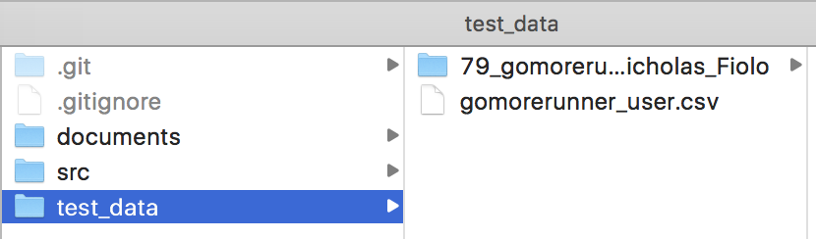
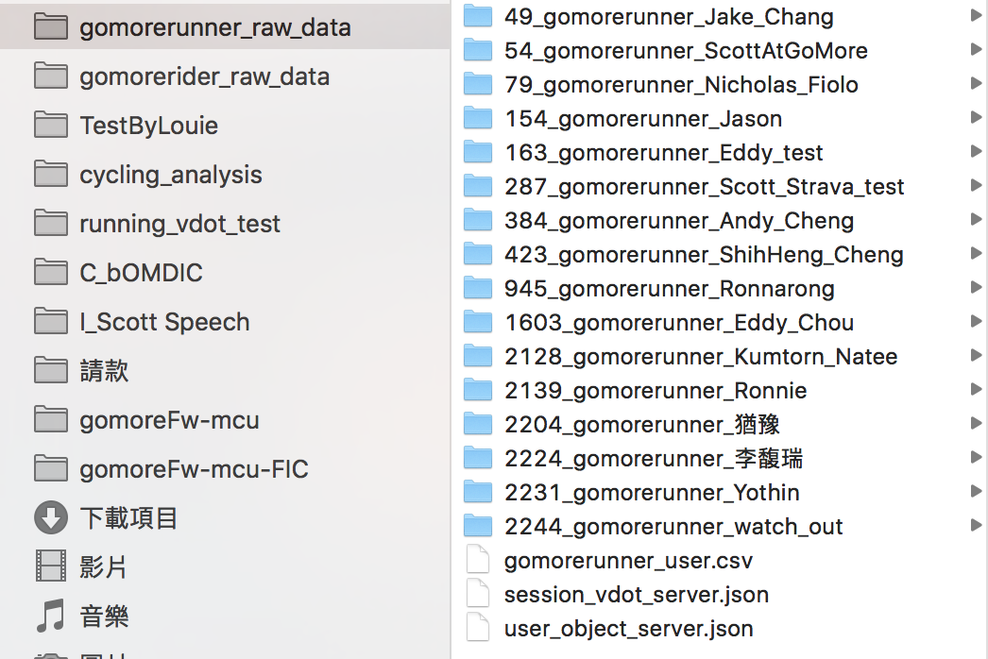
Data and Code Separation
Git repository
Code
Test data
documents
Data folder
data
Never commit data folder to git !
Increase git loading
Increase unnecessary conflists

Slide 5
Test Driven Development (TDD)

Slide 6
Todo
Create Stamina-based TRIMP analysis and plot
Create pytest test
Git merge and conflict handeling

