Slide 1
Jump Analysis for CMJ / SJ / DJ / IMTP
Scott

Slide 2
Basic Structure
Module
(Data Processing: parsing / calculation)
request
Control
(Handling main process / directory / file access)
result
request
Plot
(Generate figures)
result

Slide 3
Data Parsing Modules
CMJ Analysis Control
CMJ Analysis Modules
dispatch_daul_input
CMJ Plot
parsing_force_plate_raw_data
SJ Analysis Control
SJ Analysis Modules
Jump Analysis Control
(for all users)
Single User Analysis Control
(Jump dispatch)
SJ Plot
DJ
Analysis Control
DJ Analysis Modules
Error
Msg
CMJ Statistics Control
SJ Statistics Control
DJ Plot
Data Plot
IMTP Analysis Control
IMTP Analysis Modules
DJ Statistics Control
IMTP Statistics Control
IMTP Plot

Slide 4
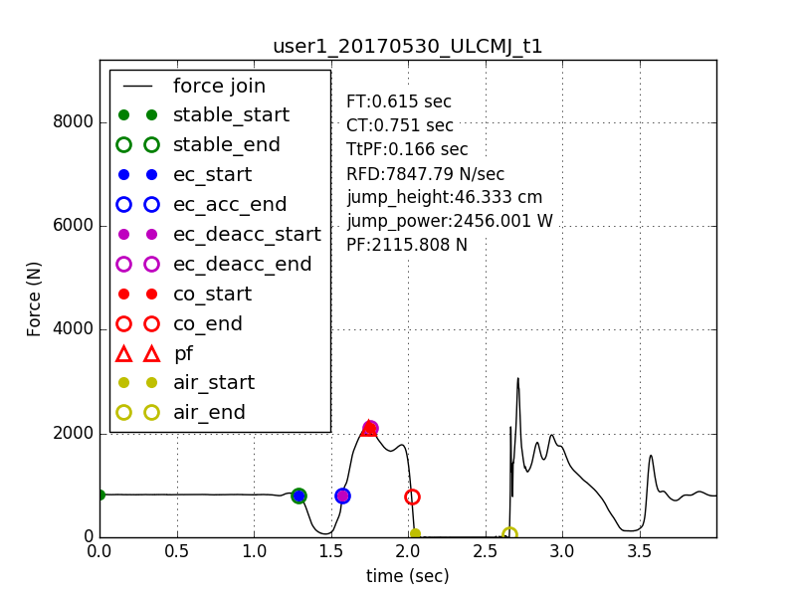
CMJ Analysis Modules

Slide 5
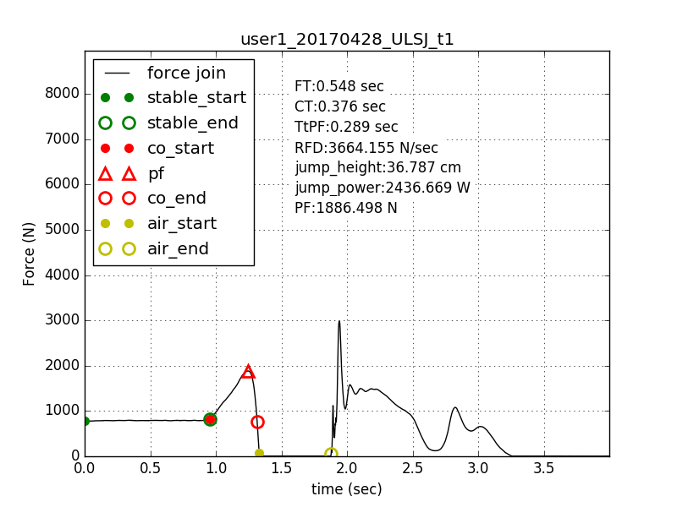
SJ Analysis Modules

Slide 6
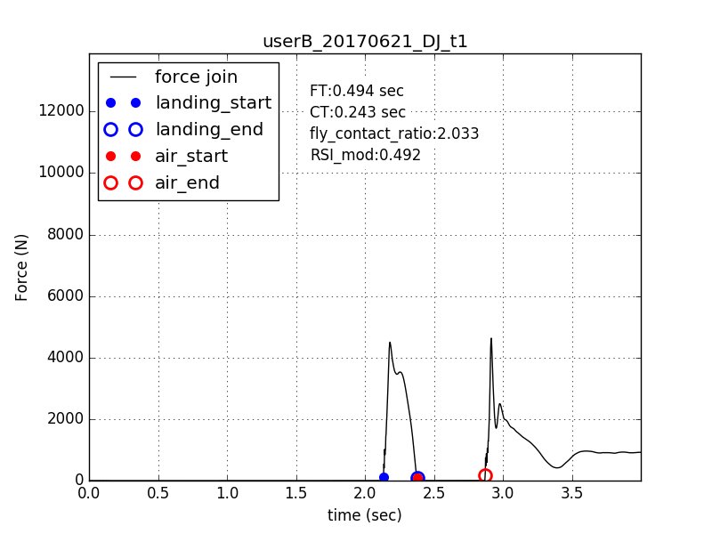
DJ Analysis Modules

Slide 7
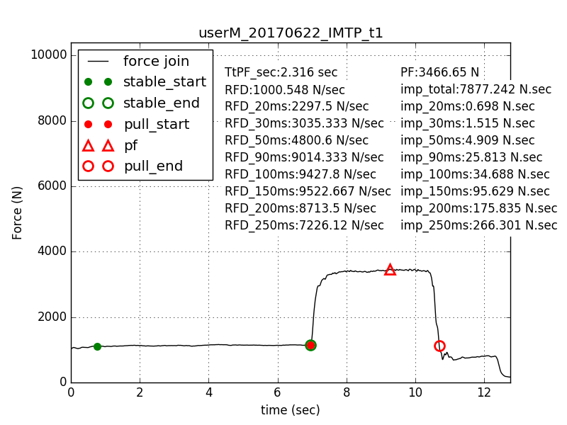
IMTP Analysis Modules

Slide 8
Operation Flow
Parse new dual input data
Single User Analysis Control
[Jump Type] Analysis Control
[Jump Type] Analysis Modules & Plot
Parse new data in user1’s folder
Single User Analysis
Parse new data in user2’s folder
Activity Detection
CMJ
Analysis
Plot
…
SJ
…
DJ
…
Single User Avg Statistics
IMTP
…

Slide 9
CMJ Analysis

Slide 10
CMJ Analysis
Stand by
Eccentric acc
stage
Eccentric deacc stage
Concentric stage
On air
Landing

Slide 11
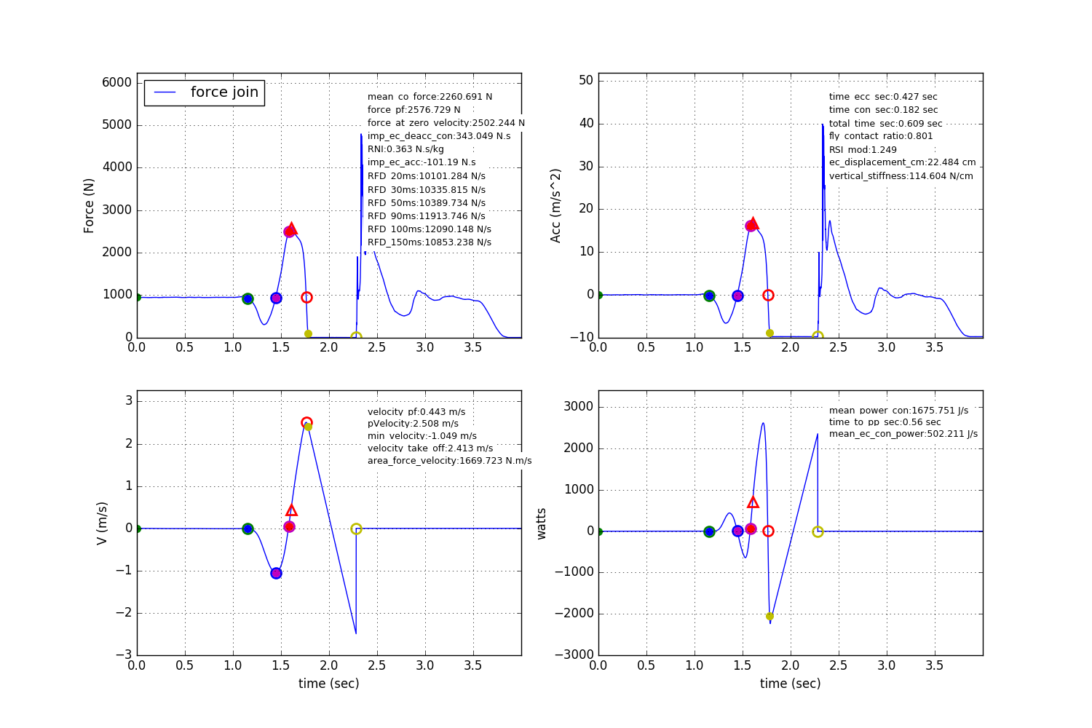
CMJ Analysis
Stand by
Eccentric acc
stage
Eccentric deacc stage
Concentric stage
On air
Landing

Slide 12
CMJ Analysis
abs(force_N_join[i] - mean) < 10
For more than 0.1sec
force_N_join[i] > 100 N
stable_time
> 0.5sec
& Std >= 15
force_N_join[i] > 100 and
(i-air_start_tick)>=100
v > v_min
v = 0
Stand by
Eccentric acc
stage
Eccentric deacc stage
Concentric stage
On air
Landing
std < 15.0
Concentric stage end
(mean - force_N_join[i])
< 20
a = 0
(no extra force
F = mean weight)
force_N_join[i] <= 100 and
force_N_join[pf_tick] > mean

Slide 13
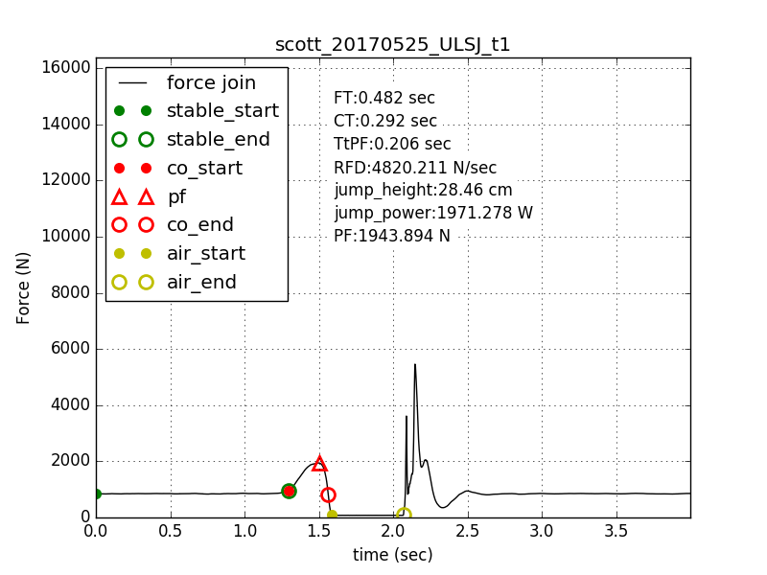
SJ Analysis
Stand by
Concentric stage
On air
Landing

Slide 14
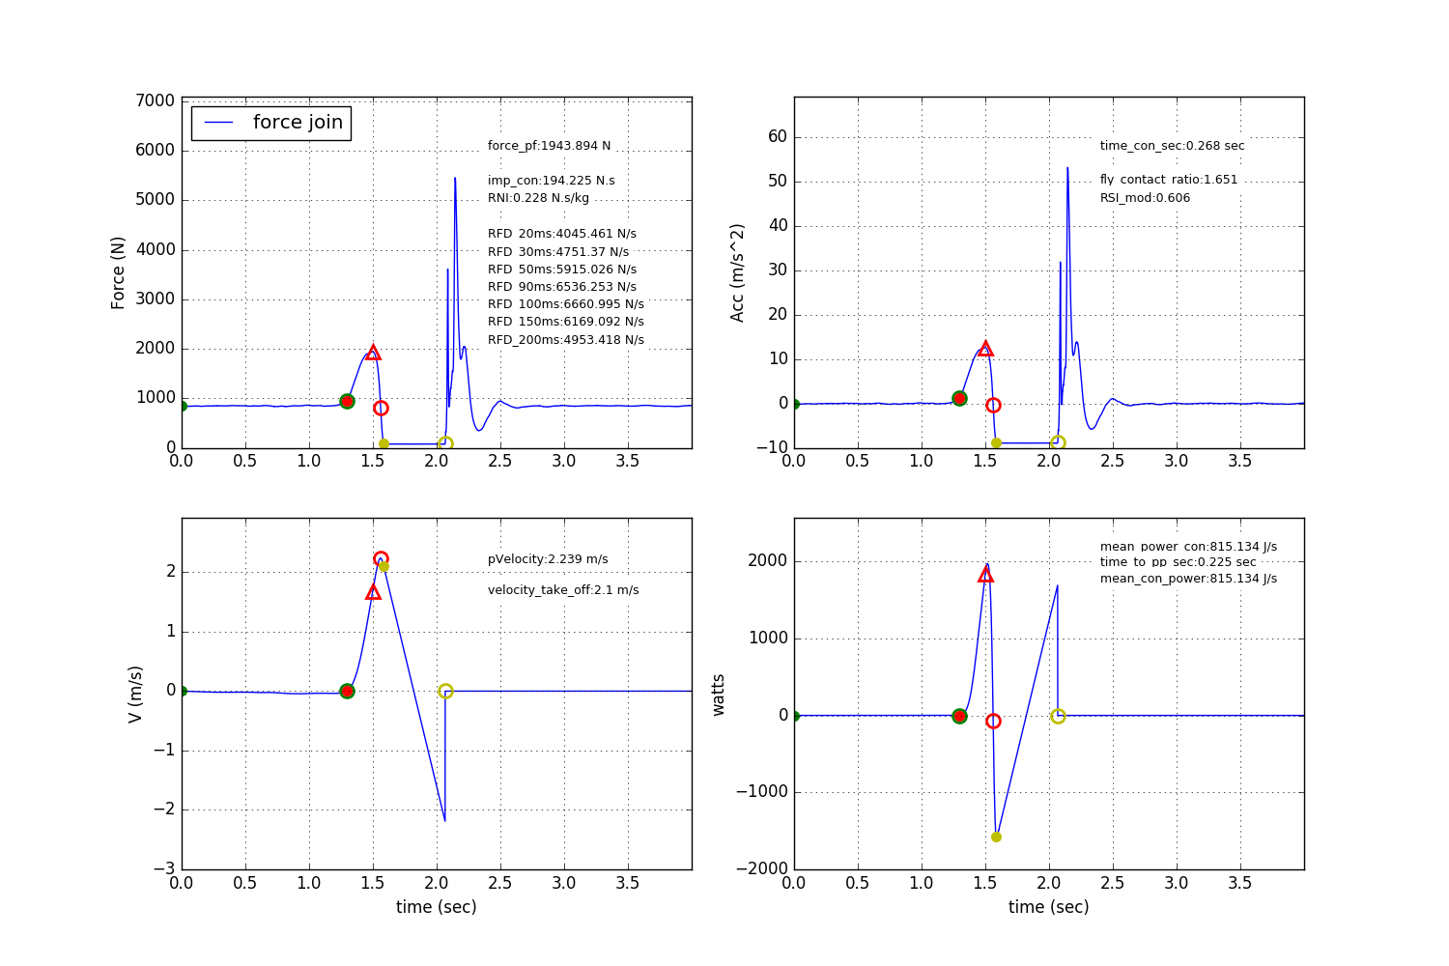
SJ Analysis
Stand by
Concentric stage
On air
Landing

Slide 15
SJ Analysis
abs(force_N_join[i] - mean) < 10
For more than 0.1sec or
(force_N_join[i] - mean) < -50 (detect ec)
force_N_join[i] > 100 N
stable_time
> 0.25sec
& Std >= 20
force_N_join[i] > 100 and
(i-air_start_tick)>=100
Stand by
Concentric stage
On air
Landing
std < 20.0
Concentric stage end
(mean - force_N_join[i])
< 20
a = 0
(no extra force
F = mean weight)
force_N_join[i] <= 100 and
force_N_join[pf_tick] > mean

Slide 16
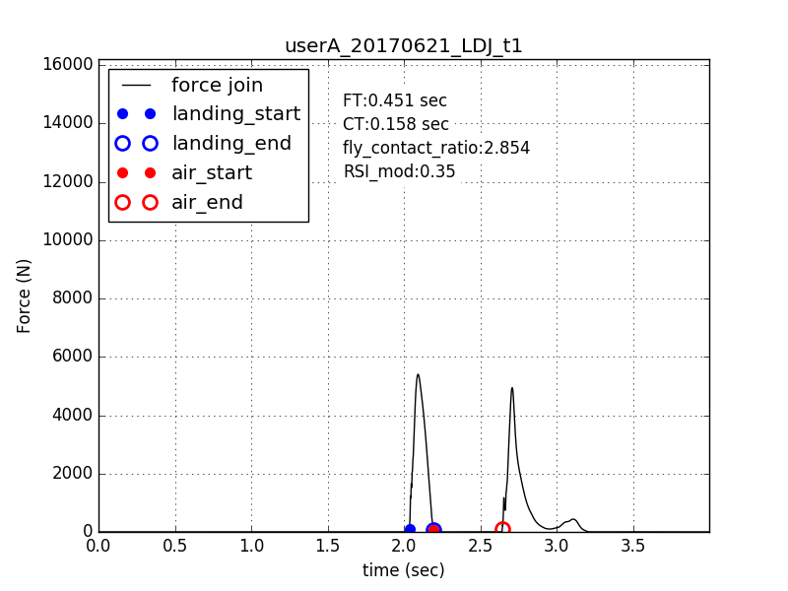
DJ Analysis
before_
jump
landing
On air
landing_
again

Slide 17
DJ Analysis
No force time
> 0.5sec &
force_N_join[i] >= 100
force_N_join[i] > 100 and
(i-air_start_tick)>=100
force_N_join[i] <= 100
before_
jump
landing
On air
landing_
again

Slide 18
IMTP Analysis
stand_by
pull_stage
release_
stage

Slide 19
IMTP Analysis
abs(force_N_join[i] - mean) < 50
For more than 0.1sec (detect ec) or
(force_N_join[i] - mean) < -50
force_N_join[i] > 100 N
stable_time
> 0.25sec
& Std >= 20
abs(force_N_join[i] - mean) < 10 and
(pull_height - mean) > 200
stand_by
pull_stage
release_
stage
std < 15.0
(mean - force_N_join[i])
< 20

