Slide 1
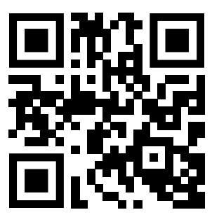
Free webinar on applying to grad school in ecology, evolution, and related fields
Thursday, Oct 24, 2024
11 am US Eastern, 8 am US Pacific, 15:00 UTC
http://www.ApplyingToEEB.info
Masters or PhD?
How to find a good mentor?
How to find a good program?
How is this different from undergrad?
You get paid to go to grad school? [sort of…]
Timeline
Mental health in grad school
And much more!
This is part of our goal of teaching the “hidden curriculum” — information that is not typically formally taught that otherwise privileges some insiders who know it. Panelists are Brian O’Meara and Xingli Giam, both long-serving members of the U. of Tennessee, Knoxville, EEB graduate admissions committee. There will be a presentation followed by Q&A.

