Slide 1
Smart Contact Tracing System
Team name: 5Bugs

Slide 2
Pitfalls of current contact tracing system
Requires smart devices (TraceTogether) or NRIC (SafeEntry)
Difficult for certain groups of people
BlueTrace runs poorly on older smartphone models and operating systems
SafeEntry is easy to exploit

Slide 3
Smart Identification Traceability (S.I.T)
Works together with SafeEntry
Leverage AWS technologies
Item-free check-in
Automation of contact tracing and visiting of SafeEntry areas
3 component solution
1. Biometrics Identity Tracker (B.I.T)
2. Level Imaging Thermology (L.I.T)
3. Human Identification and Tagging (H.I.T)

Slide 4



Smart Identification Traceability (S.I.T)
CCTV
Thermal
Camera
Pi
Pi
Fingerprint Scanner
1 Metre
1 Metre

Slide 5



Biometrics Identity Tracker (B.I.T)
Fingerprint Capture
Fingerprint Process
Fingerprint Match
  (99.75% accuracy)

Slide 6
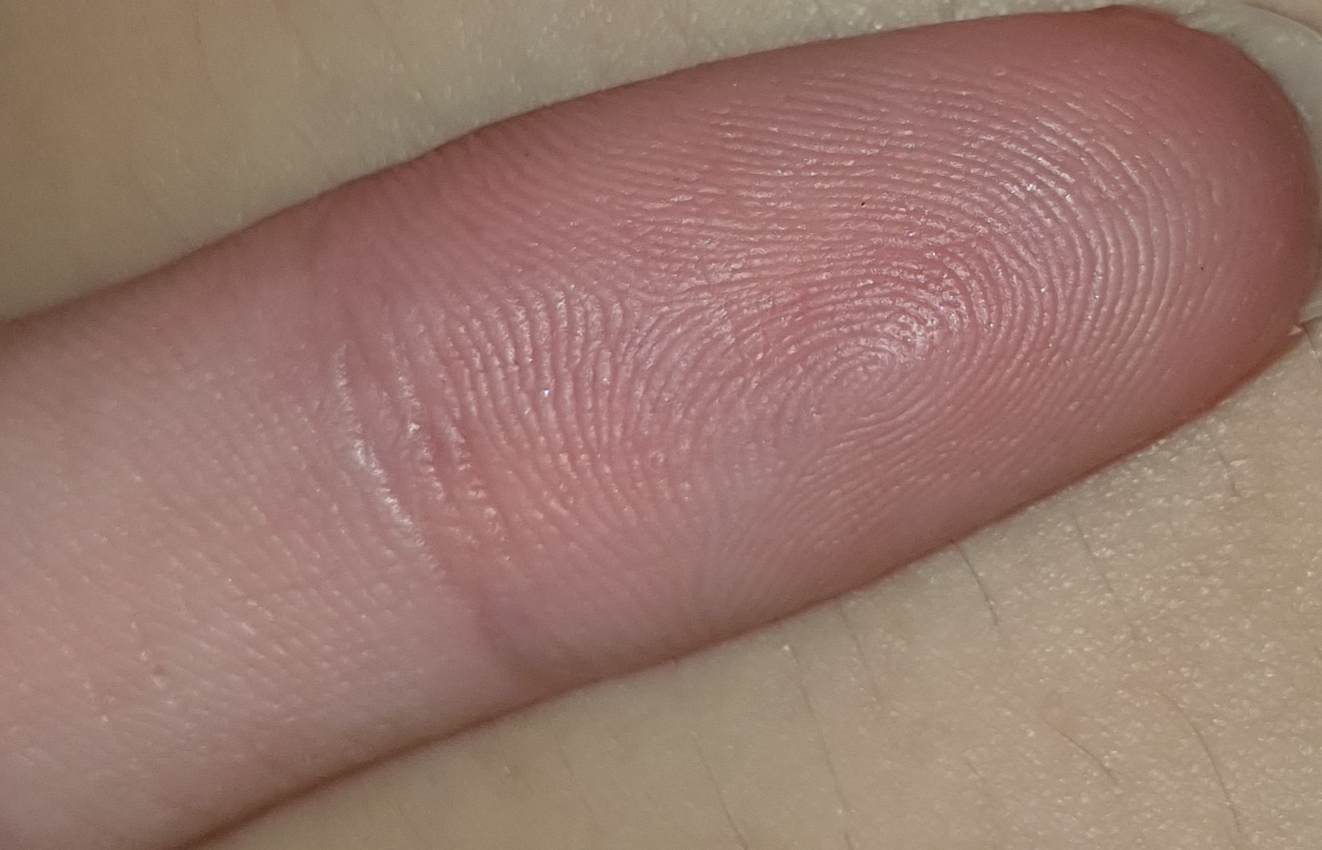

Fingerprint Capturing and Processing

Slide 7
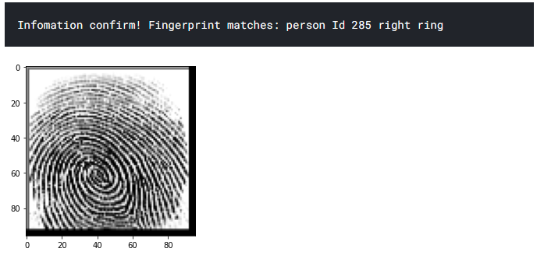
Fingerprint Matching

Slide 8



Level Imaging Thermology (L.I.T)
Real-time detection of temperature
Alert sounds off when temperature ≥37.5°
Makes use of low cost hardware

Slide 9
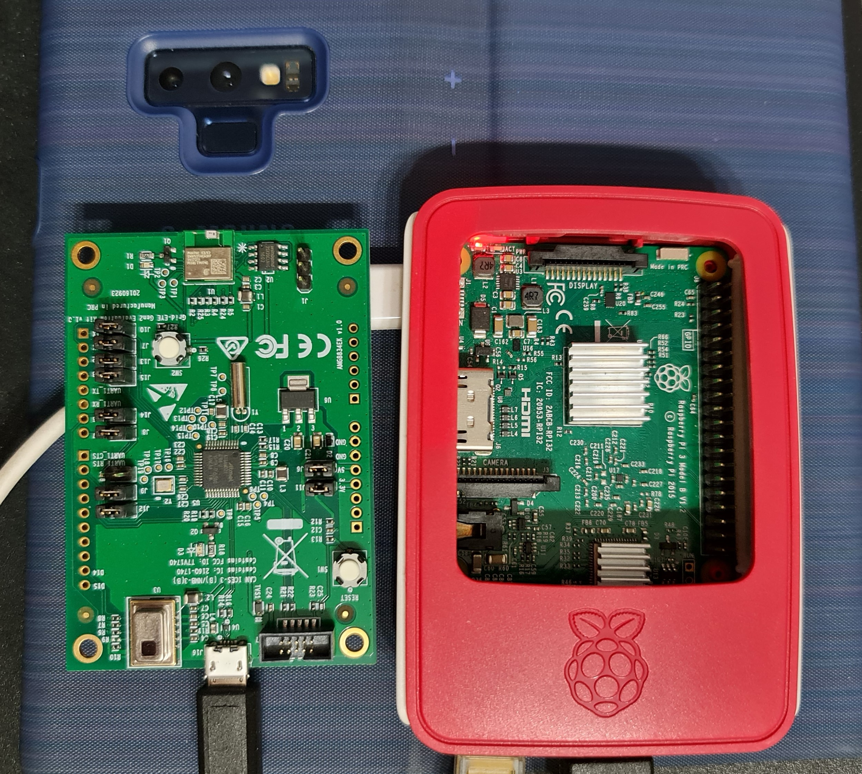
L.I.T Hardware

Slide 10



Human Identification and Tagging (H.I.T)
Utilizes recorded CCTV footages
Identify and tag humans based on various elements
Dashboard for tracing affected person

Slide 11
Model Flow
Frame Extraction
Human Identification + Cropping
Reidentification

Slide 12
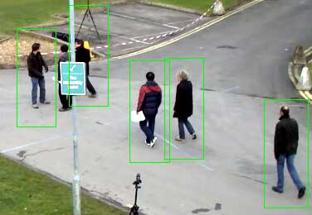
Human Identification

Slide 13
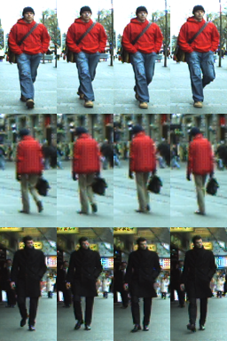
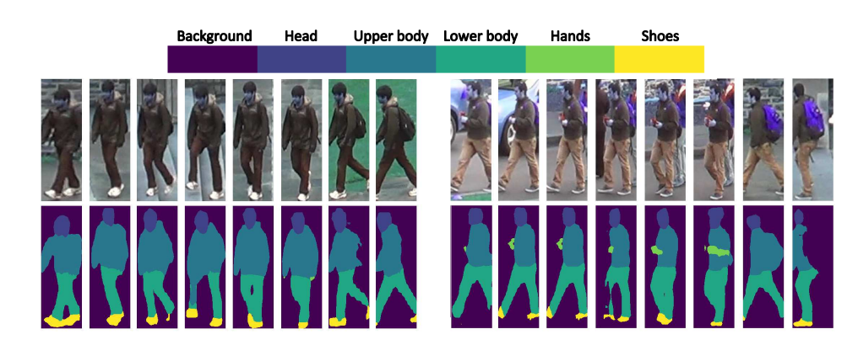
Reidentification

Slide 14
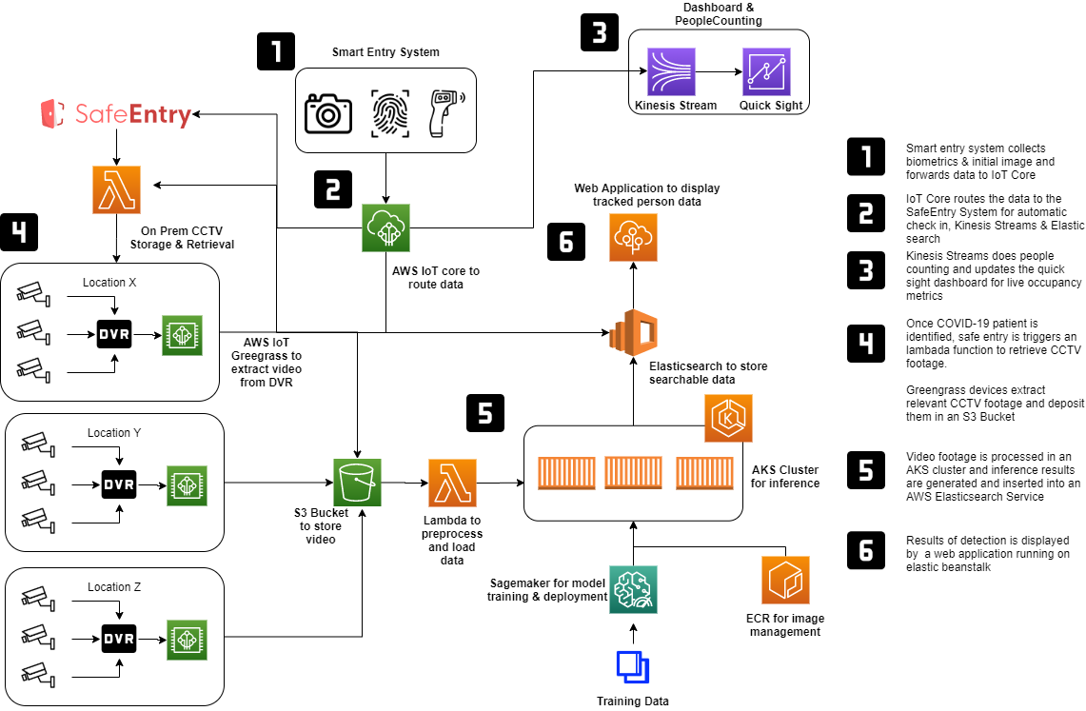
How does it work together?

Slide 15
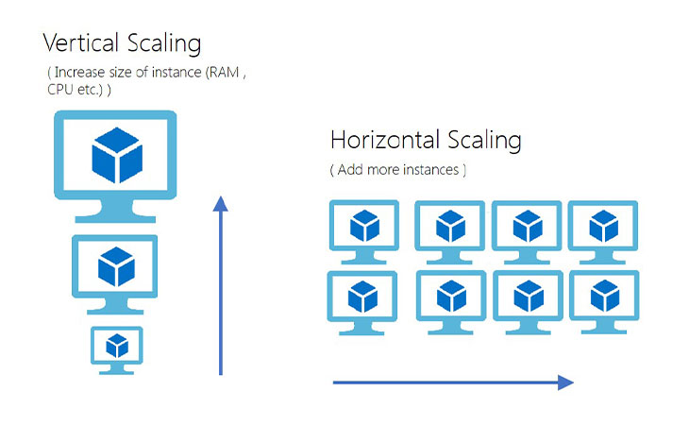
Scalability
Able to build the solution with low cost as compared to the market.
Leverage on AWS Cloud services to scale
  Horizontal scaling – Able to add on more AWS instances
  Vertical scaling – Scale up the instance

Slide 16
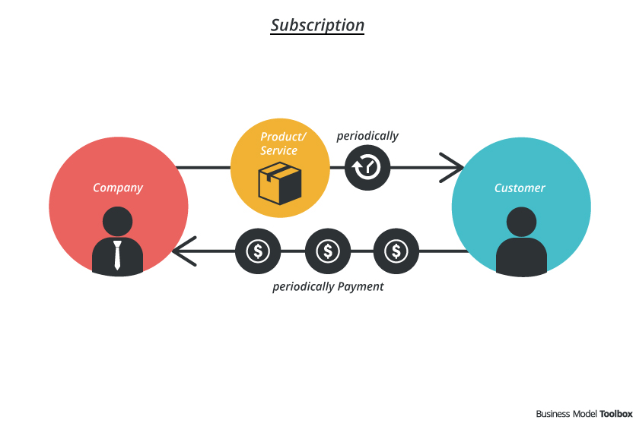
Business Model
Product and Service model
Model 1 – Subscription service, provide technical assistance to deploy and maintain the components. (Periodic payment)
Model 2 – Product, package and sell the different components (Revenue based on Units sold)
Notes:
Assist the businesses who has limited knowledge on technology, to build and deploy this system
Assist and sell to

Slide 17

Thank you

