Slide 1
ARTIFICIAL INTELLIGENCE & MACHINE LEARNING
SHORT TERM INTERNSHIP PROGRAM
17/05/2025 - 17/07/2025
BLACKBUCKS
Name: G Mahesh Babu
Roll no: 22KT1A4343

Slide 2
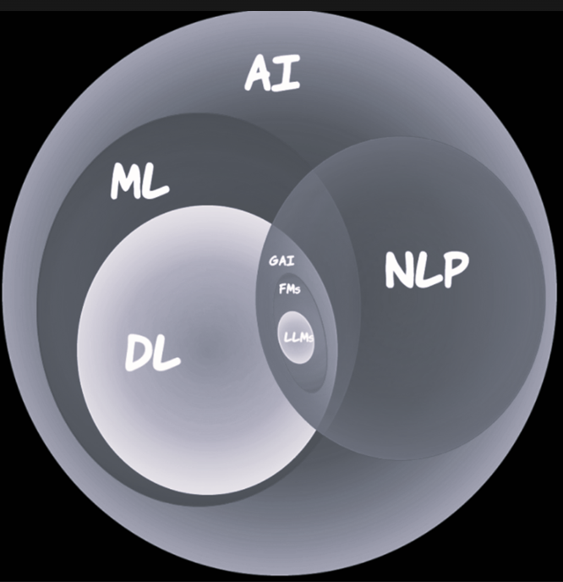
Definition of AI & ML
AI: Simulation of human intelligence in machines.
ML: Subset of AI enabling machines to learn from data.
Deep Learning (DL): Subset of ML using neural networks.

Slide 3
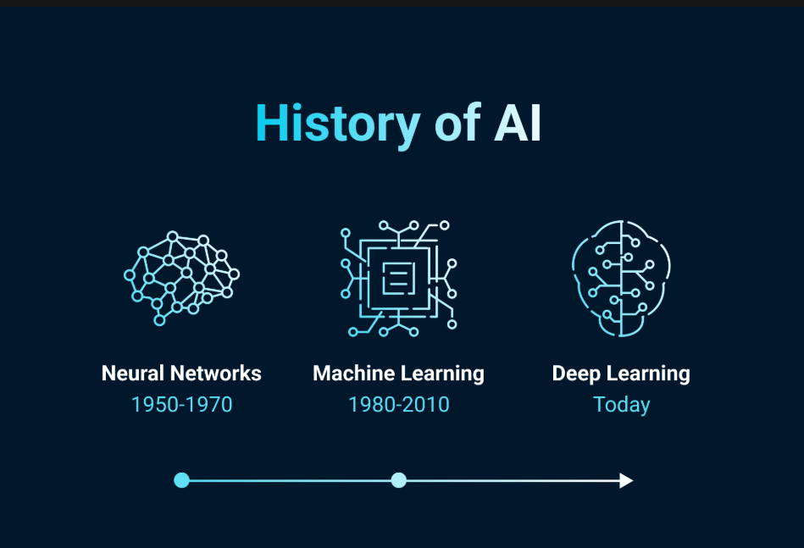
History of AI/ML
1950s: Turing Test
1980s: Expert Systems
2000s: Big Data & ML
2010s+: Deep Learning

Slide 4
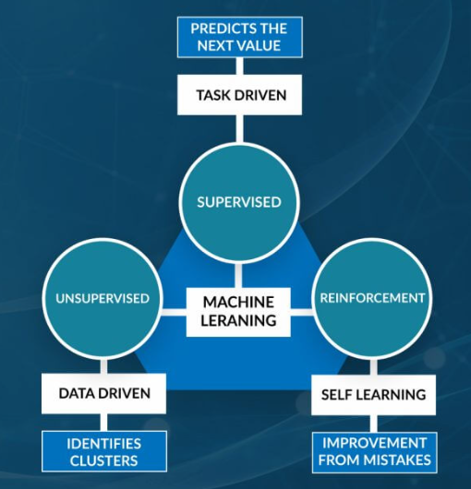
Types of Learning in ML
1. Supervised Learning
2. Unsupervised Learning
3. Reinforcement Learning

Slide 5
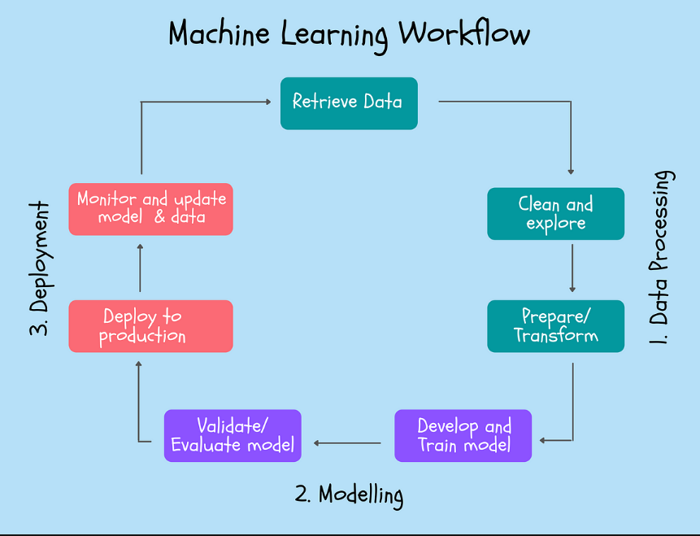
ML Workflow
1. Problem Definition
2. Data Collection
3. Data Preprocessing
4. Model Training
5. Evaluation
6. Deployment

Slide 6
Core ML Algorithms
1. Linear Regression
2. Logistic Regression
3. Decision Trees
4. KNN
5. SVM
6. Naive Bayes

Slide 7
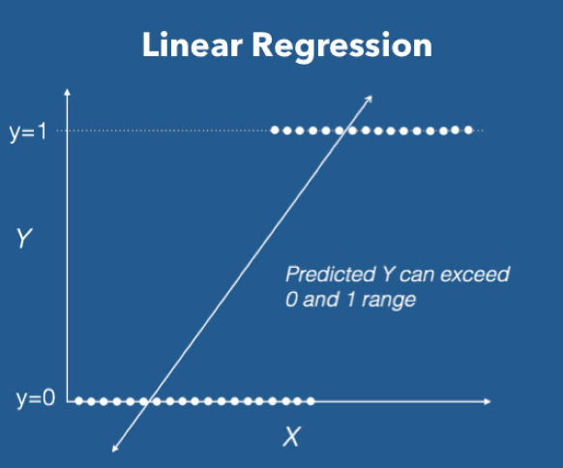
Linear Regression (Detailed)
Used for predicting continuous values using linear relation.

Slide 8
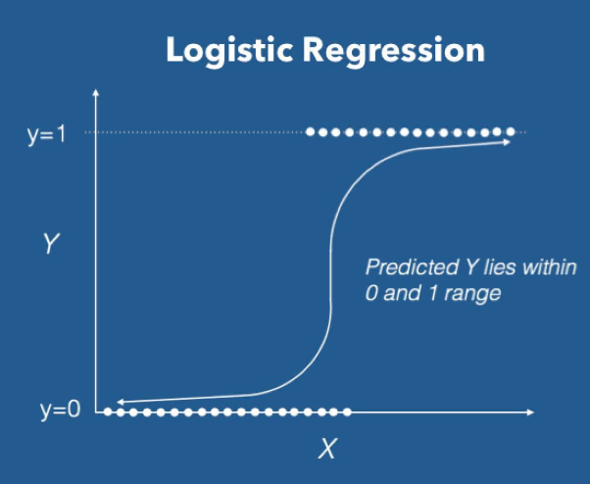
Logistic Regression (Detailed)
Used for binary classification tasks using sigmoid function.

Slide 9
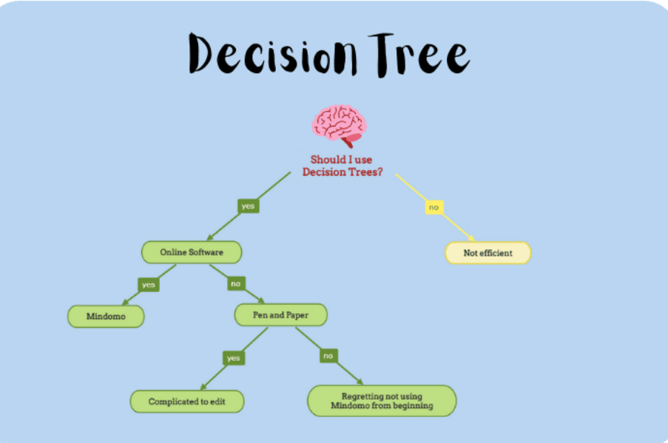
Decision Trees (Detailed)
Tree-based model using feature splits to make decisions.

Slide 10
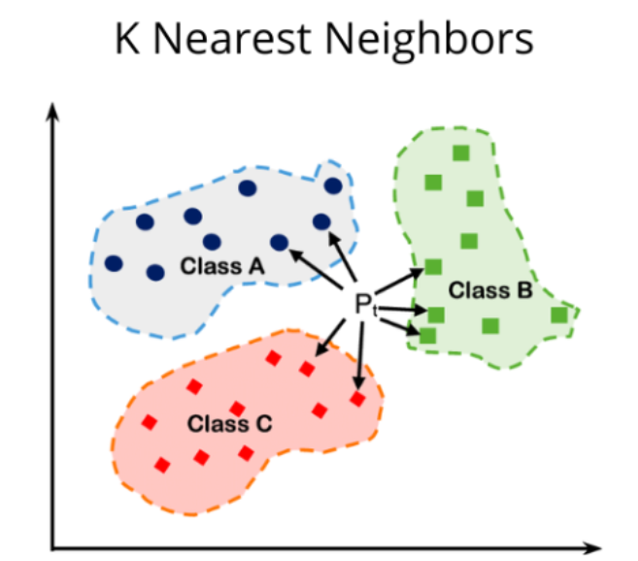
K-Nearest Neighbors (Detailed)
Instance-based learning using proximity for classification.

Slide 11
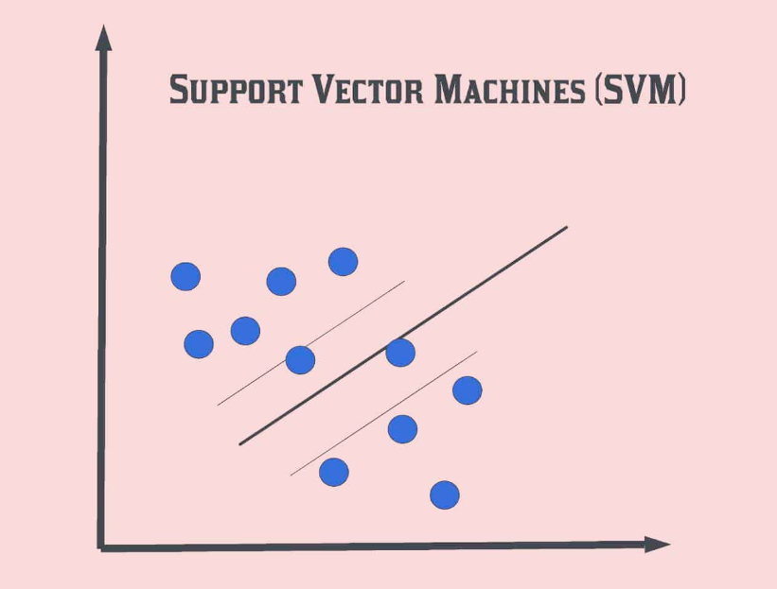
Support Vector Machine (Detailed)
Finds optimal hyperplane for classification tasks.

Slide 12
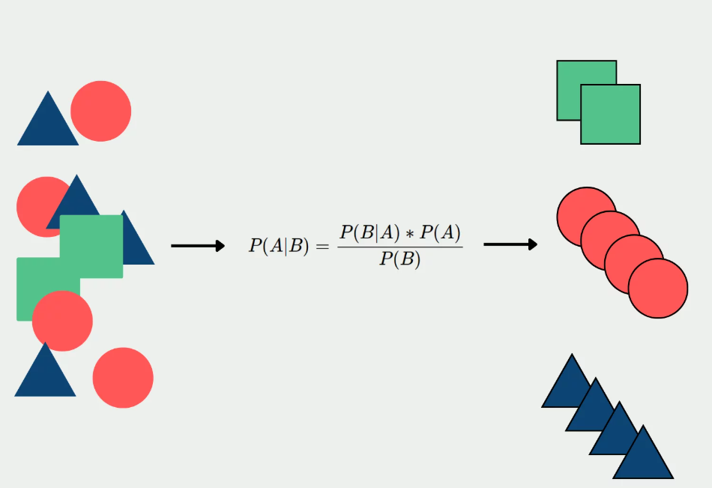
Naive Bayes (Detailed)
Probabilistic classifier based on Bayes’ Theorem.

Slide 13
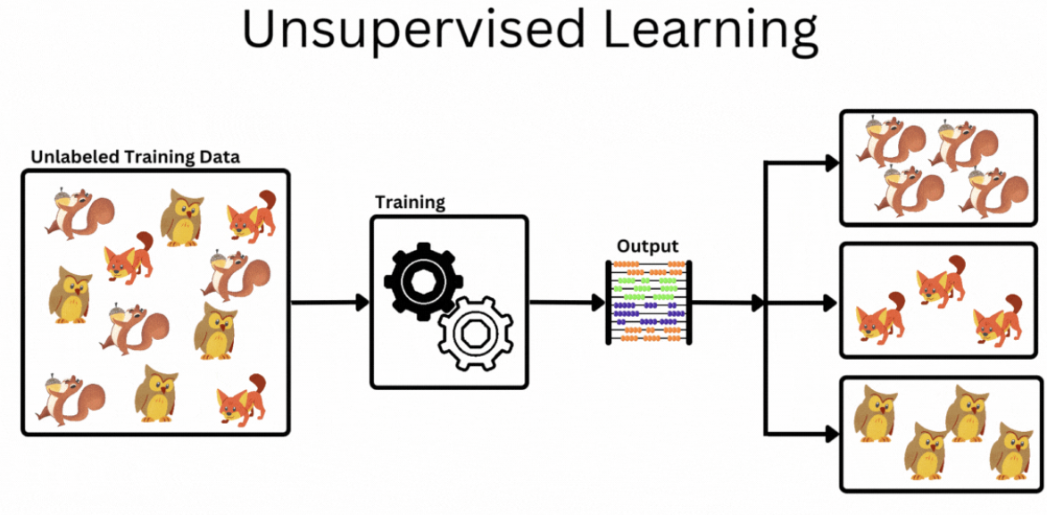
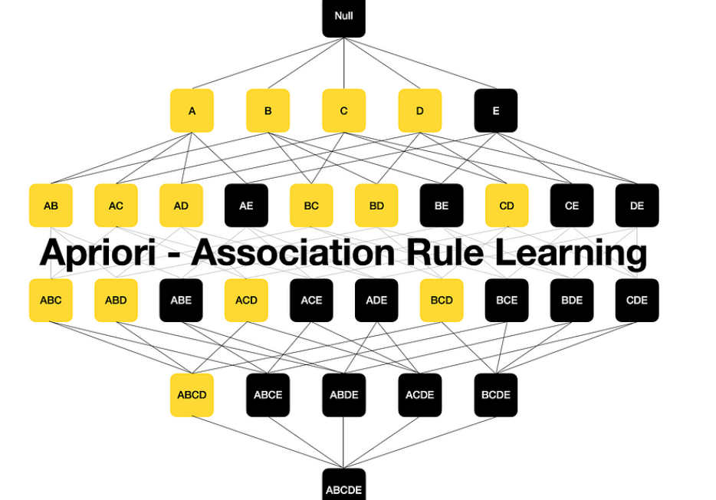
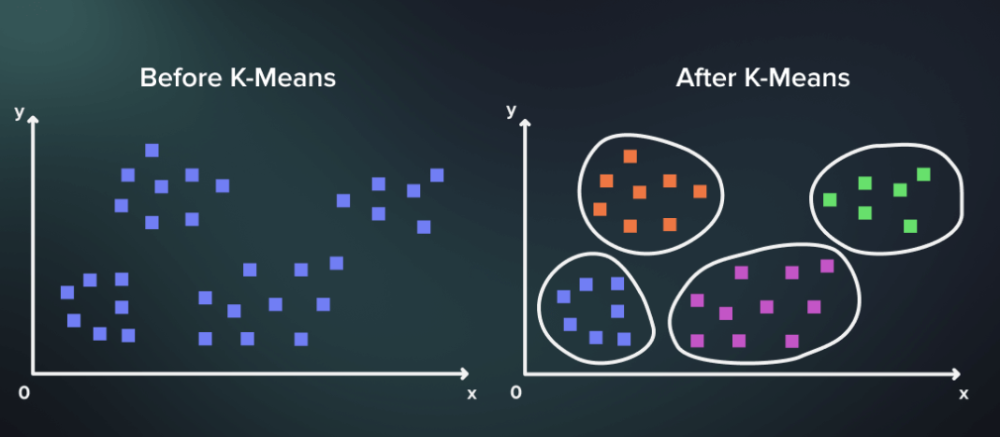
Unsupervised Learning
Includes clustering and association (e.g., K-Means, Apriori).

Slide 14
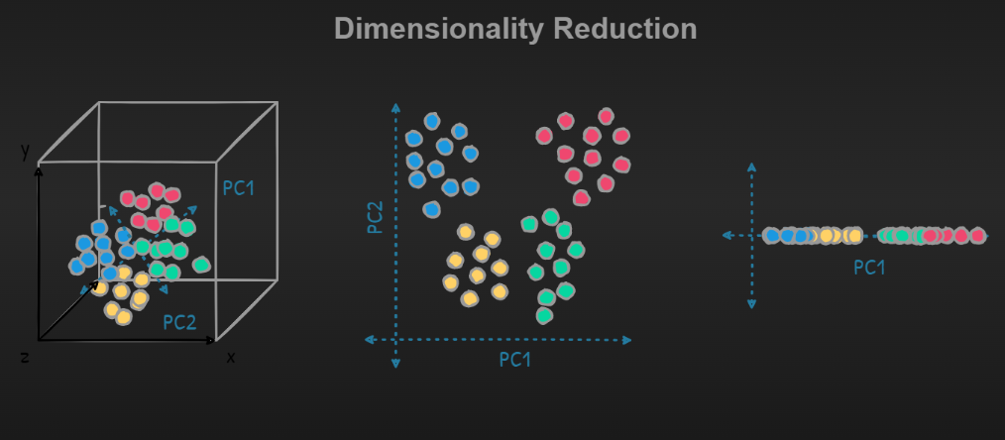
Dimensionality Reduction
PCA, t-SNE used to reduce feature space while retaining information.

Slide 15
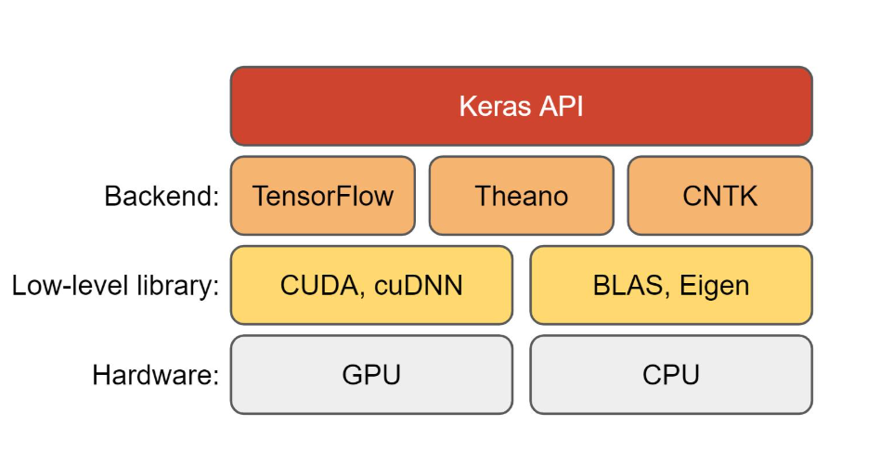
Deep Learning with Keras/TensorFlow
Deep Learning is a subset of machine learning that uses artificial neural networks with multiple layers (also called deep neural networks) to learn patterns from large amounts of data.
• Building Neural Networks
• Model Compilation
• Training and Evaluation
It excels at:
Image recognition
Natural language understanding
Speech processing
Autonomous systems

Slide 16
PROJECT
TITLE:
Handwriting Recognition: A Computer Vision Approach for Efficient Text Classification.
Introduction: Handwriting recognition refers to the ability of a computer to receive and interpret handwritten input from sources like paper documents, photographs, touch-screens, and other devices. It is a subfield of pattern recognition and computer vision and has applications in postal services, banking (e.g., check processing), document digitization, and education.
This project aims to develop a deep learning-based model capable of recognizing and classifying handwritten text with high accuracy. It combines image processing techniques with neural network architectures to interpret human writing styles and translate them into digital, machine-readable text.

Slide 17
Abstract: Handwriting recognition has emerged as a significant and challenging field within computer vision and pattern recognition, driven by the increasing demand for automated systems capable of understanding human-written content. This study presents a computer vision-based approach for efficient text classification from handwritten inputs, addressing the complexities of diverse handwriting styles, noise, distortions, and inconsistencies in penmanship. The proposed methodology leverages advanced deep learning techniques, primarily Convolutional Neural Networks (CNNs) and Recurrent Neural Networks (RNNs), including Long Short-Term Memory (LSTM) units, to perform end-to-end recognition and classification of handwritten text.
The system pipeline begins with robust preprocessing, which includes grayscale conversion, image binarization, skew correction, noise removal, and normalization to ensure high-quality input for the learning models. CNNs are employed for spatial feature extraction, capturing intricate local patterns from handwritten images, while LSTM networks are utilized for sequential modeling to preserve the temporal relationships between characters or strokes. For word-level and line-level recognition, Connectionist Temporal Classification (CTC) loss is applied to align the predicted output with the input sequence without requiring character-level segmentation.

Slide 18
Future Enhancements
Integration of Transformer models like CRNN + Attention or Vision Transformers (ViT)
Real-time handwriting recognition using mobile camera
Support for multi-language handwriting recognition
Use of few-shot or zero-shot learning for rare handwriting styles
Deployment as a cloud-based or mobile app
Applications
Document digitization
Bank cheque processing
Classroom assessment tools
Assistive tech for the visually impaired
Postal address recognition

Slide 19
THANK YOU

