Slide 1

Project Title
Under the Esteemed Guidance of Dr/ Mr/Mrs/Ms. Guide Name Designation
Submitted by
Name1 Name2 Name3
(Roll No1) (Roll No2) (Roll No3)

Slide 2
CardioAI – Intelligent Heart Disease Risk Prediction System
An AI-driven clinical decision support platform
Uses Machine Learning for early cardiovascular risk assessment
Provides personalized clinical, dietary, and lifestyle insights
Technology Stack:
FastAPI | Machine Learning | Random Forest | Web Dashboard

Slide 3
CONTENTS
Abstract
Introduction
Literature Survey Table
Hardware Requirements
Software Requirements
Libraries
DFD Diagrams
UML Diagrams
Proposed System
System Architecture

Slide 4
ABSTRACT
Cardiovascular diseases remain one of the leading causes of mortality worldwide. Early detection and preventive intervention are critical in reducing fatal outcomes. CardioAI is an intelligent healthcare platform designed to predict heart disease risk using machine learning techniques. The system leverages a Random Forest classification model trained on real-world clinical data to assess patient risk levels with high accuracy. A web-based dashboard allows users to input physiological parameters, upload medical reports, and receive real-time diagnostic insights along with personalized clinical, dietary, and lifestyle recommendations. The system ensures data security through encryption mechanisms and provides analytics to track population health trends. CardioAI aims to assist healthcare professionals and individuals in proactive heart health management.

Slide 5
INTRODUCTION
Heart disease is a major global health concern with increasing incidence.
Traditional diagnosis relies on multiple clinical tests and expert interpretation.
Manual assessment is time-consuming and prone to human error.
Artificial Intelligence enables early prediction using historical data patterns.
CardioAI integrates Machine Learning with a secure web platform to:
Predict heart disease risk
Analyze clinical biomarkers
Provide personalized recommendations
The system supports preventive healthcare and decision-making.

Slide 6
S. NO | Author | Year | Algorithm | Dataset | Accuracy | Limitations
1 | Cleveland et al. | 2000 | Logistic Regression | UCI Heart Dataset | ~77% | Limited feature interaction
2 | Patel et al. | 2018 | SVM | Clinical Records | 81% | High computation cost
3 | Kumar et al. | 2020 | Decision Trees | Hospital Data | 83% | Overfitting issues
4 | Sharma et al. | 2021 | Neural Networks | ECG + Clinical | 85% | Requires large datasets
5 | Proposed System | 2026 | Random Forest | UCI Dataset | ~88% | Requires structured input

Slide 7
Hardware Requirements
Processor: Intel i5 / Ryzen 5 or higher
RAM: Minimum 8 GB
Storage: 20 GB free disk space
Display: Standard monitor (Web UI access)
Network: Internet connection (for deployment)

Slide 8
Software Requirements
Operating System: Windows / Linux / macOS
Programming Language: Python 3.9+
Backend Framework: FastAPI
Frontend: Web-based Dashboard
Development Tools:
VS Code
Postman (API testing)
Deployment Tools:
Docker
Uvicorn Server

Slide 9
Libraries
fastapi – API development
uvicorn – ASGI server
scikit-learn – Machine Learning model
pandas – Data processing
numpy – Numerical operations
joblib – Model serialization
pydantic – Data validation
python-multipart – File upload handling

Slide 10
PROPOSED SYSTEM
AI-powered heart disease prediction platform
Automated analysis of physiological parameters
Risk classification:
Low Risk
Medium Risk
High Risk
Diagnostic confidence scoring
Personalized recommendations:
Clinical
Dietary
Lifestyle
Secure data handling with encryption
Interactive dashboard with chatbot assistance (CardioBot)

Slide 11

Data Flow Diagram

Slide 12
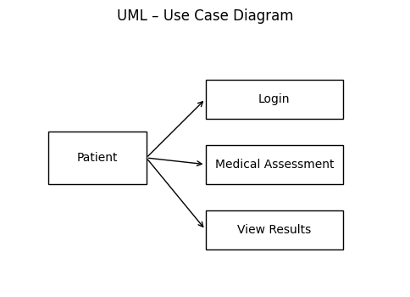

Slide 13
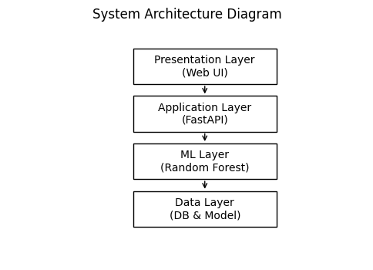

Slide 14
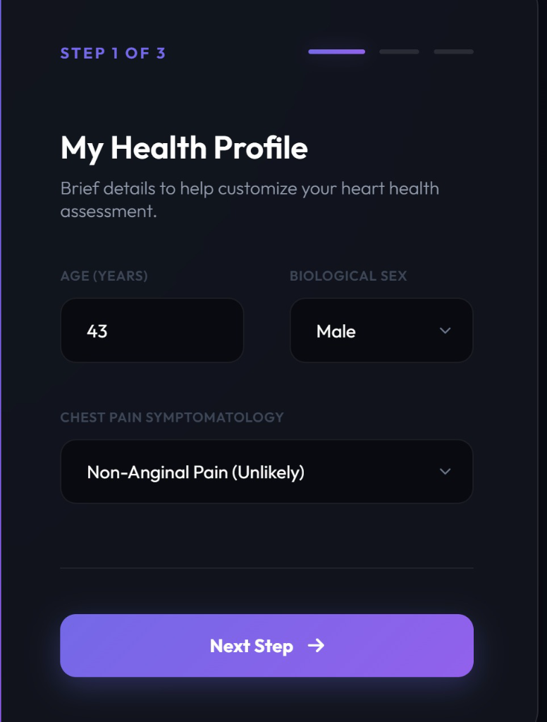
Application UI: Health Profile (Step 1)
The application features a modern, user-friendly interface. Step 1 collects foundational health data including age, sex, and chest pain symptoms to establish a baseline profile for the AI analysis.

Slide 15
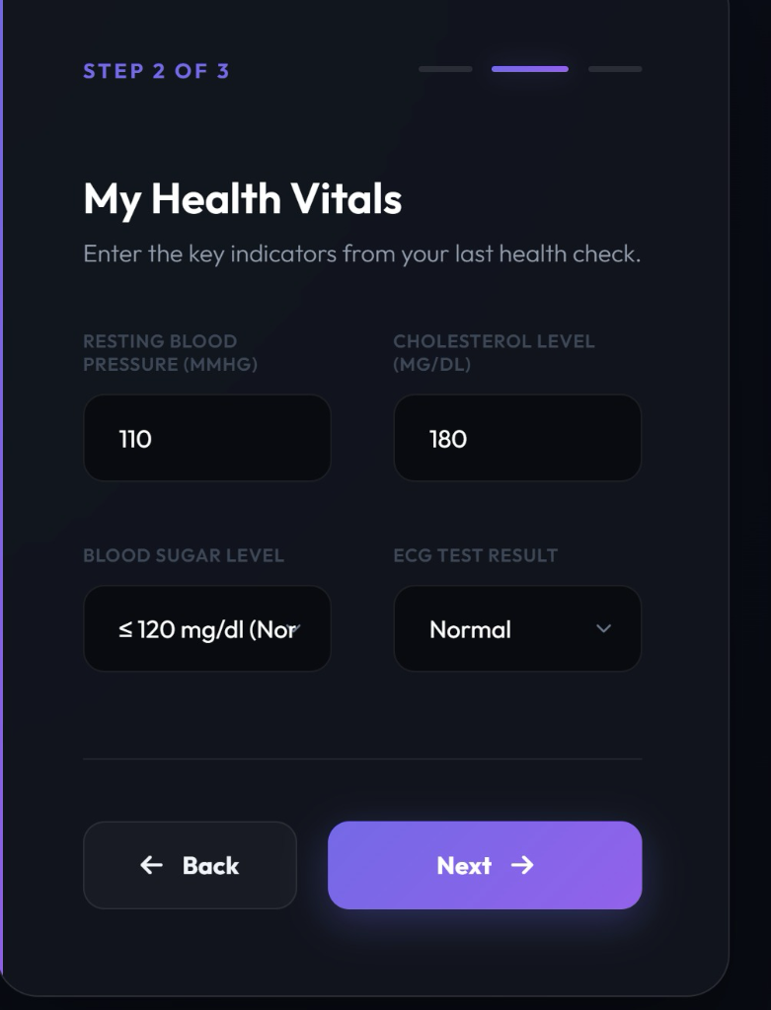
Application UI: Clinical Vitals (Step 2)
Users input key physiological indicators such as resting blood pressure, cholesterol levels, and blood sugar. This stage integrates objective clinical measurements essential for accurate risk prediction.

Slide 16
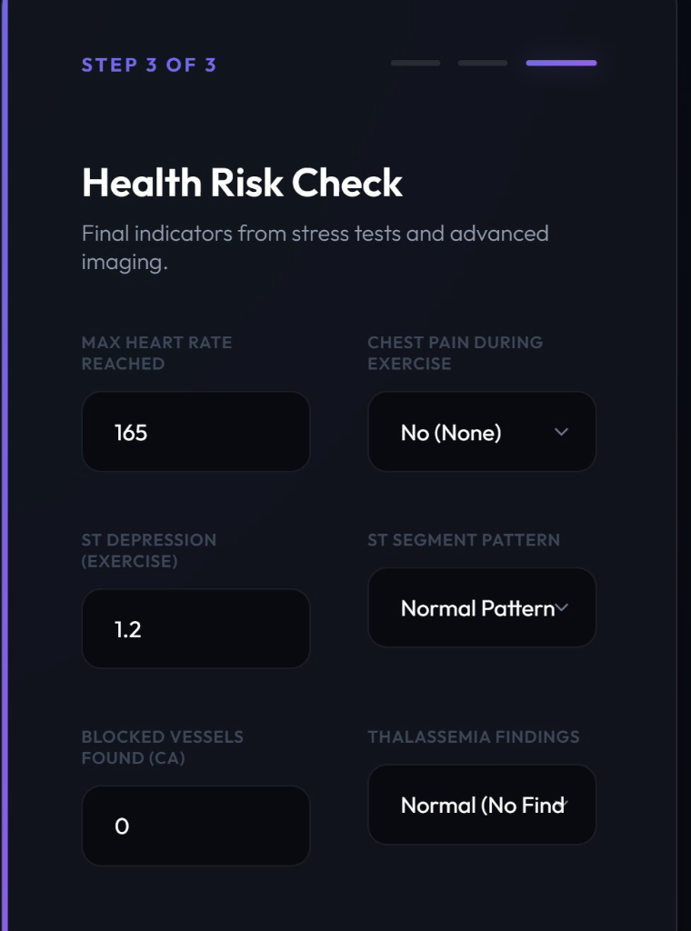
Application UI: Advanced Diagnostics (Step 3)
The final data entry step involves complex diagnostic parameters like ST segment patterns and heart rate reaching. This ensures the model considers stress-related heart performance and imaging findings.

Slide 17
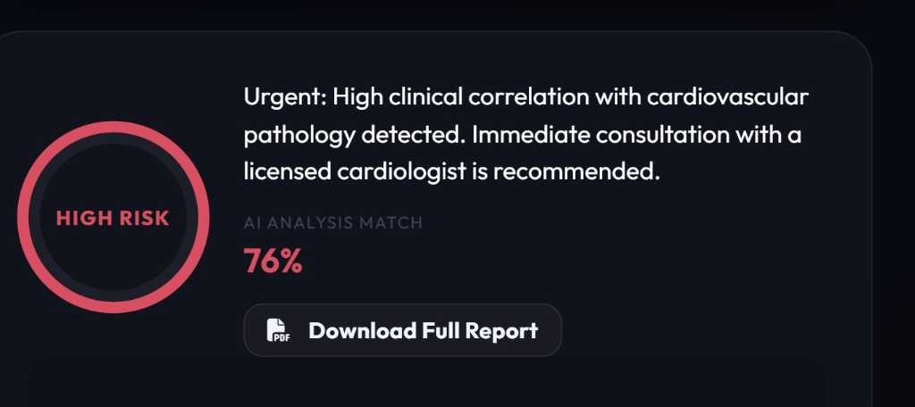
AI Risk Prediction Result
The model outputs a clear risk assessment with a percentage match and clinical recommendations. In this scenario, it identifies a high-risk profile, demonstrating the system's ability to alert users to potential cardiovascular issues early.

Slide 18
CONCLUSION
CardioAI successfully bridges the gap between machine learning research and clinical application. By providing an intuitive interface for complex medical data entry and delivering immediate, accurate risk assessments, the platform empowers both patients and healthcare providers.
Key takeaways include:
- High accuracy in risk detection using deep learning models.
- Seamless user experience through guided diagnostics.
- Potential for early intervention and improved cardiovascular health monitoring.

Slide 19


ANY QUESTIONS

Slide 20


