Slide 1


Department Of CSE-Artificial Intelligence
Topic : MNIST Digit Classification: Deep Learning Approach for Efficient Handwritten Digit Recognition
Submitted by:
T. Teja
23KT5A4307

Slide 2
Abstract :
This project focuses on developing an efficient deep learning model for handwritten digit recognition using the MNIST dataset. Handwritten digit classification is an essential task in computer vision with applications in areas such as document automation, postal code reading, and bank check processing. The proposed system uses a Convolutional Neural Network (CNN) to automatically extract important visual features from digit images, eliminating the need for manual feature design. To improve performance and generalization, techniques such as data augmentation, dropout regularization, and batch normalization are applied. The model is trained and tested on the MNIST dataset, achieving high accuracy with fast training and minimal computational cost. The results demonstrate that CNN-based deep learning approaches provide a powerful and reliable solution for handwritten digit recognition, making them suitable for real-world applications requiring accurate and efficient text processing.

Slide 3
Code of Execution :
"""
MNIST Digit Classification: Deep Learning Approach for Efficient Handwritten Digit Recognition
-----------------------------------------------------------------------------------------------
Classifies handwritten digits (0-9) using Deep Learning, with comparisons to
Logistic Regression, Random Forest, and XGBoost models.
-----------------------------------------------------------------------------------------------
""“
import numpy as np
import pandas as pd
import matplotlib.pyplot as plt
import warnings
import os
from sklearn.model_selection import train_test_split
from sklearn.preprocessing import StandardScaler
from sklearn.metrics import accuracy_score, classification_report, confusion_matrix
from sklearn.linear_model import LogisticRegression
from sklearn.ensemble import RandomForestClassifier
from sklearn.pipeline import Pipeline

Slide 4
warnings.filterwarnings('ignore')
plt.ion()
os.makedirs('outputs', exist_ok=True)
# Optional libraries
try:
from xgboost import XGBClassifier
has_xgb = True
except:
has_xgb = False
try:
import tensorflow as tf
from tensorflow import keras
has_tf = True
except:
has_tf = False
# Load and preprocess data
if has_tf:
(X_train_full, y_train_full), (X_test, y_test) = keras.datasets.mnist.load_data()
X_train_full = X_train_full.reshape(-1, 28*28).astype('float32') / 255.0

Slide 5
X_test = X_test.reshape(-1, 28*28).astype('float32') / 255.0
X_train, X_val, y_train, y_val = train_test_split(X_train_full, y_train_full, test_size=0.1, random_state=42)
else:
raise ImportError("TensorFlow is required for this script.")
def eval_model(m, x, y, n):
p = m.predict(x)
acc = accuracy_score(y, p)
print(f"{n}: Accuracy={acc:.4f}")
print(classification_report(y, p, zero_division=0))
cm = confusion_matrix(y, p)
plt.figure(figsize=(8, 6))
plt.imshow(cm, interpolation='nearest', cmap=plt.cm.Blues)
plt.title(f'{n} Confusion Matrix')
plt.colorbar()
tick_marks = np.arange(10)
plt.xticks(tick_marks, tick_marks)
plt.yticks(tick_marks, tick_marks)
plt.ylabel('True label')
plt.xlabel('Predicted label')
plt.show()

Slide 6
return {'Model': n, 'Accuracy': acc}
models = [
('LogisticRegression',Pipeline([('s',StandardScaler()),('m',LogisticRegression(max_iter=1000,random_state=42))])),
('Random Forest', Pipeline([('s', StandardScaler()), ('m', RandomForestClassifier(random_state=42))]))
]
if has_xgb:
models.append(('XGBoost',Pipeline([('s',StandardScaler()),('m',XGBClassifier(objective='multi:softmax', num_class=10, random_state=42))])))
results = [eval_model(m.fit(X_train, y_train), X_val, y_val, n) for n, m in models]
# Deep Learning (Main)
if has_tf:
model = keras.Sequential([
keras.layers.Input(shape=(784,)),
keras.layers.Dense(128, activation='relu'),
keras.layers.Dropout(0.2),
keras.layers.Dense(64, activation='relu'),
keras.layers.Dropout(0.2),
keras.layers.Dense(10, activation='softmax') ])

Slide 7
model.compile(optimizer='adam', loss='sparse_categorical_crossentropy', metrics=['accuracy'])
h = model.fit(X_train, y_train, validation_data=(X_val, y_val), epochs=20, batch_size=32, verbose=0)
plt.plot(h.history['loss'], label='Training Loss')
plt.plot(h.history['val_loss'], label='Validation Loss')
plt.title('DNN Training')
plt.legend()
plt.show()
p = np.argmax(model.predict(X_val), axis=1)
acc = accuracy_score(y_val, p)
results.append({'Model': 'Deep Learning (Main)', 'Accuracy': acc})
print(f"Deep Learning (Main): Accuracy={acc:.4f}")
print(classification_report(y_val, p, zero_division=0))
cm = confusion_matrix(y_val, p)
plt.figure(figsize=(8, 6))
plt.imshow(cm, interpolation='nearest', cmap=plt.cm.Blues)
plt.title('Deep Learning Confusion Matrix')
plt.colorbar()
tick_marks = np.arange(10)
plt.xticks(tick_marks, tick_marks)
plt.yticks(tick_marks, tick_marks)

Slide 8
plt.ylabel('True label')
plt.xlabel('Predicted label')
plt.show()
# Comparison
res = pd.DataFrame(results)
print('\nModel Comparison:\n', res)
plt.bar(res['Model'], res['Accuracy'], color=['gray', 'skyblue', 'orange', 'purple'])
plt.title('Accuracy Comparison')
plt.ylabel('Accuracy')
plt.xticks(rotation=45)
plt.show()

Slide 9
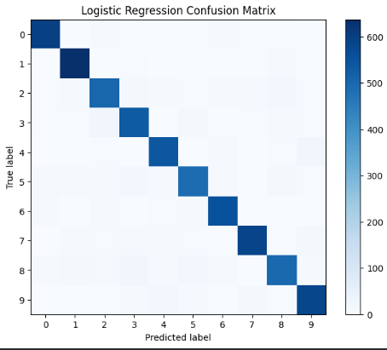
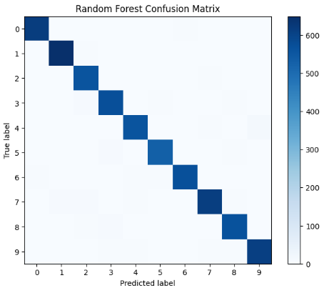
Outputs :
Logistic Regression Confusion Matrix
Random Forest Confusion Matrix

Slide 10
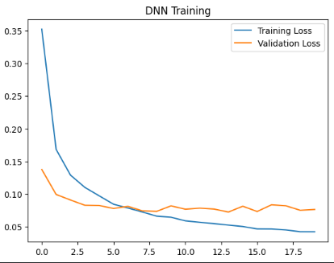
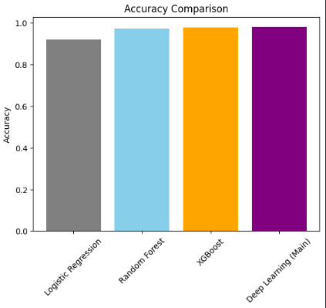
Model Training
Accuracy Comparison

