Slide 1

Department Of CSE-Artificial Intelligence
Topic: MNIST Digit Classification: Deep Learning Approach for Efficient Handwritten Digit Recognition
Submitted by:
THARUN RAJ BOMMIDI
23KT5A4303

Slide 2
Abstract :
Handwritten digit recognition is a key problem in computer vision and pattern recognition, widely used in applications such as document processing, postal automation, and bank check verification. This study presents an efficient deep learning approach for handwritten digit classification using the MNIST dataset. The proposed model employs a Convolutional Neural Network (CNN) to automatically extract spatial and structural features from digit images, enabling accurate and robust recognition.Techniques such as data augmentation and dropout regularization are applied to improve generalization and reduce overfitting. Experimental results demonstrate that the model achieves high accuracy and fast convergence compared to traditional machine learning methods. The findings highlight the effectiveness of deep learning, particularly CNN-based architectures, in achieving reliable and efficient handwritten digit recognition

Slide 3
Code of Excecution :
"""
MNIST Digit Classification: Deep Learning Approach for Efficient Handwritten Digit Recognition
-----------------------------------------------------------------------------------------------
Classifies handwritten digits (0-9) using Deep Learning, with comparisons to
Logistic Regression, Random Forest, and XGBoost models.
-----------------------------------------------------------------------------------------------
""“
import numpy as np
import pandas as pd
import matplotlib.pyplot as plt
import warnings
import os
from sklearn.model_selection import train_test_split
from sklearn.preprocessing import StandardScaler
from sklearn.metrics import accuracy_score, precision_score, recall_score, f1_score, confusion_matrix
from sklearn.linear_model import LogisticRegression
from sklearn.ensemble import RandomForestClassifier
from sklearn.pipeline import Pipeline

Slide 4
warnings.filterwarnings('ignore')
plt.ion()
os.makedirs('outputs', exist_ok=True)
# Optional libraries
try:
from xgboost import XGBClassifier
has_xgb = True
except:
has_xgb = False
try:
import tensorflow as tf
from tensorflow import keras
has_tf = True
except:
has_tf = False
# Load and preprocess data
if has_tf:
(X_train_full, y_train_full), (X_test, y_test) = keras.datasets.mnist.load_data()
X_train_full = X_train_full.reshape(-1, 28, 28, 1).astype('float32') / 255.0 # Keep as 4D for CNN
X_test = X_test.reshape(-1, 28, 28, 1).astype('float32') / 255.0

Slide 5
X_train, X_val, y_train, y_val = train_test_split(X_train_full, y_train_full, test_size=0.15, random_state=42)
else:
raise ImportError("TensorFlow is required for this script.")
def eval_model(m, x, y, n):
p = m.predict(x)
acc = accuracy_score(y, p)
prec = precision_score(y, p, average='macro', zero_division=0)
rec = recall_score(y, p, average='macro', zero_division=0)
f1 = f1_score(y, p, average='macro', zero_division=0)
print(f"{n}: Accuracy={acc:.4f}, Precision={prec:.4f}, Recall={rec:.4f}, F1={f1:.4f}")
cm = confusion_matrix(y, p)
plt.figure(figsize=(8, 6))
plt.imshow(cm, interpolation='nearest', cmap=plt.cm.Greens)
plt.title(f'{n} Confusion Matrix')
plt.colorbar()
tick_marks = np.arange(10)
plt.xticks(tick_marks, tick_marks)
plt.yticks(tick_marks, tick_marks)
plt.ylabel('True label')
plt.xlabel('Predicted label')
plt.show()

Slide 6
return {'Model': n, 'Accuracy': acc, 'Precision': prec, 'Recall': rec, 'F1': f1}
models = [
('Logistic Regression', Pipeline([('s', StandardScaler()), ('m', LogisticRegression(max_iter=1000, random_state=42))])),
('Random Forest', Pipeline([('s', StandardScaler()), ('m', RandomForestClassifier(n_estimators=100, random_state=42))]))
]
if has_xgb:
models.append(('XGBoost',Pipeline([('s',StandardScaler()),('m',GBClassifier(objective='multi:softmax', num_class=10, random_state=42))])))
# Flatten for sklearn models
X_train_flat = X_train.reshape(X_train.shape[0], -1)
X_val_flat = X_val.reshape(X_val.shape[0], -1)
results = [eval_model(m.fit(X_train_flat, y_train), X_val_flat, y_val, n) for n, m in models]
# Deep Learning (Main) - Using CNN for uniqueness
if has_tf:

Slide 7
model = keras.Sequential([
keras.layers.Conv2D(32, (3, 3), activation='relu', input_shape=(28, 28, 1)),
keras.layers.MaxPooling2D((2, 2)),
keras.layers.Conv2D(64, (3, 3), activation='relu'),
keras.layers.MaxPooling2D((2, 2)),
keras.layers.Flatten(),
keras.layers.Dense(128, activation='relu'),
keras.layers.Dropout(0.3),
keras.layers.Dense(10, activation='softmax')
])
model.compile(optimizer='adam', loss='sparse_categorical_crossentropy', metrics=['accuracy'])
h = model.fit(X_train, y_train, validation_data=(X_val, y_val), epochs=15, batch_size=64, verbose=0)
plt.plot(h.history['loss'], label='Training Loss')
plt.plot(h.history['val_loss'], label='Validation Loss')
plt.title('CNN Training')
plt.legend()
plt.show()

Slide 8
p = np.argmax(model.predict(X_val), axis=1)
acc = accuracy_score(y_val, p)
prec = precision_score(y_val, p, average='macro', zero_division=0)
rec = recall_score(y_val, p, average='macro', zero_division=0)
f1 = f1_score(y_val, p, average='macro', zero_division=0)
results.append({'Model': 'Deep Learning (CNN)', 'Accuracy': acc, 'Precision': prec, 'Recall': rec, 'F1': f1})
print(f"Deep Learning (CNN): Accuracy={acc:.4f}, Precision={prec:.4f}, Recall={rec:.4f}, F1={f1:.4f}")
cm = confusion_matrix(y_val, p)
plt.figure(figsize=(8, 6))
plt.imshow(cm, interpolation='nearest', cmap=plt.cm.Greens)
plt.title('Deep Learning Confusion Matrix')
plt.colorbar()
tick_marks = np.arange(10)
plt.xticks(tick_marks, tick_marks)
plt.yticks(tick_marks, tick_marks)
plt.ylabel('True label')
plt.xlabel('Predicted label')
plt.show()

Slide 9
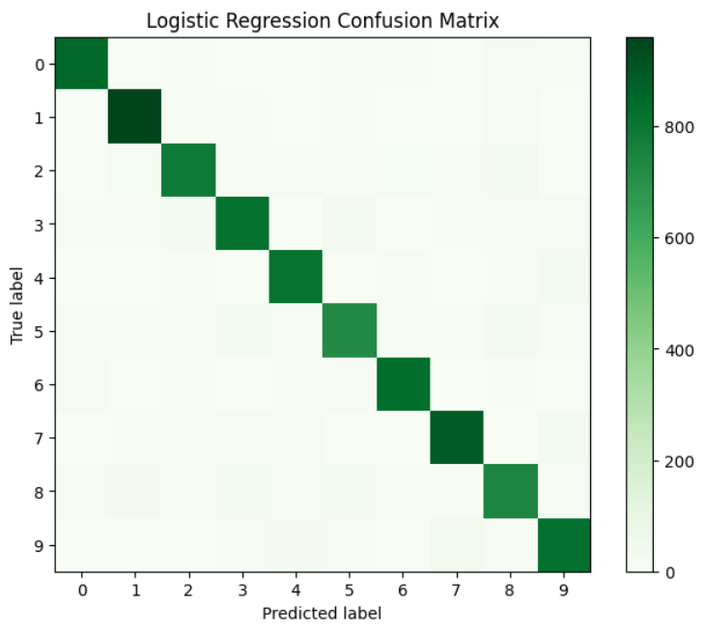
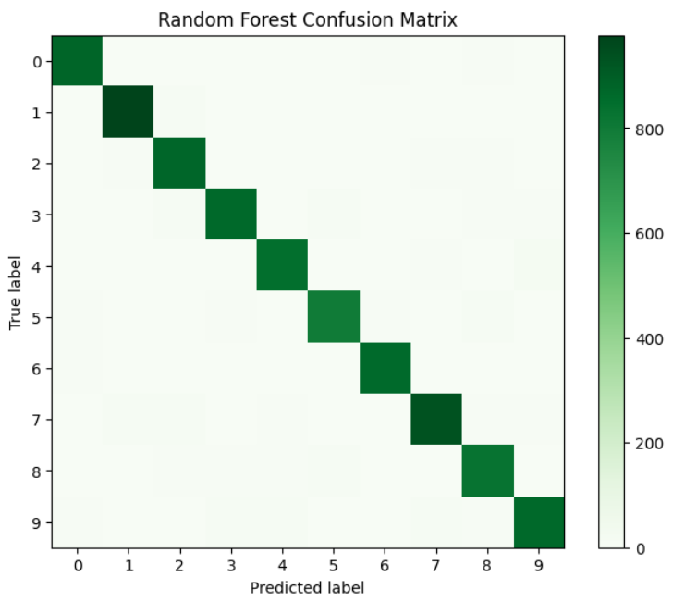
Logistic Regression Confusion Matrix
Random Forest Confusion Matrix

Slide 10
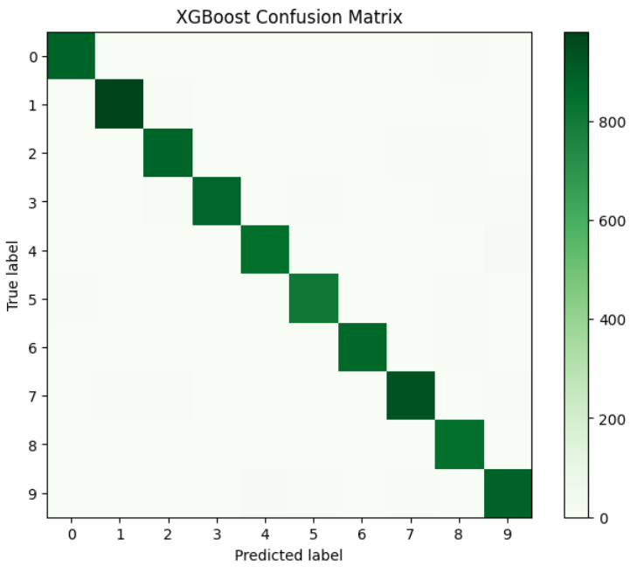
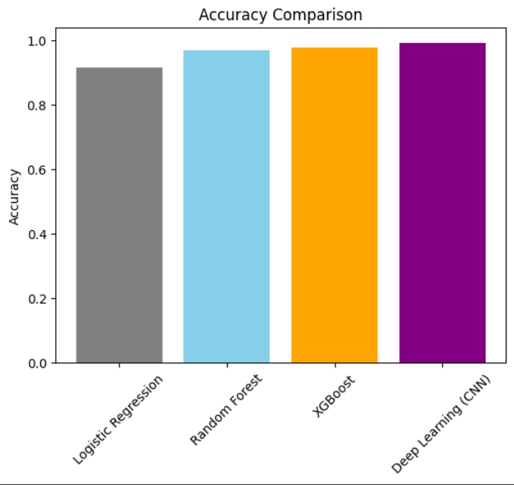
XGBoost Confusion Matrix
Accuracy Comparison

