Slide 1
Inter-City Bus Reservation System
A Java-based console application for managing inter-city bus seat reservations across multiple routes — built for reliability, clarity, and ease of use.
Java project for academic purposes / course submission.
Project Code
Supervisor
KLEHB-FED-26-10-17
Rajesh K
Team Members
Harshith
Pranav
Mohan

Slide 2
OVERVIEW
Project Overview
The Inter-City Bus Reservation System is a menu-driven Java application for managing inter-city bus bookings from seat selection to ticket generation.
Built in Java with a console-based interface for simple, structured user input.
Supports route selection, schedule viewing, seat booking, and confirmed ticket generation.
Manages 60-seat buses with real-time seat availability tracking.
Designed for clear, reliable booking across multiple inter-city routes with OTP-based security for bookings.

Slide 3
ARCHITECTURE
System Architecture
The system uses a menu-driven console interface built around a single main class. User requests move through a simple booking flow from route selection to final ticket generation.
InterCityBusRef is the main entry point and central controller.
A 60-element boolean array tracks seat availability for each bus.
The console menu guides users through route → date → bus selection.
The system uses switch-case statements for menu navigation and a while loop for seat booking.
Customers then choose seats, enter details, and complete OTP verification.
After confirmation, the system generates the final ticket.

Slide 4

CORE FUNCTION
Function 1: printSeatMap()
printSeatMap() shows the bus seats in a simple grid so customers can quickly see which seats are available and which are already booked. The grid format makes it easy for customers to find available seats quickly.
Simple Summary
When It Is Used
Takes the seat status array as input
Displays seats in a 4-column grid
Shows seat numbers for available seats
Shows 'X' for booked seats
Before Seat Selection
After Each Booking
Updated after every confirmed booking.
Shown before the customer chooses a seat.

Slide 5
CORE FUNCTION
Function 2: printTicket()
The printTicket() function generates the final e-ticket for the customer after the booking is confirmed.
Includes the customer name
Includes the route, travel date, and bus details
Includes the booked seat numbers
Called after OTP verification
Formatted with Kaveri Travels company branding for a professional look

Slide 6
MODULE 1
Route Selection Module
User selects one of 5 routes: Hyderabad → Vizag, Mumbai, Goa, Warangal, or Pune.
The system validates the choice to make sure it matches a valid route number.
If the selection is valid, the chosen route is stored for later use in the booking flow.
If the selection is invalid, the program terminates with an error message.
This selected route is then passed forward to the ticket generation step.

Slide 7
MODULE 2 & 3
Date and Bus Selection Modules
After route selection, the user chooses a travel date and then selects a bus. The system stores both choices for later use in ticket generation.
Date Selection
Bus Selection
Select from 5 travel dates
Enter a number from 1 to 5
The chosen date is stored as a string
Includes input validation to prevent errors
Morning Express: 08:00 AM to 08:00 PM
Evening Express: 09:00 PM to 09:00 AM
The chosen bus times are stored for the ticket
Includes input validation to prevent errors

Slide 8
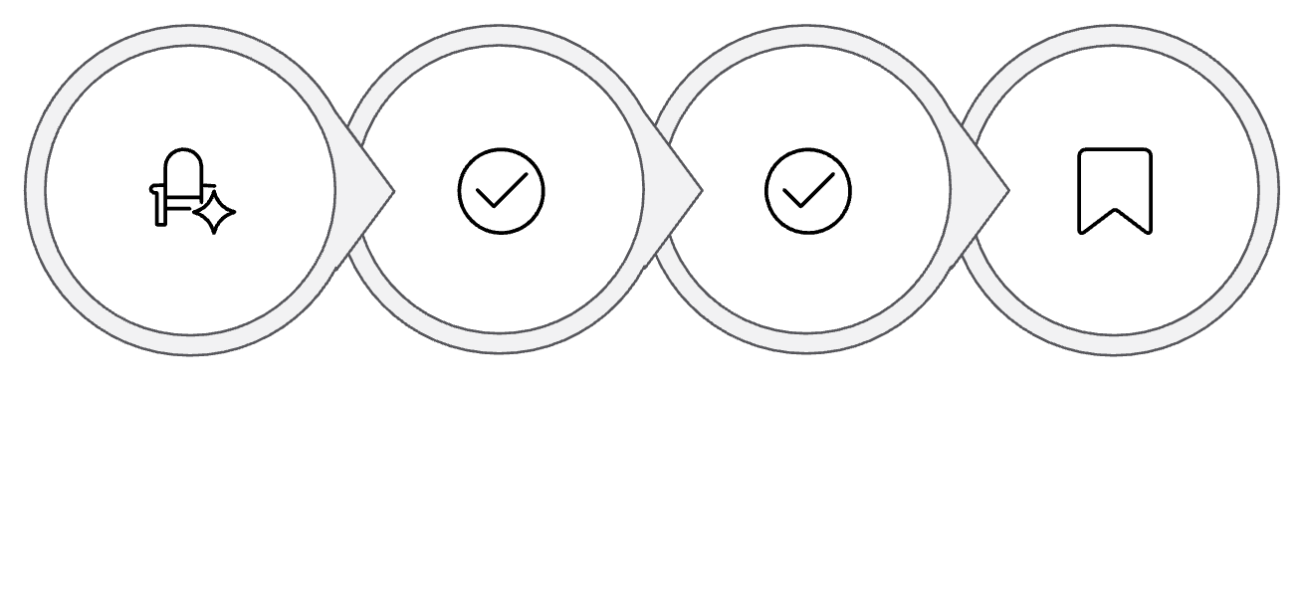
MODULE 4
Seat Booking Logic
The seat booking module lets the customer choose one seat at a time. It follows a simple loop: pick a seat, check availability, confirm booking, and repeat until the customer stops.
Core Booking Process
Simple Loop
1. Pick a seat
The customer enters a seat number.
2. Check if it is available
The system checks whether the seat is already booked and prevents double-booking by checking the boolean array before confirming each seat.
Check Availability
Confirm & Book
Book Another or Stop
Pick Seat
3. Book and confirm
If the seat is free, it is marked as booked and confirmed.
4. Repeat or stop
The customer can book another seat or end the loop by choosing to stop.
Multi-Seat & Termination
Booked seat numbers are saved together for the ticket. If the customer stops without booking, the program ends with a thank-you message.

Slide 9
MODULE 5
Customer Verification Module
Before a ticket is generated, the system collects customer details and checks an OTP for verification.
Enter Details
Send OTP
Enter OTP
The system asks for the customer name and phone number.
An OTP is sent to the customer’s phone number. For testing purposes, the demo OTP is 1234.
The customer enters the OTP to verify the booking.
Confirm Booking
The booking is confirmed only if the OTP matches.

Slide 10
SUMMARY
System Workflow Summary
Welcome & route selection
Pick date
Pick bus
Book seats
Enter customer details
Verify OTP
Generate ticket
Show confirmation
Each step validates input before moving to the next step.

