Slide 1
GenAI Use Case
COBOL to Document

Slide 2
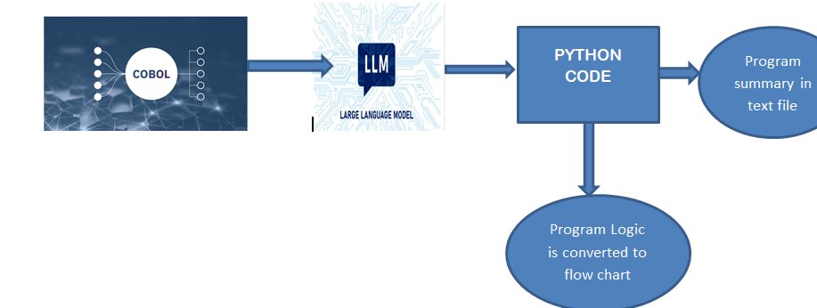
Solution Architecture

Slide 3
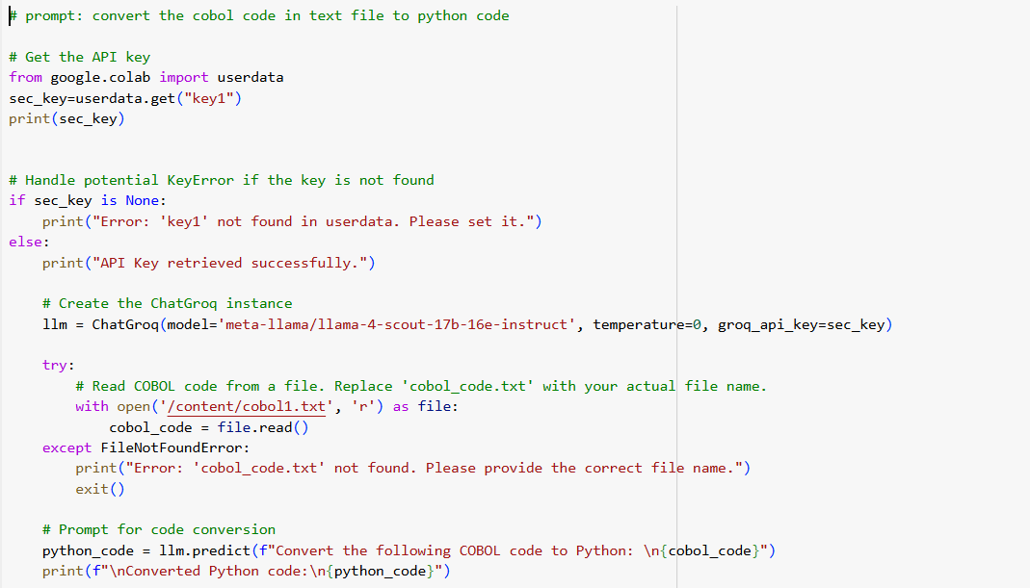
LLM to convert COBOL to PYTHON

Slide 4
Input and Output
Text Input
Text Output

Slide 5
Python code to generate flow chart

Slide 6
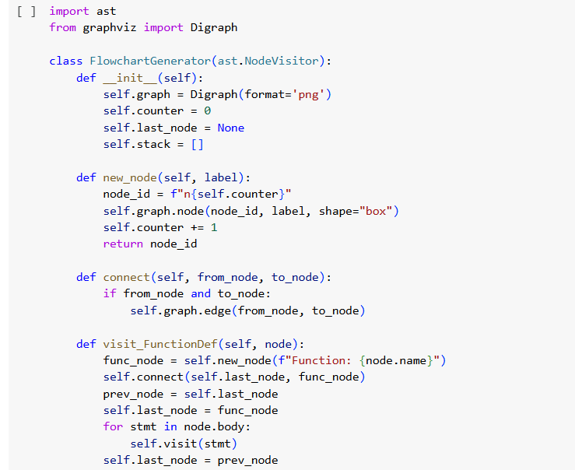

Slide 7
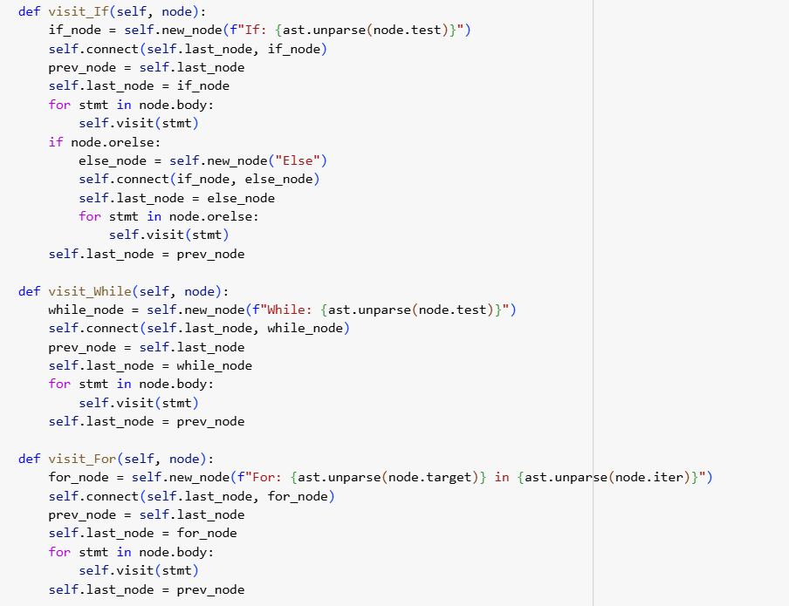

Slide 8
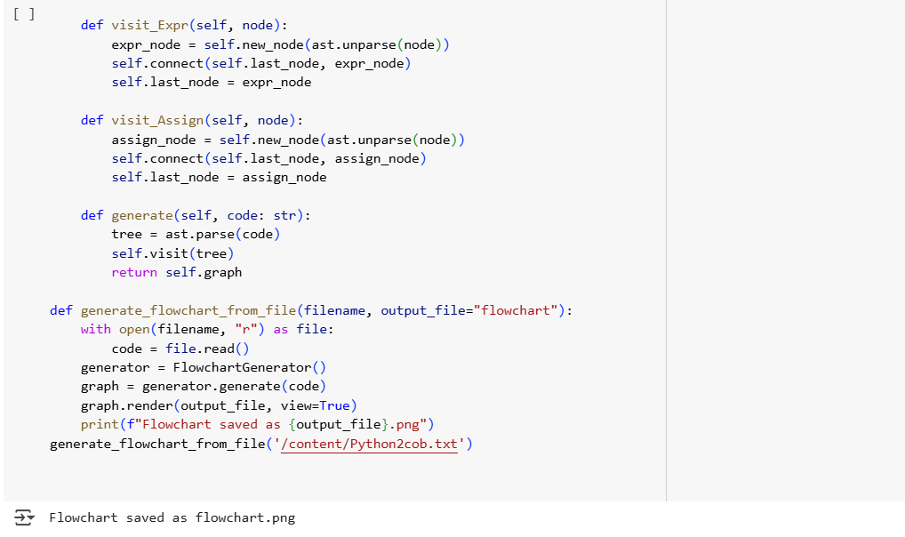

Slide 9
Generated Flow chart with the overall program logic

Slide 10
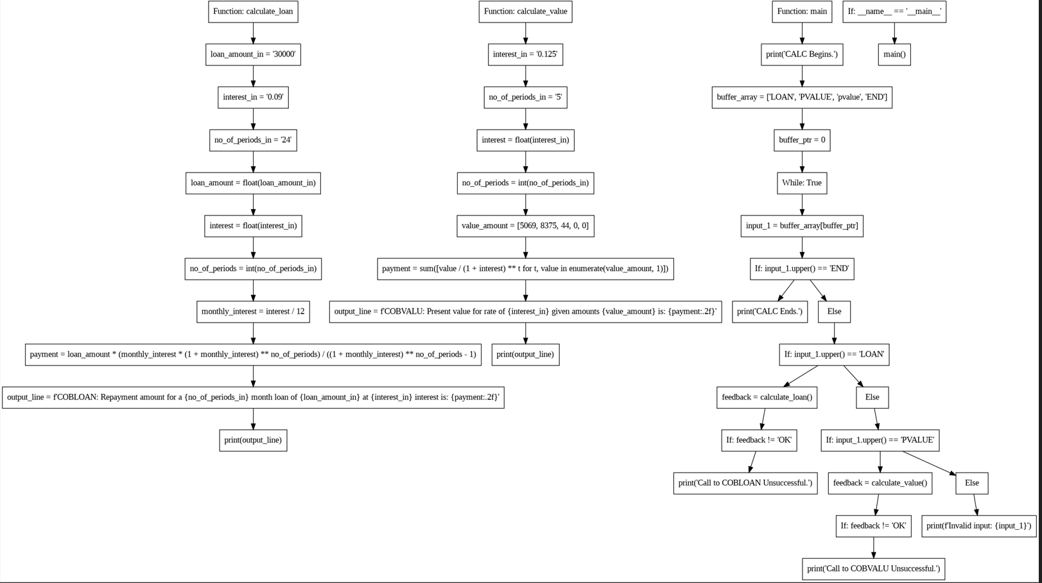

Slide 11
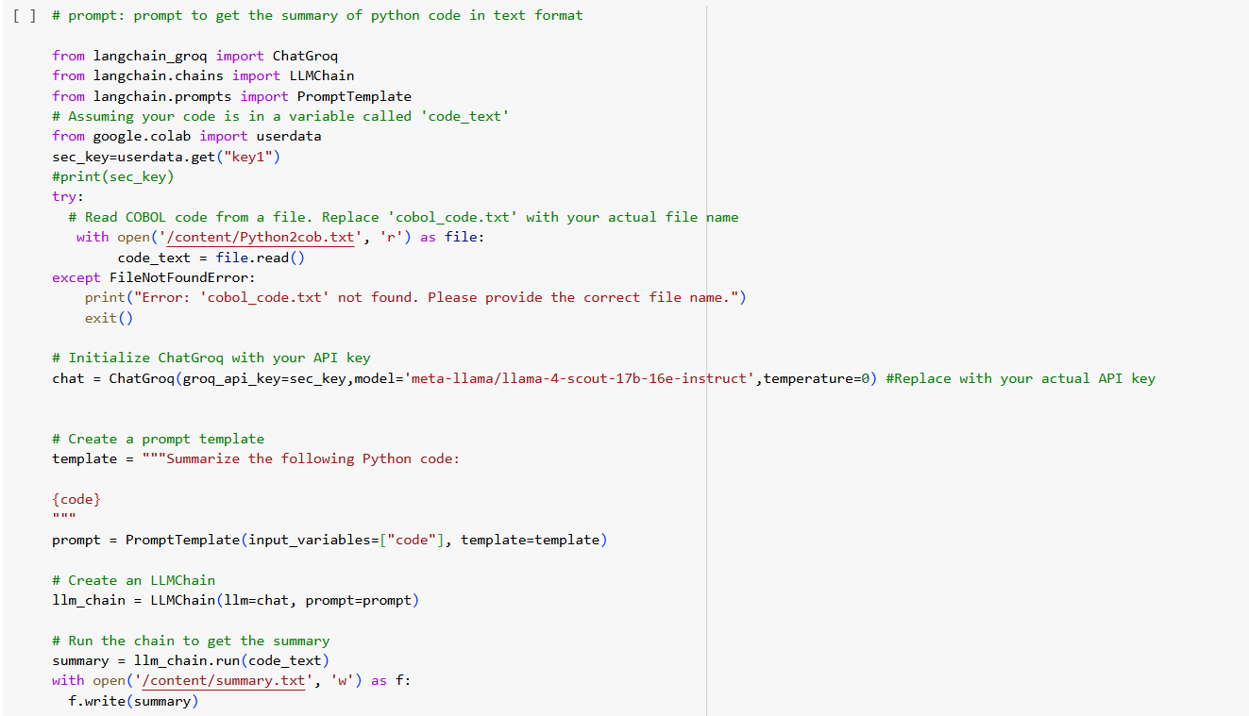
LLM to generate summary

Slide 12
Summary of the program in text file

Slide 13
