Slide 1
features
(N, C, H, W)
A = # of anchors per pixel, ex) 3x3
3x3 conv, 512
1x1 conv, Ax4
1x1 conv, Ax2
rpn_scores
(N, H*W*A, 2)
anchor
(H*W*A, 4)
rpn_locs
(N, H*W*A, 4)
rpn_loc_loss
rpn_cls_loss
gt_rpn_loc
(H*W*A, 4)
ProposalCreator
AnchorTargetCreator
gt_rpn_label
(H*W*A,)
rois
(K, 4)
roi_indices
(K,)
sample_rois
(S, 4)
gt_bbox
ProposalTargetCreator
sample_rois_ indices
(S,)
label
S ~ K
ROI Pooling
(K, C, roi_size, roi_size)
gt_loc
(S, 4)
FC, 4096
FC, 4096
gt_label
(S,)
FC, Class x 4 = 84
FC, Class = 21
roi_cls_locs
(K, Class x 4)
roi_scores
(K, Class)
suppress
roi_loc_loss
roi_cls_loss
loc
label

Slide 2
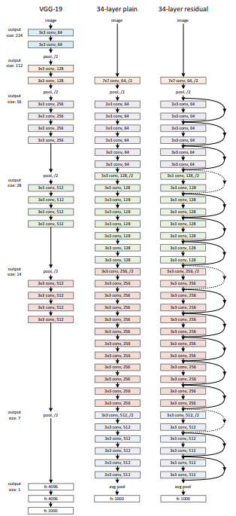

Slide 3
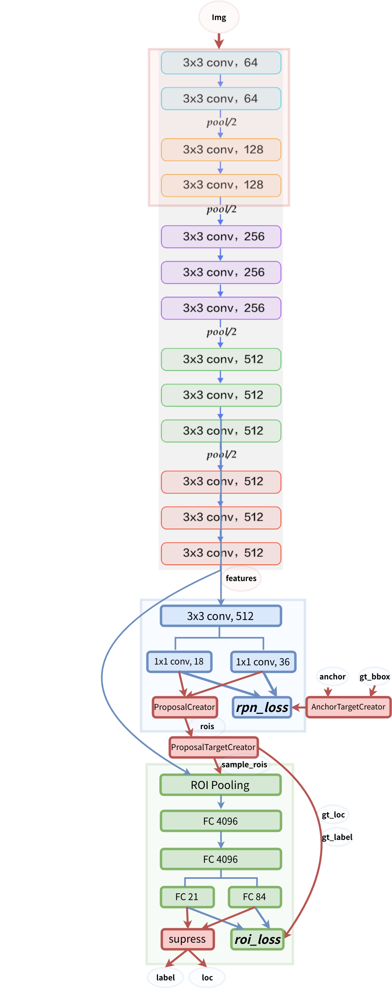

Slide 4
imgs # (N, 3, IMG_H, IMG_W)
extractor
features # (N, C, H, W)
rpn
img_size = imgs.shape[2:]
features = self.extractor(imgs) # (N, C, H, W)
rpn_locs, rpn_scores, rois, roi_indices, anchor = self.rpn(features, img_size, scale) # (N, H*W*A, 4), (N, H*W*A, 2), (K, 4), (K,), (A*H*W, 4) # K <= N*H*W*A
roi_cls_locs, roi_scores = self.head(features, rois, roi_indices) # (K, n_class*4), (K, n_class)
return roi_cls_locs, roi_scores, rois, roi_indices # (K, n_class*4), (K, n_class), (K, 4), (K,)
rois # (K, 4), K <= N*H*W*A
head
roi_cls_locs # (K, n_class*4)
roi_scores # (K, n_class)

Slide 5
_calc_ious
B1
A1
B2
A2
B3
G
7 | 14 | 18 | 11
gt_max_overlaps
2 | 1 | 2 | 0
gt_argmax_ious
11
14
18
3
1
2
5 | 4 | 3 | 11
6 | 14 | 10 | 2
7 | 14 | 18 | 9
A
max_ious
argmax_ious
ious (= anchor x bbox)

Slide 6
Helping functions

Slide 7
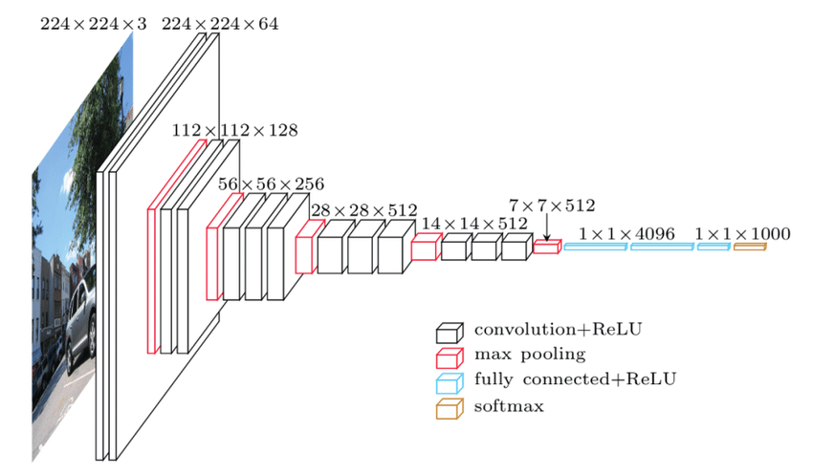
VGG16
https://datagen.tech/guides/computer-vision/vgg16/
https://www.geeksforgeeks.org/vgg-16-cnn-model/

Slide 8
RPN
image
(B, 3, h, w)
rpn_cls_score
(1, Ax2, H, W)
rpn_bbox_targets
(1, 4xA, H, W)
VGG16
anchor_target_layer
gt_boxes
(G, 5)
rpn_labels
(1, 1, HxA, W)
features
(B, 512, H=14, W=14)
rpn_cls_score
(B, Sx3x2, H, W)
Conv2D
(3 x 3)
conv1
rpn_cls_score_reshape
(B, 2, Sx3xH, W)
rpn_conv1
(B, 512, H, W)
rpn_cls_prob
(B, 2, Sx3xH, W)
Conv2D
(1 x 1)
score_conv
rpn_cls_prob_reshape
(B, Sx3x2, H, W)
rpn_cls_prob_reshape
(1 , H , W , Ax2)
proposal_layer
(NMS)
rpn_rois
(1xHxWxA, 5)
Conv2D
(1 x 1)
bbox_conv
rpn_bbox_pred
(1 , H , W , Ax4)
rpn_bbox_pred
(B, Sx3x4, H, W)
build_loss:
cross_entropy
build_loss:
smooth_l1_loss

Slide 9
anchor_target_layer
Assign anchors to ground-truth targets. Produces anchor classification
labels and bounding-box regression targets.
Parameters
----------
rpn_cls_score: for pytorch (1, Ax2, H, W) bg/fg scores of previous conv layer
gt_boxes: (G, 5) vstack of [x1, y1, x2, y2, class]
gt_ishard: (G, 1), 1 or 0 indicates difficult or not
dontcare_areas: (D, 4), some areas may contains small objs but no labelling. D may be 0
im_info: a list of [image_height, image_width, scale_ratios]
_feat_stride: the downsampling ratio of feature map to the original input image
anchor_scales: the scales to the basic_anchor (basic anchor is [16, 16])
----------
Returns
----------
rpn_labels : (1, 1, HxA, W), for each anchor, 0 denotes bg, 1 fg, -1 dontcare
rpn_bbox_targets: (1, 4xA, H, W), distances of the anchors to the gt_boxes(may contains some transform)
that are the regression objectives
rpn_bbox_inside_weights: (1, 4xA, H, W) weights of each boxes, mainly accepts hyper param in cfg
rpn_bbox_outside_weights: (1, 4xA, H, W) used to balance the fg/bg,
beacuse the numbers of bgs and fgs mays significiantly different
rpn_cls_score
(1, Ax2, H, W)
rpn_bbox_targets
(1, 4xA, H, W)
anchor_target_layer
gt_boxes
(G, 5)
rpn_labels
(1, 1, HxA, W)

Slide 10
anchor_target_layer (2)
((W-1)*stride, 0)
(0, 0)
(W-1, 0)
(0, 0)
(0, H-1)
(W-1, H-1)
# add A anchors (1, A, 4) to
# cell K shifts (K, 1, 4) to get
# shift anchors (K, A, 4)
# reshape to (K*A, 4) shifted anchors
Cf) K = H x W; A = S (scale) x R (ratio)
(0, (H-1)*stride)
((W-1)*stride, (H-1)*stride)

Slide 11
anchor_target_layer (2)
7 | 14 | 10 | 11
overlaps = bbox_overlaps(anchors, gt_boxes) # A x G
argmax_overlaps = overlaps.argmax(axis=1) # (A)
max_overlaps = overlaps[np.arange(len(inds_inside)), argmax_overlaps]
gt_argmax_overlaps = overlaps.argmax(axis=0) # G
gt_max_overlaps = overlaps[gt_argmax_overlaps, np.arange(overlaps.shape[1])]
gt_argmax_overlaps2 = np.where(overlaps == gt_max_overlaps)[0]
gt_max_overlaps
5 | 4 | 3 | 11
6 | 14 | 10 | 2
7 | 14 | 8 | 9
G
overlaps
7 | 14 | 10 | 11
gt_max_overlaps
2 | 1 | 1 | 0
gt_argmax_overlaps
gt_argmax_overlaps2
11
14
14
3
1
1
5 | 4 | 3 | 11
6 | 14 | 10 | 2
7 | 14 | 8 | 9
0
1
1
2
2
3
1
2
0
1
A
anchors
max_overlaps
argmax_overlaps
overlaps
(x,y,x,y)
(x,y,x,y)
(x,y,x,y)
1
0
1
bbox_targets = bbox_transform(anchors, gt_boxes[argmax_overlaps, :])
# fg label: for each gt, anchor with highest overlap
labels[gt_argmax_overlaps] = 1
# fg label: above threshold IOU
labels[max_overlaps >= cfg.TRAIN.RPN_POSITIVE_OVERLAP] = 1
bbox_targets
labels

Slide 12
proposal_layer
Parameters
----------
rpn_cls_prob_reshape: (1 , H , W , Ax2) outputs of RPN, prob of bg or fg
NOTICE: the old version is ordered by (1, H, W, 2, A) !!!!
rpn_bbox_pred: (1 , H , W , Ax4), rgs boxes output of RPN
im_info: a list of [image_height, image_width, scale_ratios]
cfg_key: 'TRAIN' or 'TEST'
_feat_stride: the downsampling ratio of feature map to the original input image
anchor_scales: the scales to the basic_anchor (basic anchor is [16, 16])
----------
Returns
----------
rpn_rois : (1 x H x W x A, 5) e.g. [0, x1, y1, x2, y2]
# Algorithm:
#
# for each (H, W) location i
# generate A anchor boxes centered on cell i
# apply predicted bbox deltas at cell i to each of the A anchors
# clip predicted boxes to image
# remove predicted boxes with either height or width < threshold
# sort all (proposal, score) pairs by score from highest to lowest
# take top pre_nms_topN proposals before NMS
# apply NMS with threshold 0.7 to remaining proposals
# take after_nms_topN proposals after NMS
# return the top proposals (-> RoIs top, scores top)
#layer_params = yaml.load(self.param_str_)
rpn_cls_prob_reshape
(1 , H , W , Ax2)
proposal_layer
(NMS)
rpn_rois
(1xHxWxA, 5)
rpn_bbox_pred
(1 , H , W , Ax4)

Slide 13
bbox_targets
(1xHxWxA, Kx4)
rpn_rois
(1xHxWxA, 5)
proposal_target_layer
labels
(1xHxWxA, 1)
gt_boxes
(G, 5)
RPN
rois
(1xHxWxA, 5)
roi_pool
(pooled_height, pooled_width) = (7, 7)
features
(B, 512, H=14, W=14)
pooled_features
(1xHxWxA, 512, 7, 7)
Score_fc
(4096, C)
cls_score
Fc6
(512 x 7 x7,
4096)
dropout
Fc7
(4096, 4096)
dropout
build_loss:
cross_entropy
build_loss:
smooth_l1_loss
Bbox_fc
(4096, C x 4)
bbox_pred

Slide 14
proposal_target_layer
Assign object detection proposals to ground-truth targets. Produces proposal
classification labels and bounding-box regression targets.
Parameters
----------
rpn_rois: (1 x H x W x A, 5) [0, x1, y1, x2, y2]
gt_boxes: (G, 5) [x1 ,y1 ,x2, y2, class] int
gt_ishard: (G, 1) {0 | 1} 1 indicates hard
dontcare_areas: (D, 4) [ x1, y1, x2, y2]
_num_classes
----------
Returns
----------
rois: (1 x H x W x A, 5) [0, x1, y1, x2, y2]
labels: (1 x H x W x A, 1) {0,1,...,_num_classes-1}
bbox_targets: (1 x H x W x A, K x4) [dx1, dy1, dx2, dy2]
bbox_inside_weights: (1 x H x W x A, Kx4) 0, 1 masks for the computing loss
bbox_outside_weights: (1 x H x W x A, Kx4) 0, 1 masks for the computing loss
bbox_targets
(1xHxWxA, Kx4)
rpn_rois
(1xHxWxA, 5)
proposal_target_layer
labels
(1xHxWxA, 1)
gt_boxes
(G, 5)
rois
(1xHxWxA, 5)

Slide 15
RoIPool
features = (B, C, H, W)
rois = (R, …)
outputs = (R, C, Pooled_H, Pooled_W)
For I, roi in enumerate(rois):
Pooled_H
MAX
MAX
ROI_H
Pooled_W
ROI_W
image

Slide 16
Helping functions

Slide 17
bbox_transform
computes the distance from ground-truth boxes to the given boxes, normed by their size
:param ex_rois: n * 4 numpy array, given boxes
:param gt_rois: n * 4 numpy array, ground-truth boxes
:return: deltas: n * 4 numpy array, ground-truth boxes

Slide 18
generate_anchors
base_size
* sqrt(ratio)
h = base_size
= 16
Same area
(cx, cy)
w = base_size = 16
base_size / sqrt(ratio)
base_size = 16
ratios = [0.5, 1, 2]
scales = 2**np.arange(3, 6)
#array([[ -83., -39., 100., 56.],
# [-175., -87., 192., 104.],
# [-359., -183., 376., 200.],
# [ -55., -55., 72., 72.],
# [-119., -119., 136., 136.],
# [-247., -247., 264., 264.],
# [ -35., -79., 52., 96.],
# [ -79., -167., 96., 184.],
# [-167., -343., 184., 360.]])
H * scale (=8, 16, and 32)
W * scale

Slide 19
bbox_overlaps
Parameters
----------
boxes: (N, 4) ndarray of float
query_boxes: (K, 4) ndarray of float
Returns
-------
overlaps: (N, K) ndarray of overlap between boxes and query_boxes
bbox_intersections
For each query box compute the intersection ratio covered by boxes
----------
Parameters
----------
boxes: (N, 4) ndarray of float
query_boxes: (K, 4) ndarray of float
Returns
-------
overlaps: (N, K) ndarray of intersec between boxes and query_boxes

Slide 20
Back Up 2

Slide 21
RPN
rois
Conv2D
(1 x 1, score_conv)
VGG16
Conv2D
(3 x 3, conv1)
Conv2D
(1 x 1, score_conv)
proposal_layer
rpn_cls_score
rpn_cls_prob_reshape
(n x n x (AS x 3 x 2))
rpn_cls_score
rpn_cls_prob_reshape
(n x n x (AS x 3 x 2))
Conv2D
(1 x 1, bbox_conv)
image
(h x w x 3)
features
(n x n x 512)
rpn_conv1
(n x n x 512)
anchor_target_layer
Build_loss
rpn_bbox_pred
(n x n x (AS x 3 x 4))
rpn_data
loss

