Slide 1
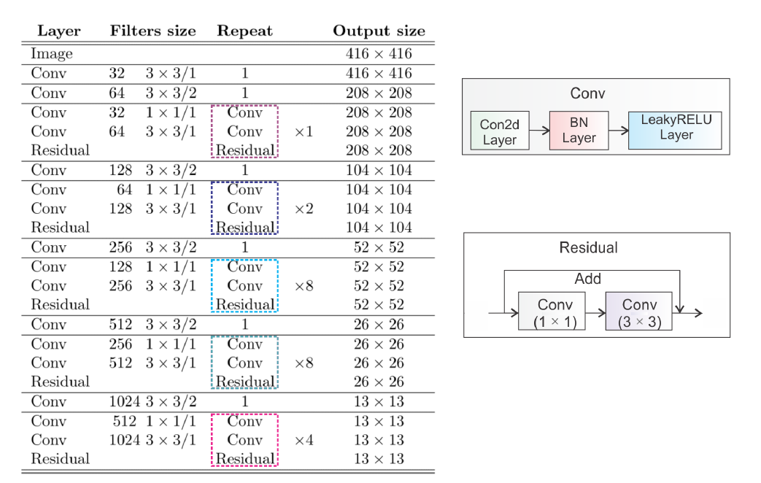

Slide 2
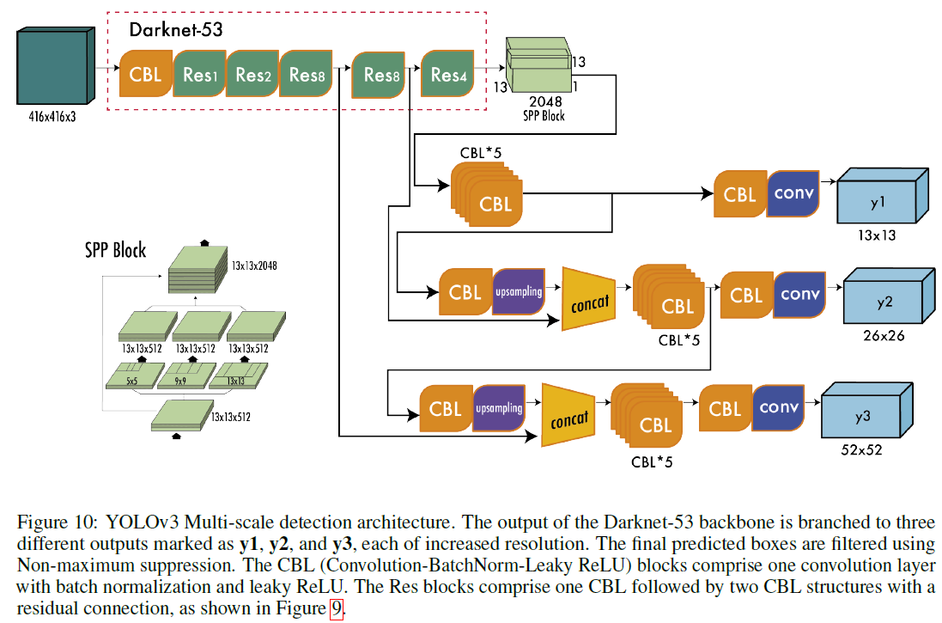

Slide 3
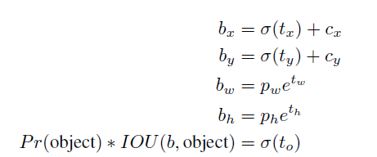
(B, A, H//n, W//n, 4 + 1 + num_classes)
pxy = ps[:, :2].sigmoid()
pwh = torch.exp(ps[:, 2:4]) * anchors[layer_index]

