Slide 1
Towards High Productivity and Performance for Irregular Applications in Chapel
Thomas B. Rolinger University of Maryland
Joseph Craft Laboratory for Physical Sciences
Christopher D. Krieger Laboratory for Physical Sciences
Alan Sussman University of Maryland

Slide 2
Agenda
Background
Irregular applications
Chapel programming language
Productivity-performance tradeoffs
Application Studies
Breadth First Search (BFS) – message aggregation
PageRank – selective data replication
Conclusions and Future Work

Slide 3

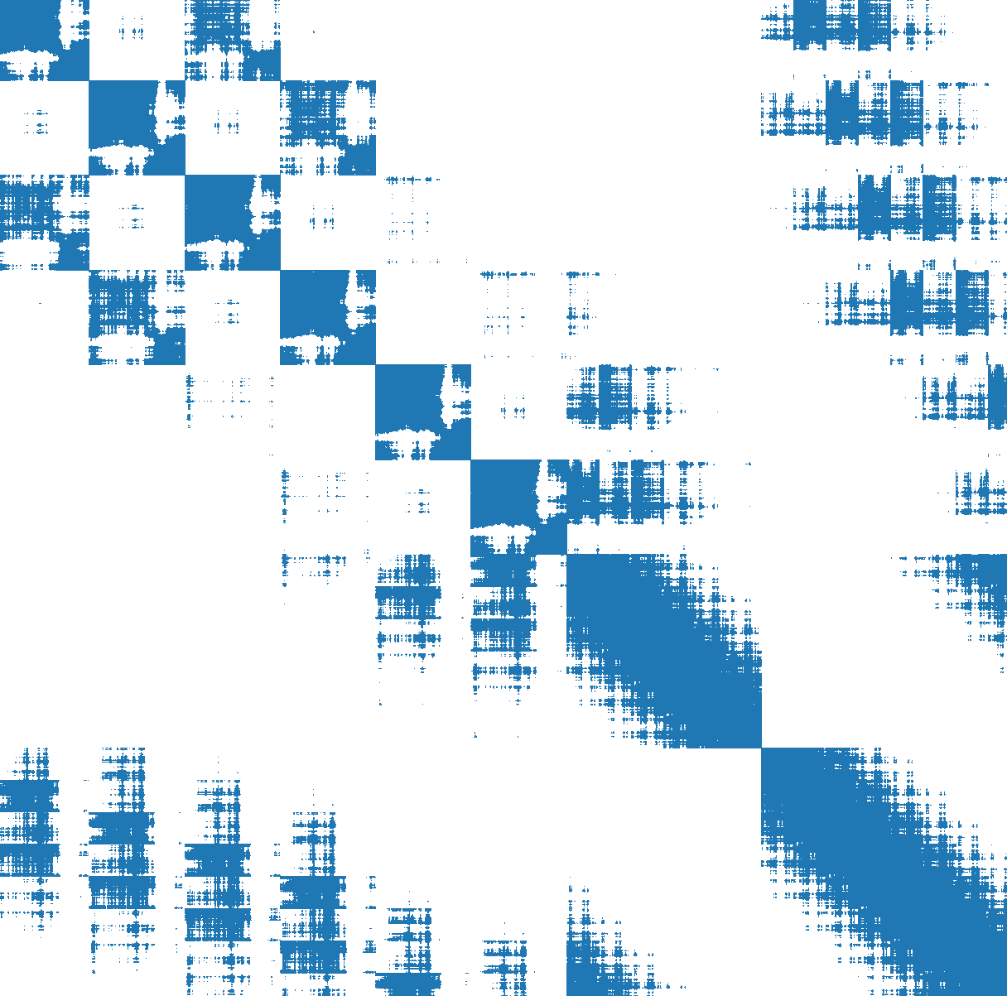
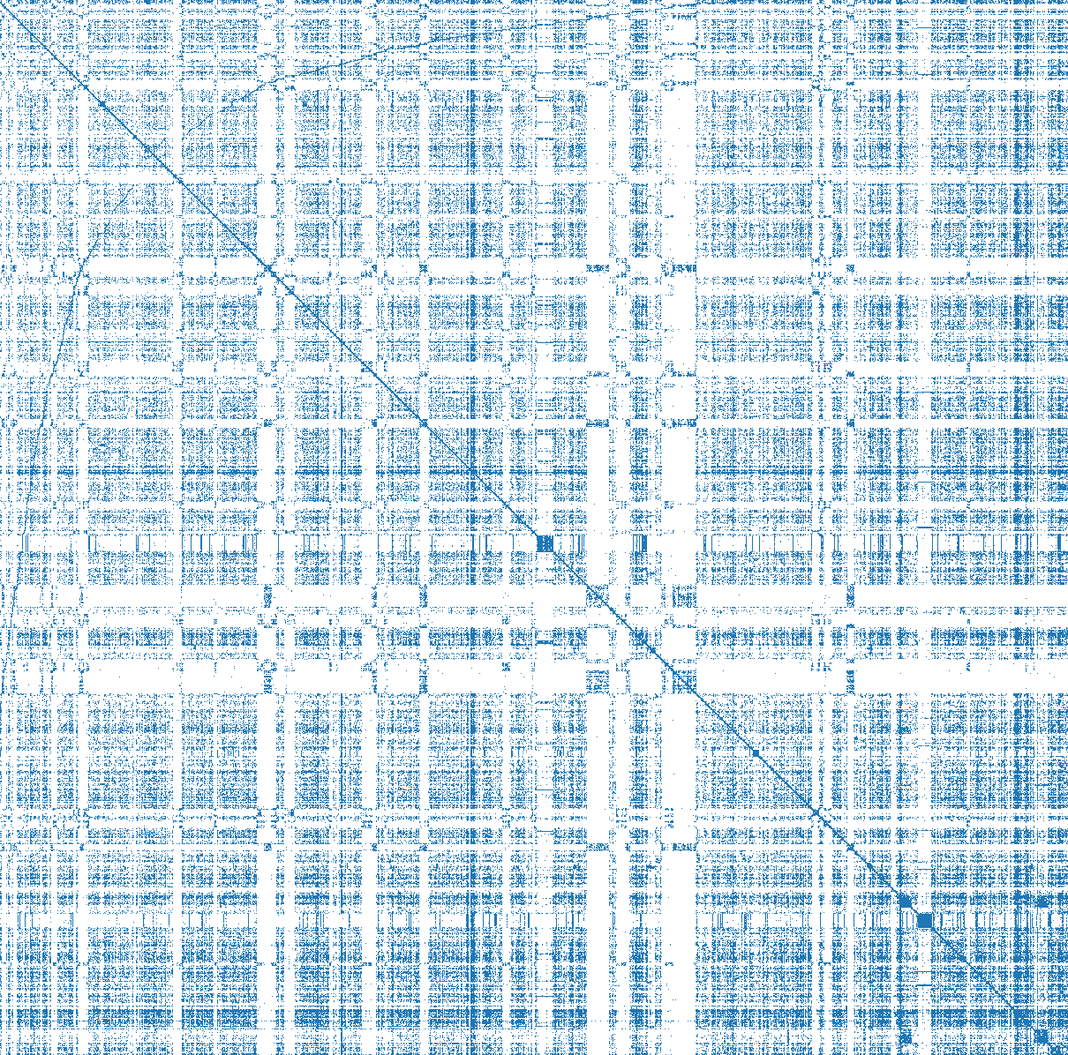
Background: Irregular Applications
Defining feature:
fine-grained, sparse memory access patterns (i.e., A[B[i]]) not known until runtime
On distributed-memory systems, irregular accesses to distributed data leads to fine-grained remote communication
Example applications:
Conjugate Gradient
Molecular Dynamics Simulation
Graph Analytics
Runtime Optimizations for Irregular Applications in Chapel, CHIUW 2021

Slide 4
Background: Chapel Programming Language
Implements a Partitioned Global Address Space (PGAS)
High-level constructs for both shared- and distributed-memory programming
Executes tasks and distributes data across locales
Can think of a locale as a compute node in a cluster
Implicit remote communication
accesses to remote elements of a distributed array look no different from local accesses

Slide 5
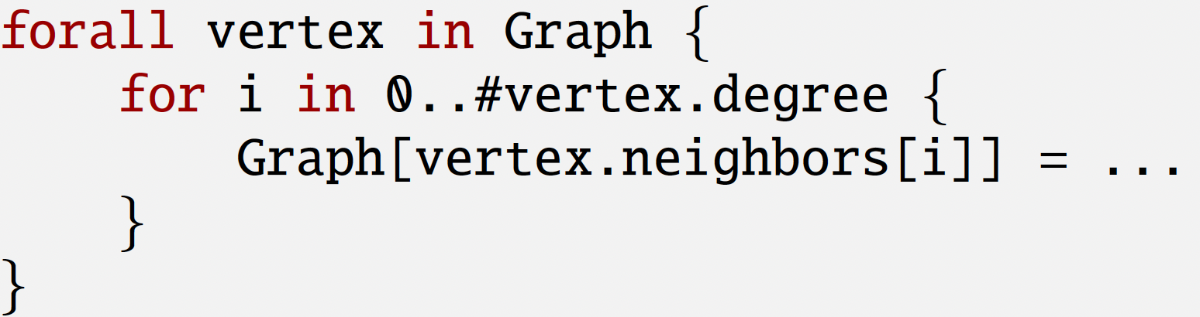
Background: Chapel Programming Language
Implements a Partitioned Global Address Space (PGAS)
High-level constructs for both shared- and distributed-memory programming
Executes tasks and distributes data across locales
Can think of a locale as a compute node in a cluster
Implicit remote communication
accesses to remote elements of a distributed array look no different from local accesses
Graph is a block distributed array of vertices
forall loop iterates over vertices in parallel, creating tasks on the locale where the vertex is located
3 lines of code that performs shared- and distributed-memory parallel graph kernel – good productivity
but has fine-grained remote communication – bad performance

Slide 6


Background: Productivity-Performance Tradeoffs
Productivity:
writing distributed irregular applications is “easy” due to not having to use explicit communication for access patterns that are not known until runtime
Performance:
distributed irregular applications will naturally contain fine-grained remote communication
today’s HPC systems are not optimized for this
Our paper: how to bridge the gap between
productivity and performance for irregular applications in Chapel?

Slide 7
Agenda
Background
Irregular applications
Chapel programming language
Productivity-performance tradeoffs
Application Studies
Breadth First Search (BFS) – message aggregation
PageRank – selective data replication
Conclusions and Future Work

Slide 8
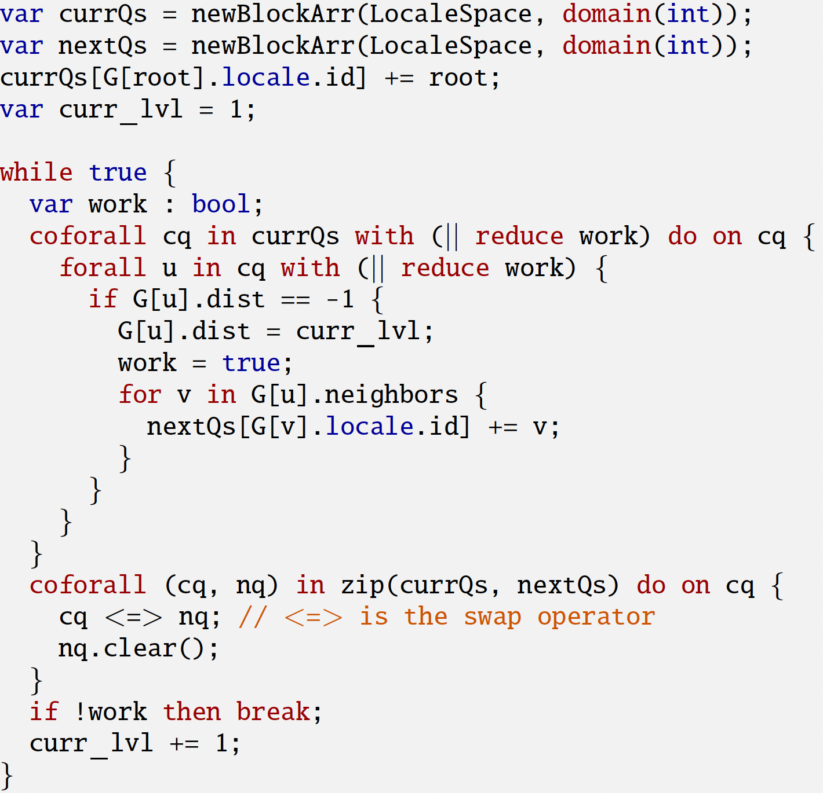
Application Study: Breadth First Search (BFS)
A fundamental algorithm in graph analytics
Algorithm: starting from a root vertex, visit each neighbor of the root and then visit each of their neighbors, etc. → proceeds level-by-level
Difficult to parallelize
relies on a queue data structure to store vertices for processing at each iteration
High-productivity BFS code in Chapel

Slide 9
Application Study: Breadth First Search (BFS)
Each locale stores two queues:
currQ holds vertices to visit at current level.
nextQ holds vertices to visit at next level.
A queue is represented as an associative domain (i.e., dictionary) → allows for safe concurrent insertions
A fundamental algorithm in graph analytics
Algorithm: starting from a root vertex, visit each neighbor of the root and then visit each of their neighbors, etc. → proceeds level-by-level
Difficult to parallelize
relies on a queue data structure to store vertices for processing at each iteration
High-productivity BFS code in Chapel

Slide 10
Application Study: Breadth First Search (BFS)
A fundamental algorithm in graph analytics
Algorithm: starting from a root vertex, visit each neighbor of the root and then visit each of their neighbors, etc. → proceeds level-by-level
Difficult to parallelize
relies on a queue data structure to store vertices for processing at each iteration
coforall loop creates a task on each locale and forall loop processes all vertices in a given locale’s currQ in parallel
High-productivity BFS code in Chapel

Slide 11
Application Study: Breadth First Search (BFS)
A fundamental algorithm in graph analytics
Algorithm: starting from a root vertex, visit each neighbor of the root and then visit each of their neighbors, etc. → proceeds level-by-level
Difficult to parallelize
relies on a queue data structure to store vertices for processing at each iteration
for each neighbor v of vertex u, add it to the nextQ on the locale where v is located (G is a block distributed array of vertices)
→ fine-grained remote write
High-productivity BFS code in Chapel

Slide 12
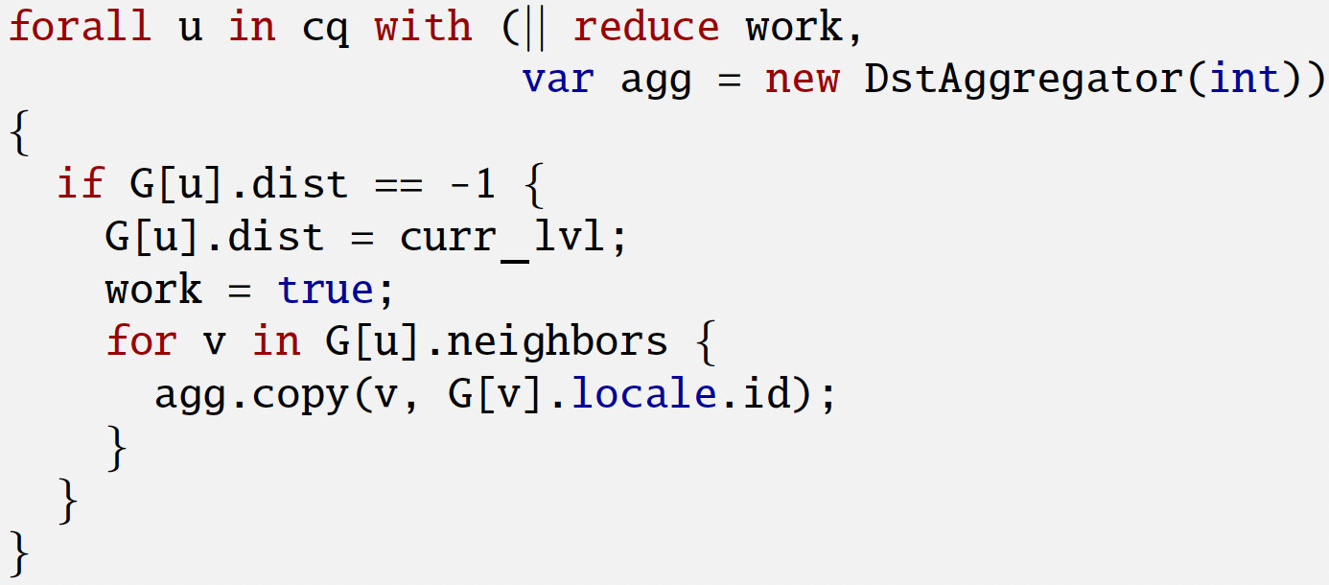
Application Study: Breadth First Search (BFS)
Problem: improve performance without sacrificing productivity
Solution: leverage well-known benefits¹ of message aggregation
“Buffer” remote writes and perform them in bulk for a given destination locale
Can hide all the aggregation details in a Chapel module, leaving the application code more or less unchanged
potential to generalize aggregation and apply it automatically to programs
¹Communication Optimizations for Fine-grained UPC Applications, W.-Y. Chen, C. Iancu, and K. Yelick, PACT’05
BFS using built-in aggregation

Slide 13
Application Study: Breadth First Search (BFS)
Problem: improve performance without sacrificing productivity
Solution: leverage well-known benefits¹ of message aggregation
“Buffer” remote writes and perform them in bulk for a given destination locale
Can hide all the aggregation details in a Chapel module, leaving the application code more or less unchanged
potential to generalize aggregation and apply it automatically to programs
each task created via the forall gets its own aggregator instance agg.
We extended Chapel’s built-in CopyAggregation module to support this type of aggregation
BFS using built-in aggregation

Slide 14
Application Study: Breadth First Search (BFS)
Problem: improve performance without sacrificing productivity
Solution: leverage well-known benefits¹ of message aggregation
“Buffer” remote writes and perform them in bulk for a given destination locale
Can hide all the aggregation details in a Chapel module, leaving the application code more or less unchanged
potential to generalize aggregation and apply it automatically to programs
buffer the vertex ID we want to write and the locale where we want to write it to.
When a given task’s aggregation buffer is full for some destination locale, it performs a flush of all the vertex IDs to that locale’s nextQ
See paper for more details on how the flush is performed
BFS using built-in aggregation

Slide 15
Application Study: Breadth First Search (BFS)
Performance evaluation:
16 node FDR-Infiniband cluster, 20 cores per node, 512 GB of memory per node
Chapel v1.24.1, GASnet, ibv comm substrate
Compare high productivity Chapel code to:
built-in aggregation Chapel code
fixed size aggregation buffers, flushes happen “behind the scenes”
manual aggregation using MPI+OpenMP (2-sided communication)
aggregation buffers grow dynamically to accommodate all remote writes in a given iteration, performs a single flush
manual aggregation Chapel code
same aggregation approach as MPI+OpenMP but implemented in Chapel
do we improve performance by sacrificing productivity in Chapel?

Slide 16
BFS Runtime Speed-ups over High Productivity Chapel
better
better

Slide 17
BFS Runtime Speed-ups over High Productivity Chapel
Significant speed-ups over high-productivity Chapel
built-in aggregation requires minimal changes to user’s code
MPI+OpenMP slower than the optimized Chapel codes
largely due to differences in memory allocator used, which is crucial for buffer resizing in all approaches

Slide 18
BFS Runtime Speed-ups over High Productivity Chapel
Significant speed-ups over high-productivity Chapel
built-in aggregation requires minimal changes to user’s code
MPI+OpenMP slower than the optimized Chapel codes
largely due to differences in memory allocator used, which is crucial for buffer resizing in all approaches

Slide 19
BFS Runtime Speed-ups over High Productivity Chapel
Built-in aggregation is generally faster than manual aggregation
built-in aggregation uses fixed size buffers and flushes when full
manual approach dynamically grows buffers to accommodate all remote-writes in an iteration
Overhead of flushes becomes apparent on large data sets and high locale counts
Manual aggregation runs out of memory on g500_scale-28 on 2 locales
too much data to aggregate all-at-once in an iteration

Slide 20
BFS Runtime Speed-ups over High Productivity Chapel
Built-in aggregation is generally faster than manual aggregation
built-in aggregation uses fixed size buffers and flushes when full
manual approach dynamically grows buffers to accommodate all remote-writes in an iteration
Overhead of flushes becomes apparent on large data sets and high locale counts
Manual aggregation runs out of memory on g500_scale-28 on 2 locales
too much data to aggregate all-at-once in an iteration

Slide 21
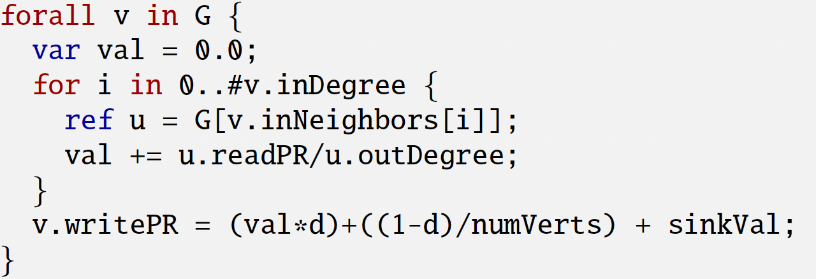
Application Study: PageRank
Purpose: compute a ranking/importance factor for each vertex in the graph based on its incoming edges/links
Originally developed for website ranking in search engines, but often used in more general graph analytics
Iterative
performs kernel on same graph until convergence
High-productivity PageRank kernel in Chapel

Slide 22
Application Study: PageRank
Purpose: compute a ranking/importance factor for each vertex in the graph based on its incoming edges/links
Originally developed for website ranking in search engines, but often used in more general graph analytics
Iterative
performs kernel on same graph until convergence
G is a block distributed array of vertex records, where each vertex stores an array of incoming neighbor IDs
High-productivity PageRank kernel in Chapel

Slide 23
Application Study: PageRank
Purpose: compute a ranking/importance factor for each vertex in the graph based on its incoming edges/links
Originally developed for website ranking in search engines, but often used in more general graph analytics
Iterative
performs kernel on same graph until convergence
irregular access to G to access each neighbor of vertex v
this access pattern does not change throughout all executions of this kernel
High-productivity PageRank kernel in Chapel

Slide 24
Application Study: PageRank
Problem: improve the performance without sacrificing productivity
Solution: use inspector-executor technique to perform selective data replication
Inspector: routine that performs one-time analysis of the memory access pattern in the kernel to determine which data is remotely accessed and create local copies of that data
in PageRank, the data replicated are the vertex pagerank values
Executor: modified version of the kernel that reads from the local copies rather than performing remote reads
before each kernel execution, perform an update to ”refresh” the local copies
exploits data reuse → perform one remote read to refresh and reuse that local value many times in the kernel
An inspector-executor can be implemented as a compiler optimization, which will be the focus of our future work
For now, we hand-generate the code that the compiler would generate
Refer to the paper and our CHIUW 2021 paper¹ for more details
¹Runtime Optimizations for Irregular Applications in Chapel, CHIUW 2021

Slide 25
Application Study: PageRank
Problem: improve the performance without sacrificing productivity
Solution: use inspector-executor technique to perform selective data replication
Inspector: routine that performs one-time analysis of the memory access pattern in the kernel to determine which data is remotely accessed and create local copies of that data
in PageRank, the data replicated are the vertex pagerank values
Executor: modified version of the kernel that reads from the local copies rather than performing remote reads
before each kernel execution, perform an update to ”refresh” the local copies
exploits data reuse → perform one remote read to refresh and reuse that local value many times in the kernel
An inspector-executor can be implemented as a compiler optimization, which will be the focus of our future work
For now, we hand-generate the code that the compiler would generate
Refer to the paper and our CHIUW 2021 paper¹ for more details
¹Runtime Optimizations for Irregular Applications in Chapel, CHIUW 2021

Slide 26
Application Study: PageRank
Problem: improve the performance without sacrificing productivity
Solution: use inspector-executor technique to perform selective data replication
Inspector: routine that performs one-time analysis of the memory access pattern in the kernel to determine which data is remotely accessed and create local copies of that data
in PageRank, the data replicated are the vertex pagerank values
Executor: modified version of the kernel that reads from the local copies rather than performing remote reads
before each kernel execution, perform an update to ”refresh” the local copies
exploits data reuse → perform one remote read to refresh and reuse that local value many times in the kernel
An inspector-executor can be implemented as a compiler optimization, which will be the focus of our future work
For now, we hand-generate the code that the compiler would generate
Refer to the paper and our CHIUW 2021 paper¹ for more details
¹Runtime Optimizations for Irregular Applications in Chapel, CHIUW 2021

Slide 27
Application Study: PageRank
Performance evaluation:
16 node Cray XC cluster, 44 cores per node, 128 GB of memory per node
Chapel v1.24.1, ugni, aries comm substrate
Compare high productivity Chapel code to:
inspector-executor (I/E) optimized Chapel code
only replicates the pagerank values that are accessed remotely
includes cost of the inspector analysis
MPI+OpenMP code with full-data replication (see paper for details)
each rank replicates ALL of the pagerank values, since no runtime analysis is performed

Slide 28
PageRank Runtime Speed-ups over High Productivity Chapel
better
better

Slide 29
PageRank Runtime Speed-ups over High Productivity Chapel
Large speed-ups over high-productivity Chapel
even though the Aries interconnect is optimized for small messages

Slide 30
PageRank Runtime Speed-ups over High Productivity Chapel
MPI+OpenMP slower than optimized Chapel code on webbase-2001
this graph is very sparse with low average degree per vertex
As a result, there is less remote communication per locale
I/E will replicate only what is remotely accessed
MPI+OpenMP does full replication
→ I/E performs less communication, leading to better performance
even considering the time to execute the inspector

Slide 31
PageRank Runtime Speed-ups over High Productivity Chapel
MPI+OpenMP faster than optimized Chapel code on sk-2005
this graph is not as sparse with high average degree per vertex compared to webbase-2001
As a result, I/E replicates a comparable amount of data as MPI+OpenMP
now overhead of inspector comes into play
Other factors contributing to performance loss vs. MPI+OpenMP
wide-pointer references in Chapel code lead to 1.23x slow-down

Slide 32
Conclusions and Future Work
High productivity ≠ high performance for irregular applications in Chapel
implicit fine-grained communication
We explored techniques that leave productivity intact but significantly improve performance
message aggregation, selective data replication
1,219x speed-up for BFS, 22x speed-up for PageRank
Future work
perform these optimizations automatically
look at irregular applications with other data access patterns

Slide 33
Towards High Productivity and Performance for Irregular Applications in Chapel
Thomas B. Rolinger University of Maryland
Joseph Craft Laboratory for Physical Sciences
Christopher D. Krieger Laboratory for Physical Sciences
Alan Sussman University of Maryland

