Slide 1
Application of PGAS Programming to Power Grid Simulation
Bruce Palmer
Pacific Northwest National Laboratory
Richland, WA

Slide 2

The Power Grid: The Biggest Machine in the World

Slide 3
Parallel Computing and the Power Grid
Most problems are fairly small and still fit on workstations
But…
There is interest in simulating problems very fast. Going from 2 minutes to 15 seconds can be important for real-time control
Contingency calculations can spawn thousands or even millions of individual simulations. These can all be run concurrently
Bigger calculations are on the horizon (optimization, transmission plus distribution, etc.)

Slide 4
GridPACK™ Framework
Base Factory
Network-wide Operations
Base Network Components
Neighbor Lists
Matrix Elements
GridPACK™ Applications
Application Driver
Application Factory
Application Components
GridPACK™ Framework
Import Module
PTI Formats
Dictionary
Network Module
Exchanges
Partitioning
Configure Module
XML
Export Module
Serial IO
Task Manager
Math and Solver Module
PETSc
Mapper
Utilities
Errors
Profiling
Core Data Objects
Matrices and Vectors
Power Grid Network

Slide 5
Global Arrays Communication Library
Distributed arrays with a global address space
One-sided access using put/get/accumulate (structured access) and scatter/gather/scatter-accumulate (unstructured access)
Read-increment functionality
Native runtimes: Infiniband, Portals4, and Cray
MPI-based runtimes: Two-sided, progress ranks, multi-threaded, progress threads, and MPI-3

Slide 6
Parallel Tasks Implemented using PGAS
Ghost bus (node) and branch (edge) exchanges (scatter/gather)
I/O (scatter/get)
Task manager (read-increment)
Collective hash tables (put/get and read-increment)
etc.

Slide 7
Collective Hash Tables
P0
P1
P2
P3
Bus 4
Bus 7
Bus 8
Bus 13
Bus 19
Bus 20
Bus 1
Bus 2
Bus 11
Bus 12
Bus 17
Bus 18
Bus 3
Bus 9
Bus 10
Bus 14
Bus 15
Bus 16
Bus 5
Bus 6
Bus 21
Bus 22
Bus 23
Bus 24
Distribution of buses on processors
1-V1
2-V2
3-V3
4-V4
5-V5
6-V6
7-V7
8-V8
9-V9
10-V10
11-V11
12-V12
13-V13
14-V14
15-V15
16-V16
17-V17
18-V18
19-V19
20-V20
21-V21
22-V22
23-V23
24-V24
Distribution of data on processors

Slide 8
Hash Algorithm
Setup and access are collective operations
Requests can be bundled and processed all at once
Progress is assumed on all processors
Create a hash function that maps bus (node) indices to a processor
Processor doesn’t need to own the bus, but it is the place to go for information
Create a hash table that maps all bus (node) indices to the processors that contain the bus
Use the hash table to route data to processors that own the bus

Slide 9
Initialization:Evaluate Bin Sizes and Offsets
Global array with P elements
P0
1
3
P0
Offsets
Bin Sizes
P1
1
Read-Increment
0
P1
P2
2
1
P2
P3
1
5
P3
Process J

Slide 10
Initialization: Put All Data in Global Array
Global Array Containing All Key-Value Pairs
0
5
10
17
Put
3
5
3
0
5
5
Binned Keys-Value Pairs
1
7
11
5
8
23
Relative Offsets
Total Keys per Process
Global Offsets

Slide 11
Initialization: Key-Value Pairs Are Distributed
P0
P1
P2
P3
0
5
10
17
Key-value pairs from P0
Key-value pairs from P1
Key-value pairs from P2
Key-value pairs from P3

Slide 12
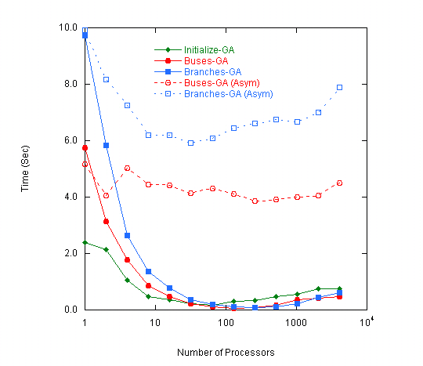
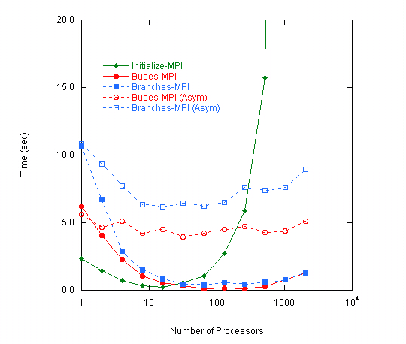
Results

Slide 13
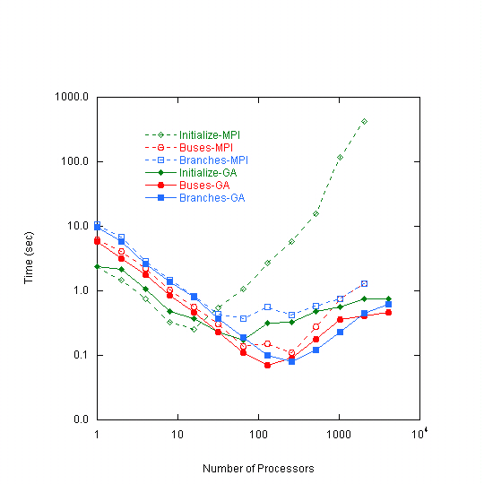
Results

Slide 14
Conclusions
PGAS programming models are easily applied to power grid applications
Performance is comparable to MPI for many functions, in some cases it is better
Collective hashing can be used to redistribute data efficiently based on matching keys
GridPACK available at https://www.gridpack.org

