Slide 1



Experiences of Applying One-Sided Communication to Nearest-Neighbor Communication
Hongzhang Shan¹, Weiqun Zhang¹,Yili Zheng¹, Samuel Williams¹, Stephane Ethier², Bei Wang³, Zhengji Zhao³
¹⁾ CRD, LBNL; ²⁾ PPPL ³⁾ ; PICSciE, Princeton Univ. ⁴⁾ NERSC, LBNL
PGAS Applications Workshop, SC16
Salt Lake City, Utah, Monday, Nov 14th, 2016

Slide 2
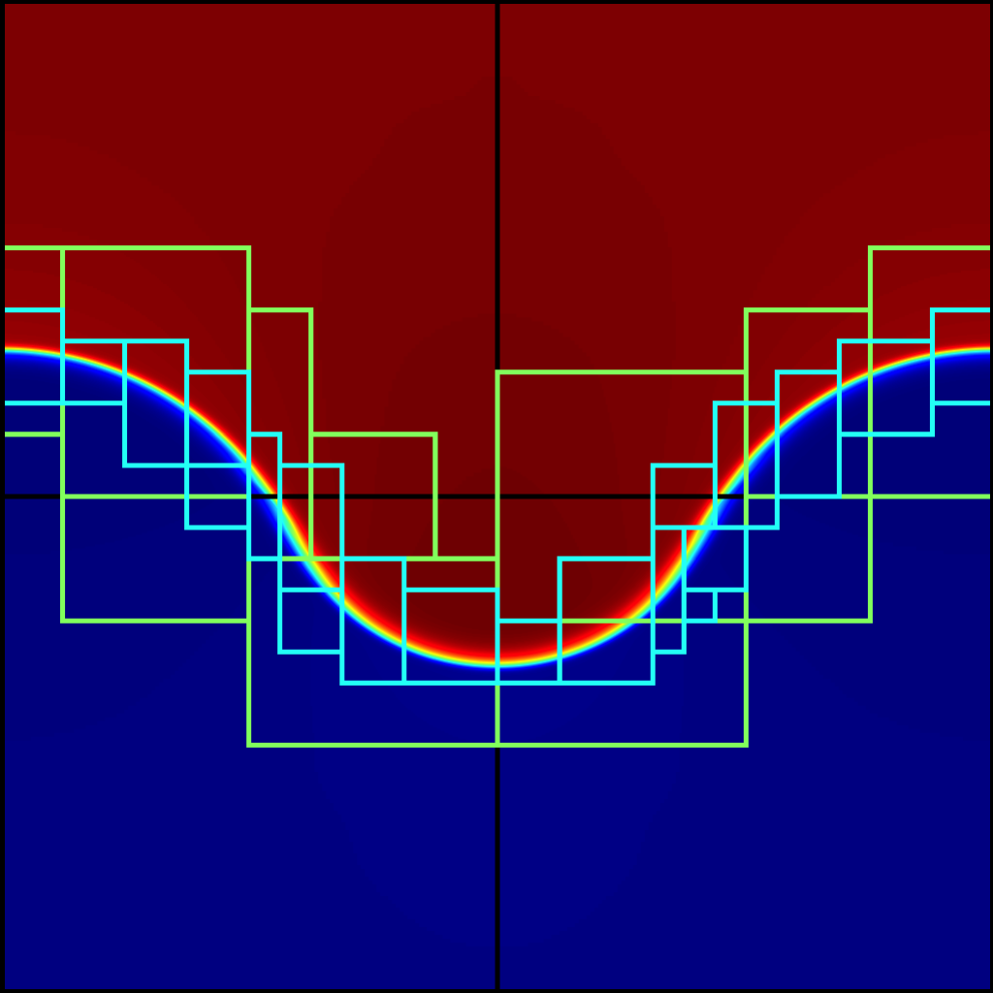
Nearest-neighbor Communication
One of the most important communication patterns, appearing in many scientific applications, such as HPGMG, Boxlib, GTCP, LAMMPS, CoMD, MILc, Luesh, etc.
HPGMG
Boxlib

Slide 3
Typical MPI Implementation
Using point-to-point communication
Data are aggregated so at most one message between a pair of processes for better performance
Packing/Unpacking
Often implemented with:
Non-blocking functions
Overlap packing / unpacking and local computation with data communication
Fit well with two-sided MPI messages

Slide 4
Questions
With the arrival of MPI3 RMA, can MPI one-sided outperform the commonly used two-sided implementations ?
How about UPC++, which also implements the one-sided message and supports Partitioned Global Address Space (PGAS) and Active Messages (AM) ?

Slide 5
Outline
Differences between two-sided messages and one-sided messages
Differences between MPI one-sided and UPC++
Application performance
GTC-P
Boxlib

Slide 6
MPI Two-sided vs. MPI One-sided
Message Information
Two-sided: sender knows source information, receiver knows destination information
One-sided: message initiator knows both source and destination information
Synchronization
Two-sided: Implicit synchronization, one sender matching one receiver
One-sided: Separates data transfer and synchronization, explicit synchronization

Slide 7
One-sided Advantage
Two-sided
One-sided
Source Destination
Source Destination
Send
Put
Receive
N messages
Send
Receive
Synchronization
Receiver has to match N sends with N receives
Receiver only needs to be involved at synchronization point
Sender can control the message sizes

Slide 8
MPI One-sided API (subset)
Create a window object
MPI_Win_create(base, size, …, win)
MPI_Win_create_dynamic (win)
Data Transfer:
MPI_Put : non-blocking
MPI_Put ( origin_addr, origin_count, origin_type
target, target_disp, target_count, target_type, win)
Synchronization (win based)
MPI_Win_fence
MPI_PSCW (Post + Start + Complete + Wait)
MPI_Win_lock/MPI_in_unlock

Slide 9
UPC++
Supports Partitioned Global Address Space (PGAS)
Global pointer : global_ptr<double> gp
Data transfer
async_copy(src, dest, count)
async_copy_and_signal(src, dest, count, event…)
Synchronization
Global data (spin-waiting)
remote task execution
async(remote, *event)(func, args)
Barrier

Slide 10
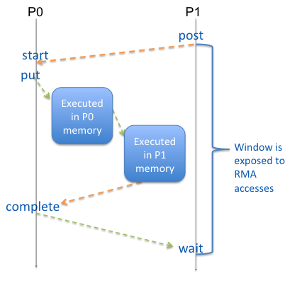
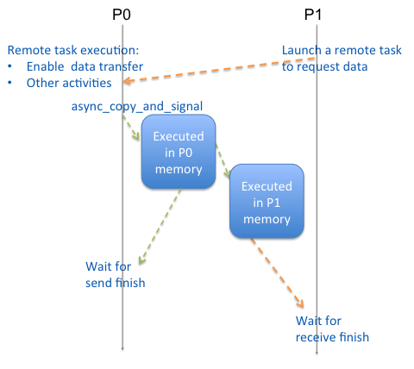
MPI (PSCW) vs. UPC++
MPI (PSCW) Remote Task
Parameters

Slide 11
Applications
GTC-P
Communicate with left and right neighbors
Large message size
Boxlib
Dynamic nearest neighbor communication
All message initiators have to collect destination info before the data transfer

Slide 12
Approach
Focus on the communication only
GTC-P shift
Boxlib FillBoundary
Replace MPI two sided calls with MPI one-sided or UPC++ API, optimize where applicable

Slide 13
Gyrokinetic Toroidal Code (GTC-P)
A particle-in-cell (PIC) code that solves the five-dimensional (5D) gyrokinetic Vlasov-Poisson equation in full, global torus geometry to address turbulence issues in tokamaks
Domain partitioned in both zeta and psi direction
Particles (electrons and ions) following the same partition in zeta direction
Network performance becomes increasingly important for the overall performance

Slide 14
Communication Pattern (shift)
Focus on particle movement, mainly in zeta direction and only across a few subdomains
Communicate with left and right neighbors only

Slide 15
MPI Two-sided Implementation
Start position
Scan particle arrays from position start to compute “msendleft” and “msendright”
Exchange msendleft and msendright with left and right neighbors using MPI_Sendrecv
Pack particles into sendbuffer
Call MPI_Sendrecv to send data into recvbuffer
Unpack data from recvbuffer to the end of particle array
Particle Arrays
Particle Arrays
sendbuffer
recvbuffer
Particle Arrays
Start position

Slide 16
MPI One-sided Implementation
MPI Two-sided MPI One-sided
Scan particle arrays from position start to compute “msendleft” and “msendright”
Exchange msendleft and msendright with left and right neighbors using MPI_Sendrecv
Pack particles into sendbuffer
Call MPI_Sendrecv to send data into recvbuffer
Unpack data from recvbuffer to the end of particle array
1. MPI_Win_create(
recvbuffer, …., win)
2. Exchange displacements
3. Create send (sgroup) and receive (rgroup)
MPI_Win_post(rgroup, win)
MPI_Win_start(sgroup, win)
MPI_Put(left, disp))
MPI_Put(right, disp)
MPI_Win_complete(win)
MPI_Win_wait(win)

Slide 17
UPC++ Implementation
MPI One-sided UPC++
1. MPI_Win_create(
recvbuffer, …., win)
2. Exchange displacements
3. Create send (sgroup) and receive (rgroup)
1. Allocate sendbuffer, recvbuffer in global address space
2. Store shared_ptr in global variables
MPI_Win_post(rgroup, win)
MPI_Win_start(sgroup, win)
MPI_Put(left, disp))
MPI_Put(right, disp)
MPI_Win_complete(win)
MPI_Win_wait(win)
Async(left)(func)
Async(right)(func)
Async_copy(src, leftbuf, count)
Advance()
Async_copy(src, rightbuf, count)
Advance()
Async_wait()

Slide 18
GTC-P Shift Performance on Cori
Run with MPI+OpenMP
MPI One-sided scales worse than MPI two-sided
UPC++ scales best

Slide 19
Time Breakdown for Case 256*8
 | Packing (s) | Comm (s) | Unpacking (s) | Imbalance (s) | Total (s)
MPI (Two-sided) | 17.2 | 39.0 | 4.9 | 24.2 | 85.3
MPI (One-sided) | 17.2 | 54.3 | 4.9 | 16.0 | 92.5
UPC++ | 18.8 | 18.4 | 7.2 | 15.1 | 59.4
Main difference lies in communication time
In UPC++, after the data transfer, advance() is called to push the data onto network immediately

Slide 20
One-sided Optimization
Directly send data from source to destination
Apply message pipelining to overlap packing and data transfer
sendbuffer
SendBuffer
recvbuffer
Particle Arrays
Particle Arrays
Particle Arrays
Particle Arrays

Slide 21
Time Breakdown (GTC-P, 256x8)
 | Packing (s) | Comm (s) | Unpacking (s) | Imbalance (s) | Total (s)
MPI (Two-sided) | 17.2 | 39.0 | 4.9 | 24.2 | 85.3
MPI (One-sided) | 17.2 | 54.3 | 4.9 | 16.0 | 92.5
UPC++ | 18.8 | 18.4 | 7.2 | 15.1 | 59.4
 | Packing + Comm (s) | Unpacking (s) | Imbalance (s) | Total (s)
MPI (One-sided, pipeline) | 58.2 | 0 | 15.6 | 73.7
UPC++ (pipeline) | 34.8 | 0 | 14.8 | 49.6

Slide 22
Improved Performance (shift)
With message pipelining and no unpacking, MPI one-sided now outperforms MPI two-sided
UPC++ still performs best, 1.6-1.9X better than two-sided

Slide 23
Improved Performance (Total)
UPC++ performs about 20% better than MPI two-sided for total running times

Slide 24
Boxlib
An adaptive mesh refinement software framework for solving hyperbolic, parabolic and elliptic PDEs on a hierarchy of block-structured grids.
Finer level composed of union of regular subgrids but the union may be irregular
Total together more than 300,000 lines of C++, Fortran, and C.
The main communication routines are packaged in a single file, enabling incremental changes

Slide 25
Communication Pattern (FillBoundary)
Nearest-neighbor Communication pattern needed:
Between levels
Neighbors within the same level
Calculate the receiving data size and allocate the receive buffer
For each receiving neighbor, call MPI_Irecv
For each sending neighbor, pack the data into sending buffer and call MPI_Isend
Perform local work
Call MPI_Waitall()
Unpack the receiver buffer

Slide 26
One-sided Implementation
Dynamic communication buffer
MPI Two-sided: not a problem
MPI One-sided:
Using mpi two-sided to exchange info
MPI_Put
Using MPI_Win_PSCW synchronization
UPC++
Using remote task execution to synchronize
Target address can be carried as func parameters
Async_copy_and_signal

Slide 27
Performance On Cori (Boxlib)
MPI One-sided performs better than two-sided
UPC++ performs best

Slide 28
Performance Characteristics (Boxlib)
 | Packing | Sending | Waiting | Local | Unpacking | Exchange | Total (s)
MPI (Two-sided) | 0.77 | 0.20 | 14.29 | 0.48 | 1.57 | N/A | 19.4
MPI (One-sided) | 0.93 | 2.93 | 7.50 | 0.55 | 0.62 | 2.80 | 14.40
UPC++ | 0.69 | 3.56 | 3.60 | 0.49 | 0.73 | N/A | 10.50
MPI Two-sided: dominating by “Waiting”
MPI One-sided: higher sending time, mainly due to exchange
UPC++: higher sending time but best waiting time

Slide 29
Summary
Applied MPI one-sided messages and UPC++ two production codes, GTC-P an Boxlib for which Nearest-Neighbor communication is dominated.
MPI one-sided delivers close or better (Boxlib, GTC-P with message pipelining) performance than MPI two-sided
UPC++ delivers best performance
Synchronization (using remote task)
Better overlap data transfer with local operations

