Slide 1
Designing, Implementing, and Evaluating the Upcoming OpenSHMEM Teams API
David Ozog, MD. Wasi-ur- Rahman, Gerard Taylor, James Dinan
Parallel Applications Workshop, Alternatives to MPI+X (PAW-ATM)
November 17, 2019

Slide 2
Legal Disclaimers
All information provided here is subject to change without notice. Contact your Intel representative to obtain the latest Intel product specifications and roadmaps. Intel provides these materials as-is, with no express or implied warranties.
This document contains information on products in the design phase of development which Intel may change at any time without notice. Do not finalize a design with this information. Results have been estimated or simulated using internal Intel analysis or architecture simulation or modeling, and provided to you for informational purposes. Any differences in your system hardware, software or configuration may affect your actual performance. For more complete information about performance and benchmark results, visit www.intel.com/benchmarks.
Intel® , Intel logo and Xeon® are trademarks or registered trademarks of Intel Corporation or its subsidiaries in the U.S. and/or other countries. Other names and brands may be claimed as the property of others.
Intel technologies' features and benefits depend on system configuration and may require enabled hardware, software or service activation. Performance varies depending on system configuration. No computer system can be absolutely secure. Check with your system manufacturer or retailer or learn more at [intel.com].
The products described may contain design defects or errors known as errata which may cause the product to deviate from published specifications. Current characterized errata are available on request.
WARNING - This document contains technical data whose export is restricted by the Arms Export Control Act (Title 22, U.S.C., Sec 2751, etq.) or the Export Administration Act of 1979, as amended, Title 50, U.S.C., App. 2401 et seq. Violations of these export laws are subject to severe criminal penalties. Disseminate in accordance with provisions of DoD Directive 5230.25.
This document contains information on products in the design phase of development which Intel may change at any time without notice. Do not finalize a design with this information. Results have been estimated or simulated using internal Intel analysis or architecture simulation or modeling, and provided to you for informational purposes. Any differences in your system hardware, software or configuration may affect your actual performance. For more complete information about performance and benchmark results, visit www.intel.com/benchmarks.
Copyright © 2019 Intel Corporation.

Slide 3
Optimization Notice
Optimization Notice
Intel's compilers may or may not optimize to the same degree for non-Intel microprocessors for optimizations that are not unique to Intel microprocessors. These optimizations include SSE2, SSE3, and SSE3 instruction sets and other optimizations. Intel does not guarantee the availability, functionality, or effectiveness of any optimization on microprocessors not manufactured by Intel. Microprocessor-dependent optimizations in this product are intended for use with Intel microprocessors. Certain optimizations not specific to Intel microarchitecture are reserved for Intel microprocessors. Please refer to the applicable product User and Reference Guides for more information regarding the specific instruction sets covered by this notice. Notice revision #20110804
Software and workloads used in performance tests may have been optimized for performance only on Intel microprocessors.
Performance tests, such as SYSmark and MobileMark, are measured using specific computer systems, components, software, operations and functions. Any change to any of those factors may cause the results to vary. You should consult other information and performance tests to assist you in fully evaluating your contemplated purchases, including the performance of that product when combined with other products. For more complete information visit www.intel.com/benchmarks.
Test and System Configurations: Sandia OpenSHMEM running on Diamond cluster (Intel® Omni-Path 100 Series, Intel® Xeon Platinum 8170 (Skylake), and Cori, Intel®Xeon E5-2698 v3 (Haswell)
Performance results are based on testing as of Sept 19, 2019 and may not reflect all publicly available security updates. See configuration disclosure for details. No component or product can be absolutely secure.

Slide 4
Introduction to OpenSHMEM
PE 0
PE 1
PE N
Open standard PGAS model
Emphasizes one-sided operations (put/get, atomics)
Symmetric memory exposed for remote access
Collective Operations:
Barrier, broadcast, collect, reductions, all-to-all, etc.
Symmetric Data
Symmetric Data
Symmetric Data
Symmetric Heap
Symmetric Heap
Symmetric Heap
Remotely Accessible
…
Private Data
Private Data
Private Data

Slide 5
Teams - Motivation
0
0
1
1
2
2
3
3
4
4
5
5
6
6
7
7
8
8
9
PEs:
9

Slide 6
Teams - Motivation
PEs:
0
1
2
3
4
5
6
7
8
9

Slide 7
Teams - Motivation
0
1
2
3
4
5
6
7
8
9
0
2
4
6
8
1
3
5
7
9

Slide 8
Teams - Motivation
0
1
2
3
4
5
6
7
8
9
World ID space:
0
2
4
6
8
1
3
5
7
9
World ID space
Team ID space:
0
1
2
3
4
0
1
2
3
4
Team ID space:

Slide 9
Teams - Motivation
0
1
2
3
4
5
6
7
8
9
World ID space:
0
2
4
6
8
1
3
5
7
9
World ID space
Team ID space:
0
1
2
3
4
0
1
2
3
4
Team ID space:
Independent Operations:
Synchronizations
Reductions
All-to-All’s
Context creations
Independent Operations:
Synchronizations
Reductions
All-to-All’s
Context creations

Slide 10
Teams – Some Motivating Examples
Shared Memory Teams
Pipelining / Rings
Team 1
Pre-Process
Team 2
Process
Team 3
Post-Process
Multi-node Application
Node 1
Node 2
Node 3
Local
Team
Local
Team
Local
Team
Useful Topologies (like Cartesian)
Y-axis Teams
Leaders Team
X-axis
Teams
3rd Party Library management
Parallel HDF5, ADIOS, PETSc, etc.

Slide 11
OpenSHMEM Collectives APIs
Current Version 1.4:
Active set based: if (start, log_stride, size) == (3, 1, 4), then the active PEs are {3, 5, 7, 9}.
User supplies a “pSync” array: used for explicit synchronization control.
OpenSHMEM Teams proposal (version 1.5):
The “active set” is specific to a team – defined during team creation.
No more pSync exposure – managed by the implementation.
void shmem_broadcast32(void *dest, const void *source, size_t nelems,
int PE_root, int PE_start, int logPE_stride, int PE_size, long *pSync);
int shmem_broadcast(shmem_team_t parent_team, TYPE *dest, const TYPE *source, size_t nelems, int PE_root);

Slide 12
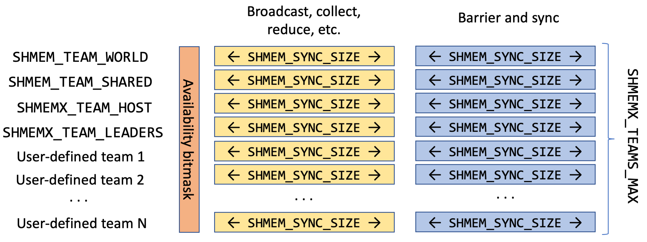
pSync Allocation and Management
pSync/pWrk allocation done at initialization.
A bitmask dictates which teams utilizes a particular pSync/pWrk region.
Team creation bottleneck becomes an AND reduction across the bitmask.
Can have any number of psyncs for back-to-back collectives)

Slide 13
Team creation via team_split_strided
int shmem_team_split_strided(shmem_team_t parent_team,
int start, int stride, int size,
shmem_team_config_t *config, long config_mask, shmem_team_t *new_team);
Always collective on the parent team.
If a PE is outside the (child) active set, call an internal barrier.
If PE is inside the (child) active set, agree on a pSync via an AND reduction.
Set the determined pSync reservation bit to 1, update team pool pointer.
Finish parent barrier.

Slide 14
Teams Sharing Memory
Iterate over all PE numbers and check shmem_ptr()
shmem_ptr() returns NULL if PE’s address is inaccessible.
For each PE, check that the stride stays consistent.
Certain teams not representable via a triplet, like {0, 1, 2, 4}.
If inconsistent, we give up and set SHMEM_TEAM_SHARED to the self PE.
Various alternative teams possible:
PEs sharing a hostname
PEs sharing a NUMA domain
PEs within a topological fabric group
Multi-node Application
Node 1
Node 2
Node 3
TEAM SHARED
TEAM SHARED
TEAM SHARED
Leaders Team

Slide 15
Performance Experiments
Cori at NERSC:
Cray XC40, Intel®Xeon E5-2698 v3 (Haswell), 64 Hyper-Threaded cores per node, Cray Aries with dragonfly, GNU GCC version 8.2.0, libfabric version 1.8.x with the GNI provider.
Diamond at Intel:
Intel® Xeon® Platinum 8170 (Skylake), 104 Hyper-Threaded cores per node, Intel® Omni-Path 100 series fabric with fat-tree, GNU GCC 4.8.5, libfabric version 1.7.0 with the PSM2 provider.
OSU sum reduction microbenchmark
Reduce across SHMEM_TEAM_SHARED, then across SHMEM_TEAM_LEADERS.
Ring
Reduce-Scatter followed by all-gather
Bandwidth optimized
Recursive Doubling
Series of pairwise transfers between PE’s with powers of 2
Latency optimized

Slide 16
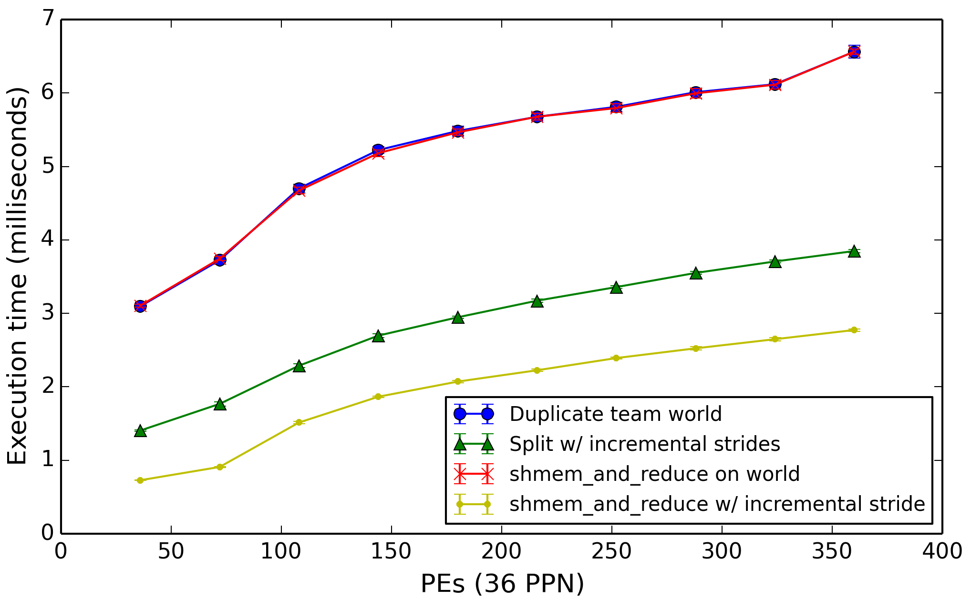
Team Creation Latency Experiment
64 team creations (max supported) per iteration
1000 iterations – average time measured
Blue – TEAM_WORLD “duplicate” split
Red – reduction across TEAM_WORLD
Green – TEAM_WORLD “halve” split
1st split = {0, 1, 2, 3, …, N} (size=N)
2nd split = {0, 2, 4, …, ~N}. (size=N/2)
3rd split = {0, 4, 8, …, ~N} (size=N/4) etc.
Yellow – reduction across the “halved” teams

Slide 17
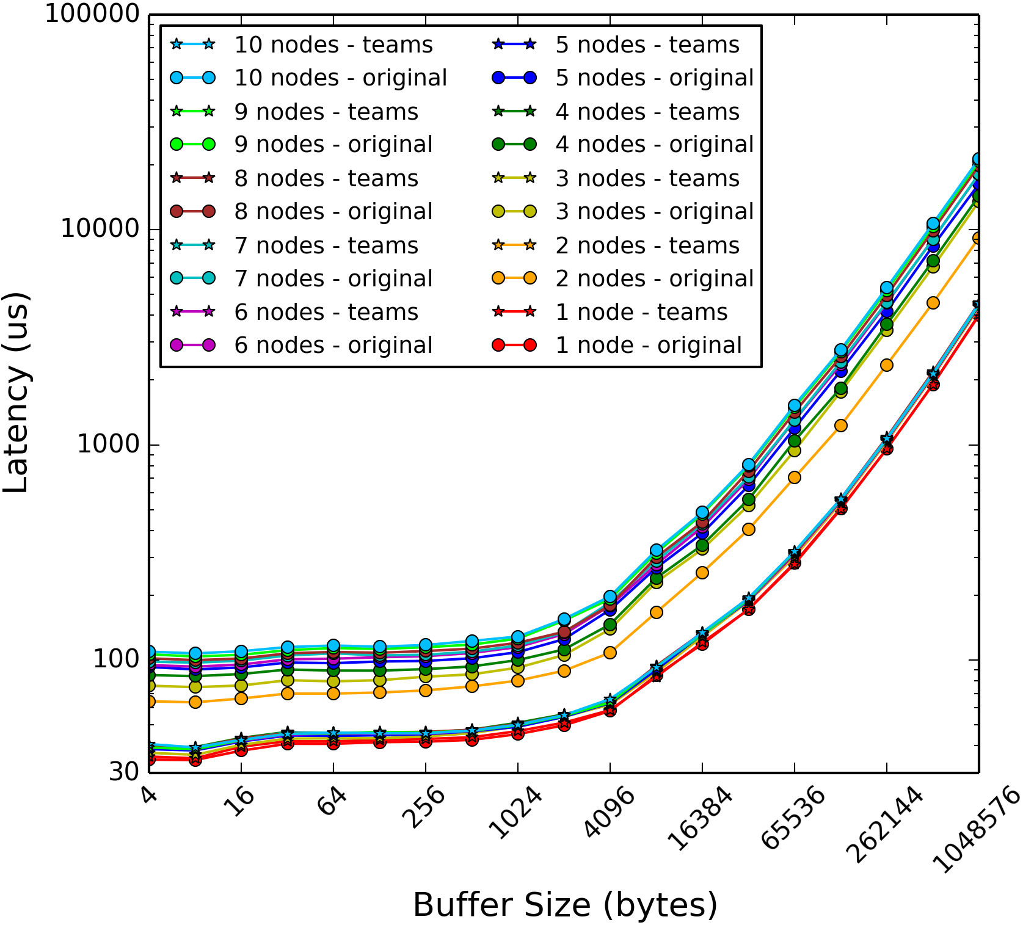
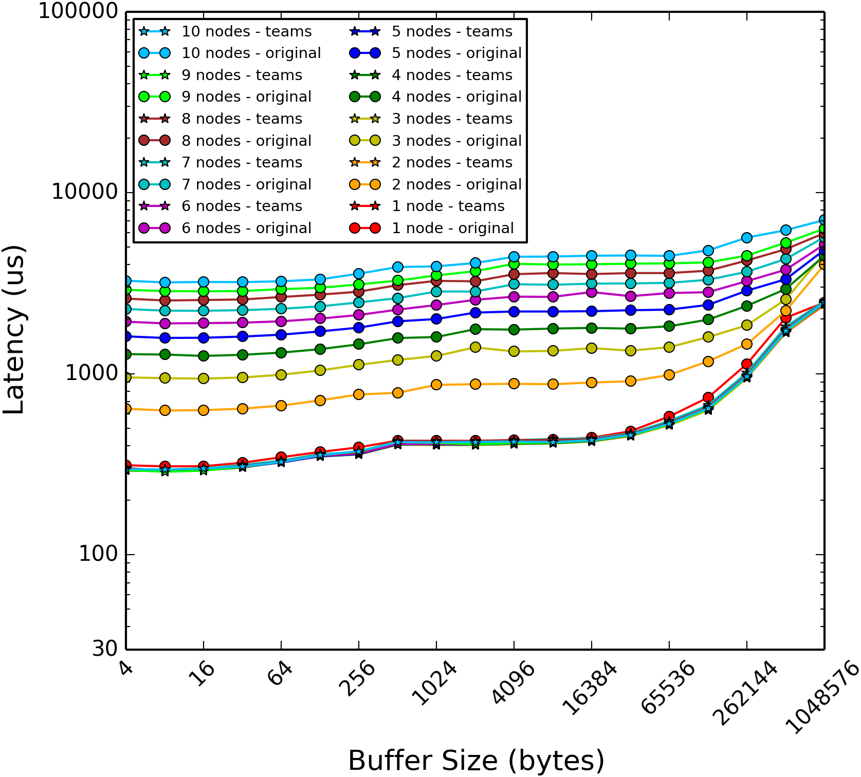
Diamond Sum-Reduction Measurements
Recursive Doubling Ring

Slide 18
Diamond Sum-Reduction Measurements
Recursive Doubling Ring
Original Version
nodes
Original Version
Teams Version
Teams Version

Slide 19
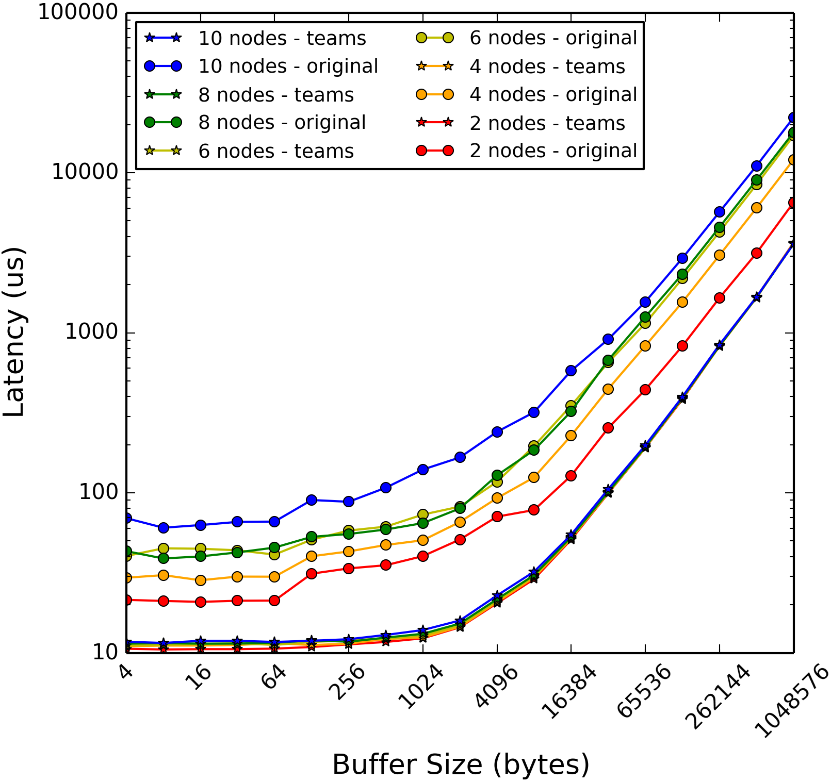
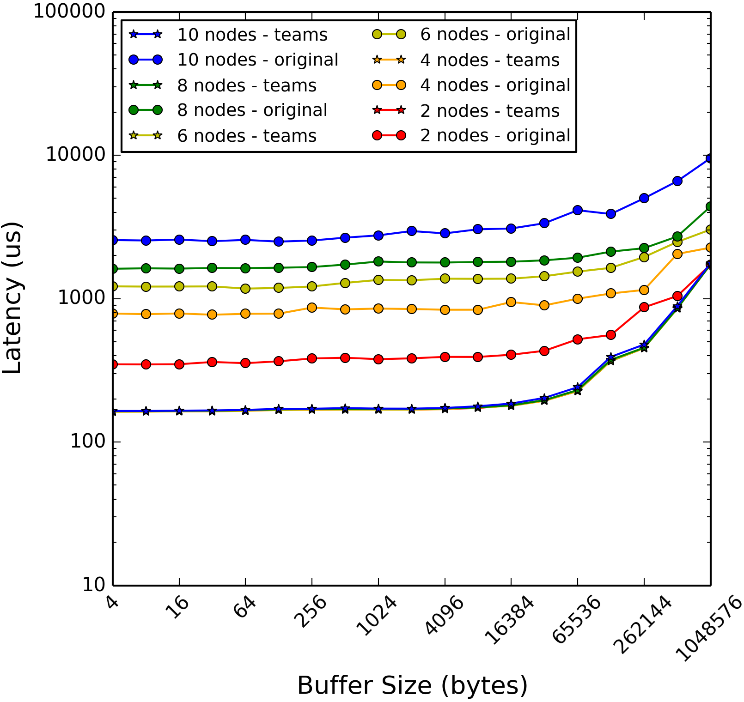
Cori Sum-Reduction Measurements
Recursive Doubling Ring

Slide 20
Cori Sum-Reduction Measurements
Recursive Doubling Ring
Original Version
nodes
Original Version
Teams Version
Teams Version

Slide 21
Conclusion
The OpenSHMEM Teams API is impactful for applications: easier decomposition, better locality, simpler collectives usage.
The latest API is implementable and shows good performance characteristics.
From the experiments:
Team creation is dominated by a reduction.
Both bandwidth-optimized (ring) and latency optimized (rec. dbl.) algorithms benefit from team-based shared memory reduction.
This code is under review within the SOS topic/teams branch:
https://github.com/Sandia-OpenSHMEM/SOS/pull/886
Status:
Recently ratified by the specification committee – will be released in v1.5.

Slide 22
Future Work
Support non-triplet (set-based) teams?
More general support for SHMEM_TEAM_SHARED.
May enable topological optimizations.
Various teams-related extensions:
Memory Spaces
Teams-based memory allocation
Different traits for different memories
Atomicity domains
Isolate atomic operations to within a team (or team hierarchy)

Slide 24
Outline
Introduction / Overview to OpenSHMEM library and Teams API
Motivation
Examples of teams usage
Design
pSync management
Team creation
Pre-defined teams
SHMEM_TEAM_WORLD, SHMEM_TEAM_SHARED, etc.
Performance Experiments
Team creation latency
Sum reduction (OSU microbenchmark) with shared-memory teams (Ring vs. recursive doubling)
Conclusion / Future Work

Slide 25
Design – internal team type
shmem_internal_team_t {
int my_pe;
int start, stride, size;
size_t psync_idx;
int psync_avail[N_PSYNCS_PER_TEAM];
shmemx_team_config_t config;
long config_mask;
size_t contexts_len;
struct shmem_transport_ctx_t **contexts;
}

Slide 26
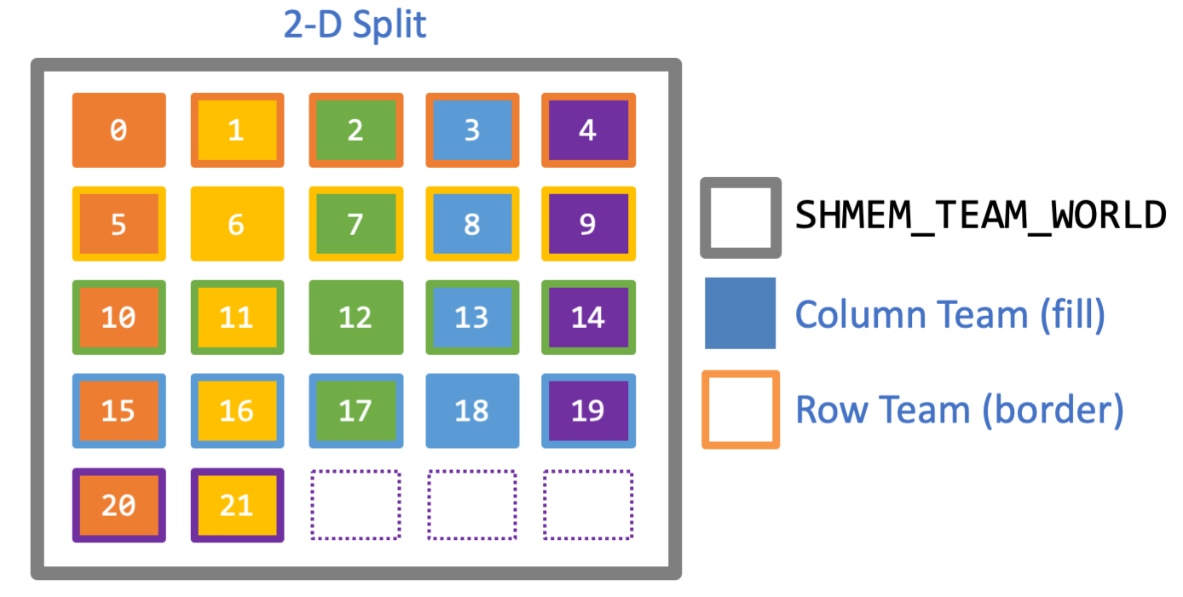
Design – 2D split
A valid parent and triplet passed to team_split_strided always results in a valid child team/triplet (start, stride, size).
Consider 2D split:
Assume we start with a valid parent team (i.e., a valid triplet).
xteams always have “original” stride.
yteams always have uniform stride w/ the # of columns.
☞ x and y teams may always be split via team_split_strided.

Slide 27
Design - Contexts
Context management:
Context management is cribbed from the SOS transport layer.
User-defined teams start with zero contexts, and realloc’s (in chunks of 128) contexts during ctx_create.
SOS doesn’t (yet) make use of NUM_CONTEXTS…
The teams API seems to change little with regard to SOS contexts… except:
The default context is associated with the SHMEM_TEAM_WORLD object.
Each team contains an array of pointers to its contexts.
All the shareable contexts are destroyed during team_destroy.
ctx-based RMAs and AMOs translate the target PE ID to the global ID (an FMA).

Slide 28
Pre-Defined Teams
SHMEM_TEAM_WORLD
SHMEM_TEAM_SHARED
Check for valid triplet, otherwise only self PE
SHMEMX_TEAM_HOST
Using PMIx or SOS node utility, finds all PEs that share the same hostname
SHMEMX_TEAM_LEADERS
Consists of the 1st PE in each host team

