Slide 1
Development and Performance Comparison of MPI and Fortran Coarrays within an Atmospheric Research Model
Soren Rasmussen with Ethan D Gutmann, Brian Friesen, Damian Rouson, Salvatore Filippone, Irene Moulitsas
11.16.2018

Slide 2
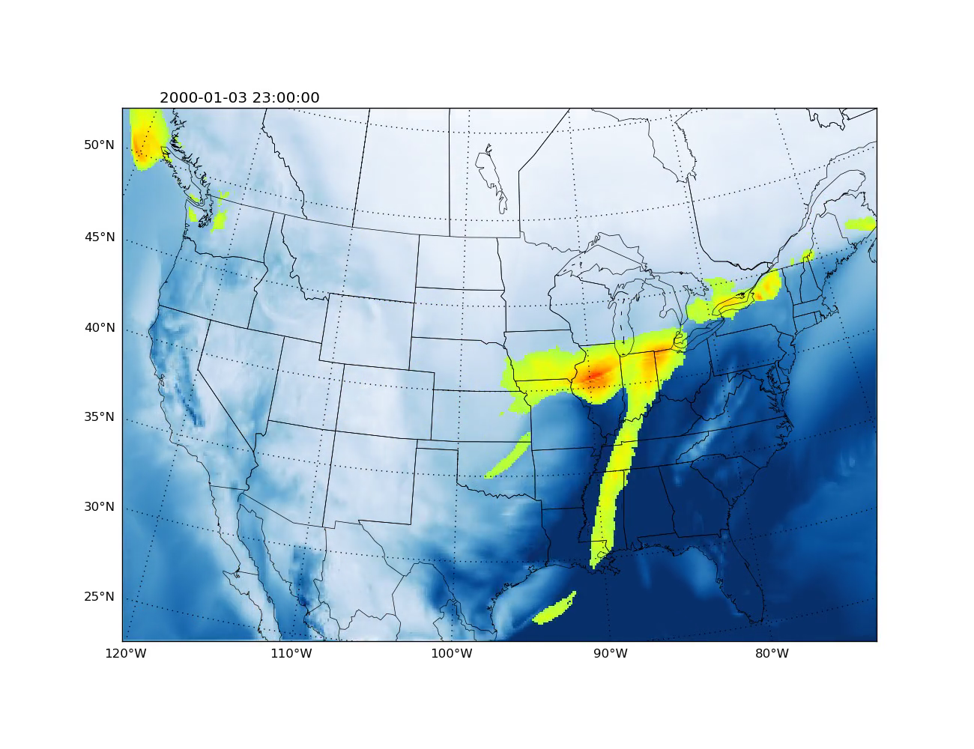
Motivation and Background
Fortran Coarrays: an alternative to MPI
Parallel syntax in the Fortran standard
Partitioned global address space (PGAS)
Like MPI, Coarrays is SPMD
Application
Mini-app of the Intermediate Complexity Atmospheric Research (ICAR) model
Simplified atmospheric model that does high-resolution meteorological simulations

Slide 3
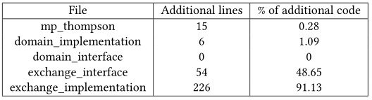
Programmability: communicating boundary regions
Coarray
east_halo(1:halo_size,:,:) [west_neighbor] = A(start : start + halo_size, :, :)
MPI
call MPI_Type_create_subarray(ndims, sizes, subsizes, starts, order, oldtype, newType,ierr)
call MPI_Isend(A(start:start+halo_size, :, :), length, newType, west_neighbor, tag, MPI_COMM_WORLD, send_request, ierr)
call MPI_Irecv(east_halo(1:halo_size,:,:), length, newType, east_neighbor, tag, MPI_COMM_WORLD, & recv_request, status, ierr)
call MPI_Wait(request, status, ierr)
Additional MPI Lines

Slide 4
Resources
Hardware and Software
National Center for Atmospheric Research’s (NCAR) Cheyenne, a SGI ICE XA Cluster.
4032 computation nodes, each node is dual socket with 2.3-Ghz Intel Xeon E5-2697V4 processors. Mellanox EDR Infiniband interconnect with a partial 9D Enhanced Hypercube single-plane topology.
GNU gfortran 6.3 with OpenCoarrays 1.9.4 using MPI and OpenSHMEM communication layers.
Lawrence Berkeley National Laboratory’s (LBNL) Cori, a Cray XC40
12,076 total compute nodes, 9688 of them are single-socket, 68-core Intel Xeon Phi Processor 7250 ("Knight’s Landing") at 1.4 GHz.
Cray Compiling Environment (CCE) 8.7.1.

Slide 5
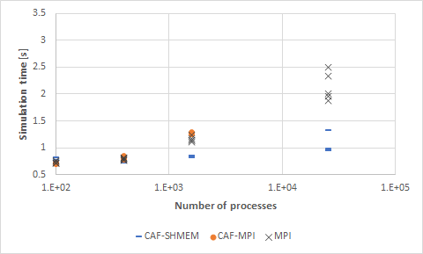
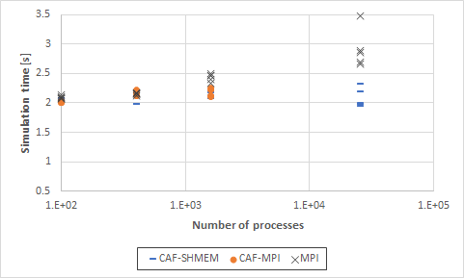
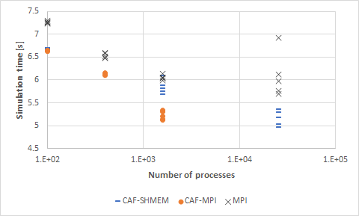
Results
Weak Scaling for Cheyenne
Up to 25,600 processes
25 points per process
100 points per process
400 points per process

Slide 6
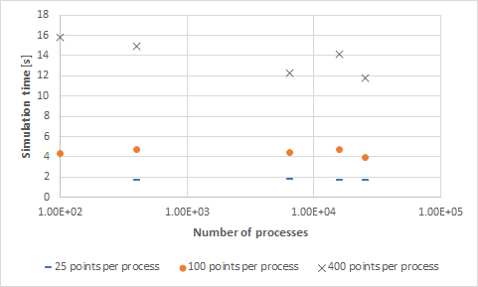
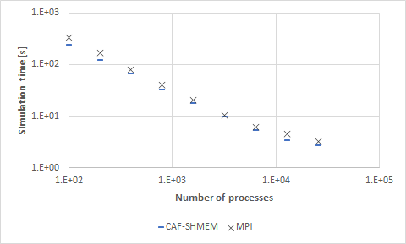
Results
Weak Scaling for Cray on Cori Cheyenne Strong Scaling

Slide 7
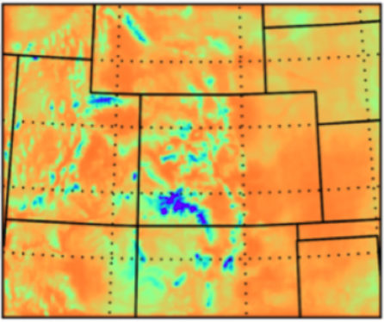
Conclusions and Future Work
CAF OpenSHMEM outperformed MPI version
No extra coding to switch OpenCoarray backend
MPI Coarray backend initialization time at 2,000 processes is an hour, 3,000 exceeds 12 hour limit
91% more code needed by MPI in communication file
Future Work
Strong scaling with CAF-MPI and on Cori
Implement OpenCoarrays on Cray for direct comparisons
Investigate CAF-MPI at higher process counts
Add MPI Cartesian topology model

Slide 8
Results
Acknowledgements
Based on work supported by NSF’s National Center for Atmospheric Research (NCAR)
The National Energy Research Scientific Computing Center (NERSC)
Fellowship sponsored by Sourcery Institute

