Slide 1

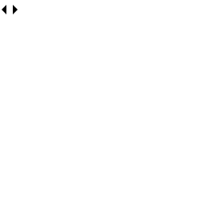
^(\w+)@(\w+)\.com$
DSA 0305 - NLP
Regular Expressions for
Real-World Text Processing
Pattern matching as a practical tool for cleaning, extracting, and structuring text in NLP pipelines.
B Rakesh – 192425241

Slide 2

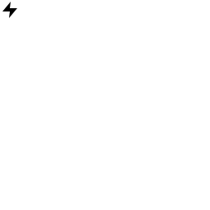
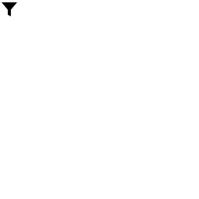

Core Building Blocks
A small set of metacharacters covers most real-world patterns.
\d \w \s
* + ?
Digit, word character, whitespace — the basic character classes
Zero-or-more, one-or-more, optional — quantify repetition
[ ] ( )
^ $ \b
Character sets and capturing groups for structured extraction
Anchors that pin a match to a position: start, end, word boundary
pattern = r'\b[A-Za-z]+\d{2,4}\b' matches: "user23", "log2024"

Slide 3
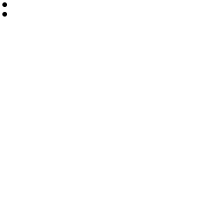
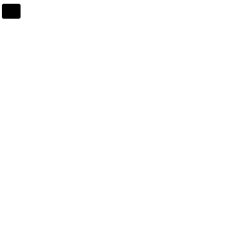


Where Regex Shows Up in NLP Pipelines
Before statistical or neural models ever see text, regex handles the messy first pass.
Tokenization & Cleaning
Entity Extraction
Split on whitespace/punctuation, strip HTML tags, normalize repeated characters.
Pull emails, phone numbers, URLs, and dates out of unstructured text.
re.sub(r'<[^>]+>', '', html)
re.findall(r'[\w.+-]+@[\w-]+\.\w+', txt)
PII Redaction
Validation & Normalization
Detect and mask sensitive identifiers before text enters a model.
Confirm well-formed input and standardize casing, whitespace, or IDs.
re.sub(r'\d{3}-\d{2}-\d{4}', '[SSN]', t)
re.match(r'^[A-Z]{2}\d{6}$', code)

Slide 4
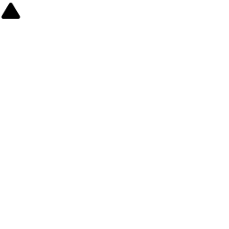
Using Regex Well in Practice
Powerful, but easy to misuse on messy, real-world corpora.
Good Practice
Common Pitfalls
Compile patterns once and reuse them in loops
Use raw strings (r'...') so backslashes stay literal
Prefer named groups (?P<year>\d{4}) for readability
Test against edge cases: empty strings, unicode, casing
Reach for an NLP tokenizer once patterns get too complex
Greedy .* matching far more than intended
Trying to fully parse HTML/XML with regex alone
Ignoring unicode letters, accents, or non-ASCII scripts
Catastrophic backtracking on nested quantifiers
Hard-coding patterns that don't generalize across a corpus

