Slide 1
Low-Level Gamma Counting
introduction
common materials
shield configurations
discussion of secondary radiation
contributions from impurities in shielding material
location of external radiation sources and detector
active shielding
radioactive materials in detector structure
cosmic Radiation
summary

Slide 2
Introduction
shielding from external radiation sources is a must for low-level measurements
significant background sources are:
  cosmic radiation
  traces of natural radioactivity in building materials and in soil
  nearby radiation sources and nuclear facilities

Slide 3
Common Materials
lead is frequently used to shield gamma counters from external radiation sources
high density and large atomic number ⇒ need relatively little material to achieve acceptable attenuation effects

Slide 4
Common Materials
generally used in brick form—stacked in courses
to keep radiation from leaking through cracks and seams:
  use multiple layers
  use bricks of interlocking geometries
Pb is fairly easy to cast into solid shapes

Slide 5
Common Materials
some shields are made from containers which are filled with lead shot
such shields are of lower density than lead bricks ⇒ need more of this material to shield for low-level analysis

Slide 6
Common Materials
less expensive alternative is steel
since steel is less dense and has a lower atomic number than lead, more steel than lead must be used to shield in low-level applications
as a cost/benefit trade-off, a steel sheet with a lead liner is generally used in situations where lead alone would be too costly

Slide 7
Common Materials
steel produced before ~ 1950 has much less intrinsic activity than new steel ⇒ old steel is better for shielding applications
in the 1950’s ⁶⁰Co was frequently injected into blast furnaces to study the erosion of the furnace liner

Slide 8
Common Materials
concrete is also frequently used as a radiation shield
  good for large-volume shielding situations.
  fairly inexpensive
  regular concrete is composed of low Z materials
for shielding applications, Barytes concrete is generally used- significant amount of heavier components than regular concrete

Slide 9
Common Materials
concrete often contains a large amount of activity.
  mostly from ⁴⁰K, uranium and nuclear fallout.
usually used as the outer layer in a shielding configuration.
  ⇒ its own activity is attenuated by the inner components of the shield.

Slide 10
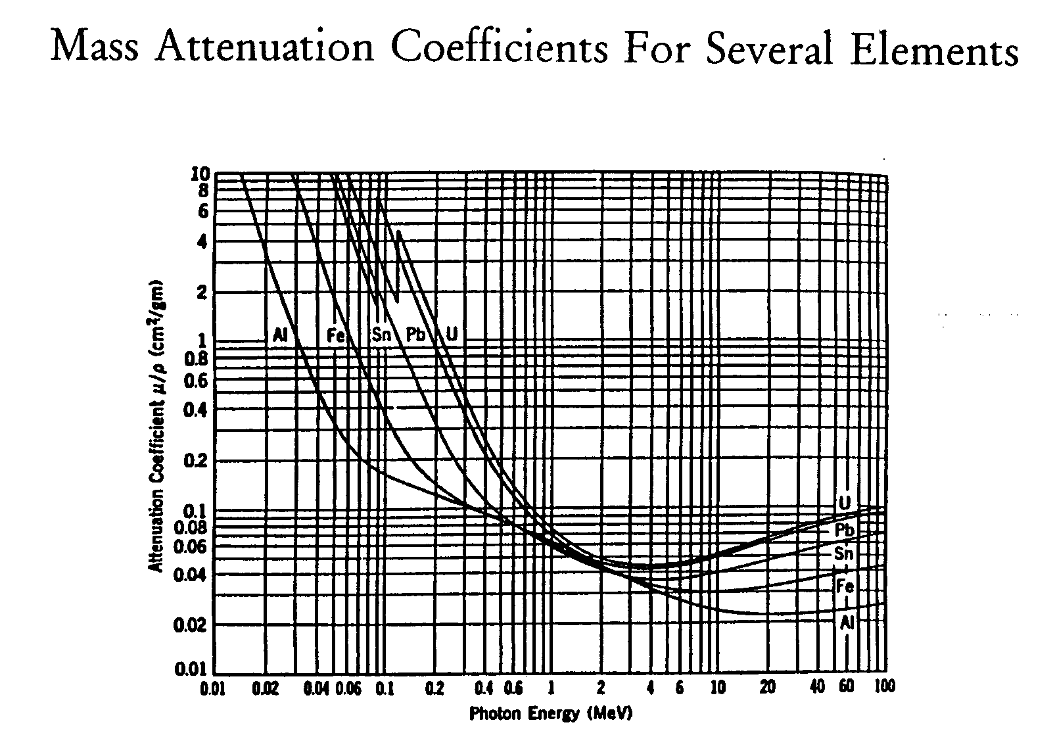

Slide 11
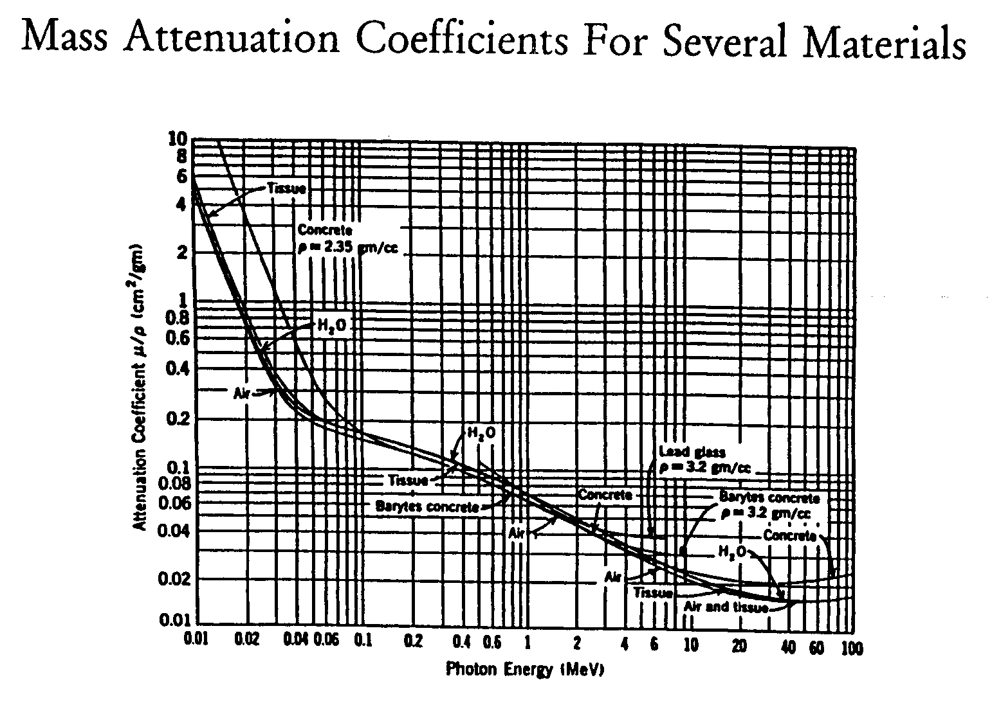

Slide 12
Shield Configurations
best shielding configuration is a “cave” (a.k.a. “castle” or “house”)
this is a shielding arrangement which completely encloses the entire detection system, including the dewar assembly

Slide 13
Shield Configurations
to save money and to account for the limited load capacity of some floors, smaller cave arrangements can be built
in this case, special care should be taken to ensure that entire detector arm is well shielded from external radiation sources

Slide 14
Shield Configurations
shield thickness depends mostly upon:
  strength of surrounding radiation field.
  degree to which environmental radiation must be attenuated (varies with application)
recommended lead shield thickness is 5- 10 cm

Slide 15
Secondary Radiation
when designing a cave, its walls should not be too close to the detector or the source.
when a source photon hits the shielding material it is possible to produce Compton-scattered photons, adding substantially to the overall count rate.

Slide 16
Secondary Radiation
by increasing the distance from the wall to the source/detector a smaller fraction of secondary photons will reach the detector.
the recommended minimum distance between the wall and the detector/source is approximately 10 cm.

Slide 17
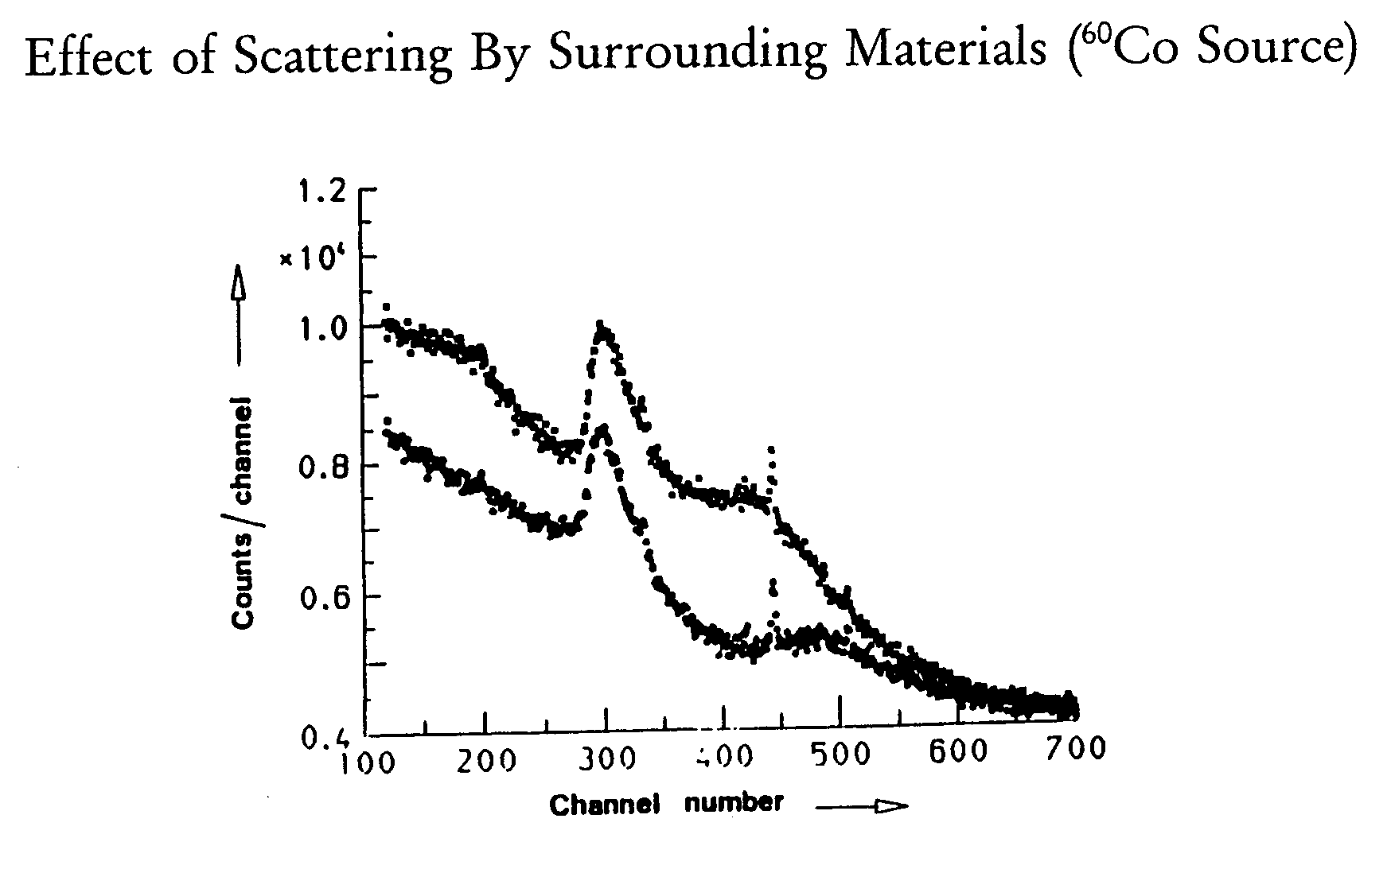

Slide 18
Secondary Radiation
bottom spectrum is ⁶⁰Co without a shield.
top spectrum is ⁶⁰Co with a lead brick located 1 cm behind it.
at high energies (≥ channel number 600) there is no major difference between the spectra.
below channel number 500, noticeable differences due to scattered radiation are evident.

Slide 19
Secondary Radiation
increasing the shield thickness does not necessarily result in a decrease in background radiation!
the amount of secondary radiation produced by cosmic rays is directly proportional to the mass of the shield
increasing shield mass results in a corresponding increase in secondary radiation.

Slide 20
Secondary Radiation
an additional source of background radiation is x-ray fluorescence in the shielding material.
  for a lead shield, x-ray energies are 12 keV and 80 keV.
  these x-rays can hinder the accurate examination of photons in a spectrum!
  to minimize these effects, the cave should be lined with a material which absorbs lead x-rays. In this case, a 1mm thick sheet of cadmium would be appropriate.

Slide 21
Secondary Radiation
x-rays will be produced in the cadmium liner!
a layer of 0.2 mm copper can be used to absorb the cadmium x-rays.
this will also reduce the energy from fluorescence-radiation to 8 keV.

Slide 22
Secondary Radiation
review:
always consider secondary radiations when selecting shielding materials
may have to use multiple layers of different materials, depending upon situation being examined
e.g.: if only one sheet of 5 mm thick iron was used (same attenuating effect as 1 mm thick Cd), there would be a large increase in Compton-scattered radiation

Slide 23
Secondary Radiation
one possible solution:
commercially available low-background lead shielding material can be used.
these are either made from very old sources of lead or specially refined to achieve a low activity level.
Pb which has been recently refined may show trace levels of contaminants from atmospheric fallout.

Slide 24
Contributions from Impurities in Shielding Material
background can come from radioactive impurities in the shielding material
typical lead shielding material contains:
  ²¹⁰Pb (46.5 keV γ-ray)
  ²¹⁰Bi (1161 keV β-ray)
shielding material may also contain slight amounts of ⁶⁰Co and ¹³⁷Cs, which may cause problems for some low-level measurements.
some samples of lead have shown activity levels of 1.5 Bq/g.

Slide 25
Contributions from Impurities in Shielding Material
to diminish the effects of these interactions, two layers of material should be used:
  a layer of paraffin to moderate the neutrons.
  a layer of cadmium (or other material with a high neutron absorption cross section) to eliminate the moderated neutrons.

Slide 26
Location of External Radiation Sources and Detector
location between external radiation sources and detector equipment is also a variable to be considered
e.g. an external neutron source can create additional gamma radiation through an (n, γ) reaction. If the neutrons are able to interact with the liquid nitrogen in the coolant dewar, some high-energy γ-rays can be produced

Slide 27
Active Shielding
to reduce background radiation even further, use active shielding methods
  active shielding methods ⇒ use of special materials when designing and building the detector structure
  are used to reduce background radiation from:
    surrounding materials.
    interaction of cosmic rays with material near the detector.
    materials which comprise the detection device.

Slide 28
Active Shielding
example of an active shield:
a Ge semiconductor detector is enclosed by an annular detector, which is operated in anti-coincidence mode
anti-coincidence ⇒ a pulse in the semiconductor detector is discounted when a coincident pulse is registered in the annular detector

Slide 29
Active Shielding
the following figure shows passive and active shields being used in a low-background detection system
in this case, the annular detector has been replaced by two NaI(Tl) detectors which are operated in anti-coincidence mode
the variety of passive shielding devices: lead for γ, borated paraffin for neutrons, etc

Slide 30
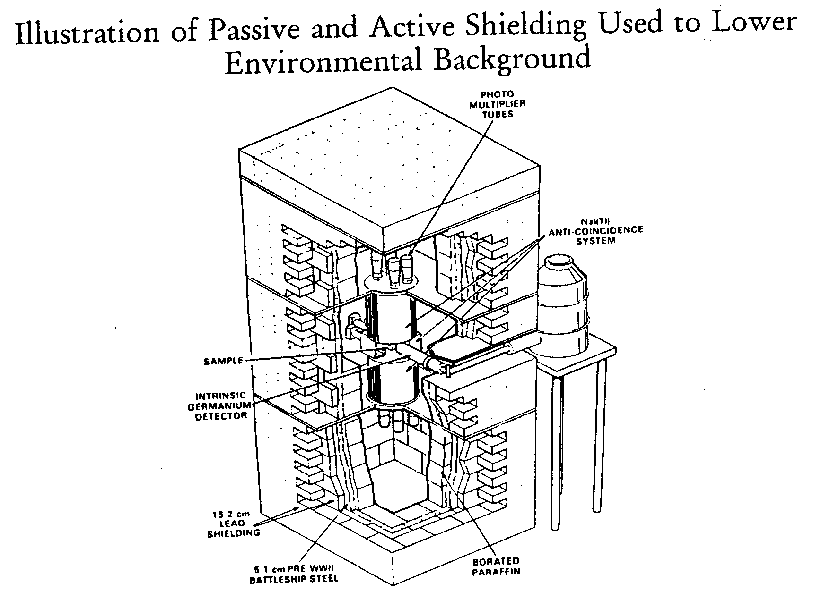

Slide 31
Active Shielding
an active shield will reduce interactions from external sources because these γ-rays will interact with the annular detector before hitting the semiconductor device. These interactions will then be discounted
the annular detector should be constructed from a thick and/or highly dense material to ensure a high probability of detection for interactions with background γ-rays

Slide 32
Active Shielding
active shielding also reduces Compton distribution in a spectrum
Compton event will be rejected by an anti- coincidence active shielding device.
the original photon interacts with the central detector and the Compton scattered photon is registered in the annular detector. The anti-coincidence system will discount this interaction!

Slide 33
Active Shielding
some possible replacement materials include:
  aluminum → copper and/ or magnesium (detector housing)
  stainless steel → brass (screws)
  rubber o-rings → indium (vacuum seals)
to deal with the activity from electronic components:
move preamplifier away from detector so it can be shielded.

Slide 34
Radioactive Materials in Detector Structure
further reductions in background radiation can be made by decreasing the amount of radioactive materials found in the detector structure.
major sources of activity
  aluminum
  capacitors, resistors and field-effect transformers
  rubber O-rings, stainless steel

Slide 35
Radioactive Materials in Detector Structure
some additional sources of radiation from detector components include:
  molecular sieve (used to preserve high vacuum in cryostat)
  contains ⁴⁰K, ²⁰⁸Tl and ²¹⁴Bi.
    replace with activated charcoal or other non-radioactive material.
    move it to a location where it can be shielded

Slide 36
Radioactive Materials in Detector Structure
solder
  contains ²¹⁰Pb, ²¹⁰Bi, and ²¹⁰Po
  emits α-particles (5.3 MeV), γ-rays (46.5 and 803 keV), and lead x-rays (discussed earlier)
  replace solder with a low-activity product

Slide 37
Radioactive Materials in Detector Structure
A Summary of Activities From Natural Sources In Typical Construction Materials
 | Disintegrations/min per gram of Material
Material | ²³²Th(583 keV) | ²³⁸U | ⁴⁰K
Aluminum (6061 from Harshaw) | 0.42 | 0.04 | < 0.05
Aluminum (1100 from Harshaw) | 0.24 | < 0.017 | < 0.06
Aluminum (1100 from ALCOA) | 0.08 | < 0.026 | < 0.11
Aluminum (3003 from ALCOA) | 0.10 | < 0.026 | 0.56
Stainless steel (304) | < 0.006 | < 0.007 | < 0.06
Stainless steel (304-L) | < 0.005 | < 0.005 | < 0.02
Magnesium (rod) | 0.06 | < 0.04 | 0.1
Magnesium (ingot) | < 0.01 | < 0.002 | < 0.02
Magnesium (4 in.Ø x 4 in. from Dow) | < 0.005 | < 0.002 | < 0.02

Slide 38
Radioactive Materials in Detector Structure
 | Disintegrations/min per gram of Material
Material | ²³²Th(583 keV) | ²³⁸U | ⁴⁰K
Magnesium (from PGT) | < 0.05 | < 0.03 | < 0.05
Beryllium copper alloy | < 0.02 | < 0.06 | < 0.2
Copper (sheet) | <0.05 | < 0.06 | < 0.2
Pyrex window | 0.45 | 0.27 | 3.8
Quartz window | < 0.018 | < 0.018 | < 0.07
Molecular sieve | 4.4 | 3.0 | 9.0
Neoprene | < 0.008 | < 0.01 | 0.36
Rubber | 0.12 | 1.0 | 2.0
Apiezon Q | 4.5 | 4.5 | 2.7
Electrical tape—3M | < 0.04 | < 0.06 | < 0.1
Cement (Portland) | 0.25 | 1.3 | 4.5
Epoxy | 0.006 | 0.01 | 0.19
Lacquer | 0.002 | 0.005 | 0.04

Slide 39
Cosmic Radiation
cosmic rays are composed of:
  nuclei
  electrons
  photons
  muons
first three can be handled using passive and/or active shielding arrangements considered earlier

Slide 40
Cosmic Radiation
locating the detector underground can also reduce background from muon-produced secondary radiation
common sites for underground detector location are mines, tunnels and caves
by moving apparatus underground, the detector must be shielded from natural radioactivity in the soil

Slide 41
Cosmic Radiation
however, muons present a problem!
  since muons are highly energetic, they can travel large distances in a medium.
  their interactions can result in the production of neutrons and activation products in the shielding material.
to reduce these effects, the detector assembly should be moved underground.

Slide 42
Cosmic Radiation
by using combinations of passive and active shielding, it is possible to lower the environmental background radiation level
a comprehensive example illustrating the procedures to lower the background for a 135 cm³ Ge detector
these processes included passive and active shielding, solder replacement, and underground emplacement

Slide 43
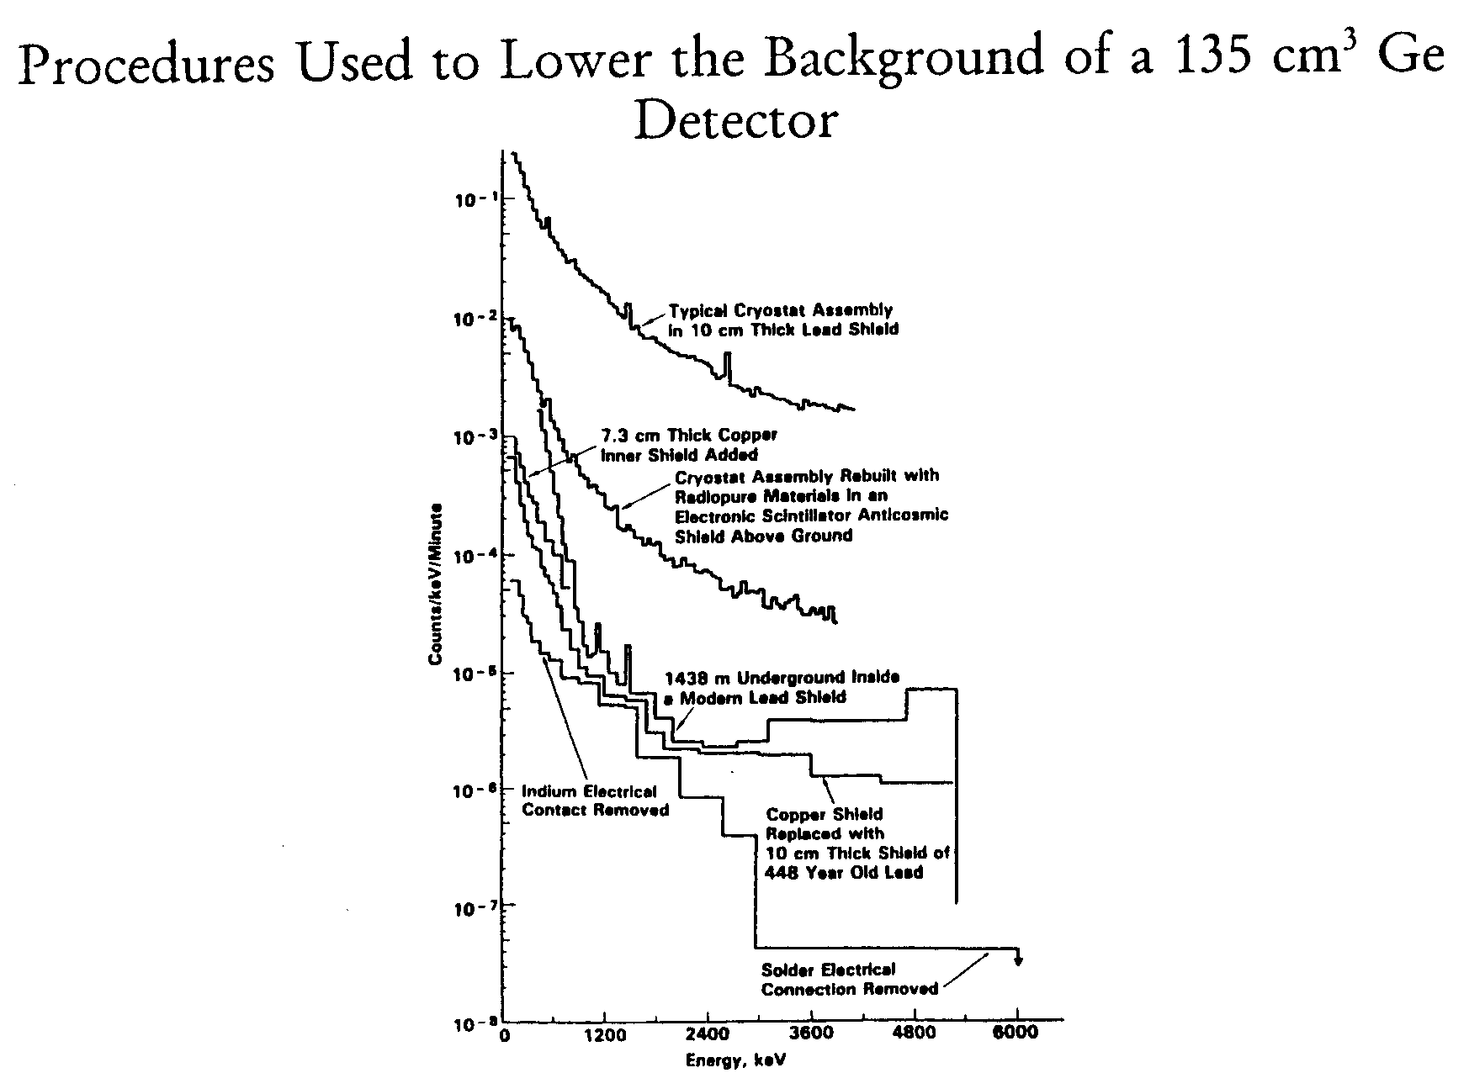

Slide 44
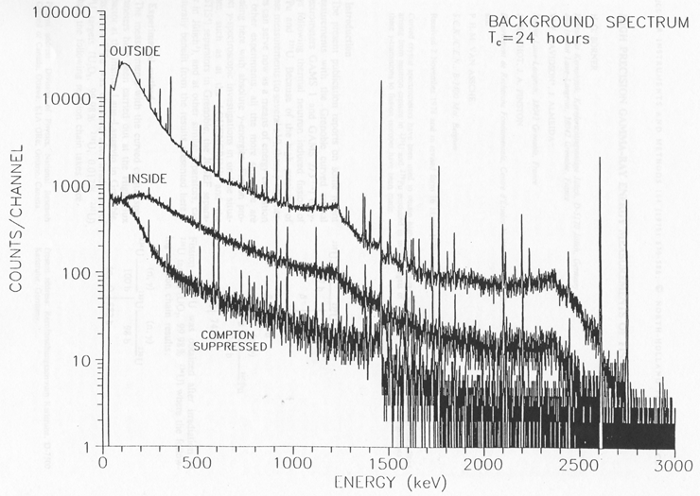
Ge Detector Shielding

Slide 45
Summary
background radiation is a significant problem for low-level analysis
background radiation can come from a variety of sources:
  external sources
  impurities in shielding material
  secondary radiation sources
  radiation in detector components
  cosmic rays

