Slide 1
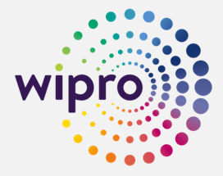
CHIEF EXECUTIVE
AMIT DAWN
Marketing Department Organigram.
Effektif 1 MAR 2022
MKT DIRECTOR
ANDANI
SR MKT MGR
WILSA
GROUP BRAND MGR
ACTING MKT MGR
ASTI
MEDIA MANAGER
VACANT
BRAND MGR
ROMANO &
ENCHANTEUR
VACANT
BRAND MGR
VITALIS
MONICA
SR BRAND MGR
DOREMI
FEBRI
JR BRAND MGR
EVERCARE &
E-com COORD
CHRISTIA
NPD
EXECUTIVE
EVELYN
RESEARCH EXECUTIVE
MIEKE
BRAND EXE
VITALIS
CLARISSA
BRAND EXE
AIKEN &
MAXKLEEN
DIZAR
DIGITAL MKT
EXECUTIVE
VACANT
BRAND SPV
IZZI
Livia
CREATIVE Spv
RIYO
BRAND SPV
SUMBER AYU
Firdha
Mkt Data Support & Admin Spv
NANIK
CREATIVE SPV
SARDJIE
Creative
Staff
DIMAS
CREATIVE Staff
DEVINA
Digital CREATIVE Staff Vacant
DIGITAL CREATIVE Staff
Vacant
Mkt Admin Staff 1
FIHA
Mkt Admin/ Warehouse Staff 2
DIAN

