Slide 1
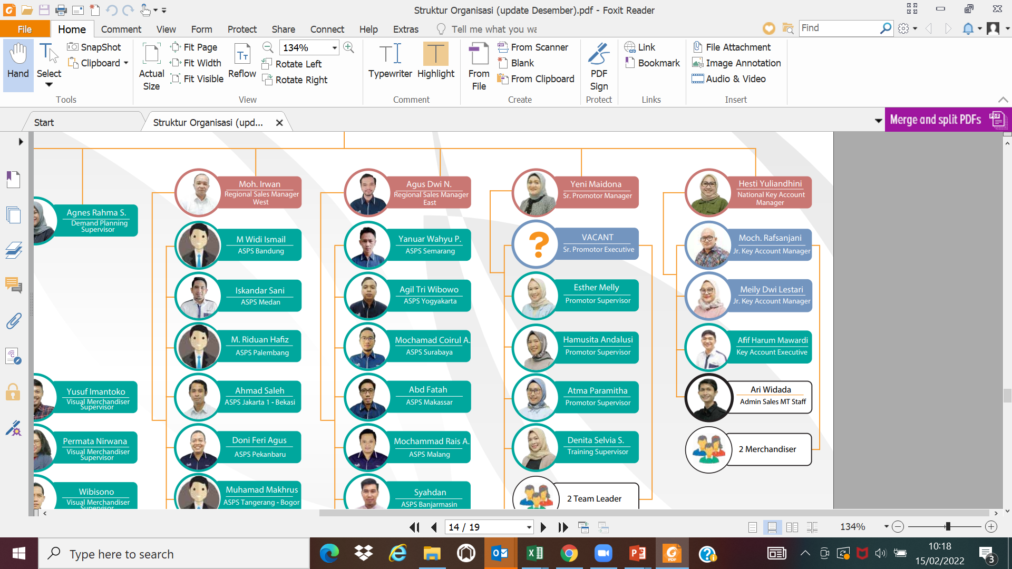
STRUKTUR ORGANISASI & RESPONSIBILITY
Effective date 1st Apr ‘22
VACANT
Watsons, Lulu, Farmers, Boots, Lottemart, Aeon, Diamond
Contr 12,7%
IDM, SAT, Alfamidi, Dan Dan, Guardian
Contr 75,6%
LSI, Yogya, Borma, Tip Top, Naga, GL, GS, Boston, Yomart
Contr 11,8%
- Reporting Sales, Stock
Distributor, OPSC to all Skincare team
- Perhitungan incentive team sales (GT & MT)
- Claim Distributor untuk MT Activity
+ 1 Person under Agency
Taking order, makesure PO terkirim dan terinvoice, ekskusi program , merchandising

