Slide 1

PISA for Schools Paris, 18 July 2019

Slide 2
Validation study: how to use the dashboard
Bonaventura Pacileo

Slide 3
The old validation study (VS)
Each NSP was doing its own Validation Study report and preparing its own codes in their preferred statistical software;
2E prepared a template using in several countries but only for reporting;
The PISA-S team was not replicating the VS analysis.
No efficiency/consistency/reliability

Slide 4
The new validation study
Standardised template and reproducible R code;
Integrated tool for all countries;
On-the-fly results;
Interactivity;
Scalability;
Deeper analysis.

Slide 5
Next steps
Actions | Examples | Benefits
Creating an exportable template | Markdown document to export results as PDF/Word/HTML | Having a document to share with NSPs/MoEs irrespective of their technical capacity Creating a repository with reports for each country/year
Adding school-level analysis | % of correct responses to each item % of missing/not-reached items to each item | Detecting issues with implementation in selected schools Creating an historical archive of such issues to use as best practices
Adding cross-country comparisons | Gender DIF between country A and Pilot (or country B) IRT item difficulty between country A and B (or country B with same language as A) | Detecting cross-country patterns with selected items Quality control of translation & adaptation Cross-country analyses for capacity building
Creating diagnostics checks to run every year | Gender DIF Point-biserial correlation (“mis-keyed items”) PCA analysis (“Westminster”) Percentage of correct responses to each item over time (“teaching to the test”) % of missing/not-reached items to each item | Ensuring quality of each implementation Reducing coding mistakes Detecting possible data issues due to sample size Detecting unexpected patterns with items Ensuring students are exposed to the right content
Adding integration to gold-dataset generator | Adding panel to “switch on” the gold-dataset generator | Integrating the different R programs Having a user-friendly interface to ‘switch on’ the gold-dataset generator Incorporating decisions over items (e.g. drops) automatically
Including item preview for dodgy items | Open the source and national versions of dodgy items | Looking for possible issues with item display, item translation

Slide 6
Tutorial

Slide 7
How to launch it
Open R project;
Initialise packages (only once)
Execute PBTS-VS_shell.R
Open it in the browser (optional)
Required files are in
Gitlab
Folder
Readme copy paste

Slide 8
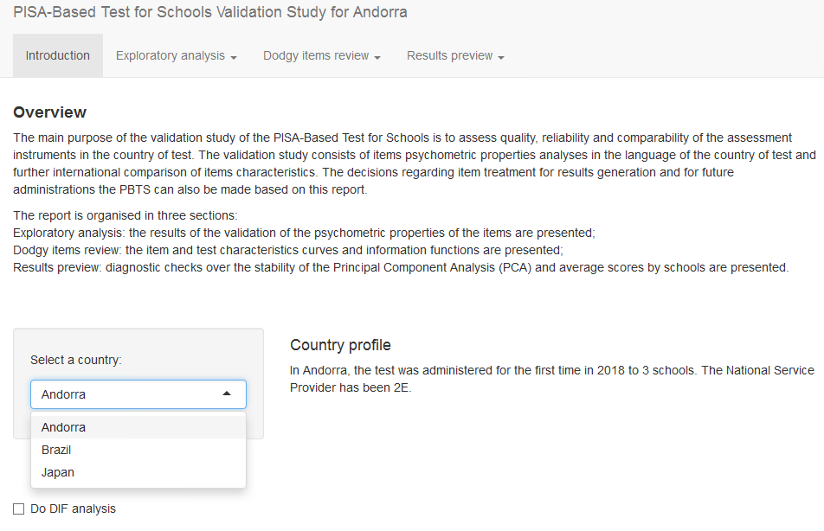
Introduction
Select the country to analyse;
Understand how the report is organised;
Country profile is customised to the selected country;
Switch on or off the gender DIF analysis (computationally intensive).

Slide 9
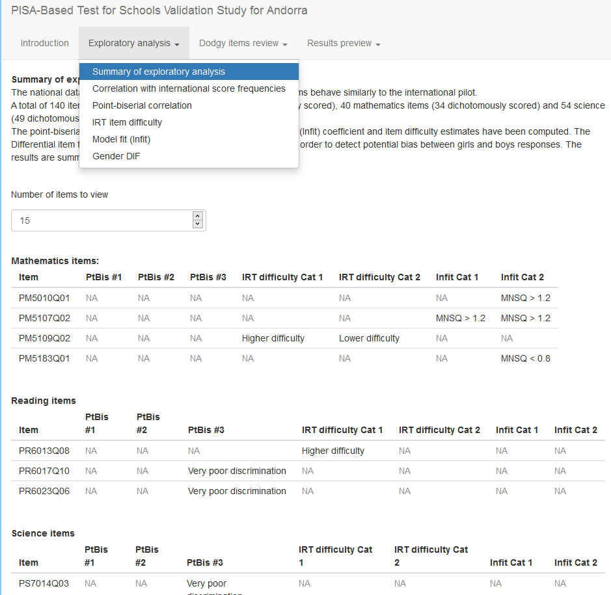
Exploratory analysis
The exploratory analysis has 5 analysis-specific tabs and a summary one;
The summary tab presents the results of all the analyses and displays items with at least one “dodgy” criterion;
Items with at least one “dodgy” criterion should be reviewed more closely in the second section (“Dodgy items review”)
The different analyses are explained in detail in their respective tab panel

Slide 10
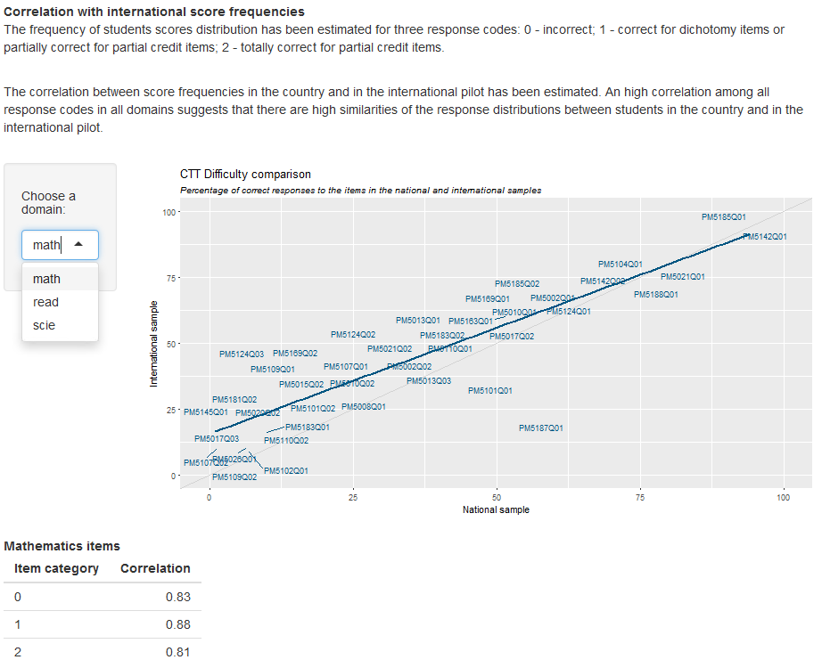
Correlation with international score frequencies
The scatter plot shows the percentage of correct responses to the items in the international pilot against the percentage for the country under scrutiny;
Items below the blue line have more correct responses in the country than in the pilot (and viceversa);
It is possible to change domain to look at the other plots;
The table below presents the correlation for each response category between the international pilot and the country.

Slide 11
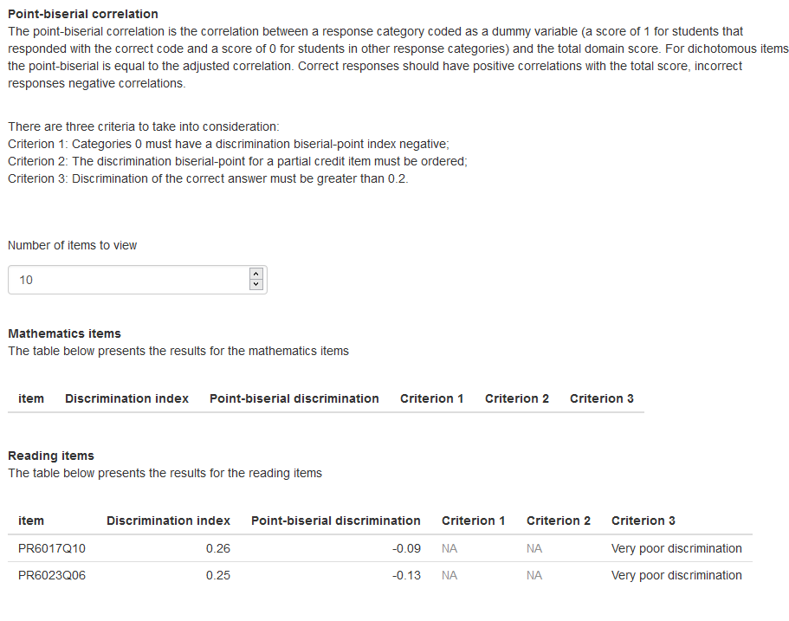
Point-biserial correlation
A negative point-biserial correlation could indicate mis-keyed items (the correct answer coded as 0 instead of 1);
Low discrimination for the correct answer should be compared with overall discrimination index

Slide 12
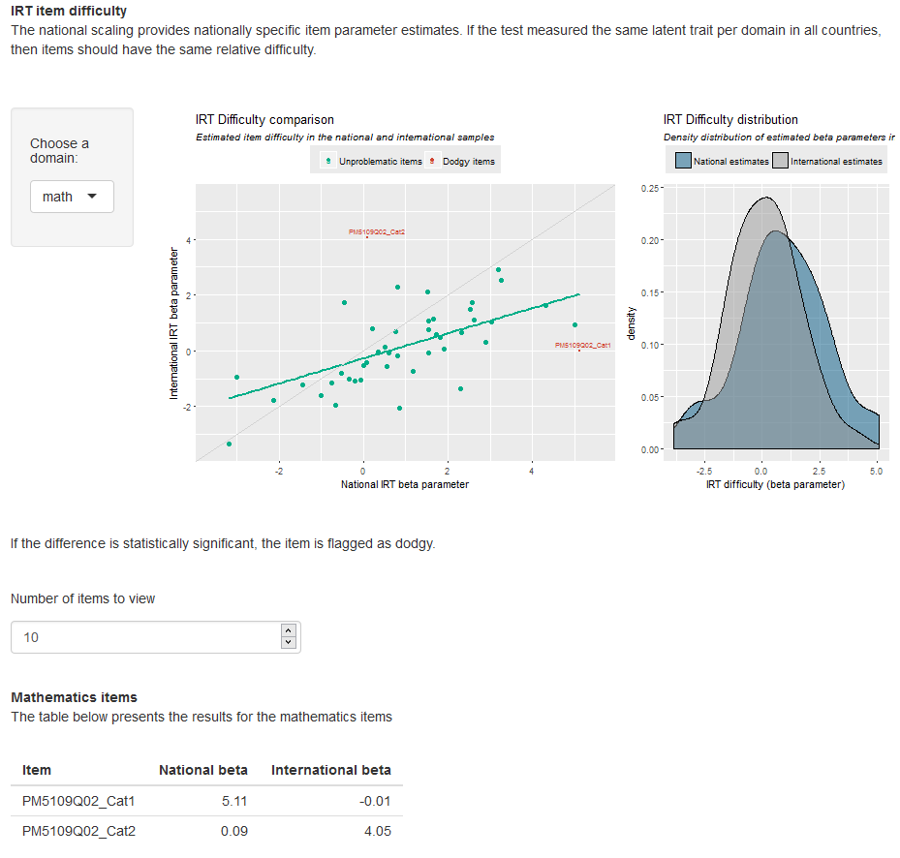
IRT item difficulty
The scatter plot presents the IRT difficulty of the items in the international pilot against the estimated IRT difficulty of the items in the country;
Items are flagged when the two difficulty parameters are significantly different;
When the density of item parameters in the country is to the right of the density of item parameters in the international pilot, it means items are on average more difficult in the country.

Slide 13
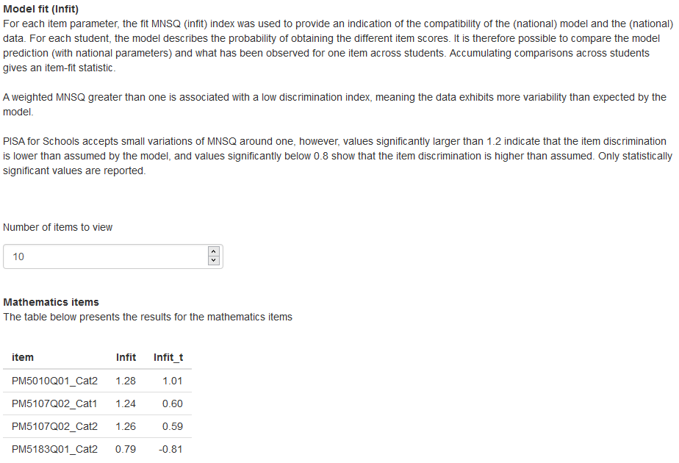
Model fit
Item fit to the model is checked with national estimated item parameters;
It is important to check also whether the Infit is significant (if Infit_t is greater in absolute value than 1.96)

Slide 14
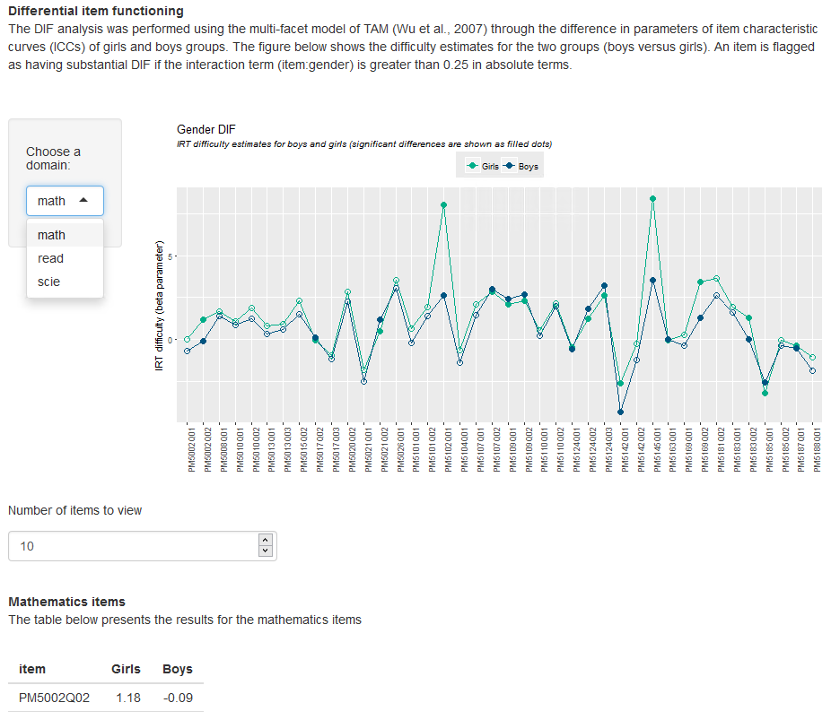
Gender DIF
This analysis is computationally intensive;
It is possible to switch between the different domains;
The dots are filled when the difference is statistically significant between the parameters for boys and girls;
It is important to look also for patterns, e.g. items in a given domain are consistently easier (or harder) for one gender group.

Slide 15
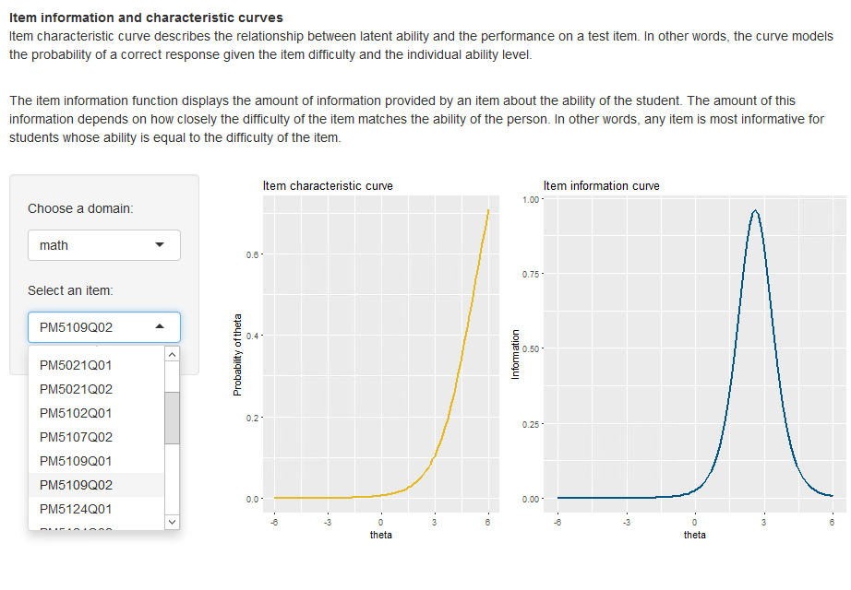
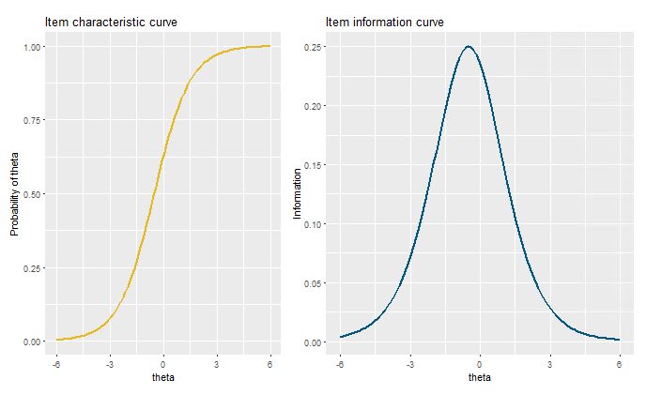
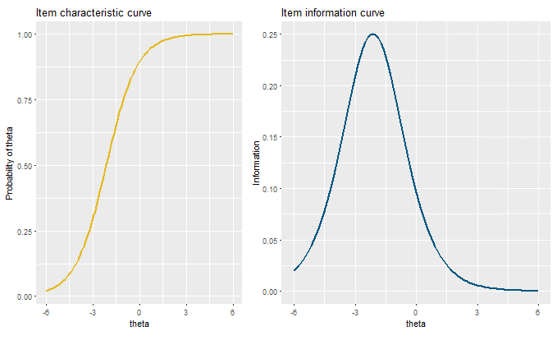
Item characteristic and function curves
The items that showed at least a dodgy criterion in the exploratory analysis are reviewed here;
The item characteristic curve should be S-shaped; it does not discriminate well for ability levels in which it is flat;
Correspondingly, the item information curve will be centred around the ability levels for which the item provides more information;
When the IFC is flat, it means that the item does not provide information on those ability levels;
Good discrimination for a narrow subset of ability levels and similarly information only around them
Good discrimination across the distribution and well-shaped information curve
Poor discrimination for low level of ability and low information for high level of ability

Slide 16
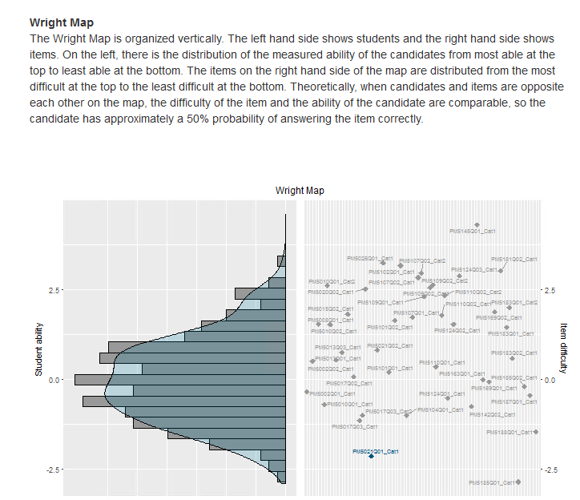
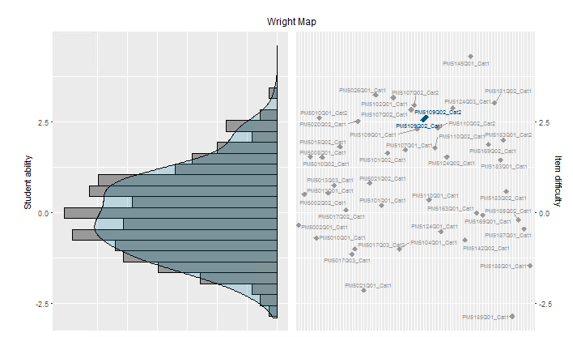
Wright Map
In the Wright Map, it is possible to locate the items in terms of difficulty (right axis) and compare that to the distribution of ability of the students (left plot);
Students with ability equal or higher than the difficulty of the items have 50% of answering correctly;
The higher the location (difficulty) of the item, the fewer the students able to answer correctly with at least 50% chance.
Easy item
Difficult item

Slide 17
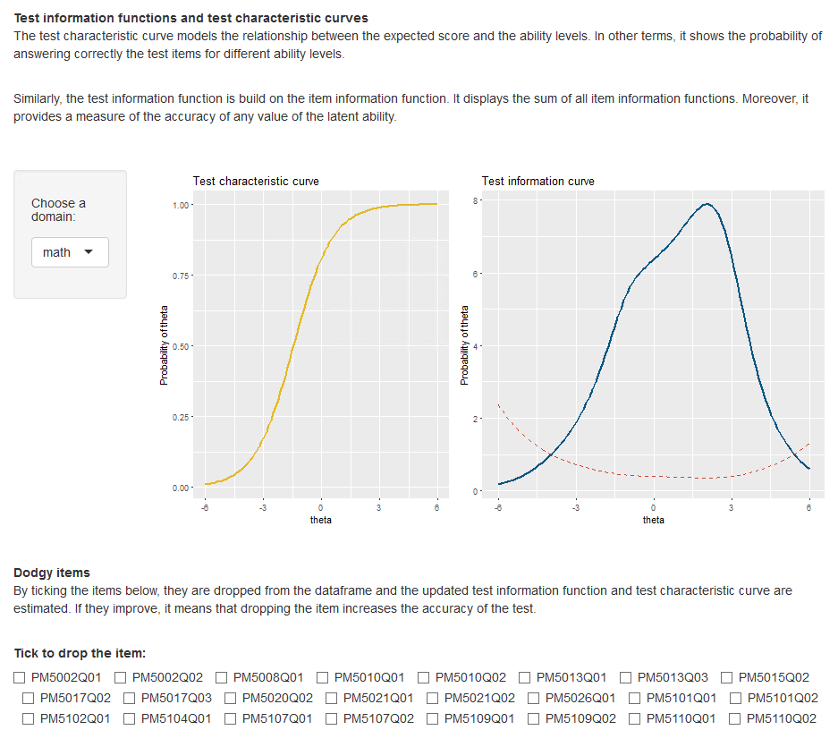
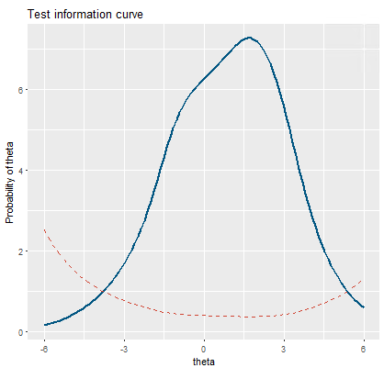
Test information function
The test characteristic and information curves provide information on the overall validity and reliability of the test;
By ticking the items, it possible to observe changes in the two curves as the items are dropped from the sample;
If they improve (e.g. the TIC becomes more bell-shaped) it could be indicative that the items should be dropped.
Original TIF
Improved TIF after dropping one item

Slide 18
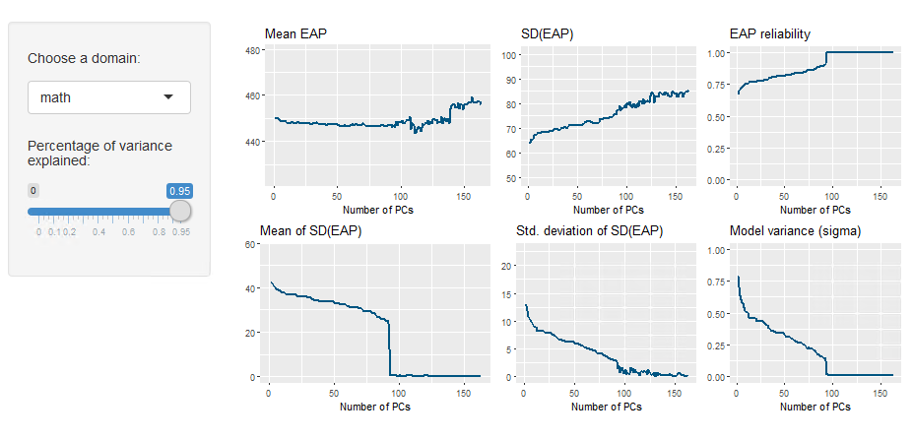
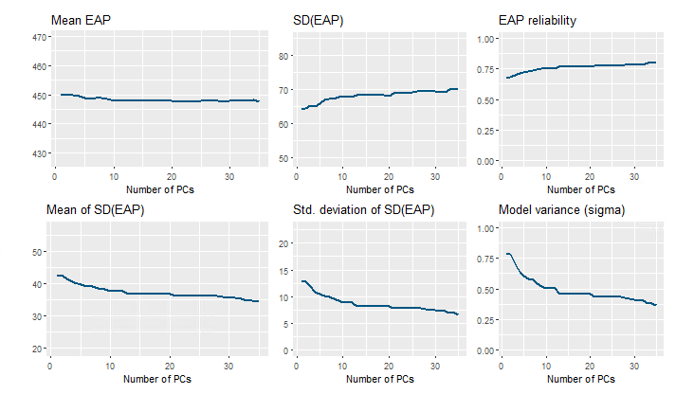
PCA diagnostics
Expected A Posteriori (EAP): posterior probability distribution of latent trait scores --specifically, the predicted (from our prior background information) distribution of scores for a given student given (a) the response pattern of that student, and (b) the estimated model parameters;
If the mean and the SD of the EAP start to wiggle as the number of PCA vectors reaches a certain threshold, it means that the computed ability estimates are unstable;
If the model variance goes to zero (or similarly the Mean of the SD of EAP), then it signals that all the variability in the model is provided by the prior background information and the students’ test responses play no role;
Reducing the number of factors ( corresponding to the percentage of variance explained) or increasing the sample size could ensure more stable and reliable estimates.
Unstable estimates
Stable estimates

Slide 19
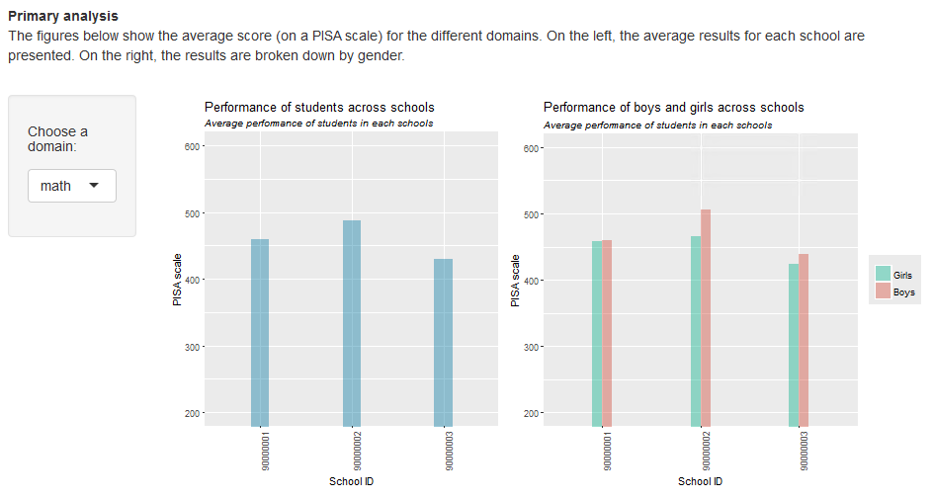
Results preview
The last panel shows the final results
It is required to have PCA input data to compute the final scores

