Slide 1

PISA for Schools Paris, 18 July 2019

Slide 2
Validation study: how to use the dashboard
Bonaventura Pacileo

Slide 3
The old validation study (VS)
Each NSP was doing its own Validation Study report and preparing its own codes in the preferred statistical software;
2E prepared a template using in several countries but only for reporting;
The PISA-S team was not replicating the VS analysis.
No efficiency/consistency/reliability

Slide 4
The new validation study
Standardised template and reproducible R code;
Integrated tool for all countries;
On-the-fly results;
Interactivity;
Easy to customise/expand;
Deeper analysis.
Video preview

Slide 5
Next steps
Create an exportable template (e.g. PDF/Word);
Add school-level analysis, e.g.:
Percentage of correct responses to each item
Percentage of missing/not-reached items to each item
Add cross-country comparisons, e.g.:
Gender DIF between country A and Pilot (or country B)
IRT item difficulty between country A and B (or country B with same language as A)
Create diagnostics checks for every year, e.g.:
Gender DIF
Point-biserial correlation (“mis-keyed items”)
PCA analysis (“Westminster”)
Percentage of correct responses to each item over time (“teaching to the test”)
Add integration to gold-dataset generator (“control room”);
Include item preview for dodgy items (source and national versions)

Slide 6
Tutorial

Slide 7
How to launch it
Open R project;
Initialise packages (only once)
Execute PBTS-VS_shell.R
Open it in the browser (optional)
Required files are in
Gitlab
Folder
Readme copy paste

Slide 8
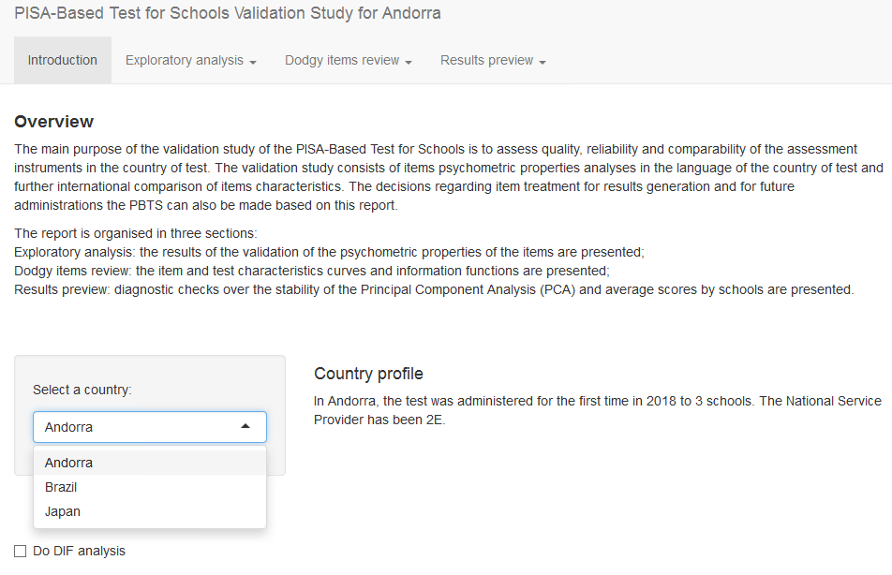
Introduction

Slide 9
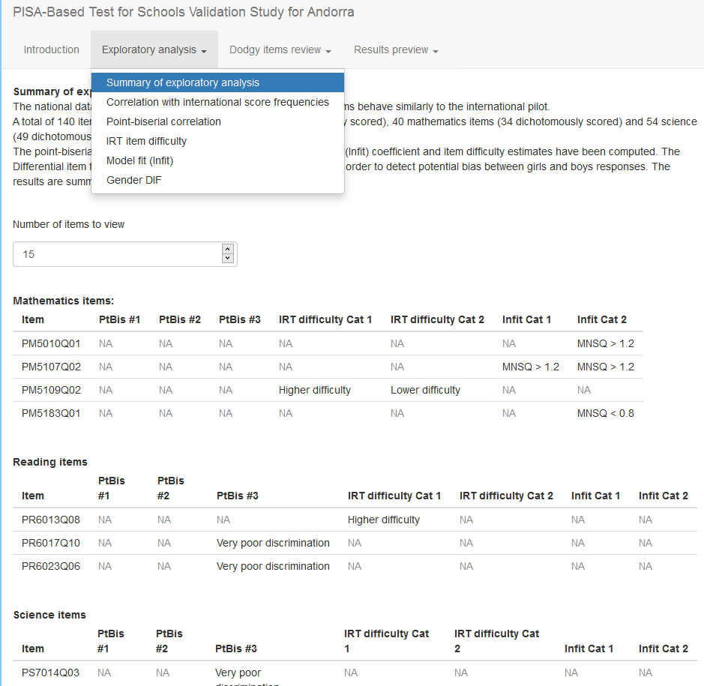
Exploratory analysis

Slide 10
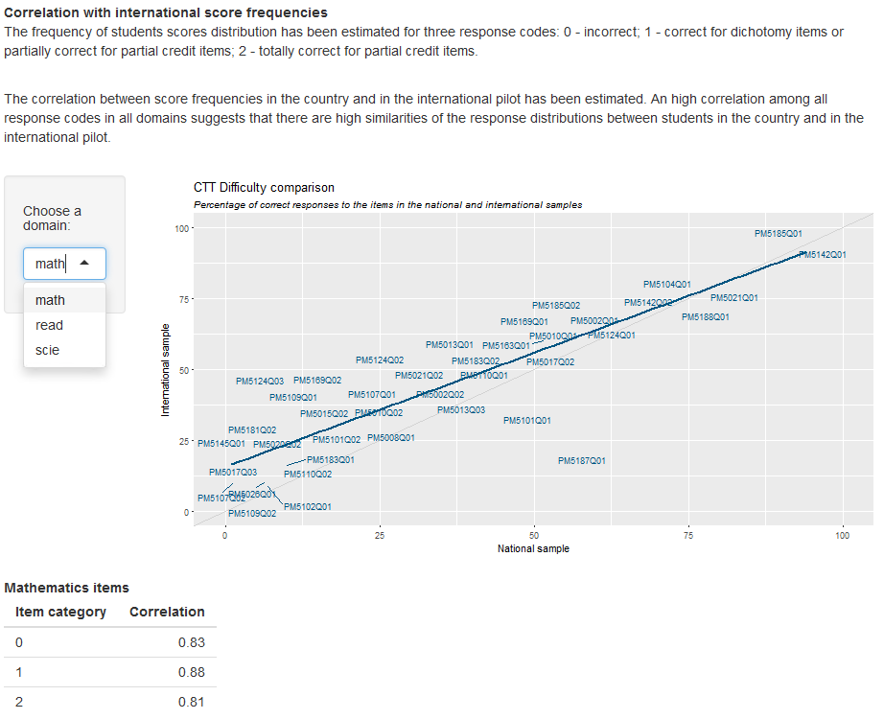
Correlation with international score frequencies

Slide 11
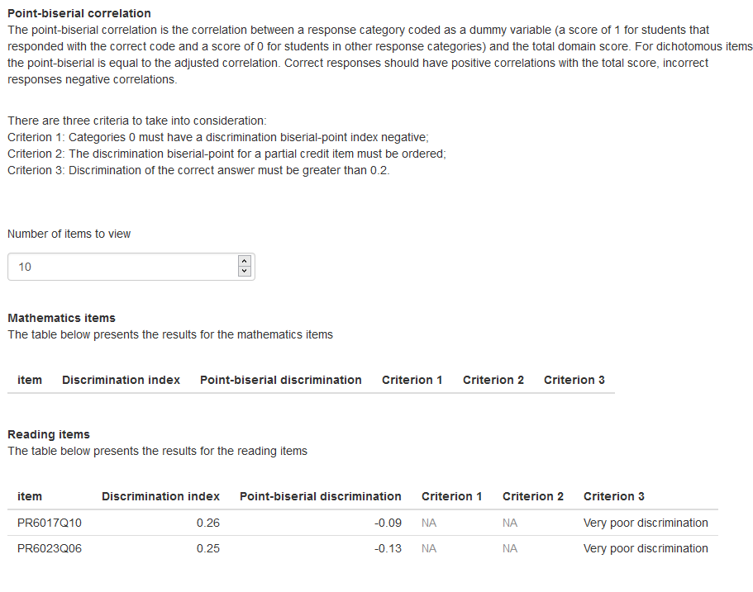
Point-biserial correlation
Negative pt biserial could indicate mis-keyed items

Slide 12
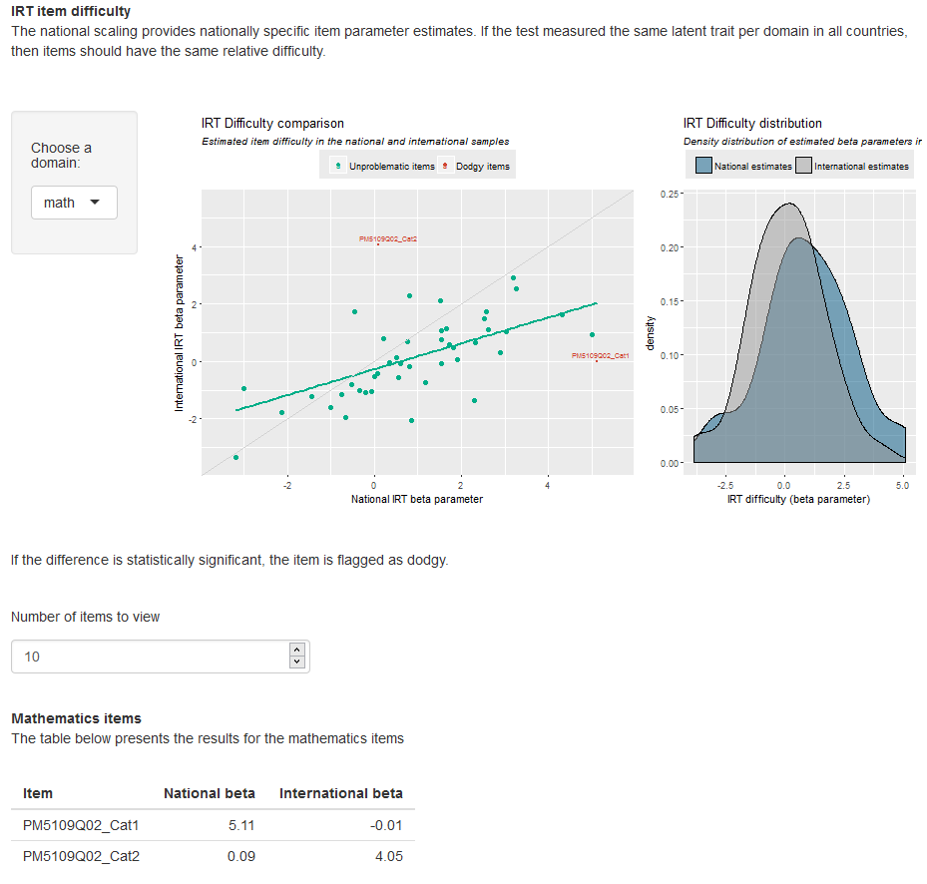
IRT item difficulty
If the density is to the right, items more difficult

Slide 13
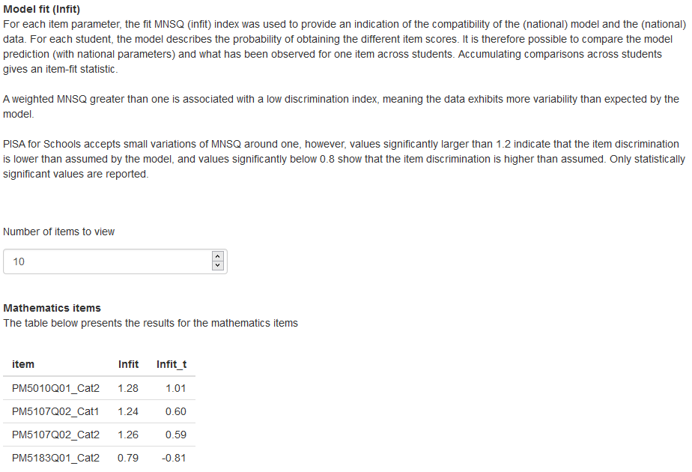
Model fit
Check also t-statistics (normally distributed0

Slide 14
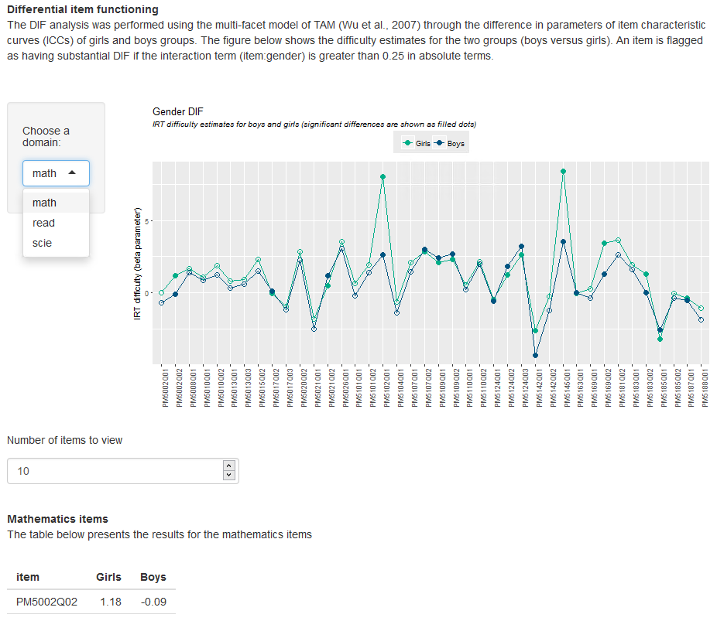
Gender DIF
.

Slide 15
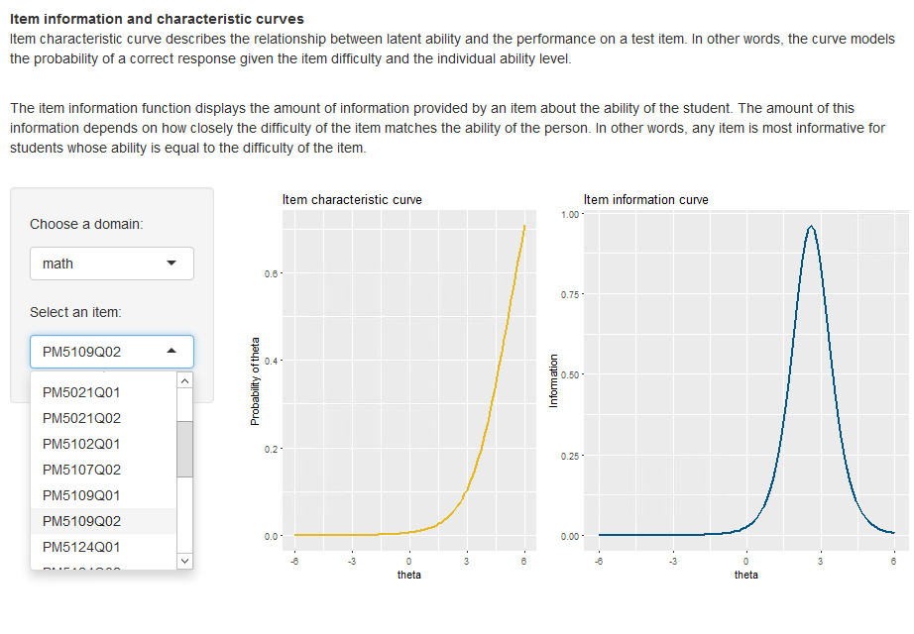
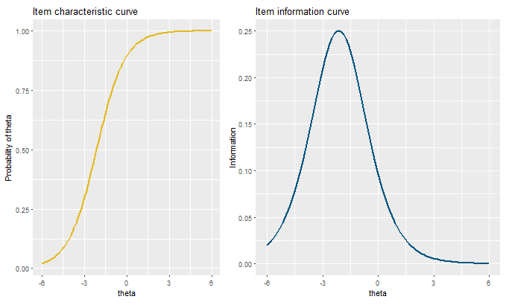
Item characteristic and function curves
For a subset of items
Compare good vs bad

Slide 16
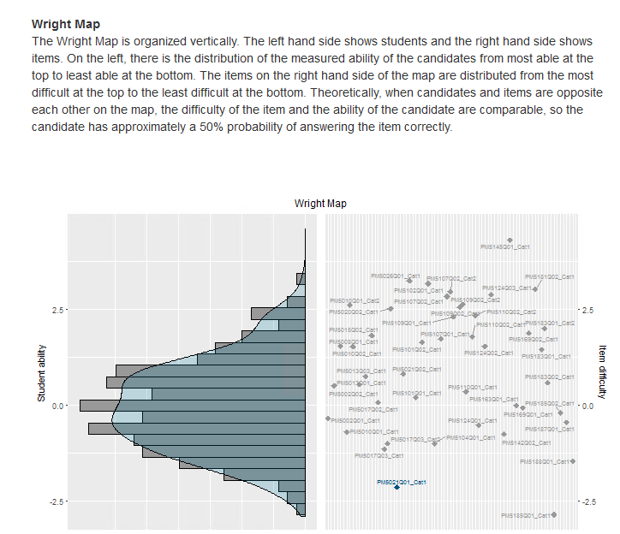
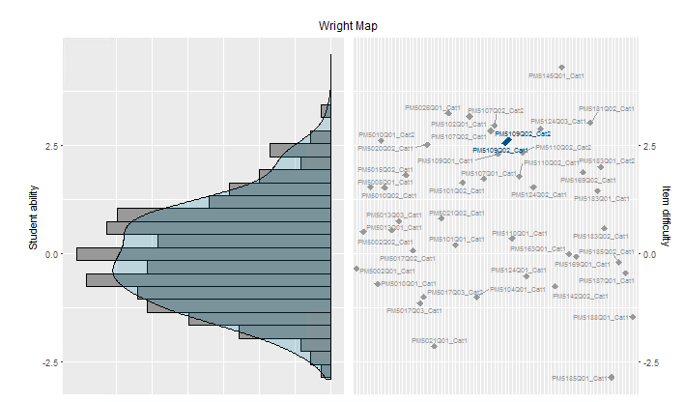
Wright Map
.

Slide 17
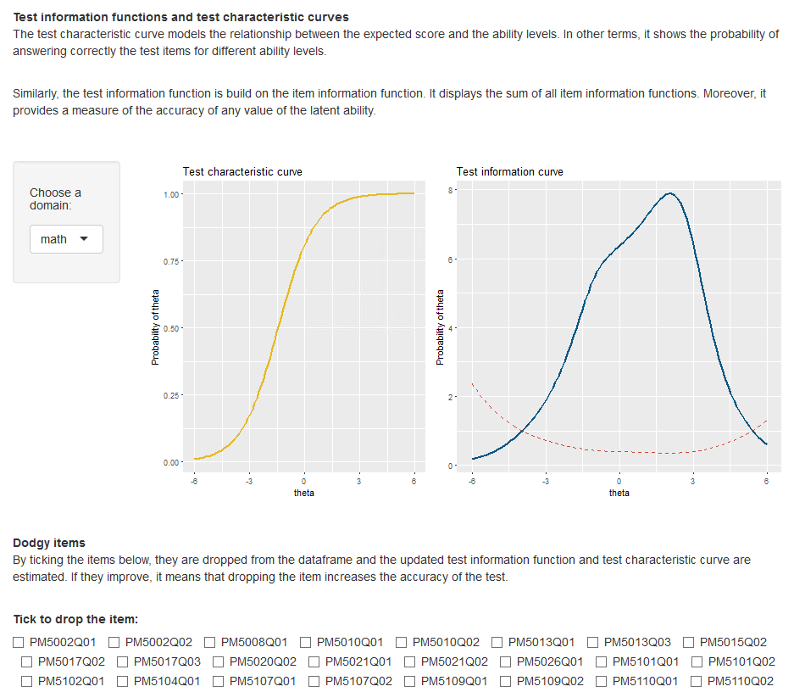
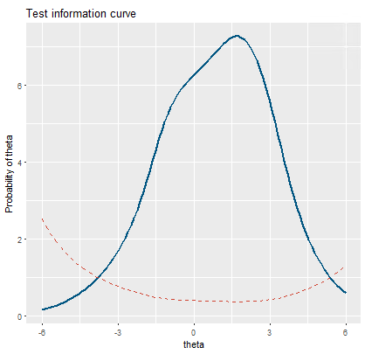
.

Slide 18
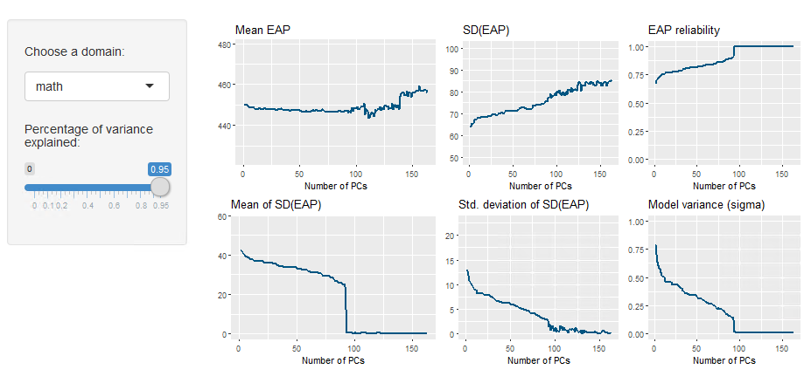
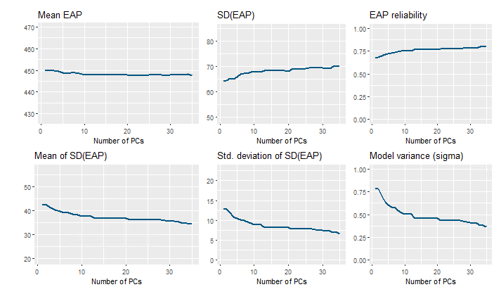
PCA diagnostics
.wiggle, model variability
Definition of EAP

Slide 19
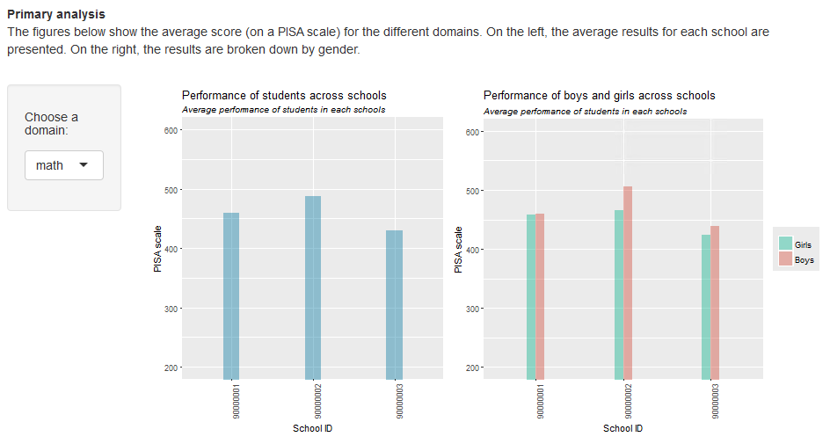
Results preview
.

