Slide 1
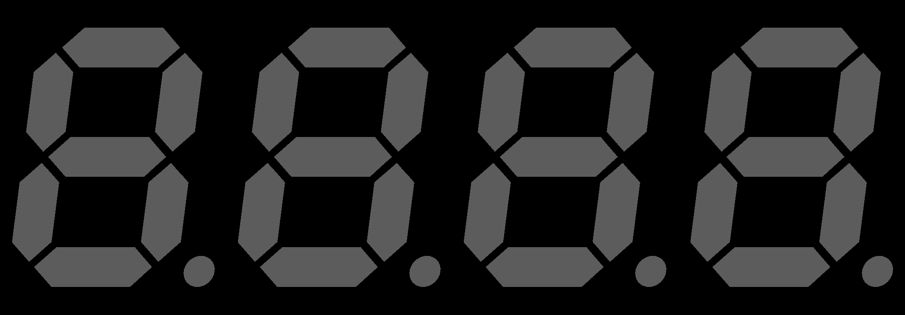
D
G
H
B
r_w_v
lock_mem
lock_mem
fin_jeu
en_mem_v
4
8
score
Diplay_driver
VGA_controller
Coeur
r_w_c
fin_score
en_mem_c
fin_jeu
mem
address
address
mem_r
mem_w
score
MUX
lock_mem
6
6
8
v
CPU
MUX
lock_mem
MUX
lock_mem
6
Memory
r_w
mem_out
address
mem_in
en_mem
Memory

Slide 2
fsm_ready
chute
Gest_decal
Droite
rot
deb
load
Haut
decal
fin
next_pos
Gauche
sens
sens
current_pos
MUX
Mouvement
chute
fsm_ready
rot
deb_decal
decal
fin_decal
deb
Gest_rot
deb_rot
fin
fin_rot
load
FSM
deb_chute
next_pos
fin_chute
address
deb_refresh
current_pos
fin_refresh
MUX
Sens
1 → droite
2 → gauche
mux_add
Gest_chute
deb
fin
next_pos
load
Mux add & next
00 → decal
01 → rot
10 → chute
11 → refresh
current_pos
Gest_refresh
reg_current
deb
current_pos
mux_add
Lock_mem
fin
clock
load
next_pos
reg_next

Slide 3
0 | start | NOR | allone; | CLR Accu
1 |  | NOR | b | Accu = b
2 |  | ADD | one | Accu = -b
3 |  | ADD | a | Accu = a-b
4 |  | JCC | end | Si carry = 0, a<b alors end, sinon carry = 0
5 |  | NOR | allone | Accu =0
6 |  | ADD | a | Accu = a
7 |  | STA | b | b = accu (=a)
8 |  | JCC | end | fin
9 | mem | zero |  | 000000
10 |  | one |  | 000001
11 |  | allone |  | 111111
12 |  | a |  | Current_score
13 |  | b |  | Best_score

