Slide 1
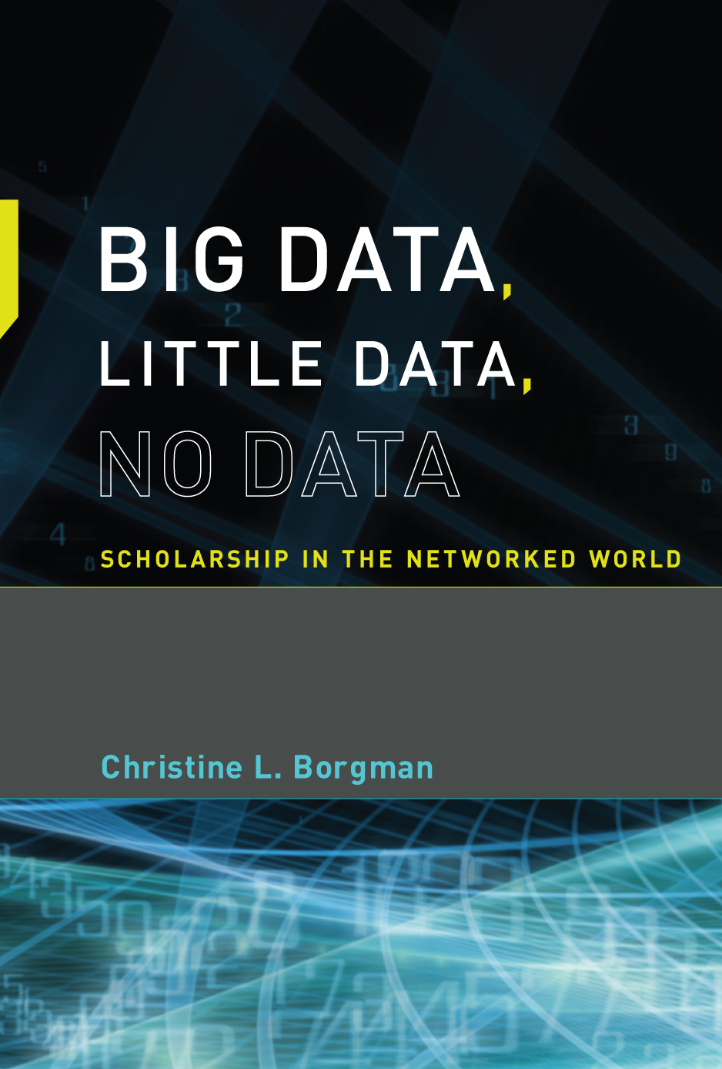
When and Why Should Research Data be Sustained?
Christine L. Borgman
Distinguished Professor
& Presidential Chair in Information Studies
University of California, Los Angeles
Christine.Borgman@UCLA.edu
Center for Knowledge Infrastructures
https://knowledgeinfrastructures.gseis.ucla.edu/
National Science Foundation Workshop
Cyberinfrastructure for Large Facilities
December 1-2, 2015

Slide 2

Open Data: OECD criteria
Openness
flexibility
transparency
legal conformity
protection of intellectual property
formal responsibility
professionalism
interoperability
quality
security
efficiency
accountability
sustainability
Organization for Economic Cooperation and Development (2007)
http://www.oecd.org/science/sci-tech/38500813.pdf

Slide 3
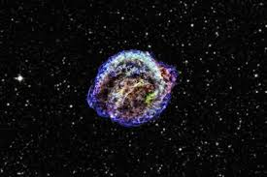
Why sustain access to data?
Purposes
Record of observations
Reference
Reproducibility of research
Aggregation from multiple sources
Users
Investigator
Collaborators
Unaffiliated or unknown others
Time frame
Months
Years
Decades
Centuries
http://chandra.harvard.edu/photo/2013/kepler/kepler_525.jpg

Slide 4
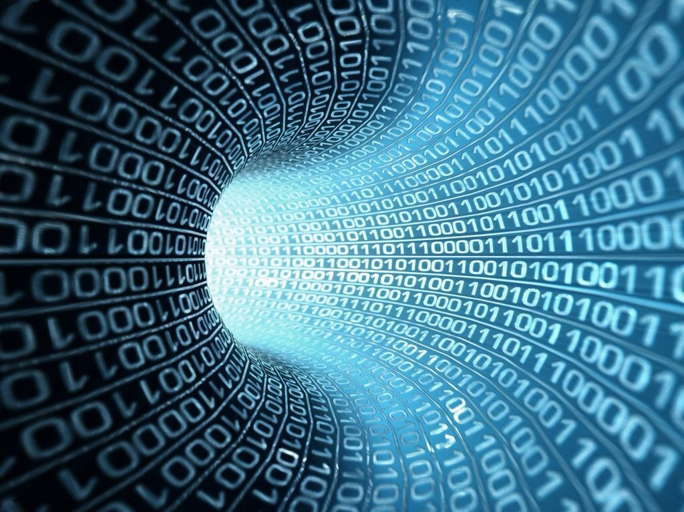
Simplifying the Challenge

Slide 5
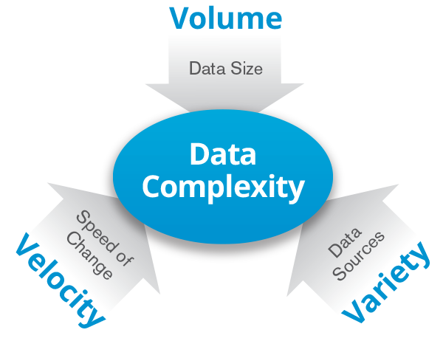
Big Data
http://www.datameer.com/product/hadoop.html

Slide 6
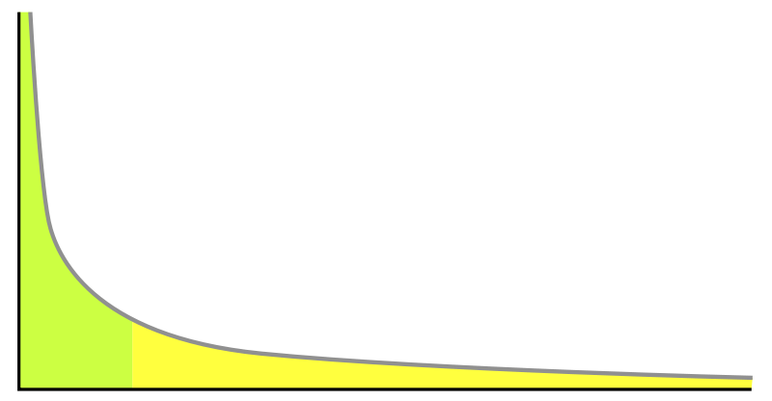
Long tail of data
Volume of data
Number of researchers
Slide: The Institute for Empowering Long Tail Research

Slide 7
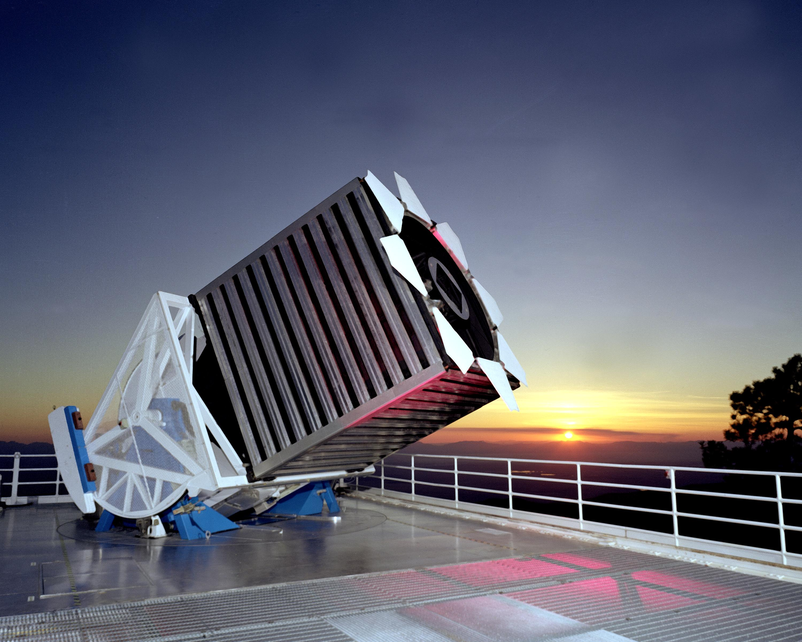
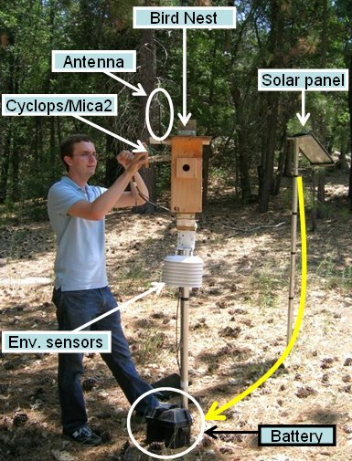
Big Science <–> Little Science
Large instruments
High cost
Long duration
Many collaborators
Distributed work
Centralized data collection
Small instruments
Low cost
Short duration
Small teams
Local work
Decentralized data collection
Sensor networks for science
Sloan Digital Sky Survey

Slide 8
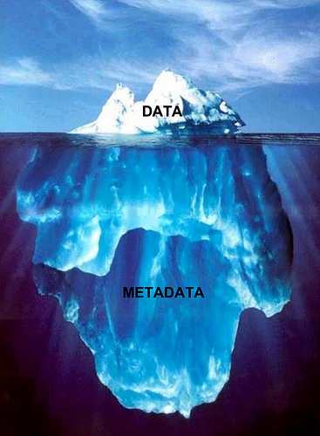
How to sustain data?
Identify the form and content
Identify related objects
Interpret
Evaluate
Open
Read
Compute upon
Reuse
Combine
Describe
Annotate…
Image from Soumitri Varadarajan blog. Iceberg image © Ralph A. Clevenger. Flickr photo

Slide 9
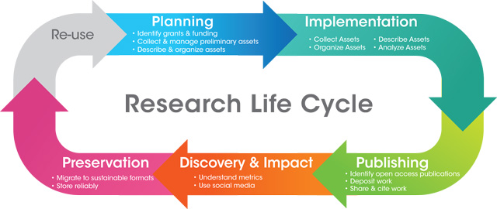
When to invest in data?
http://www.lib.uci.edu/dss/images/lifecycle.jpg

Slide 10
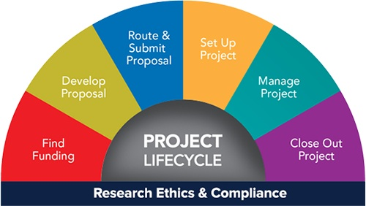
When to invest in data?
http://www.finance.umich.edu/programs

Slide 11
Economics of the Knowledge Commons
 | Subtractability / Rivalry
 |  | Low | High
Exclusion | Difficult | Public Goods General knowledge Public domain data | Common-pool resources Libraries Data archives
 | Easy | Toll or Club Goods Subscription journals Subscription data | Private Goods Printed books Raw or competitive data
Adapted from C. Hess & E. Ostrom (Eds.), Understanding knowledge as a commons:
From theory to practice. MIT Press.

Slide 12
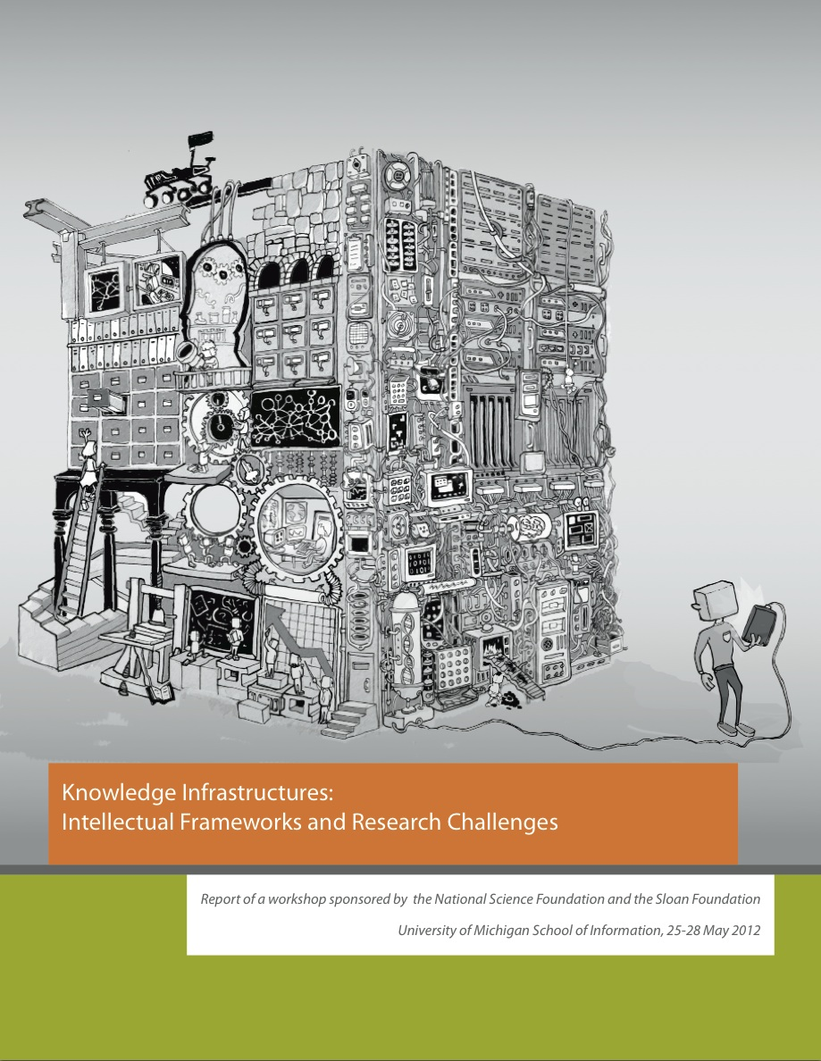
http://knowledgeinfrastructures.org

Slide 13
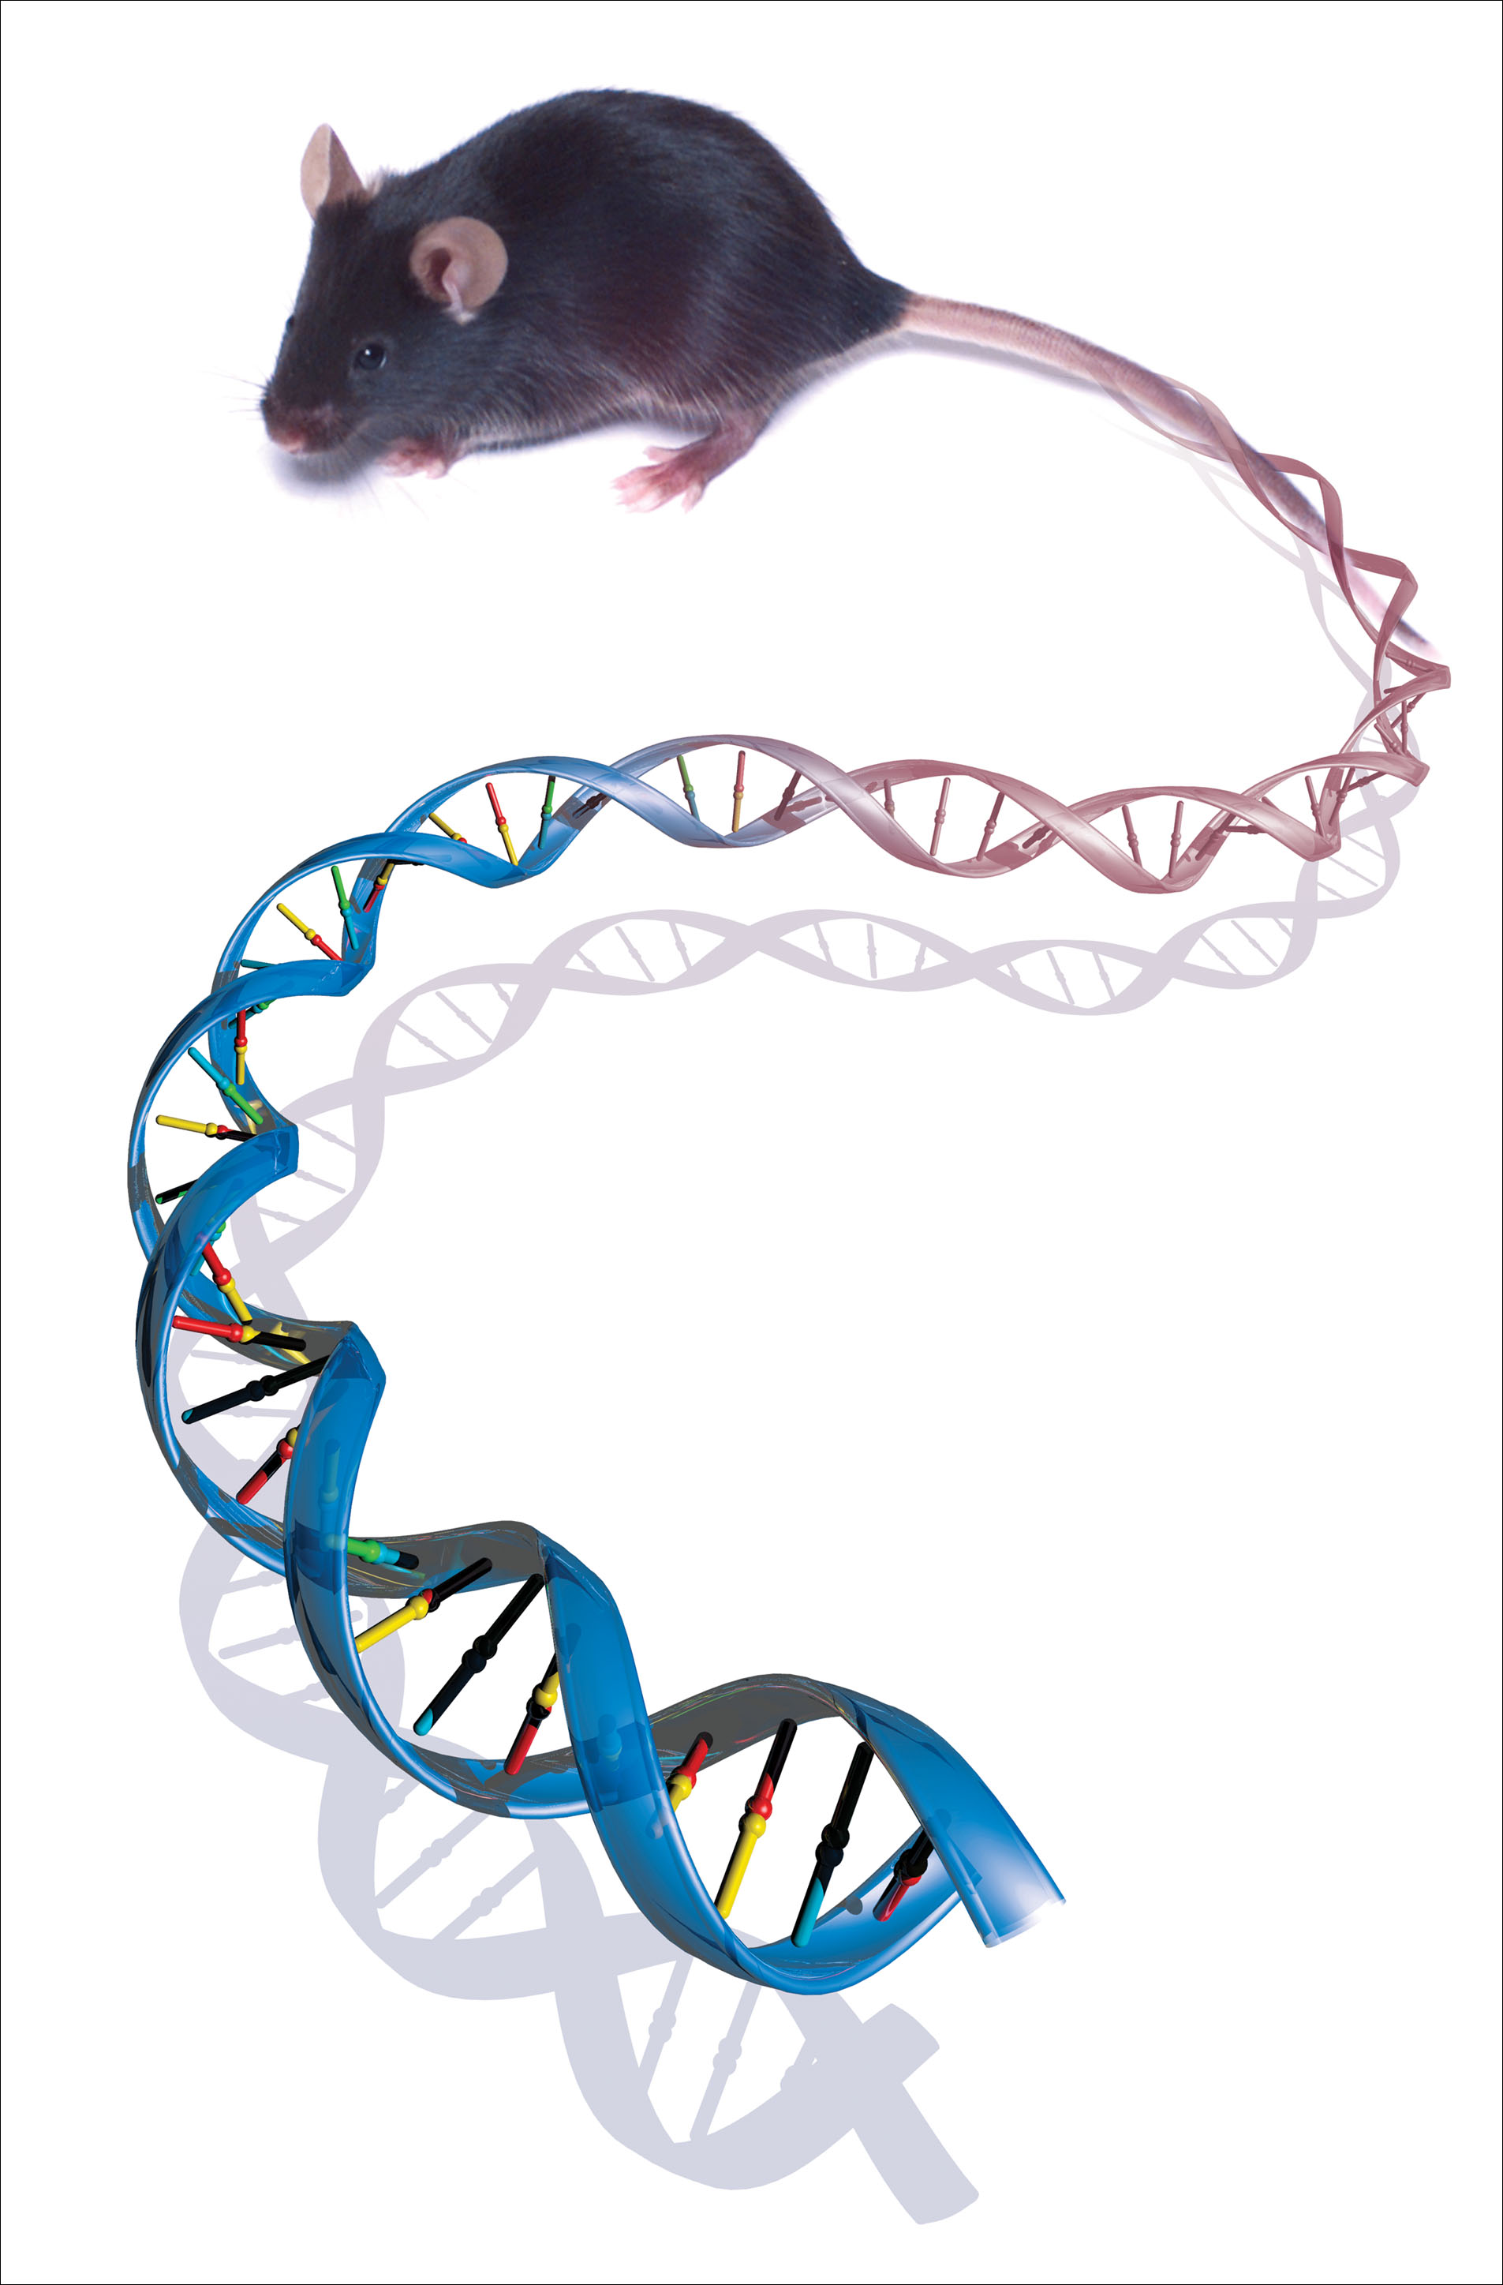
Data are representations of observations, objects, or other entities used as evidence of phenomena for the purposes of research or scholarship.
C.L. Borgman (2015). Big Data, Little Data, No Data: Scholarship in the Networked World.
MIT Press
http://www.genome.gov/dmd/img.cfm?node=Photos/Graphics&id=85327

