Slide 1



MARCC:
On Data Subject
to Restrictions
Jaime E. Combariza
Associate Research Professor
Department of Chemistry
Director MARCC
Johns Hopkins University
2016 IDIES Annual Symposium

Slide 2


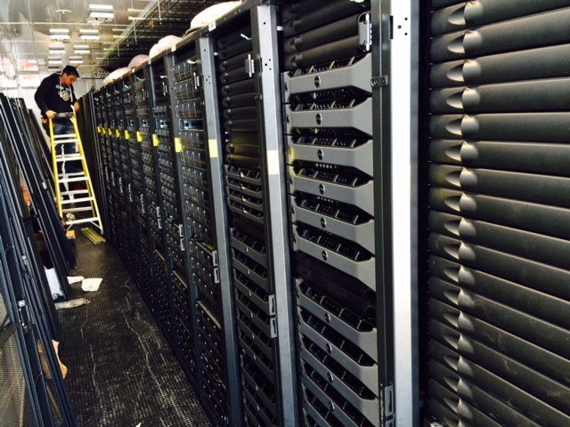
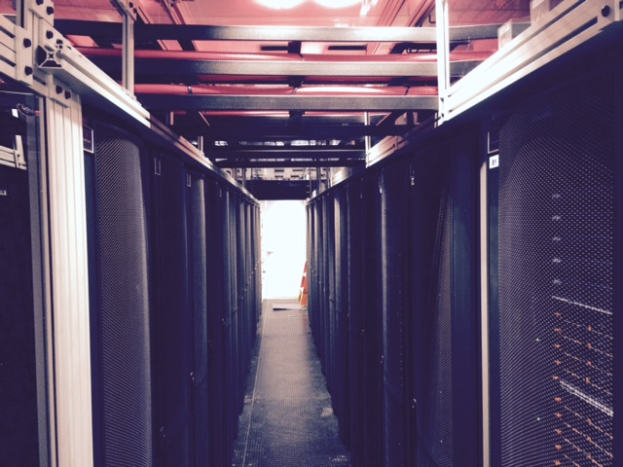
Configuration 2015
Count | Description
648 | Compute nodes, 128GB RAM, 24 cores, 2.5GHz Haswell processors
50 | Large memory nodes, 1024 GB RAM, 48 cores
48 | GPU nodes, 2 Nvidia K80 GPUs/node, 24 CPU cores
2 PBytes | High Performance File System (Lustre)
14 Pbytes | ZFS File System
Condo, 28 nodes (MEDE + 2 PIs) :: 19,776 cores 932.5 TFLOPs

Slide 3
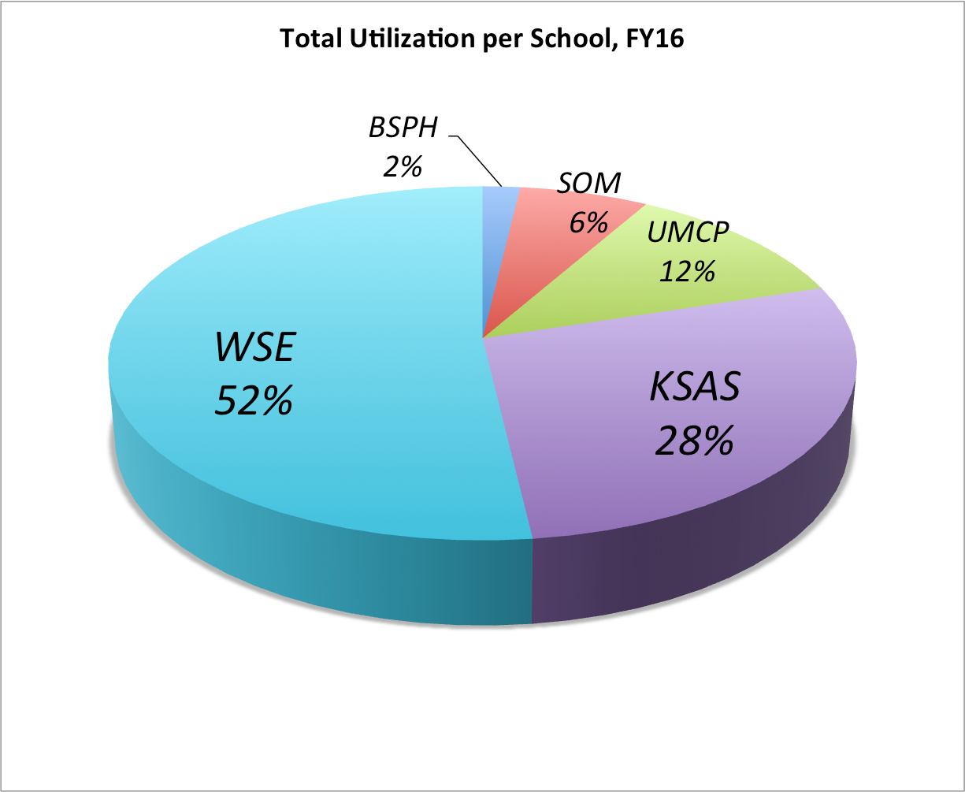
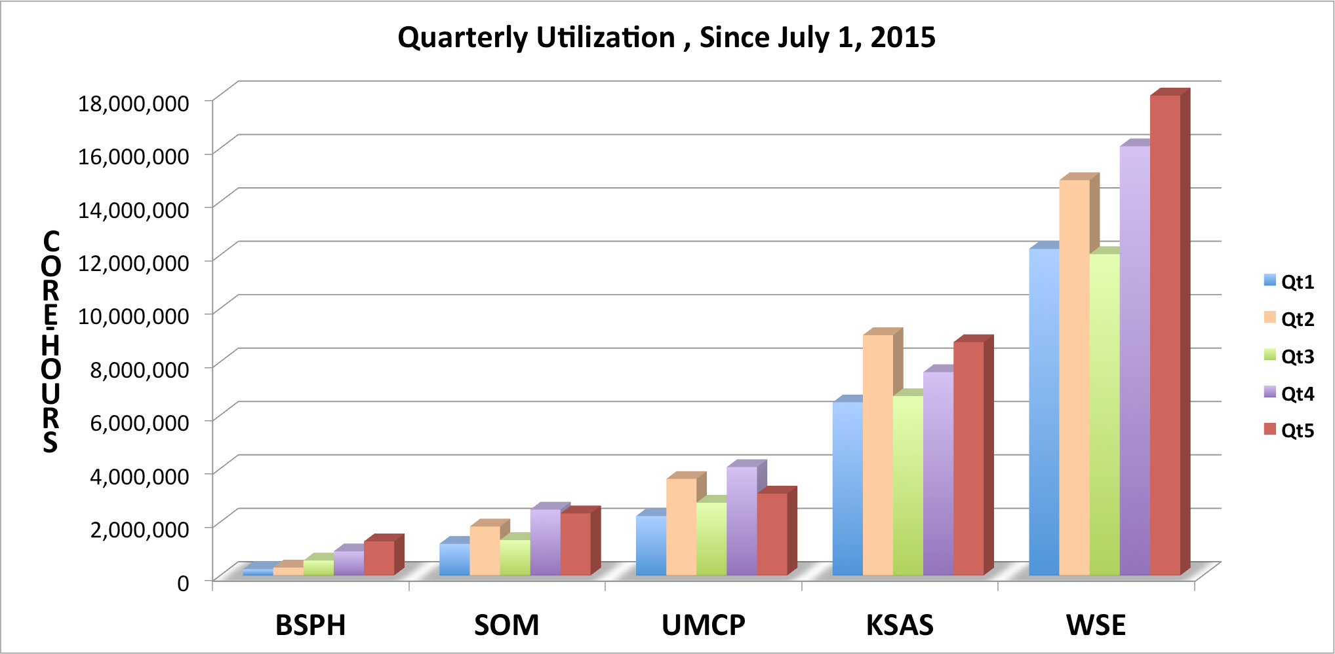
Utilization

Slide 4

Metrics
Number of Research Groups | > 200
Number of Users | > 950
Number of CPU-cycles | 106,299,604
Effective Utilization | ~85%
Number of Scientific Applications | > 300
Number of Publications | > 70
Number of Classes | 10
Training | >600 users

Slide 5
GPU Computing
NWChem | TeraChem | Quantumespresso | Gamess
VASP | LAMMPS | Abaqus | Terachem
Amber | NAMD | Gromacs | Ab Init
Caffe | Torch7 | Theano | Charmm
Lsdyna | Bluebottle | S3D | WRF
NVBowtie | Soap3 | GPUBlast | Matlab

Slide 6
Configuration 2016
Count | Description
676 | Compute nodes, 128GB RAM, 24 cores, 2.5GHz Haswell processors
50 | Large memory nodes, 1024 GB RAM, 48 cores
48 | GPU nodes, 2 Nvidia K80 GPUs/node, 24 CPU cores
+48 | Compute nodes, 128GB RAM, 28 cores, 2.6 Broadwell Processors
+24 | GPU nodes, 2 Nvidia K80 GPUs, 28 cores.
Bluecrab 2016 :: 21,792 cores; 1.1 PFLOPs

Slide 7
What is new
Two Factor Authentication (TFA)
        Gloogle authenticator
Security (Bro-IDS, IPTables)
        Log/network traffic analysis
Enhanced DTN, Globus+
        Fast data transfer

Slide 8
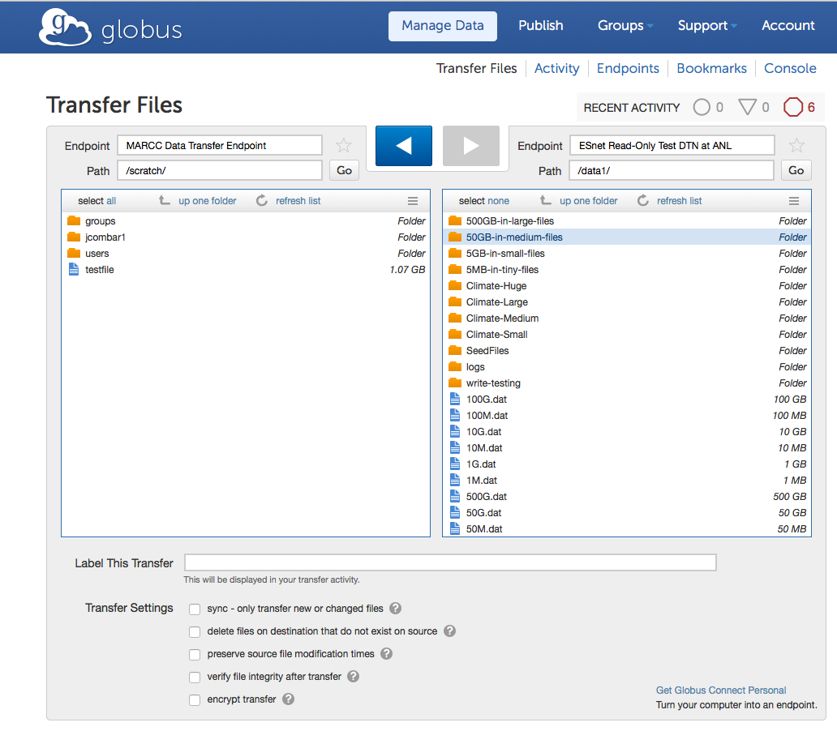
Data Transfer (globus.org)

Slide 9
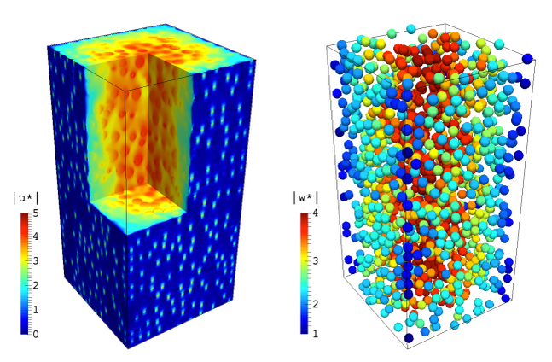
Showcase
Prosperetti (1.7M core-hours)
CFD using the Physalis method (Prosperetti et. al. 2005), which allows direct numerical integration of fluid flows with suspended particles

Slide 10
Showcase
Prof. Mark Robbins (13.7M core-hours)
Ken Hass Outstanding Student Paper Award, “Chain Ends and the Ultimate Tensile Strength of Polyethylene Fibers”, APS March meeting Baltimore, 2016.

Slide 11
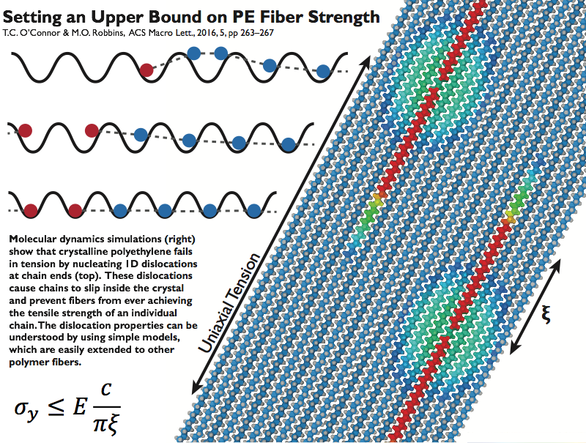

Slide 12
Data Subject to Restrictions
Landscape :
    Traditionally HPC for Science & Engineering == open data
    Security (system and file integrity)
              CPU cycles, RAM, Storage
              Some de-identified data (approval)
Regulatory Compliance
      New, unknown concept
      Additional security, RISK control, single user?
      Motivation

Slide 13
Reality
Clinical Research Computing -> confined to Med school small servers
Public Health a bit less
Computer Science, Brain Science & BME steady increment
Need for compute power, storage (usually at HPC)
With dbGaP data and ePHI data there is a need for HIPAA compliance within HPC Facilities
Notes:
dbgap database of Genotypes and Phenotypes
Health Insurance Portability and Accountability Act

Slide 14
What is at Stake
New HIPAA Omnibus Rule (2013)
Random HIPAA audits (~2014)
End to end security -> customer end (data generation) -> Network -> data analysis -> data disposal
Monitor entire research workflow

Slide 15
Standard Data Life-Cycle
Pre-Grant: Preliminary research Cyberinfrastructure design Data Management | Proposal: Preparation Budget Submission/award
Execution: Data Acquisition Data Analysis Data Management Data Sharing | Post-Grant: Publishing Data Archival Data Disposal Data Sharing

Slide 16
Confidential-Data Life-Cycle
Pre-Grant: Preliminary research Cyberinfrastructure design Data Management | Proposal: Preparation Budget IRB Process
Execution: Data Acquisition Data Analysis Data Management Data Sharing | Post-Grant: Publishing Data Archival Data Disposal Data Sharing

Slide 17
HIPAA Security Rule
Requires Administrative, physical and technical safeguards
        Ensure confidentiality, integrity and availability of all ePHI data
        Identify and Protect against reasonably identified threats to the security or integrity of the data
        Protect against reasonable anticipated, improper use or disclosures
        Ensure compliance by the workforce
        Provide means for managing risk on an ongoing fashion (process)
Security Breach Notification laws

Slide 18
Secure Research Environment
Handle data subject to restrictions, mainly HIPAA
Based on VMs and VLANs
            Security, network fragmentation, isolation
80% of documentation by MARCC 20% end user
Based on full cost recovery (business model)
Needs IRB or higher endorsement

Slide 19
Secure Research Environment (II)
Base system:
      VM with 4 cores, 8 GB RAM, 1 TB
Flexible (per request more cores more RAM)
Storage
      Add storage as needed.
Needs testing . . .
Capability to add servers & Storage
Partnership/Collaboration MARCC-Research group

Slide 20
Status
Availability Early 2017
Working on cost recovery model/SLA
Training modules
Identify best —secure—location
Future — FISMA Compliance

Slide 21
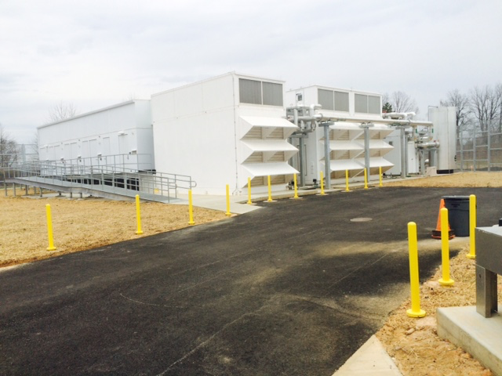
Thanks
marcc-help@marcc.jhu.edu
http://marcc.jhu.edu

