Slide 1
SciServer Compute
Mike Rippin

Slide 2
Agenda
Background and History of SciServer
Major Objectives
Current System
SciServer Compute – Now
SciServer Compute – Future
Q&A

Slide 3
Background

Slide 4
“The Project aims to create a sustainable collaborative ecosystem built around several large scientific data sets for the broader science community, based upon the expertise developed for the Sloan Digital Sky Survey (SDSS) SkyServer and associated projects.”
Notes:
Based upon the proposal, this is what SciServer is aiming for. It’s quite general in a way, but is focused on collaborative access to, and sharing of, large scientific data sets.

Slide 5
Project Management
NSF Cooperative Agreement
5 years duration, just completed first 3
Development of Cyberinfrastructure
Science Driven

Slide 6
Motivation and History
Started with the SDSS SkyServer
Goal: instant access to rich content
Idea: bring the analysis to the data
Interactive access at the core

Slide 7
Where Are We Going?
Interactive science on petascale data
Create scalable open numerical laboratories
Large footprint across many disciplines
Use commonly shared building blocks
Major national and international impact

Slide 8
Current System

Slide 9
SciServer : Core Functions
Cyber Infrastructure
Science Collaboration
SDSS Integration
Outreach & Education
Notes:
The SCiServer project as a whole has 4 main “Core Functions”
This presentation will focuses mostly on the Cyber Infrastructure, which is basically the underlying hardware and software infrastructure.
This is driven by Science Collaboration, so I will touch on that where relevant.

Slide 10
SciServer : Core Functions
Cyber Infrastructure
Science Collaboration
SDSS Integration
Outreach & Education
Notes:
The SCiServer project as a whole has 4 main “Core Functions”
This presentation will focuses mostly on the Cyber Infrastructure, which is basically the underlying hardware and software infrastructure.
This is driven by Science Collaboration, so I will touch on that where relevant.

Slide 11





Main components:
Database storage & Query:
Data analysis:
File storage:
Data exploration:
User sign-on:

Slide 12
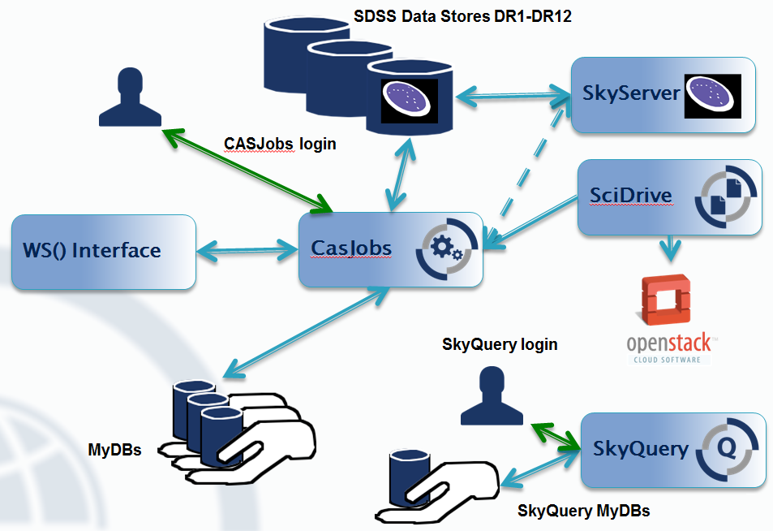
How they fit together : Original

Slide 13
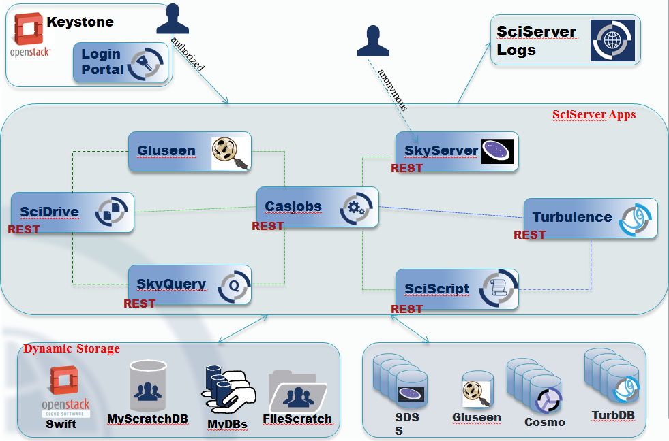
Intermediate Refactoring

Slide 14
SciServer : CyberInfrastructure
Cyber Infrastructure
Cyber Infrastructure
Hosted Data
Query
Compute
Personal Data
Single Sign-On

Slide 15
SciServer : Compute
Cyber Infrastructure
Server Cluster
Hosted Data
Query
Compute
VM
VM
Personal Data
Docker
Docker
Docker
Single Sign-On
Jupyter

Slide 16
SciServer : Compute
Cyber Infrastructure
Server Cluster
Hosted Data
Query
Compute
VM
VM
Personal Data
Docker
Docker
Docker
Single Sign-On
Jupyter

Slide 17
SciServer : Compute
Cyber Infrastructure
Server Cluster
Hosted Data
Query
Compute
VM
VM
Personal Data
Docker
Docker
Docker
Single Sign-On
Jupyter

Slide 18
SciServer : Compute
Cyber Infrastructure
Server Cluster
Hosted Data
Query
Compute
VM
VM
Personal Data
Docker
Docker
Docker
Single Sign-On
Jupyter
Notes:
Jupyter Notebooks are where Python, R, and Matlab scripts get executed.

Slide 19
SciServer : Compute
Cyber Infrastructure
INTERACTIVE & SYNCHRONOUS
Server Cluster
Hosted Data
Query
Compute
VM
VM
Personal Data
Docker
Docker
Docker
Single Sign-On
Jupyter

Slide 20
SciServer : Compute
“Engine” for executing analysis on data sets
Environment for executing Python Notebooks Interactively
Utility API Libraries in Python and R
Interacts with ALL other SciServer components that have a WS API:
Login Portal for authentication
CASJobs for Queries
SkyServer and SkyQuery for Astronomy data
SciDrive for Storage

Slide 21
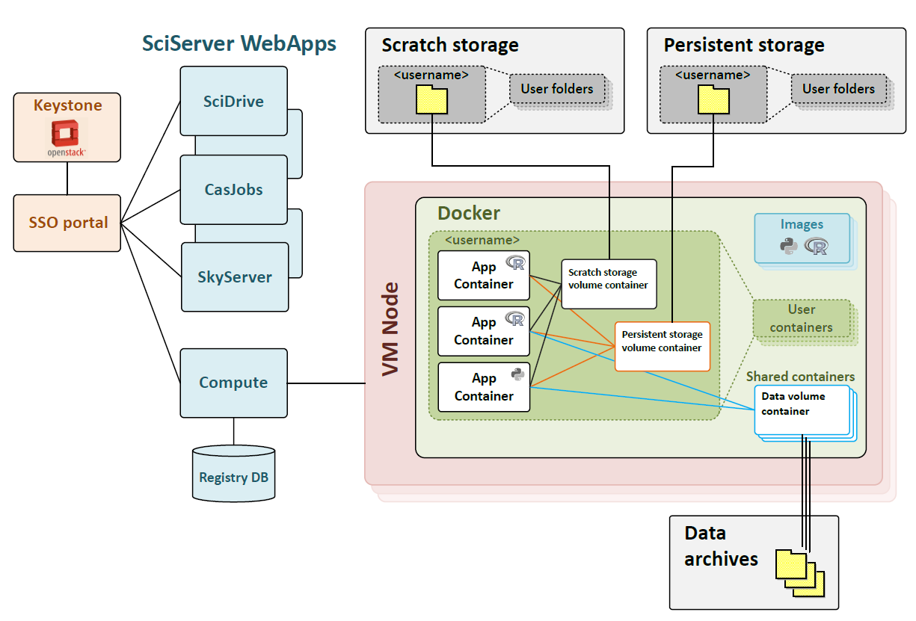
Compute Architecture

Slide 22
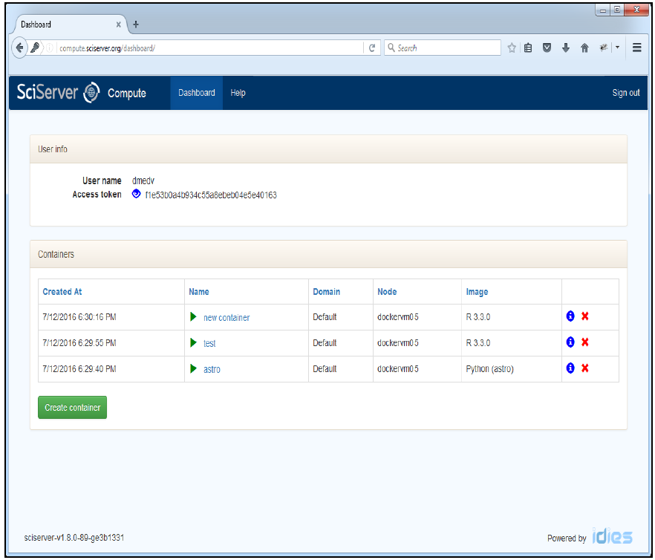
Compute Dashboard

Slide 23
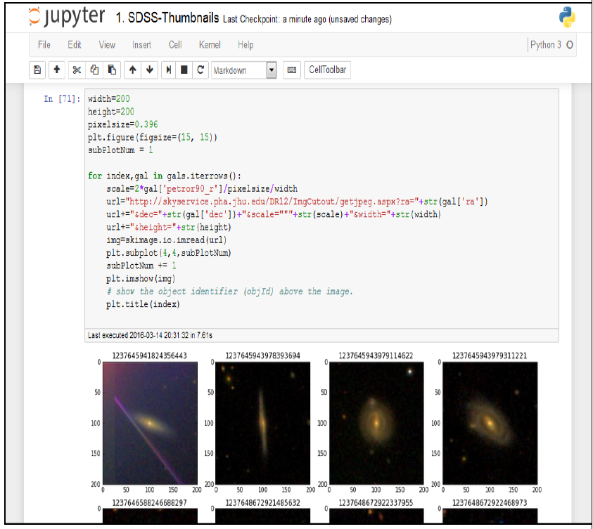
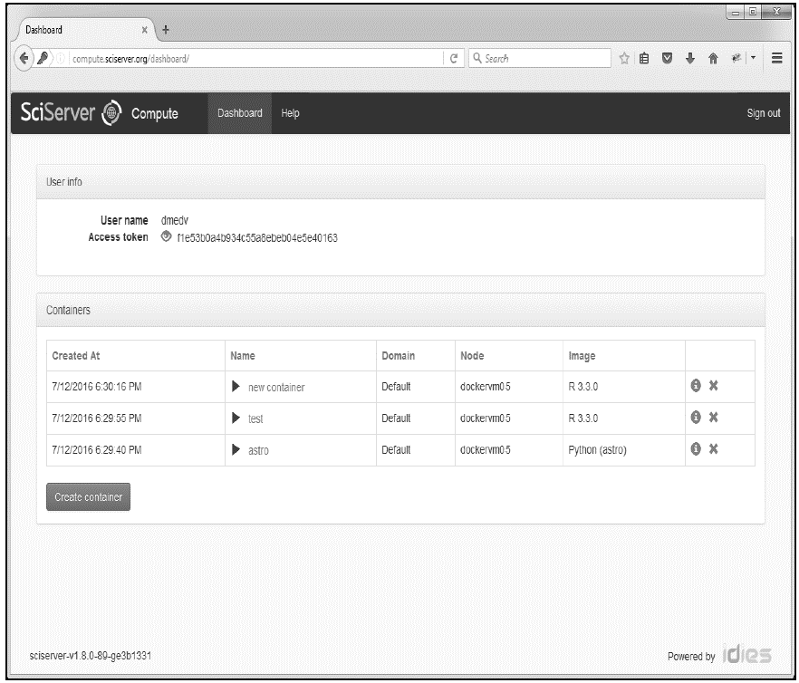
Compute : Jupyter Notebook

Slide 24
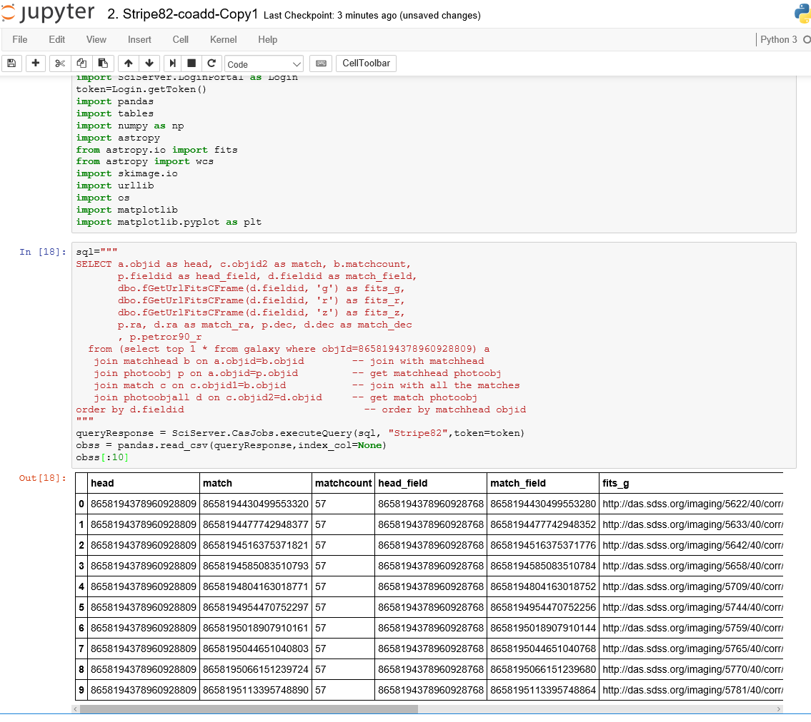
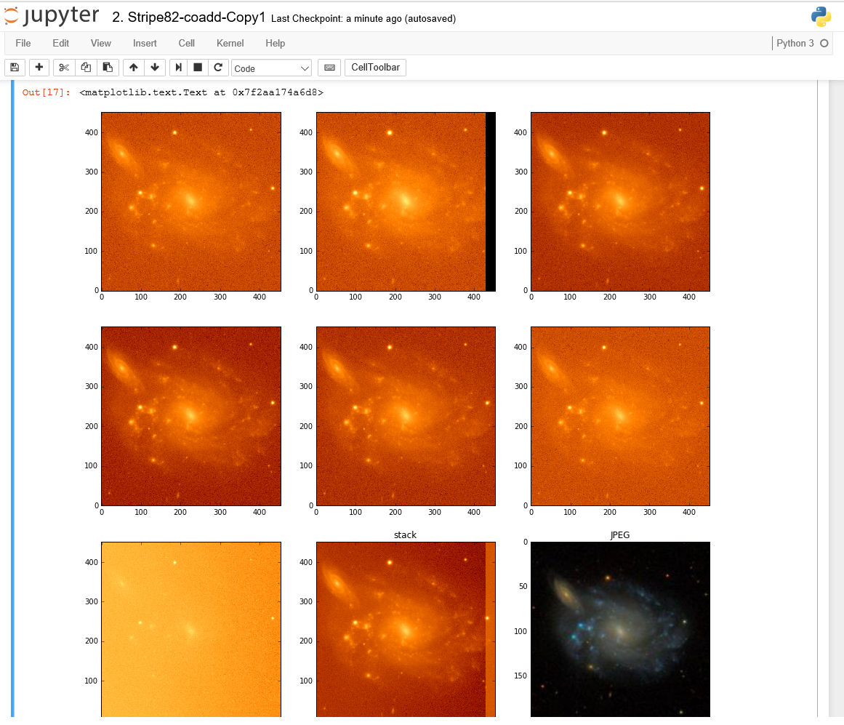
Example : Astronomy (SDSS)
Notes:
Query database from Sloan Digital Sky Survey with 100s of millions of galaxies, and retrieve the images they were detected in from auto-mounted file system (~80TB). Analyse all in python notebook.

Slide 25
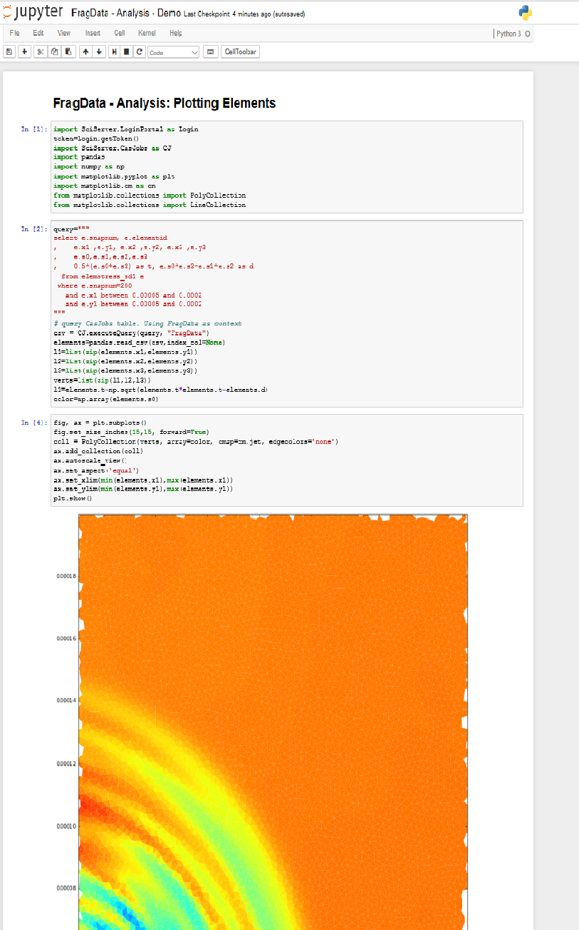
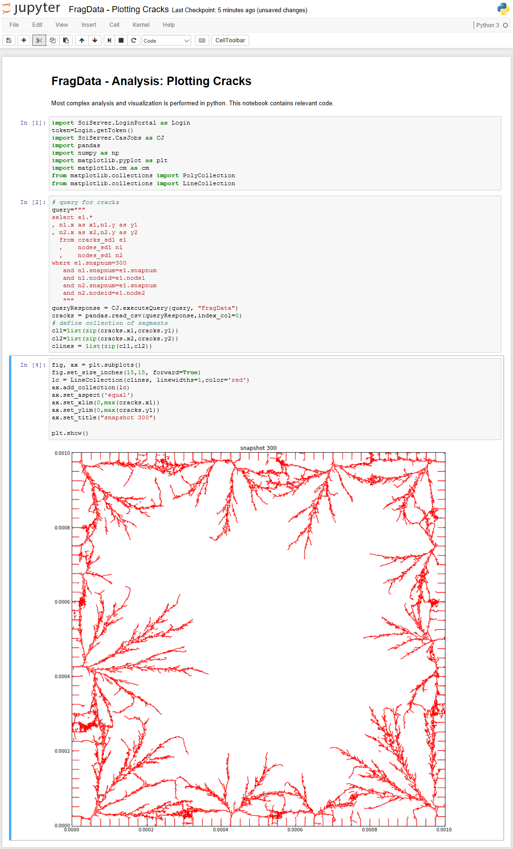
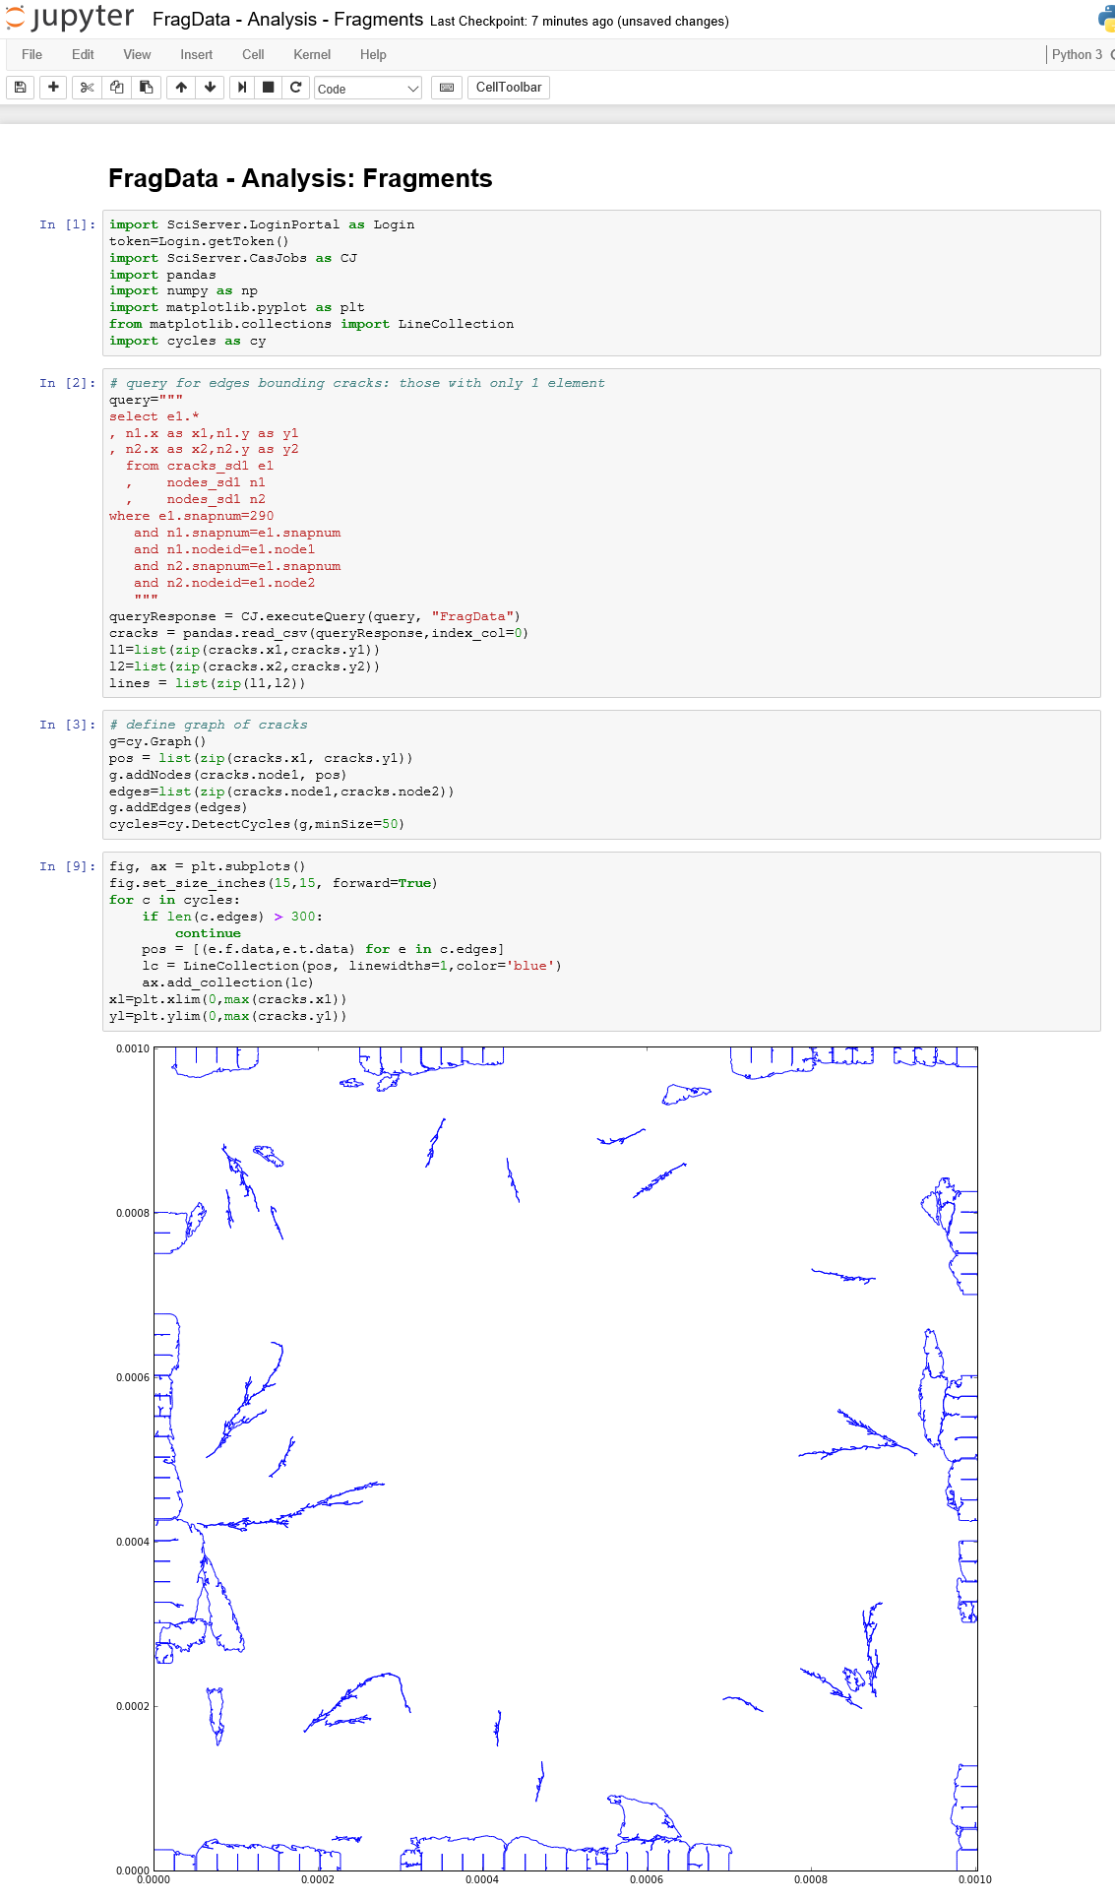
Example : Material Science
Notes:
Query and analyze simulations of fragmentation of 2-dimensional materials under external stress.

Slide 26
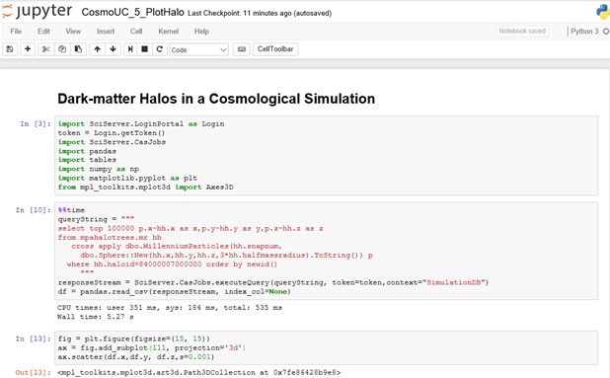
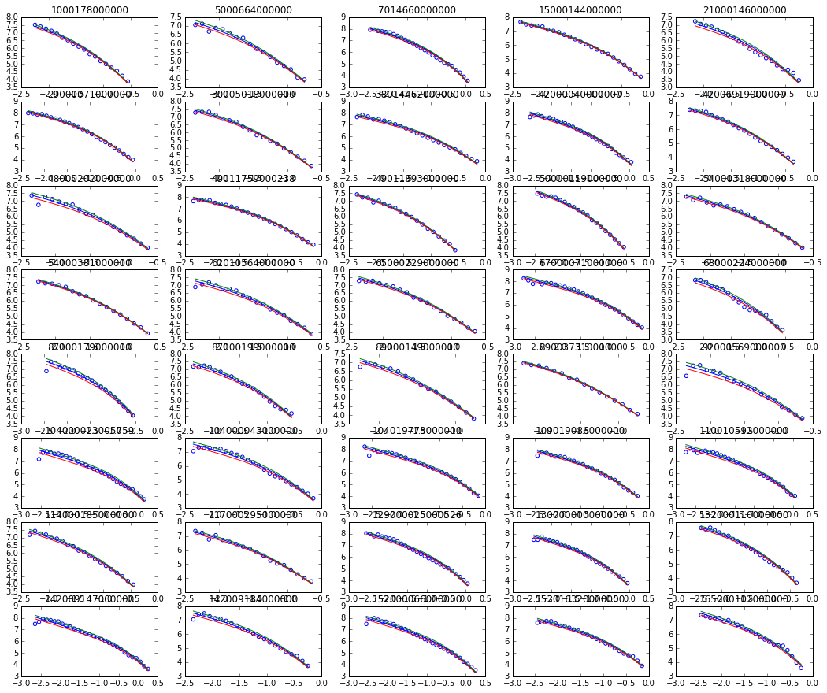
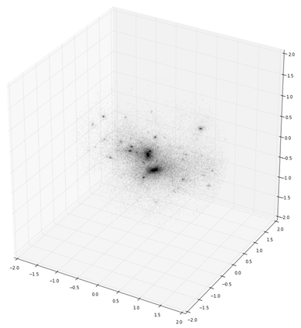
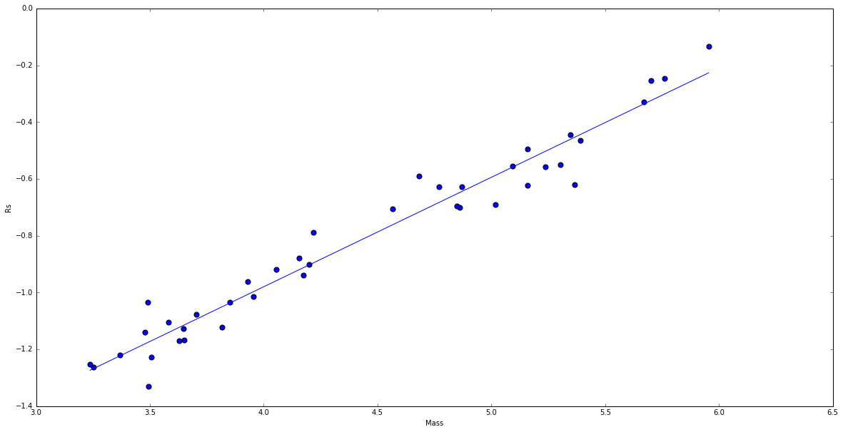
Example : Cosmology
Notes:
Analyze the properties and scaling characteristics of dark matter halos in cosmological simulations.
Querying their constituents from raw data consisting of 10 billion particles, all server-side, to determine density profiles and fit these to standard models.

Slide 27
Compute Next Stage
Notes:
I’ll now just quickly explain what we are currently in the process of completing for the next stage of not just Compute, but SciServer as a whole, that aims to develop out the scalability of the system in both data and compute requirements.

Slide 28
System Balance
HPC
Compute
cycles/byte
SciServer
DB
SciDrive
Cloud Store
SkyServer
indexing
Notes:
Its important to identify what it is we are trying to “bite-off” with SciServer Compute.
We are not trying to be a HPC copy-cat
Our focus is on computations either derived from HPC, or from observational data sets.
We are also not trying to compete with Google Drive, Dropbox or any other major cloud store.

Slide 29
Compute Development
Build on VM/Docker Architecture
Scalable non-interactive, asynchronous Job management (JOBM)
Rich Access Controls (RACM)
Distributed compute execution (COMPM)
Support Python, R, Matlab

Slide 30
Compute Manager
D
D
D
D
D
D
D
Jupyter
Dashboard UI
PUSH
Server Cluster
Script Job
PULL
Async
Job Manager
Resource and Access Control Manager
PUSH
Script Job
SciDrive Plugins
ACLs
Resources
Job List
Metadata
PULL
Async
PUSH
Query Job
CASJobs
Compute Manager
D
D
D
D
D
D
D
Server Cluster

Slide 31
Compute Manager
D
D
D
D
D
D
D
Jupyter
Dashboard UI
PUSH
Server Cluster
Script Job
PULL
Async
Job Manager
Resource and Access Control Manager
PUSH
Script Job
SciDrive Plugins
ACLs
Resources
Job List
Metadata
PULL
Async
PUSH
Query Job
CASJobs
Compute Manager
D
D
D
D
D
D
D
Server Cluster

Slide 32
Compute Manager
D
D
D
D
D
D
D
Jupyter
Dashboard UI
PUSH
Server Cluster
Script Job
PULL
Async
Job Manager
Resource and Access Control Manager
PUSH
Script Job
SciDrive Plugins
ACLs
Resources
Job List
Metadata
PULL
Async
PUSH
Query Job
CASJobs
Compute Manager
D
D
D
D
D
D
D
Server Cluster

Slide 33
Compute Manager
D
D
D
D
D
D
D
D
Jupyter
Dashboard UI
PUSH
Server Cluster
Script Job
PULL
Jupyter Notebook (INVISIBLE)
Async
<code>
{
CJ.Query()
SD.Write()
Open.File()
}
EXTERNAL
Job Manager
Resource and Access Control Manager
PUSH
Script Job
SciDrive Plugins
ACLs
Resources
Job List
Metadata
CASJobs
Persistent File
SciDrive
PULL
Async
PUSH
Query Job
CASJobs
Compute Manager
D
D
D
D
D
D
D
MyDB
ScratchDB
Scratch File
SDSS
Turbulence
MatSci
Server Cluster

Slide 34
Summary
SciServer Compute Interactive is live now
Supports Python, R, Jupyter
Runs on a 4 node cluster
Access to several domain databases
Asynchronous Job Execution early 2017
Please register with SciServer and try it out

Slide 35
Questions?

