Slide 1


Slide 2

Using Causal Inference To Make Sense of Messy Data
Ilya Shpitser
John C. Malone Assistant Professor of Computer Science
Malone Center for Engineering in Healthcare
The Johns Hopkins University

Slide 3
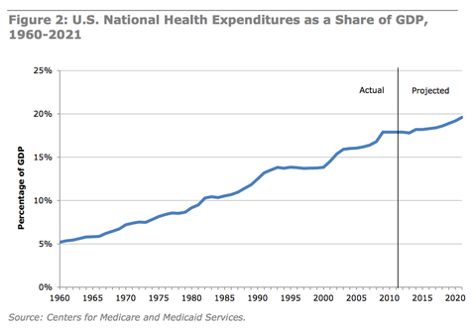
Health Care: Costs
Absolute expenditures – $3.0 trillion 17.5% GDP (2014)
Relative expenditures – 50% increase in past 10 years
Potential efficiency gains – $750 billion (2009) – more than 25% of the total
From “Best Care At Lower Costs: The Path to Continuously Learning Health Care in America” Institute of Medicine, 2012
Notes:
For 31 of the past 40 years, health care costs have increased at a greater rate than the economy as a whole
Health care costs constitute 18% of U.S. GDP
30% increase in personal income over the past decade effectively eliminated by a 76% increase in health care costs
$750B in waste

Slide 4
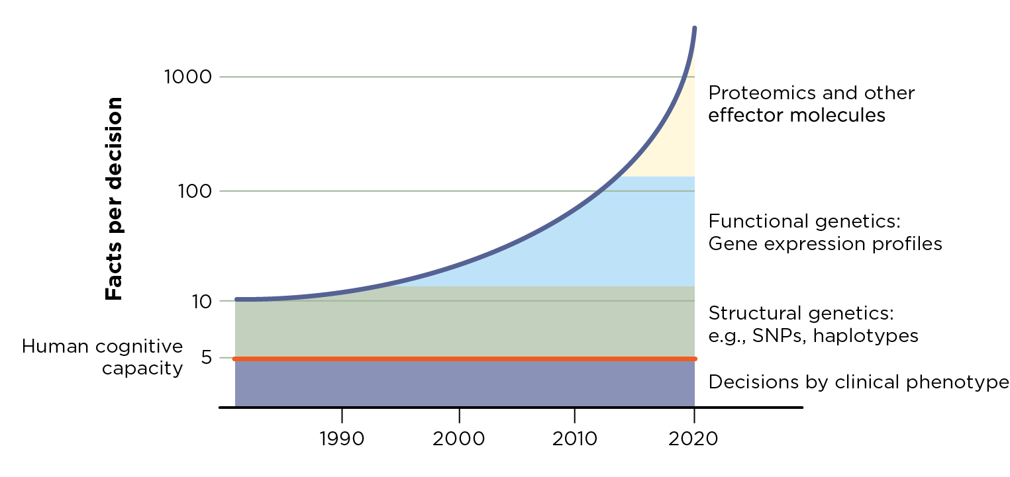
Health Care: Complexity
More conditions – e.g. 79 year old patient with 19 meds per day
More clinicians – e.g. 200 other doctors treating patients of a single primary care doctor
More choices – e.g. hundreds of diagnostic factors; dozens of treatments
More activities – e.g. ICU clinicians with 180 activities per day
From “Best Care At Lower Costs: The Path to Continuously Learning Health Care in America” Institute of Medicine, 2012
Notes:
Physicians in private practice interact with as many as 229 other physicians in 117 different practices just for their Medicare patient population
ICU clinicians have 180 activities per patient per day
Chronic disease: a 79 year old patient with osteoporosis, osteoarthritis, type 2 diabetes, hypertension, and chronic obstructive pulmonary disease: 19 medications per day

Slide 5

Malone Center Mission:
To catalyze and accelerate the development, translation, and deployment of research-based innovations that advance the effectiveness and efficiency of health care.
Smart Devices and Systems for Healthcare creating devices and information analytics that enhance care in the clinical environment
Modeling and Optimization for Healthcare Delivery exploiting traditional and new sources of data to enhance the efficiency and quality of healthcare
Mobile Health and Healthy Living developing innovations that support individuals outside traditional care environments, that enhance health in everyday life, and that augment traditional health care approaches
Notes:
We have a unique opportuinty at JHU to play in this space
We have to think beyond point solutions, and toward methodlogies and a culture of engineering innovation that will sustain and accelerate continuous improvement in healthcare.
We are a startup, and we are unique … its exciting but important that we develop a focus ... Let me give you a sense of how I see the landscape today (which in the world of startups will be change as we learn more)

Slide 6
My Work at the Malone Center
Science from biased data
Poor treatment outcomes: bad treatment, poor adherence, confounding?
Decision support
Treatment decisions are a complex combination of medical training and institutional knowledge.
Can we use learning algorithms to help?
Dealing with missing data
Most datasets in practice have systematically missing entries. This creates bias if not properly handled.
How do we handle complex missing data?

Slide 7
Science from biased data
Better healthcare means making better decisions
Decisions are about causal efficacy
Randomized controlled trial data often not available
Practical data: confounding bias, selection bias, missing data, measurement error
The field of causal inference aims to provide answers in this challenging setting

Slide 8
Adherence in HIV Patients
Setting: longitudinal observational studies of HIV patients (PEPFAR program).
Outcome: viral failure, treatments are anti-retroviral therapies
Question: how are outcomes affected by:
Poor drug choice, or
Poor adherence
Formally, adherence mediates (all?, some?) of the effect of the drug.

Slide 9
Adherence as a causal problem
What causes virological failure in patients?
A single slice of a longitudinal study:
C (age, gender, etc.) A (HIV drug), D (white blood cell #), M (% pills taken), Y (outcome)
Lots of reasons Y might be poor!

Slide 10
Predicting the hypothetical
Every patient was on some drug, had some toxicity, and some adherence level.
What would have happened to their outcome
If toxicity were low?
If adherence were high?
RCTs possible for this, but expensive, lengthy.
Alternative approach for existing, messy data:
Fit observed data models
Combine in a particular way to mimic the right RCT.
Hard in general due to confounding, selection bias.

Slide 11
Predictions under counterfactual adherence
How would less effective treatment do if adherence was of more effective treatment?
Most significant effects negative. Meaning:
More effective treatments are “harder to take.”
Effectiveness driven by biochemistry, not adherence.
 |  | Baseline treatment
 |  | 2 | 3 | 4 | 5
Comparison treatments | 1 | 0.412* | 0.210 | -0.059 | -0.068*
 | 2 | - | 0.132 | -0.495* | -0.198*
 | 3 | - | - | -0.566* | -0.135*
 | 4 | - | - | - | -0.027*

Slide 12
Clinical decision support
Exploiting patterns in complex data is difficult for (unaided) humans, even very experienced clinically.
Naïve analysis can be misleading
Example: in crashing sepsis patients, treatment is associated with worse outcomes.
Wanted: a tool that can output counterfactual outcomes at a complex decision point

Slide 13
Decision Support
Treatment 1
Treatment 2
MAP
Treatment 2 or 3?
MAP
3
3
3: risk 60%
2
2
1: risk 80%
time
time
Causal inference methods exist for predicting counterfactual outcomes based on factual data.
Work in progress (with Suchi Saria’s group) on learning treatment policies.

Slide 14
Missing Data
Ubiquitous problem.
Often handled poorly.
Possibility of severe bias (example):
HIV prevalence in Zambia Demographic and Health Survey
Sick people (severely) underreport
Complete case analysis underestimates prevalence by as much as 10%.

Slide 15
Dealing With Missing Data
K
K
o
o
o
o
o
Logistic regression
o
☑
Sample size
☒
o
o
o
o
o
o
o
o
x
x
x
o
o
x
x
x
x
o
x
o
CR
CR
K
Missing data
o
K
o
o
o
o
o
Non-linear complex separation
o
o
o
o
o
o
x
o
o
x
x
x
x
o
x
x
o
o
o
x
x
x
x
x
x
o
x
o
o
mean
CR
CR

Slide 16
New methods for missing data
Most complex setting is data missing not at random (MNAR)
People don’t report sexual history due to that history.
Voting intent, intermittent dropout, etc.
Easier settings: reweigh observed cases based on typicality (recent NYT article on polls about this)
Developed new extension of this to MNAR data.
More generally: work on a complete theory of when missing data is a solvable problem.

Slide 17
Selected projects
Decision support in the ICU (with Suchi Saria and Katie Henry)
Next generation methods for data missing not at random (with Eric Tchetgen Tchetgen and James Robins)
Mediation analysis for understanding adherence in HIV studies (with Eric Tchetgen Tchetgen and Phyllis Kanki)
Mediation analysis for study of radiation side effects (with Todd McNutt and the Oncospace Consortium)

Slide 18
THANK YOU! Ilya Shpitser (ilyas@cs.jhu.edu)

