Slide 1

Affectedness & Emergence of Differential Object Marking in Alor-Pantar languages
Marian Klamer, Leiden University
“Inventory of Affectedness”, Nanyang Technological University, Singapore, June 17-20, 2014

Slide 2
Differential Object Marking in the Alor-Pantar family
Different patterns
Different triggers
No evidence for DOM in ancestor language

Slide 3
What is DOM?
DOM: “The non-uniform grammatical marking of objects”. Variation that occurs “within one and the same language with objects of one and the same verb”
(Dalrymple and Nikolaeva 2011: 1)

Slide 4
Background
0º
15ºS
105ºE
120ºE
135ºE
150ºE
Indonesia
1000 km
Australia

Slide 5
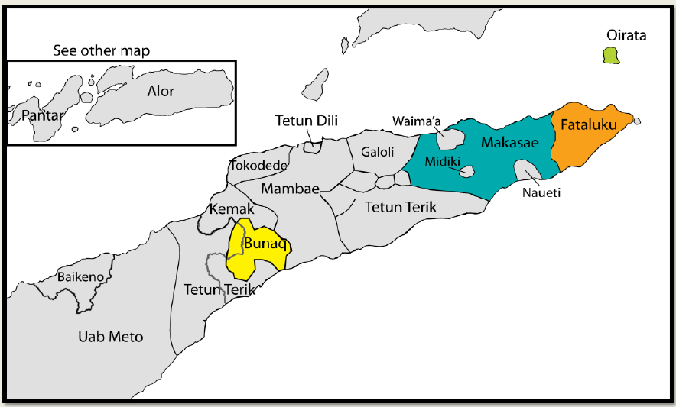
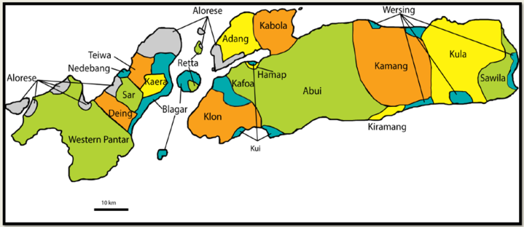
Background
Timor

Slide 6

Background
Teiwa: 4,000 speakers, Kaera: 5,500 speakers
Abui: 16,000 speakers

Slide 7
Typological profile AP languages
SV, APV, head-final, serial verbs
No case marking
Pronominal prefixes mark P on verb
Identical prefix encoding P and POSS
Notes:
Big issue for the area and wider. [DPB: note that the possessor prefix is used to nominalize verbs in Teiwa - see Marian’s grammar page 76]

Slide 8
History
Proto-Alor Pantar
Semantic / Split-S
Teiwa
Accusative
DOM
Kaera
Accusative/Split S
DOM
Abui
Semantic
DOM
8

Slide 9
What is P?
P, A, S are comparative concepts
P = least Agent-like argument of transitive clause
Typical transitive verbs:
hit, kick, carry, search for, take, hold
(cf. Tsunoda 1981, Comrie 1989:111, Haspelmath 2011: 545, 547)
Not: psychological verbs (think, remember), speech verbs (say), transfer verbs (give, buy)

Slide 10
Differential Marking of P in Kaera, Teiwa, Abui
P is verbal prefix, NP, or both
P is complement of single or (grammaticalised) serial verb
Variable choice of P-paradigms

Slide 11
Kaera DOM
Verbal inflection classes
1. P is prefix or free constituent (‘hold’) (prefix often triggered by animacy)
2. P is free constituent only
(‘hit’, ‘carry’, ‘take’, ‘search for’)
P is obligatory prefix: affected Ps, including causees
(Klamer 2014)

Slide 12
Kaera DOM
P +/- animate (Tendency, NO dichotomy!)
+ Animate
Nang dur gi-pin-o.
1SG mouse 3PL-hold-FIN
‘I caught [the] mice.’
- Animate
Gang gelas __ pin-o.
3SG glass(Mly) hold-FIN
‘He holds (a) glass.’

Slide 13
Kaera DOM
P +/- affected
Nang lampu tub-o
1SG lamp burn-FIN
‘I light a lamp.’
Kabakut gu gu-tub-o.
cigarette that 3SG-burn-FIN
‘Smoke that cigarette.’

Slide 14
Kaera DOM
P is free constituent only
Nang gang kup-o.
1SG 3SG hit-FIN
‘I hit him/her/it.’
*Nang gu-kup-o.
1SG 3SG-hit-FIN
Intended: ‘I hit him/her/it.’

Slide 15
Kaera DOM
P is obligatory prefix
Gang uxai gu ga-bar.
3SG child that 3SG-kill
‘He killed that child.’
*Gang uxai gu bar.
3SG child that kill
Intended: ‘He killed that child.’

Slide 16
Kaera DOM
P is less affected
Gang gelas __ pin-o.
3SG glass(Mly) hold-FIN
‘He holds (a) glass.’
Gang gelas wang pin-o.
3SG glass (Mly) be/exist hold-FIN
‘He touches a glass’

Slide 17
Wang ‘be, exist’
Siax wang
chicken be/exist
‘There are chicken’

Slide 18
Wang introduces Location/Goal arguments
Nang sepeda wang amar.
1SG bicycle (Mly) be/exist move
‘I go by bike’. (Lit. ‘I move on a bicycle’)
gang ekeng abang wang gi.
3SG climb.up village be/exist go
‘He climbs up to the village’

Slide 19
Location/Goal = Less Affected P
Pan tarak-o.
candle.nut pick-FIN
‘Pick candle nuts.’
Pan wang tarak-o.
candle.nut be pick-FIN
‘Pick candle nuts [by selecting them from a pile that also contains other stuff]’

Slide 20
History of Kaera DOM morphemes
Proto-AP
A *ga(N) P *ga- POSS *ge-
A
P
Animate: NP, ga-, gV-
Affected: NP, ga-, gV-
POSS
Less affected: NP wang V
20

Slide 21
Kaera DOM: Triggers
Verbal inflection classes
Inherent properties of argument (+/-ANIM)
Relation predicate and argument (+/- AFF)
Less affectedness: [P wang V]

Slide 22
Teiwa DOM
(Klamer 2010)
P +/- Animate
Na qavif ga-mar gi si....
1SG goat 3SG-take go CONJ
‘I follow the goat and...’
Na met __ mar-an ma ha-mian
1SG betel vine take-REAL come 2SG-give
‘I take some betel vine (and) give (it) to you’

Slide 23
Teiwa DOM
P +/- Animate: Sometimes a special prefix!
Na gi gaɁ-tad
1SG go 3.ANIM-hit
‘I go hit him’
Na gi ga-tad
1SG go 3SG-hit
‘I go hit it’

Slide 24
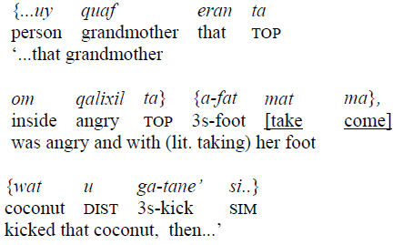

Teiwa DOM
P is (secondary) topic
Klamer 2010

Slide 25
Teiwa DOM
P +/- Affected
Na bif g-oqai ga-boxan
1SG child 3-child 3SG-guard
‘I mind (my) children’ [regular, long-term]
Na bif g-oqai wan boxan
1SG child 3-child be guard
‘I am minding (the) children’ [a few hours]

Slide 26
Teiwa DOM
Less Affected?
Na Pan her deqai
1SG candle.nut stem cut.clean
‘I cut away the candle nut tree’
Na Pan her wan deqai
1SG candle.nut stem be cut.clean
‘I cut away [stuff] around the candle nut tree’

Slide 27
Wan ‘be, exist’
Saxa’ wan
chicken be
‘There are chicken’

Slide 28
Wan introduces “Circumstantial” argument
blau ‘to chat’
wan blau ‘to chat about s.th.’
teqai ‘clean up s.th.’
wan teqai ‘clean up around s.th.’
de’ ‘burn s.o/s.th.’
wan de’ ‘burn along with s.o/s.th.’

Slide 29
History of Teiwa DOM morphemes
Proto-AP
A *ga(N) P *ga- POSS *ge-
A
P
Topic: ga-
Animate: ga-, gaɁ-Inanimate: NP, ga-
POSS
Less affected: NP wan V
29

Slide 30
Abui
(Kratochvíl 2007, 2011, 2014)
3SG prefixes
PAT ha-
LOC he-
REC ho-
BEN hee-
GOAL hoo-

Slide 31
Abui
3SG prefixes relevant in DOM
PAT ha-
LOC he-
REC ho-
BEN hee-
GOAL hoo-

Slide 32
Abui DOM
P +/- Animate
Di kanai do Ø bol took
3SG canari.nut PROX hit drop
‘He was hitting these canari nuts dropping [them]’
Baloka ne-toku he-bol he-balasi ba…
k.o.grass 1SG.POSS-leg 3SG.LOC-hit 3SG.LOC-beat SIM
‘The [sharp] grass hit my legs slashing them…’
(Kratochvíl 2014: 566)

Slide 33
Abui DOM
P +/- Human
Baloka ne-toku he-bol he-balasi ba…
k.o.grass 1SG.POSS-leg 3SG.LOC-hit 3SG.OBJ-beat SIM
‘The [sharp] grass hit my legs slashing them…’
Markus di he-l bol ne-l balasa
M. 3SG 3SG.LOC-give hit 1SG.LOC-give beat.CONT
‘Markus is beating him’
(Kratochvíl 2014: 566)

Slide 34
Abui DOM
Animacy
-ANIM: LOC +ANIM: PAT
he-wik ‘carry it [thing]’ ha-wik ‘carry it [dog]’
Semantic role of P
BEN GOAL
hee-wik ‘carry for him’ hoo-wik ‘[give] to him to carry’
(Kratochvíl 2014: 558-559)

Slide 35
Abui DOM
Affectedness
-AFF: LOC he- +AFF: PAT ha-
he-dik ‘stab at it’ ha-dik ‘pierce it through’
he-pung ‘hold it’ ha-pung ‘catch it’
he-lak ‘take it apart’ ha-lak ‘demolish it’
(Kratochvíl 2011: 596, p.c.)

Slide 36
Abui DOM
All sorts of factors involved in DOM
Inherent properties of argument (+/-ANIMATE / HUMAN P)
Relation verb-argument (+/-AFFECTED P)
Semantic role of P (Pat ≠ Loc ≠ Ben ≠ Goal)
Inflectional verb classes

Slide 37
History of Abui DOM morphemes
Proto-AP
A *ga(N) P *ga- POSS *ge-
A
P
ha-
he-
ho-
hee-
hoo-
POSS
37

Slide 38
History of Abui DOM morphemes
Proto-AP
A *ga(N) P *ga- POSS *ge-
A
P
+Affected: ha-
-Affected: he-
ho-
hee-
hoo-
POSS
38

Slide 39
History of Teiwa DOM morphemes
Proto-AP
A *ga(N) P *ga- POSS *ge-
A
P
Topic: ga-
Animate: ga-, gaɁ-Inanimate: NP, ga-
POSS
Less affected: NP wan V
39

Slide 40
History of Kaera DOM morphemes
Proto-AP
A *ga(N) P *ga- POSS *ge-
A
P
Animate: NP, ga-, gV-
Affected: ga-, gV-
POSS
Less affected: NP wang V
40

Slide 41
Triggers of DOM in AP languages
Inherent properties of argument (+/- ANIM)
Relation verb-argument (+/-AFFECTED)
Semantic role of P
Lexicalised patterns: Inflectional verb classes

Slide 42
Etymology of DOM in AP
Prefix for P *ga in proto-language survives as PAT P prefix in all languages
Kaera and Teiwa employ dichotomy free vs. bound P to encode affectedness (free:-AFF)
Kaera and Teiwa also recruited existential verb wan(g) which introduces “circumstantial” arguments to encode less affectedness
Abui recruited POSS *ge- to encode LOC P
Abui employs LOC vs. PAT prefix dichotomy to encode affectedness (LOC: –AFF)

Slide 43
Conclusions: Affectedness
Kaera and Teiwa mark less affected arguments more distinctly than +affected ones
In AP, less affected Ps are encoded like possessors, locations, or goals
Less affected P’s in AP are either free standing arguments of an existential verb in a serial construction (Kaera, Teiwa), or a locative verbal prefix (Abui)

Slide 44
Questions
How stable are expressions of affectedness historically?
Are they typically passed down to daughter languages, or is it more common to innovate them?
Is it possible to reconstruct the role of affectedness in the encoding of P for proto-AP?

Slide 45
Research Agenda
Focus on P of canonical transitive verbs (‘direct effect’, non-resultative) verbs (hit, kick, carry, search for, take, hold) (Tsunoda 1981, Comrie 1989, Haspelmath 2011)
Chart encodings of P of these verbs in AP languages
Can P vary in affectedness?
What is formally expressed: -affectedness, or + affectedness?
Chart variation in expressions; attempt reconstruction??

Slide 46










Thanks to joint work done by.... & funds provided by...
Sebastian Fedden
Grev Corbett
Dunstan Brown
Frantisek Kratochvil
Laura Robinson
Antoinette Schapper

Slide 47
References
Comrie, B. 1989. Language Universals and Linguistic Typology. Oxford: Blackwell.
Dalrymple, M. & I. Nikolaeva. 2011. Objects and information structure. Cambridge: CUP.
Haspelmath, M. 2011. On S, A, P, T, and R as comparative concepts for alignment typology. Linguistic Typology 15 (2011), 535-567.
Fedden, S., D. Brown, F. Kratochvíl, L. Robinson & A. Schapper. 2014. Variation in pronominal indexing: lexical stipulation vs. referential properties. Studies in Language.
Holton, G., M. Klamer, F. Kratochvil, L. Robinson, A. Schapper. 2012. The historical relation of the Papuan languages of Alor and Pantar. Oceanic Linguistics 51(1):87-122.
Klamer, Marian. 2010. A grammar of Teiwa. NY Berlin: De Gruyter Mouton.
Klamer, Marian. 2014. Kaera. In: Antoinette Schapper (ed.): Timor-Alor-Pantar languages: Sketch Grammars. Berlin: de Gruyter Mouton.
Klamer, Marian & Frantisek Kratochvíl. 2006. The role of animacy in Teiwa and Abui (Papuan). Proceedings of BLS 32. Berkeley: BLS.
Kratochvíl, Frantisek. 2007. A grammar of Abui. PhD diss. Leiden. Utrecht: LOT.
Kratochvíl, Frantisek. 2011. Transitivity in Abui. Studies in Language 35, 3: 588-635.
Kratochvíl, Frantisek. 2014. Differential argument realization in Abui. Linguistics 52, 2: 543-602.

Slide 48
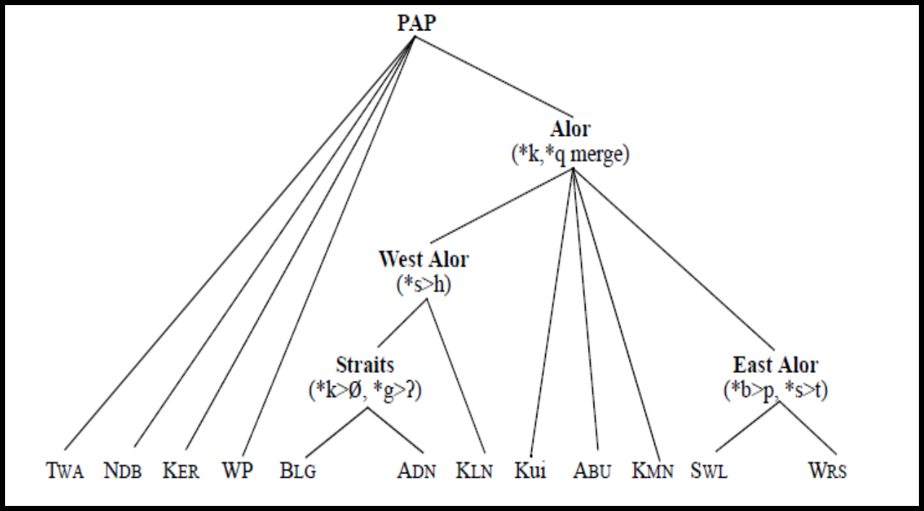

History
Proto-Alor Pantar

Slide 49
Proto-AP Split S
Proto-AP *ga-
{S_{P} , P}
TH
EXP
PAT
REC/BEN
Volatile alignment system in Proto language
Polysemous ‘PAT’ prefix
1 expression
2 grammatical functions
4 semantic categories

Slide 50
Proto-AP *ga-
{S_{P} , P}
TH
EXP
PAT
REC/BEN
ha-
PAT
TH
he-
EXP
REC/BEN
ho-
LOC
Development of specialized prefixes

