Slide 1
Translation Equivalence and Synonymy: Preserving the Synsets in Cross-lingual Wordnets
Olivia O.Y. Kwong
The Chinese University of Hong Kong
oykwong@arts.cuhk.edu.hk

Slide 2
Infrastructure of Princeton WordNet
Synsets as building blocks
Unordered sets of words that “denote the same concept and are interchangeable in many contexts”
Synonymy / mutual substitutability
Nouns, verbs, adjectives, adverbs
Adjectives not hierarchically ordered, considered polysemous but of limited use in conveying info

Slide 3
Princeton WordNet
Merge Model
Select vocabulary and develop synsets separately and locally
Generate equivalence relations to PWN
Expand Model
Start with PWN vocab and synsets
Translate synsets into target language using bilingual dictionaries
Wordnets in other languages

Slide 4
Chinese Wordnets
Various attempts (Huang et al., 2004; Xu et al., 2008; Huang et al., 2010; Wang and Bond, 2013)
(Semi-)automatic identification of translation equivalents with human verification
Some limited the number of translation equivalents for a synset, while others intentionally added more entries
Chinese Open Wordnet (Wang and Bond, 2013)
Follow Expand Model, with detailed guidelines for checking
Chinese translations obtained by merging existing data, checked manually, adding new translations from authoritative bilingual dictionaries
High coverage but possibly lower accuracy
Adjectives: 13.8% of 4,960 core synsets

Slide 5
Potential Blind Spots
01586342-a
nice (pleasant or pleasing or agreeable in nature or appearance)
体贴(的)，合意(的)，美好(的)，和蔼(的)，友好(的)，令人愉快(的)，令人快乐(的)，讨人喜欢(的)
好
Generalness of the concept
pleasant / pleasing / agreeable
nature / appearance
==> ANYTHING !
和蔼 --> person
美好 --> inanimate obj

Slide 6
Potential Blind Spots
01372049-a
kind (having or showing a tender and considerate and helpful nature; used especially of persons and their behavior)
体谅(的)，体贴(的)，善良(的)，仁慈(的)，和善(的)，宽厚(的)，友善(的)，好心(的)，好心肠(的)，亲切(的)，温和(的)，和蔼(的)，宽宏大量(的)，友好(的)，乐于助人(的)
considerate
friendly
helpful
和蔼 exists in both synsets
--> “nice” and “kind” synonymous?
--> Multiple senses of 和蔼 in most dictionaries?
--> Legitimate to treat it as translation equivalents for both synsets?
--> 和蔼 and 体贴 synonymous?
--> Still qualify as a synset?

Slide 7
Two Issues
Seriousness of the problem across different parts of speech
Nouns and verbs may have more distinct references
Fuzziness and subjectivity involved in adjectives
Problem expected to be more pronounced among adjectives
When the coverage of the meanings by the translation equivalents is at the expense of violating the requirements for synsets, are there better ways to handle such cases?

Slide 8
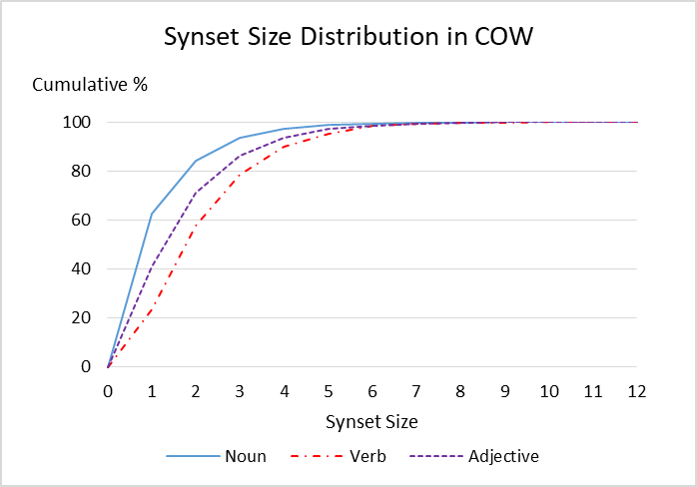
Synset sizes:
Nouns (1-39 items)
Adjs (1-15 items)
Verbs (1-13 items)
Overall tendency:
Nouns < Adjs < Verbs

Slide 9
Examples (Nouns)
12896307-n
black nightshade, common nightshade, poison-berry, poisonberry, Solanum nigrum (Eurasian herb naturalized in America having white flowers and poisonous hairy foliage and bearing black berries that are sometimes poisonous but sometimes edible)
老鸦酸浆草, 乌归菜, 野葡萄, 酸浆草, 救儿草, 黑姑娘, 天泡果, 地戎草, 七粒扣, 山海椒, 黑茄, 野茄子, 天泡草, 地泡子, 天天茄, 天茄子, 野辣 角, 野海椒, 后红子, 天茄苗儿, 老鸦眼睛草, 水茄, 水苦菜, 野伞子, 天茄菜, 山辣椒, 狗钮子, 苦葵, 苦菜, 野茄菜, 飞天龙, 龙葵, 耳坠菜, 乌疔草, 野辣椒
09823502-n
aunt, auntie, aunty (the sister of your father or mother; the wife of your uncle)
妗, 姑母, 伯母, 姑姑, 老大妈, 阿姨, 妗母, 叔母, 姑妈, 舅母, 姑, 姨妈, 姨, 舅妈, 婶子, 婶婶, 姨母, 婶母

Slide 10
Examples (Adjectives)
01256332-a
hot (extended meanings; especially of psychological heat; marked by intensity or vehemence especially of passion or enthusiasm)
流行(的), 热切(的), 激烈(的), 热门(的), 才发行(的), 急躁(的), 销路好(的), 刚出版(的), 轰动一时(的), 最新(的), 紧缺(的), 激动(的), 狂热(的),热烈(的),时新(的)
popular
impatient
hot topic
temper
new book
love affair
argument
…

Slide 11
Examples (Verbs)
01215137-v
arrest, pick up, nail, apprehend, nab, collar, cop (take into custody)
捕捉, 捉到, 捕获, 逮捕, 拘留, 拘押, 拘捕, 抓住, 抓获, 当场逮捕, 擒获, 逮住
Too general
Over-specific

Slide 12
Adjectives and Non-synsets
Examined 200 top-sized adjective synsets from COW
At most 27 out of 200 do not contain phrasal members
Show that bilingual dictionaries tend to provide translated definitions or paraphrase instead of or in addition to translation equivalents
Compatibility with WordNet structure is questionable
Possible causes of the non-synsets?

Slide 13
Different Sense Distinctions
00411886-a
civilized, civilised (having a high state of culture and development both social and technological)
文明化(的), 有礼貌(的), 有教养(的), 开化(的), 文明(的), 文雅(的)
01947741-a
cultured, polite, civilized, civilised, cultivated, genteel (marked by refinement in taste and manners)
文雅(的), 有礼貌(的), 优雅(的), 有教养(的), 有礼(的), 文明(的), 有先进文化(的), 有修养(的)
More collective sense
？
？
？
✓
✓
✓
elegant
polite
cultivated
More personal and individual behaviour

Slide 14
Over-interpretation of Concepts
02328659-a
docile (willing to be taught or led or supervised or directed)
易管教(的), 驯服(的), 易教育(的), 易驾驭(的), 可教导(的), 容易教(的), 听话(的),
驯良(的), 愿学习(的), 易训练(的), 温顺(的), 顺从(的), 易控制(的)
Lexicalised: 驯服，温顺，听话 ✓
Phrasal: 易管教 (easy to teach)，易驾驭 (easy to control) ✓
But 愿学习 (willing to learn) == willing to be taught / easy to control ??

Slide 15
Multiple Facets of Concepts
02964782-a
Chinese (of or pertaining to China or its peoples or cultures)
中国文化(的), 汉, 华, 中文(的), 中国人(的), 汉语(的), 中国话(的), 中国(的), 中
Pertains to various aspects relating to China, but
中国人 == 中国话 ？？

Slide 16
Related but Subtly Different Words
00372111-a
brown, brownish, dark-brown, chocolate-brown (of a color similar to that of wood or earth )
咖啡色(的), 呈褐色(的), 黑褐色(的), 茶褐色(的), 棕色(的), 褐色(的)
Different hues and intensities of “brownness”

Slide 17
Contradictory Connotation
00438909-a
sharp, shrewd, astute (marked by practical hardheaded intelligence)
狡黠(的), 锐利(的), 精明(的), 狡猾(的), 机敏(的), 诡计多端(的), 锋利(的)
-
+
-
+
-

Slide 18
Handling Extra-synset Information
Conceptual and lexical gaps across languages
Useful info for language learning and translation by humans and machines alike
Importance and potential use of multiple forms and renditions in a target language
Value-adding to accommodate them in wordnets in some way
Basic synset structure should be maintained

Slide 19
1. Lexicalised Items Only
Unless no lexicalised translation equivalent is available in target language
Avoid over-interpretation
01251128-a cold (having a low or inadequate temperature or feeling a sensation of coldness or having been made cold by e.g. ice or refrigeration)
冰，冻，冷，寒，冰冻，冰冷，寒冷，气温低，温度不足，温度没有达到要求

Slide 20
2. Language-specific Extensions
Separate layer of class to store non-lexicalised expressions conveying meaning close enough to the original synset
Should be a language-specific structure, not the core wordnet structure or the Inter-Lingual-Index
Linked to base concepts

Slide 21
3. Comparable Specificity
For very general or highly polysemous adjectives, similarly general equivalents should be included in corresponding synset
Collocation-specific equivalents indicating different facets or senses should be captured at a subsuming level
If no corresponding synset for specific meaning in PWN, add extra synset in target language wordnet linked to general synset
Link specific meanings with corresponding synsets in PWN with similar-to
Wise
聪明，聪颖
General
Smart
聪明，聪颖
similar_to
similar_to
sagacious, perspicacious, sapient
睿智
Specific
sharp, shrewd, astute
精明，机敏

Slide 22
4. Utilisation of Pertainym Relation
clever, wise, smart, intelligent, sharp, sagacious, canny …
聪明，聪颖，聪敏，机智，睿智，英明，精明 …
General
Mentally quick
Able to make wise decisions
Not equally synonymous
Same word in too many synsets
Distorted picture of polysemy
Pertain to:
Human
Decision

Slide 23
5. Ensure logical validity
Avoid words with contradictory connotation in a synset
Prudently handle phrasal expressions
喝醉 vs 烂醉
(drink+drunk) (very+drunk)
贫困 vs 极度贫困
(impoverished) (extremely+impoverished)

Slide 24
Conclusion
Translation equivalents not necessarily synonymous
Could be a problem for building cross-lingual wordnets
Vulnerability of adjectives, esp. the general ones
Context-dependent equivalents separately linked
Importance of keeping the theoretical foundation intact

