Slide 1

Comparing Two Thesaurus Representations for Russian
Natalia Loukachevitch,
German Lashevich, Boris Dobrov
Lomonosov Moscow State University
louk_nat@mail.ru

Slide 2
Russian Thesauri for NLP
More than four attempts to create Russian wordnet
Existing large RuThes thesaurus, which can be used for NLP
  Another structure but most techniques developed for WordNet can be applied
  But people want to have a wordnet for their own language
This talk:
  semi-automatic conversion of data from thesaurus RuThes into WordNet-like structure-> RuWordNet
  Conversion process allows better understanding the differences between resources

Slide 3
Outline
Wordnets for Russian
Thesaurus of the Russian language RuThes
  Differences from WordNet
Generation of the RuWordNet basic structure
Additional relationships in RuWordNet

Slide 4
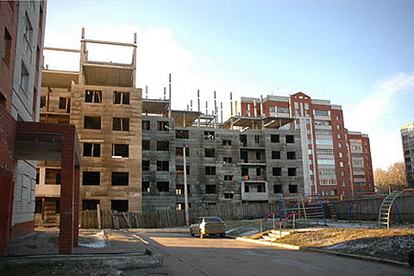
Projects of Russian Wordnets
Automatically-generated
  Balkova et al., 2008
    State of the project is unknown
  http://wordnet.ru/ (Gelfenbeyn et al., 2003)
    direct translation without any manual revision
Developed from scratch
  RussNet (Azarowa, 2008)
  YARN – Yet Another RussNet (2012)
    Crowdsourcing, use of Wiktionary
    https://russianword.net/
    Many naïve decisions
    Only synsets without relations
  Новый проект RussNet+YARN (2016)

Slide 5
RuThes Linguistic Ontology
    Linguistic Ontology - most concepts are based on senses of real language expressions
      Developed more than 20 years
      Corporate-owned, now partially published (RuThes-lite)
Unified representation – single net of concepts
  For different parts of speech
  For lexical units and domain terms
  Words and multiword expressions
Current size
  55 thousand concepts, 4.1 relations per concept
  168 thousand unique Russian words and multiword expressions
  190 thousand senses

Slide 6
RuThes-Based Projects
Informational-retrieval applications
  Conceptual indexing
  Knowledge-based text categorization
  Semantic search and query expansion
  Visualization of search results
  Document clustering
  Single document and multidocument summarization
  Sentiment analysis
Projects with
  State Bodies
    Central Bank of the Russian Federation (2006 – ..)
    Central Election Committee of the RF (1999 – 2011) ...
  Commercial organizations
    Rambler Media company (2007– 2012)
    Garant Legal Information Company (2002 – 2013..)
    Yandex (2014) …

Slide 7
Units of RuThes
Main principles
  Distinguishable concepts – distinctions with neighbor concepts on the denotational level
  Concept should have an unambiguous and concise name
  Text entries should be equivalent in respect to concept relations
A concept unites the following language expressions (ontological synonyms):
  words that belong to different parts of speech: red, redness, red color, red colour
  linguistic expressions relating to different linguistic styles, genres
  single words, idioms, free multiword expressions, which senses correspond to the concept

Slide 8
Examples of ontological synonyms
ДУШЕВНОЕ СТРАДАНИЕ (wound in the soul)
боль, боль в душе, в душе наболело, душа болит, душа саднит, душевная пытка, душевная рана, душевный недуг, наболеть, рана в душе, рана в сердце, рана души, саднить
English ontological synonyms can look as:
emotional hurt, emotional pain, emotional wound, heartache, pain, pain in the soul, wound, wound in the heart, wound in the soul
but:
WN 3.0: pain, painfulness (emotional distress; a fundamental feeling that people try to avoid) "the pain of loneliness"

Slide 9
RuThes Conceptual Relations
Small set of relations: motivated by information-retrieval thesauri and formal ontologies
  Class – subclass
    Transitivity, inheritance
  Part-whole
    Transitivity of part-whole relations
  External ontological dependence (Gangemi et al., 2001; Guarino, 2009)
    Existence of Car plant depends on existence of car
Main principle for establishing relations – reliable relations
  Concepts of lower levels of the hierarchy should be rigidly related to upper concepts

Slide 10
Part-Whole Relations in RuThes
Parts described in RuThes should be “attached” to their wholes
  Existential or generic dependence of part from whole (Gangemi et al., 2001 Guizzardi, 2011)
    Inseparable parts, Mandatory wholes
  Different semantic types
    Physical entities, elements, processes
    Roles in processes (investor – investing)
    Processes in spheres of activities
    Properties of entities
    Such a part-whole relation is close to Guarino internal relations (Guarino, 2009)
  Property of transitivity of part-whole is supposed

Slide 11
External dependence
External dependence relation concept C2 from concept C₁ (asc₁ (C₂, C₁)) can be established if:
  neither taxonomic nor part-whole relations can be established between C₁ and C₂ in RuThes linguistic ontology,
  the following assertion is true: C₂ exists means C₁ exists
  Relations asc₁ are inherited on subclasses and parts
Examples:
  asc₁ (automative industry, car (vehicle))
  asc₁ (forest, tree)
  asc₁(forest fire, forest)
  asc₁(forestry, forest)

Slide 12
RuThes-like Linguistic Ontologies
Domain-Specific
Lexicons
Banking Thesaurus
Ontology on Natural Sciencies and Technologies
94 K concepts,262 K terms
Sociopolitical
Thesaurus
General Lexicon
Avia*Ontology
Sociopolitical thesaurus
41.4 K concepts,
121 K terms
Security Thesaurus
66.8 K concepts,
236 K terms
Domain-specific
Lexicons

Slide 13
Generating RuWordNet
Source: RuThes-lite 2.0
  115 thousands words and expressions
Division to part of speech nets
  Use of morpho-syntactic representation of RuThes text entries
  Division to three synset nets
  Cross-category synonymy between divided concepts’ text entries
Providing WordNet-like (lexical) relations

Slide 14
Transfer of Relations: RuThes-> RuWordNet
Class-Subclass relations=>hyponym-hypernym relations + closure relations
  RuThes: C1 (verb) –> C2 (no verb) –> C3 (Verb)
Geographical synsets to their types=>instance - hypernym+H
Part-whole relations=>part-whole, domain relations +H
Associations=>Antonyms+H
Ontological dependence relations => cause, entailment, phrase-component relations+H

Slide 15
RuWordNet Statistics
Part of speech | Number of synsets | Number of unique entries | Number of senses
Noun | 29,296 | 68,695 | 77,153
Verb | 7,634 | 26,356 | 35,067
Adjective | 12,864 | 15,191 | 18,195
130,415 senses
Part of speech | Hypernyms | Instance- class | Wholes | Pos-synonymy | Antonyms
Noun | 39,155 | 1,863 | 10,010 | 18,179 | 455
Verb | 10,440 | 0 | 0 | 7,143 | 20
Adjective | 16,423 | 0 | 0 | 13,794 | 457

Slide 16
RuWordNet: Noun Relations
Hyponym-hypernym
Instance-hypernym (geographical locations)
Antonyms (properties and states)
POS-synonymy
Part-whole relations
  functional parts (nostrils − nose),
  ingredients (additives − substance),
  geographic parts (Sevilia − Andalusia),
  members (monk − monastery),
  dwellers (Moscow citizen − Moscow),
  temporal parts (gambit − chess party)

Slide 17
RuWordNet: Adjective Relations
hyponym-hypernym relations
  Hierarchies as in GermaNet and Polish wordnet
Antonyms
Cross-category synonymy links to noun and verb synsets:
  word строительный – POS links
  to the noun synset {стройка, постройка, возведение, сооружение..}
  to the verb synset {строить, построить, возводить ...}.

Slide 18
Enrichment of Relation Set in RuWordNet
Cause and entailment relations
Domain relations
Phrase and its component relations
Derivational relations

Slide 19
Cause and Entailment Relations for Verb synsets
Cause
  'A cause B’,
  No coincidence in time
Entailment,
  "Someone V₁" logically entails "Someone V₂".
  Coincidence in time
RuThes concepts with verb text entries
  Relations of ontological dependence (directed associations) were looked through by experts
610 cause relations:
  сажать – сесть (cause to sit – sit)
943 entailment relations:
  сниться (dream) - спать, поспать, почивать..(sleep).,

Slide 20
Domain Relations
In RuThes: domain relations are considered as a kind of part-whole relations:
  industrial plant – industry
  Thematically related concepts are grouped together
WordNet: most relations are taxonomic=> tennis problem:
  Related synsets belong to different hierarchies
  Therefore the system of domains has been introduced
WordNet’s domain system was adapted for RuWordNet (Magnini, Pianta, 2000)
  Some domains were added (World religions)
  Some domains were removed
  Domain is considered as a category in knowledge-based categorization system and described in a special interface
  Relations from synsets to domains are inferred using RuThes relation properties (transitivity and inheritance)
  Post-editing

Slide 21
Relations between phrases and their components in RuWordNet
Phrases as text entries in RuThes
  There are many phrases, including compositional or semi-compositional – now they are in RuWordNet
  For compositional phrases, ontological dependence relations are often used (=directed associations): car plant - car
  Such relations are not present in RuWordNet, relations can be lost
  Special file for describing relations between phrase and its components (synsets)
  The relations are inferred using relation properties of RuThes (transitivity and inheritance)
  Cargo vehicle:
  <sense name="ГРУЗОВОЕ СРЕДСТВО ТРАНСПОРТА" id="101933" synset_id="N26202"> <composed_of>
  <sense name="СРЕДСТВО" id="28238" synset_id="N28331"/> <sense name="ГРУЗОВОЙ" id="38045" synset_id="A9059"/> <sense name="ТРАНСПОРТ" id="41294" synset_id="N21760"/> </composed_of> </sense>

Slide 22
Derivation Relations in RuWordNet
Derivation relations are also inferred using the properties of relations
  Аренда: арендатор, арендаторский, арендаторша, арендно-хозяйственный, арендный, арендование, арендователь, арендовать, арендодатель. (Lease, leaseholder, lessee, etc.)
  Ambiguous words are connected correctly
  <sense name="ДОНОСИТЬ" id="70038" synset_id="V44416"> <derived_from>
  <sense name="ДОНОСИТЕЛЬСТВО" id="47412" synset_id="N24310"/>
  <sense name="ДОНОСИТЬСЯ" id="73759" synset_id="V46525"/>
  <sense name="ДОНОСНЫЙ" id="24104" synset_id="A9883"/> <sense name="ДОНОСЧИК" id="55658" synset_id="N35980"/> <sense name="ДОНОСЧИЦА" id="55660" synset_id="N35980"/> <sense name="ДОНОСИТЕЛЬСКИЙ" id="47411" synset_id="A4423"/> …</derived_from> </sense>

Slide 23
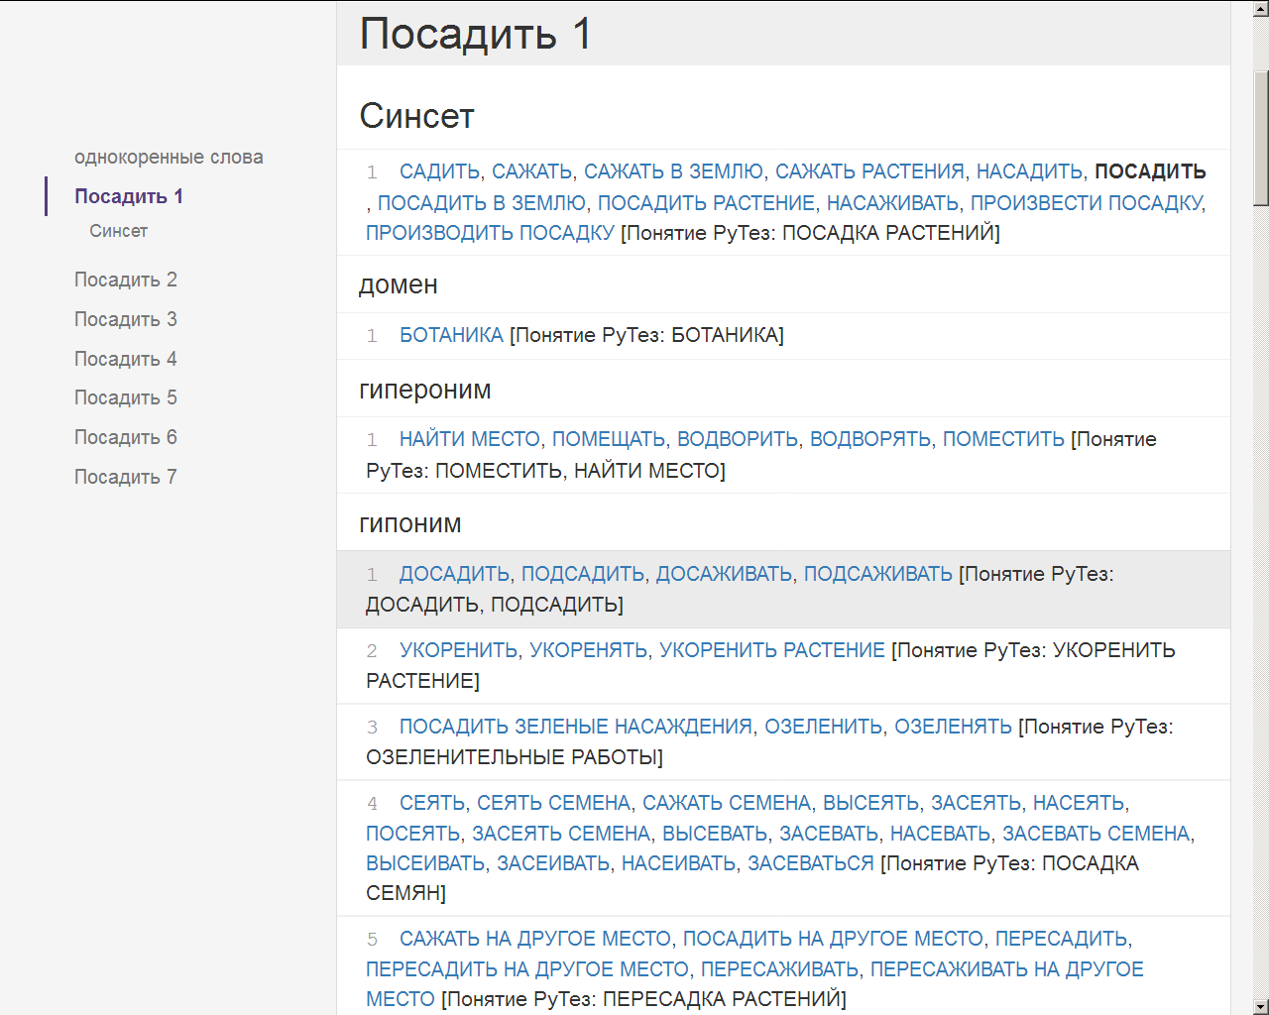
Ruwordnet.ru: посадить
Synset – to plant.1
Botany domain
hypernym
hyponyms

Slide 24
Accessibility of RuThes and RuWordNet
RuThes web-site
    http://www.labinform.ru/pub/ruthes/index.htm
RuWordNet web-sites
  http://www.labinform.ru/pub/ruwordnet/index.htm
  ruwordnet.ru
Xml-files can be obtained non-commercial use: louk_nat@mail.ru

Slide 25
Conclusion
We have described the semi-automatic process of transforming the Russian language thesaurus RuThes (in version, RuThes-lite 2.0) to WordNet-like thesaurus, called RuWordNet (130 thousand senses)
In this procedure we attempted to achieve two main characteristic features of wordnet-like resources:
  division of data into part-of-speech-oriented structures with cross-references between them
  providing a set of relations similar to wordnet-like relations
Both thesauri, RuThes-lite 2.0 and RuWordNet, are currently published
  Researchers can obtain both types of thesauri, compare them in applications
  We would like to develop both resources because the relations are different and can be useful in different applications

