Slide 1

GWC 2018 - WORD EMBEDDING
Multilingual WordNet sense Ranking
using nearest context
Authors:
Umamaheswari and Francis Bond
School of Humanities,
LMS, NTU, Singapore.

Slide 2
INTRODUCTION
Messi? ->football or Ronaldo
“Apple” in “Apple is a tasty fruit” is a fruit that can be eaten and not a company?
Need to capture meanings, semantic relationships and the different contexts they are used in.
Word embedding
Motivation: “Words with high similarity occurs in the nearest context”
You shall know a word by the company it keeps. (J. R. Firth, 1957)
Aim: Application of word embedding to estimate the Wordnet (OMW) sense ranking

Slide 3
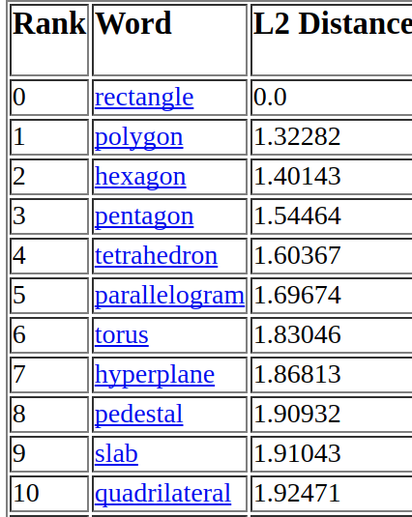
EXAMPLES – WORD EMBEDDING

Slide 4
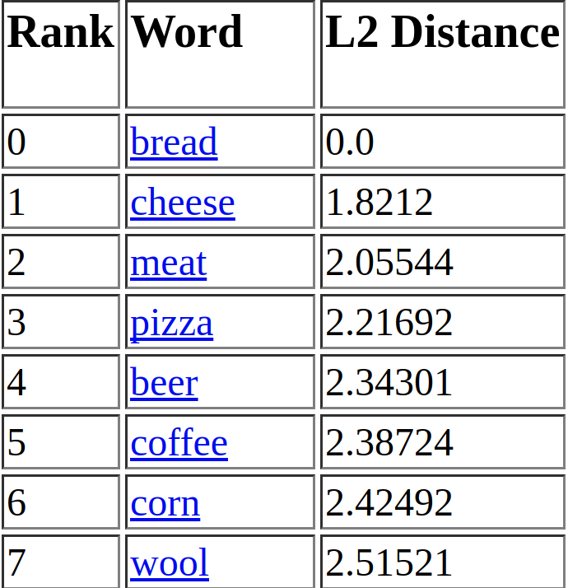
EXAMPLES – WORD EMBEDDING

Slide 5
I decorated this house in

Slide 6
I decorated this house in
red

Slide 7
I decorated this house in
blue

Slide 8
I decorated this house in
June

Slide 9
CONTEXTS - MEANING
They travel in a boat for pleasure.
They are rowing in a boat to travel the lake.
He sails on a boat to travel to island.

Slide 10
PRE-TRAINED WORD EMBEDDING
Polyglot2 - A package to build language models that learn distributed representations of words.
Glove – Global Vectors for Word Representation
-Unsupervised learning
-Computes global word-word co-occurrence statistics across the corpus
Both Polyglot2 and glove allows you to create your own embedding from the text.
-support single terms and neglected multiword terms.
-retrain the word embeddings for both single and multiword terms for English, Chinese, Japanese, Indonesian and Italian
– Polyglot2 Wikipedia corpus (Training Data available for all the WordNet languages)

Slide 11
EXISTING WORK
Word embedding is most popular in Word sense Disambiguation (WSD)
      Bhingardive et al 2015 (Similar to this proposed work): Attempted for Hindi and English word embedding based WordNet ranking and restricted only for nouns
      Panchenko (2016) – learned sense embedding by comparing AdaGram Word embeddings and BabelNet Synsets words list.
      Arora et al. (2016) – Attempted for Discourse Analysis
      Kang et al (2016) – Presented Cross-Lingual Word embedding for English and Chinese
Contribution: Training and testing in a large number of multiword expressions which are often neglected in existing word embedding.
- Application of word embedding for all languages of OMW.

Slide 12
METHODS – CORPUS CLEANING AND PREPROCESSING
Stopwords, symbols, numbers are removed
Tools used:
  NLTK toolkit (Bird et al., 2009)
  Mecab tokenizer (Japanese text)
  Multi-Word Expression Identification
    Takes the tokenized string
    Match with the WordNet MWE lexicon
    Rewritten with “Space” replaced with “underscore”
    Example:
      Input: I looked five words up.
      Ouput: I looked_up five word.

Slide 13
EXAMPLE
Anarchism is often defined as a political philosophy which holds the state to be undesirable, unnecessary, or harmful…etc.,
Anarchism often define political_philosophy which hold state undesirable unnecessary harmful….etc.,
Query:Anarchism
Resulted Word embeddings:
('Aesthetics', 0.60922151192027996),
('existentialism', 0.59618132809543023),
('Philosopher', 0.58519557120065291),
('Loving', 0.58461004258672267),
('Schopenhauer', 0.58310696414465735),
('Gandy', 0.57960487774243674),
('Theosophy', 0.57837290449897172),
('Universalism', 0.56472078138370141)
Word embedding Model file

Slide 14

PREDOMINANT SENSE SCORING
      predominant sense scoring (P_{s}(S_{w}) )
      Give word = “w”
      Senses obtained from WordNet = S_{w} = {S_{1,} S₂,….. S_{n}}.
      S_{W}^{N}(w,d) represents the neighbouring contexts obtained from Polyglot2 and Glove word embedding models.
WordNet features
( Lemmas, Definitions, examples) Match
WordNet (Hyponyms and Hypernyms) match

Slide 15
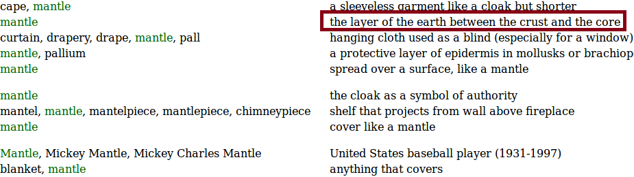
EXAMPLE
Query: Mantle
Mantle:[('bedrock', 0.73414662625100835), ('crust', 0.72017571026073068), ('magma', 0.71141779190811061), ('cavity', 0.69107739714226413), ('beneath', 0.68335675333532075), ('hollow', 0.68275839898500457), ('atmosphere', 0.68019282076443588), ('icy', 0.67775520929494848), ('lifeless', 0.6652370045077961), ('cloud', 0.65690761428595956)]
cape: [('jeans', 0.66483291343127937), ('robe', 0.65767827564173953), ('stern', 0.64575702234756183), ('mullet', 0.64499740278171336), ('stripe', 0.64378354883716771), ('tint', 0.64321309703146179), ('pale', 0.63992816829582477), ('collar', 0.62807409645143275), ('necktie', 0.62231694069806631), ('pike', 0.62231305822794247)]
Hyponym: chlamys, mantelet, pelisse, tippet
Hypernym: cloak

Slide 16
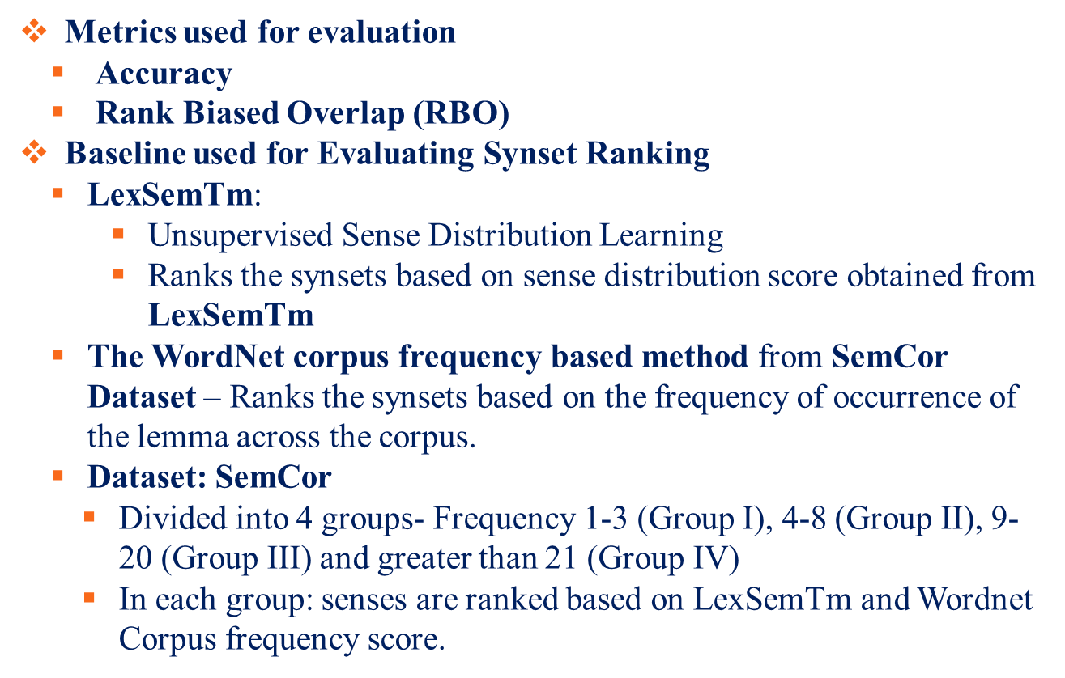
RESULTS

Slide 17
ANALYSIS ON WORD EMBEDDING
      Evaluations are carried out in English, Japanese, Chinese, Indonesian and Italian word embedding using Polyglot2 (Word2Vec) and Glove.
      Found better embeddings for Glove when compared to Polyglot2 (Word2Vec).
        Reason: Glove finds co-occurrence statistics across the corpus whereas Word2Vec depends on within the context window size.
        Depends on the type of the corpus and the hyper-parameters settings. The context window size, minimum frequency count parameters highly impact the results.
Observation:
The Pre-trained Polyglot model handles single terms well and trained Glove model handles MultiWord terms well. Hence, we have combined both the models for WordNet Synset Ranking. Thus the overall accuracy of the Glove model is 0.47 and Word2Vec is 0.31.

Slide 18
FEW RESULT SAMPLES – SINGLE TERMS
English: {Location- site, map, structure, area, direction, building, locality, settlement, line, Bridge}
Indonesian: {lokasi(location): Peta, persimpangan, pelabuhan, fondasi, celah, ruangan, wilayah, potensi, batas, otoritas - (Map, intersection, harbor, foundation, gap, room, territory, potential, limit, authority)}
Japanese:{ロケーション(Location): クルージング, デモンストレーション, 個室, バナー, ガレージ, 買い物, バルコニ, ウォーキング, ナビゲーション, -(Cruising, demonstration, private room, banner, garage, shopping, balcony, walking, navigation)

Slide 19
FEW RESULT SAMPLES – MULTI TERMS
English: {deficit_hyperactivity_disorder:attention, memory,deficit_hyperactivity_disorder, adhd, rigidly, proliferative, splinted, treat_attention, allergic_rhinitis, special}
Japanese:{プリンス\_オヴ\_ウェールズ (Prince of Wales): トレハラーゼ,ろかく,レゼルヴ,フリーア, グローヴス,レインボーカップファイナル,mishnaic,traininfomation,カタリココ– (Trehalase, fighting, reserve, free, Groves, Rainbow Cup Final, mishnaic,traininfomation,Catalina Coco)}
Chinese: {足球\_运动员(soccer player): 大\_祭台,阅览, 鐺,諫,分内事,大捷,新交,縯,井底 – (Large altar, learning, clang, remonstrance, sub-ministry, victory, new cross, play, bottom)

Slide 20
WORDNET SYNSET RANKING EVALUATION
RBO Score:
Human/Author ranking (Approach 1) – A1
Proposed Ranking (Approach 2) - A2
Corpus frequency (Approach 3) – A3
LexSemTm (Approach 4) – A4
Example: To find rank overlapping for the above said methods
Query: (gleam)
Resulted rank obtained for “gleam” is shown below.
Human/Author ranking (Approach 1) – A1 be shiny, as if wet shine brightly, like a star or a light an appearance of reflected light a flash of light (especially reflected light) appear briefly

Slide 21
WORDNET SYNSET RANKING EVALUATION
Proposed ranking (Approach 2) – A2 be shiny, as if wet shine brightly, like a star or a light appear briefly an appearance of reflected light a flash of light (especially reflected light)
Rank correlation:
Approach 3 to Approach 1 is 0.52 and Approach 2 to Approach 1 is 0.88.
Corpus frequency ranking (Approach 3) – A3 1.a flash of light (especially reflected light) 2.be shiny, as if wet 3.appear briefly 4.shine brightly, like a star or a light 5.an appearance of reflected light
The baseline (Corpus frequency) ranking (Approach 3) - dissimilar in all positions except the third position
human judgment (Approach 1) - only the 3rd synset is moved to the last position and the remaining ranking is similar to the proposed approach (Approach 2)

Slide 22
RESULTS
      Table 1: Statistics of SemCor Dataset
Languages | Lemma Count (MWs) | Lemma Count (Single words)
English | 2361 | 8187
Chinese | 2067 | 12341
Japanese | 473 | 5289
Italian | 262 | 9606
Indonesian | 1134 | 5178

Slide 23
AVERAGE RANK CORRELATION
Table 3: 2:Avg rank correlation between
With different group of senses (English)
Table 2:Avg rank correlation between
A1 to A3 and A1 to A2
Languages | A1-A3 | A1-A2
English | 0.55 | 0.75
Chinese | 0.62 | 0.68
Japanese | 0.64 | 0.69
Italian | 0.61 | 0.67
Indonesian | 0.44 | 0.59
Groups | Freq | Lemma Count | A1-A2 | A1-A3 | A1-A4
I | (1-3) | 1896 | 0.73 | 0.50 | 0.57
II | (4-8) | 567 | 0.82 | 0.49 | 0.48
III | (9-21) | 327 | 0.77 | 0.46 | 0.47
IV | >21 | 124 | 0.87 | 0.49 | 0.48
This demonstrates that the sense ranking can capture the sense preferred by a human.
Hence the word embedding score definitely aid in WordNet sense ranking.

Slide 24
FIRST HIT ANALYSIS SAMPLES
Language | Lemma | Results
English | contact | A channel for communication between groups.
 | Intrusion | Any entry into an area not previously occupied.
 | celebration | A joyful occasion for special festivities to mark some happy event
 | no more | Referring to the degree to which a certain quality is present
 | Write up | A short account of the news
Japanese | 名人(expert) | A person with special knowledge or ability who performs skillfully
 | 召集(convene) | A group gathered in response to a summons
 | ビル(building) | A structure that has a roof and walls and stands more or less permanently in one place
Chinese | 适应(adopt | Adapt or conform oneself to new or different conditions
 | 加入(join) | A process of increasing by addition (as to a collection or group)
 | 修复(repair) | Restore by replacing a part or putting together what is torn or broken
Italian | detenzione(custody) | The state of being imprisoned
 | piuma(feather) | The light horny waterproof structure forming the external covering of birds
 | esaminare(examine) | look at carefully; study mentally

Slide 25
FIRST HIT ANALYSIS SAMPLES (CONT.,)
Language | Lemma | Results
Indonesian | kehidupan(life) | the period between birth and the present time\\
 | barang(goods) | goods carried by a large vehicle
 | hanya(alone) | without any others being included or involved
When we analyze the rare sense words with frequency 1-3 and 4-8, the word embedding and WordNet feature influence the results by providing most relevant result on the first hit.

Slide 26
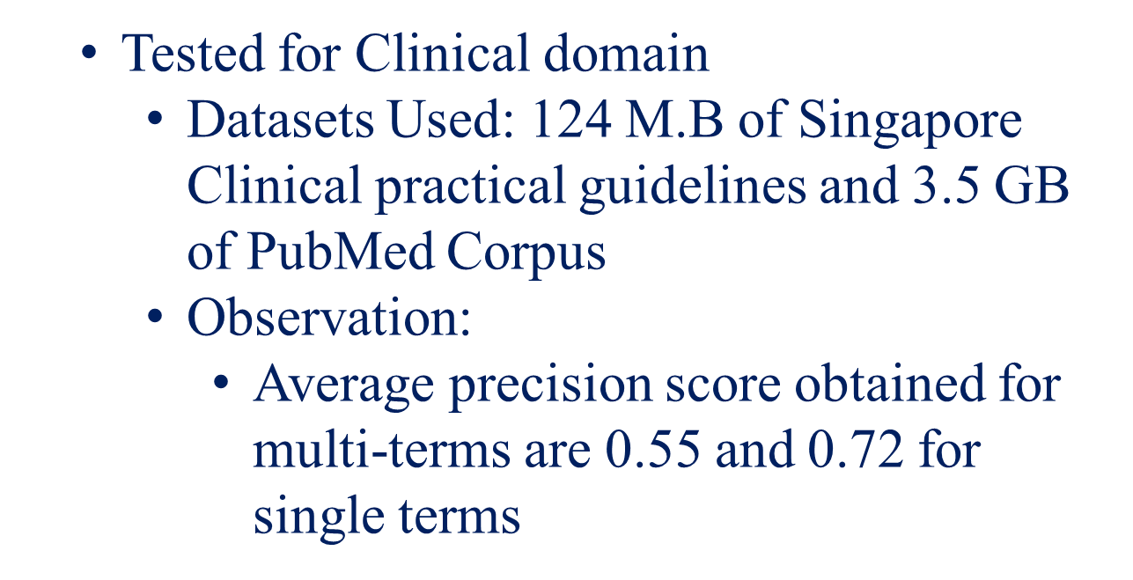
SCALABILITY

Slide 27
CONCLUSION
      OMW has over 150 languages with WordNet built automatically (Ranging from major to smaller languages)
      For all languages, polyglot has data to learn the word embeddings for WordNet Ranking
      In future, we will learn ranking for all languages and incorporate to the WordNet lexicon which is maximally useful for speakers of as many languages as possible.
      It is possible to extend this work for finding missing senses of WordNet.

Slide 28
THANK YOU.

Slide 29
SELECTED REFERENCES
Rami Al-Rfou, Bryan Perozzi, and Steven Skiena. 2013. Polyglot: Distributed word representations for multilingual nlp. In Proceedings of the Seventeenth Conference on Computational Natural Language Learning, pages 183– 192, Sofia, Bulgaria, August. Association for Computational Linguistics.
Sanjeev Arora, Yuanzhi Li, Yingyu Liang, Tengyu Ma, and Andrej Risteski. 2016. Linear algebraic structure of word senses, with applications to polysemy. arXiv preprint arXiv:1601.03764.
Sergey Bartunov, Dmitry Kondrashkin, Anton Osokin, and Dmitry Vetrov. 2015. Breaking sticks and ambiguities with adaptive skip-gram. arXiv preprint arXiv:1502.07257, pages 47–54.
Sudha Bhingardive, Dhirendra Singh, Rudra Murthy, Hanumant Redkar, and Pushpak Bhattacharyya. 2015a. Unsupervised most frequent sense detection using word embeddings. In DENVER. Citeseer.
Sudha Bhingardive, Dhirendra Singh, Rudramurthy V, Hanumant Harichandra Redkar, and Pushpak Bhattacharyya. 2015b. Unsupervised most frequent sense detection using word embeddings. In NAACL HLT 2015, The 2015 Conference of the North American Chapter of the Association for Computational Linguistics: Human Language Technologies, Denver, Colorado, USA, May 31 - June 5, 2015, pages 1238–1243.
Stephen Bird, Ewan Klein, and Edward Loper. 2009. Natural Language Processing with Python. O’Reilly. (www.nltk.org/book).
Lars Borin, Markus Forsberg, and Lennart Lönngren. 2013. Saldo: a touch of yin to WordNet’s yang. Language Resources and Evaluation, 47(4):1191–1211.
Fišer Darja, Jernej Novak, and Tomaž. 2012. sloWNet 3.0: development, extension and cleaning. In Proceedings of 6th International Global Wordnet Conference (GWC 2012), pages 113– 117. The Global WordNet Association.
Valéria de Paiva, Alexandre Rademaker, and Gerard de Melo. 2012. OpenWordNet-PT: an open Brazilian Wordnet for reasoning. EMAp technical report,
Escola de Matemática Aplicada, FGV, Brazil. Sabri Elkateb, William Black, Horacio Rodríguez, Musa Alkhalifa, Piek Vossen, Adam Pease, and Christiane Fellbaum. 2006. Building a wordnet for Arabic. In Proceedings of The fifth international conference on Language Resources and Evaluation (LREC 2006).
Christine Fellbaum, editor. 1998. WordNet: An Electronic Lexical Database. MIT Press. Radovan Garabík and Indrė Pileckytė. 2013. From multilingual dictionary to lithuanian wordnet. In Katarína Gajdošová and Adriána Žáková, editors, Natural Language Processing, Corpus Linguistics, E-Learning, pages 74–80. Lüdenscheid: RAM-Verlag. http://korpus. juls.savba.sk/attachments/publications/ lithuanian_wordnet_2013.pdf.

Slide 30
SELECTED REFERENCES (CONT.,)
Aitor Gonzalez-Agirre, Egoitz Laparra, and German Rigau. 2012. Multilingual central repository version 3.0: upgrading a very large lexical knowledge base. In Proceedings of the 6th Global WordNet Conference (GWC 2012), Matsue.
Donna Harman. 2011. Information retrieval evaluation. Synthesis Lectures on Information Concepts, Retrieval, and Services, 3(2):1–119.
Chu-Ren Huang, Shu-Kai Hsieh, Jia-Fei Hong, Yun-Zhu Chen, I-Li Su, Yong-Xiang Chen, and Sheng-Wei Huang. 2010. Chinese wordnet: Design and implementation of a cross-lingual knowledge processing infrastructure. Journal of Chinese Information Processing, 24(2):14–23. (in Chinese).
Hitoshi Isahara, Francis Bond, Kiyotaka Uchimoto, Masao Utiyama, and Kyoko Kanzaki. 2008. Development of the Japanese WordNet. In Sixth International conference on Language Resources and Evaluation (LREC 2008), Marrakech.
Hong Jin Kang, Tao Chen, Muthu Kumar Chandrasekaran, and Min-Yen Kan. 2016. A comparison of word embeddings for english and cross-lingual chinese word sense disambiguation. arXiv preprint arXiv:1611.02956.
Ravi Kumar and Sergei Vassilvitskii. 2010. Generalized distances between rankings. In Proceedings of the 19th International Conference on World Wide Web, WWW ’10, pages 571–580, New York, NY, USA. ACM.
Aiden Si Hong Lim. 2014. Acquiring Predominant Word Senses in Multiple Languages. Ph.D. thesis, School of Humanities and Social Sciences, Nanyang Technological University.
Krister Lindén and Lauri Carlson. 2010. Finnwordnet — wordnet påfinska via översättning. LexicoNordica — Nordic Journal of Lexicography, 17:119–140. In Swedish with an English abstract.
Quan Liu, Hui Jiang, Si Wei, Zhen-Hua Ling, and Yu Hu. 2015. Learning semantic word embeddings based on ordinal knowledge constraints. In Proceedings of the 53rd Annual Meeting of the Association for Computational Linguistics and the 7th International Joint Conference on Natural Language Processing (ACL-IJCNLP), pages 1501–1511.
Teng Long, Ryan Lowe, Jackie Chi Kit Cheung, and Doina Precup. 2016. Leveraging lexical resources for learning entity embeddings in multi-relational data. arXiv preprint arXiv:1605.05416. Diana McCarthy and John Carroll. 2003. Disambiguating nouns, verbs and adjectives using automatically acquired selectional preferences. Computational Linguistics, 29(4):639–654.

