Slide 1
Grammatical Role Embeddings for Enhancements of Relation Density in the Princeton WordNet
Kiril Simov¹, Alexander Popov¹, Iliana Simova², Petya Osenova¹
¹DemoSem Project, IICT-BAS, Bulgaria
²Saarland University, Saarbrücken, Germany
Workshop on Wordnets and Word Embeddings
The 9th Global WordNet Conference
11 January 2018
WWE 2018 at GWC 2018, NTU, Singapore, 11.01.2018

Slide 2
Outline
  Knowledge-based WSD
  Motivation
  Word Embeddings for Grammatical Roles
  Experiments and Results
  Conclusion
  Future Work
WWE 2018 at GWC 2018, NTU, Singapore, 11.01.2018

Slide 3
UKB: Graph Based Word Sense Disambiguation and Similarity
Knowledge-based approach to word sense disambiguation; no supervision in the form of a manually annotated corpus needed
Personalized PageRank algorithm
http://ixa2.si.ehu.es/ukb
Knowledge Graph over WordNet
  u:03038685-n (classroom) v:04146050-n (school) s:30 d:0
WWE 2018 at GWC 2018, NTU, Singapore, 11.01.2018

Slide 4
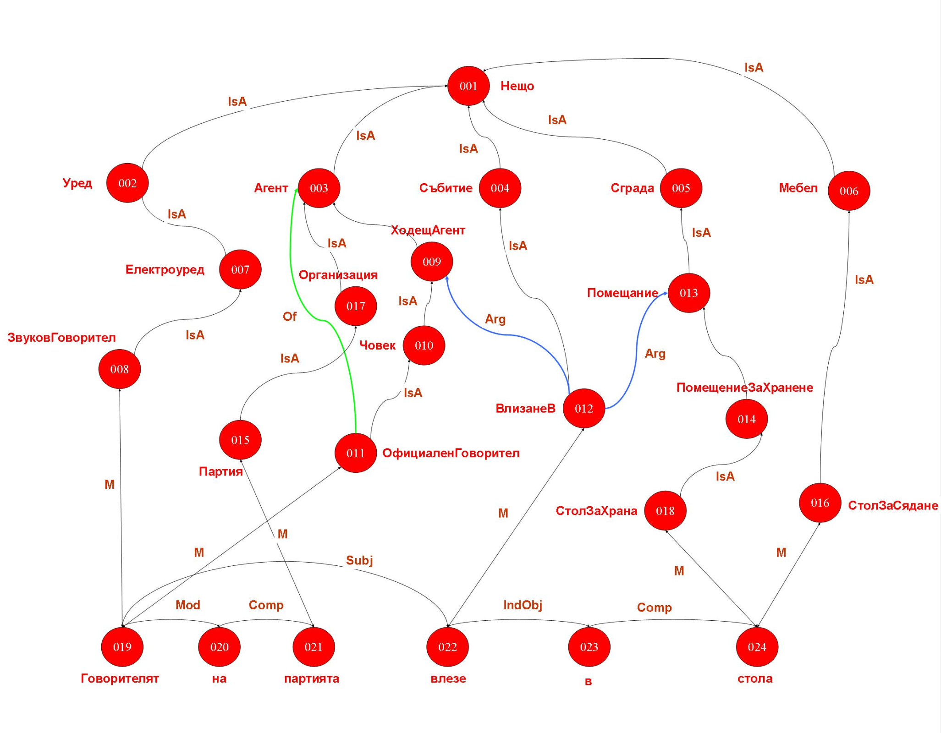
WWE 2018 at GWC 2018, NTU, Singapore, 11.01.2018

Slide 5
Knowledge Graph Extension
We performed several extensions of the Knowledge Graph with additional arcs:
  Domain relations from WordNet
  Inferred hypernymy relations
  Syntactic relations from gold corpora
  Extended syntactic relations
WWE 2018 at GWC 2018, NTU, Singapore, 11.01.2018

Slide 6
Knowledge Graph Extensions: WordNet Hierarchies
professional
investigate
professor
doctor
research
surgeon
consult
WWE 2018 at GWC 2018, NTU, Singapore, 11.01.2018

Slide 7
Knowledge Graph Extensions – Inheritance
professional
investigate
professor
doctor
research
surgeon
consult
WWE 2018 at GWC 2018, NTU, Singapore, 11.01.2018

Slide 8
Knowledge Graph Extensions – Syntax
professional
investigate
professor
doctor
research
surgeon
consult
WWE 2018 at GWC 2018, NTU, Singapore, 11.01.2018

Slide 9
Knowledge Graph Extensions – Syntax ↓
professional
investigate
professor
doctor
research
surgeon
consult
WWE 2018 at GWC 2018, NTU, Singapore, 11.01.2018

Slide 10
Knowledge Graph Extensions – Syntax ↑↓
professional
investigate
professor
doctor
research
surgeon
consult
WWE 2018 at GWC 2018, NTU, Singapore, 11.01.2018

Slide 11
Knowledge Graph Extensions – Syntax V↑
professional
investigate
professor
doctor
research
surgeon
consult
WWE 2018 at GWC 2018, NTU, Singapore, 11.01.2018

Slide 12
Results – Syntax and Inference
Graph Accuracy
WN 0.517
WNG 0.538
WNI 0.535
WNGI 0.537
WNGIS 0.565
WNGISE 0.616
WNGISEU 0.656
WWE 2018 at GWC 2018, NTU, Singapore, 11.01.2018

Slide 13
Knowledge Graph Extensions – Motivation 1
The inheritance in WordNet is not monotonic
  From “A doctor operates a patient” the inheritance is not acceptable for all hyponyms
  From “A surgeon cures a patient” the inheritance is acceptable for all hyponyms, but it is also acceptable for concepts that are not hyponyms of “surgeon”
Thus, a mechanism for evaluation of a suggested relation is necessary
Our suggestion is: To use a vector representation of features for nouns and for the grammatical roles of verbs
WWE 2018 at GWC 2018, NTU, Singapore, 11.01.2018

Slide 14
Logical Form – Motivation 2
Example from MRS
  “Every dog chases some white cat.”
  <h0, {h1:every(x,h2,h3), h2:dog(x), h4:chase(e, x, y), h5:some(y,h6,h7), h6:white(y), h6:cat(y)}, {}>
  The embeddings for the different word have to ‘agree’ on the corresponding variables for the different arguments
WWE 2018 at GWC 2018, NTU, Singapore, 11.01.2018

Slide 15
Using Word Embeddings for KWSD
How to use Word Embedding for adding new knowledge to the Knowledge Graph?
  Through adding new semantic relations
  When generating candidate syntagmatic semantic relations: Noun → Verb relations where the Noun denotes a participant in the event represented by the Verb
Generation is done by constructing combinations of a selected verb with all the nouns in the WordNet
WWE 2018 at GWC 2018, NTU, Singapore, 11.01.2018

Slide 16
Word Embedding for Grammatical Roles: Steps
Select a syntactically annotated corpus, where
Subject, Direct Object and Indirect Object represent the core participants in the event
Substitute the specific words with pseudo words
    The man saw the boy with the telescope
    SUBJ_see see DOBJ_see with IOBJ_see
A pair N-subj_of-V is good if N and SUBJ_V are close to each other
Thus we need compatible embeddings for both: the nouns and the pseudo words for the grammatical roles
WWE 2018 at GWC 2018, NTU, Singapore, 11.01.2018

Slide 17
Corpus Preparation (RTC)
WaCkypedia_EN corpus (Baroni et al., 2009)
It was reparsed by Stanford CoreNLP dependency parser (collapsed-cc)
    the dog runs and barks
    nsubj(dog, runs) and nsubj(dog, barks)
Substitution with pseudo words
    the dog runs and barks
    SUBJ_run run and SUBJ_bark bark
Dependency relations: ‘nsubj’, ‘nsubjpass’, ‘dobj’, and ‘iobj’
WWE 2018 at GWC 2018, NTU, Singapore, 11.01.2018

Slide 18
Pseudo Corpus over WordNet (PCWN)
However, a lot of nouns are not in RTC
In order to have their embeddings, we add PCWN to RTC
PCWN is generated via UKB over WN with added syntagmatic relations from existing resources (Goikoetxea et al., 2015)
  goldbrick dupery take_in gull dupe person laugh_at
WWE 2018 at GWC 2018, NTU, Singapore, 11.01.2018

Slide 19
Synset Embeddings
In order to construct semantic relations we need to evaluate N-V where N and V are Synsets, not words
Direct embeddings of Synsets depend on the semantically annotated corpus
Or in other words, an embedding for a Synset is the average of the embeddings of the lemmas in the Synset
We performed three sets of experiments:
  Embeddings of lemmas
  Embeddings of lemma-POS pairs
  Embeddings of Synsets
WWE 2018 at GWC 2018, NTU, Singapore, 11.01.2018

Slide 20
Embeddings Training
RTC was used several times with different combinations of pseudo words
    The man saw the boy with the telescope
    SUBJ_see see DOBJ_see with IOBJ_see
    SUBJ_see see DOBJ_see with the telescope
    SUBJ_see see the boy with IOBJ_see
We used the Word2Vec tool (skip-gram model)
Settings:
  context window of 5 words; 7 iterations; negative examples set to 5; and frequency cut sampling set to 7
WWE 2018 at GWC 2018, NTU, Singapore, 11.01.2018

Slide 21
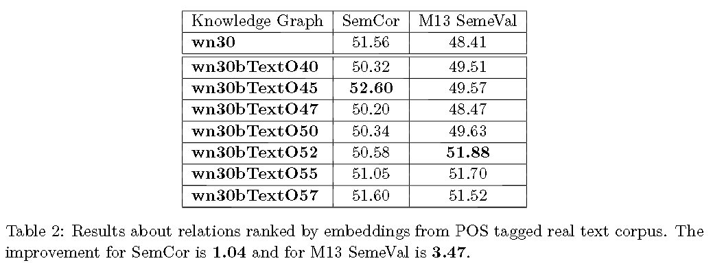
Results Text-Only
WWE 2018 at GWC 2018, NTU, Singapore, 11.01.2018

Slide 22
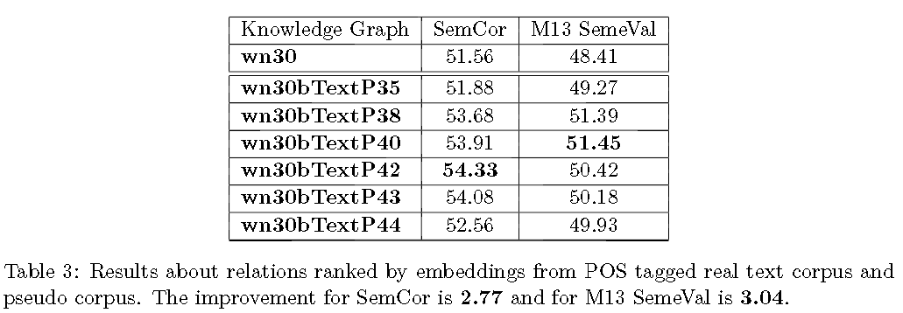
Results Text + Pseudo Corpus
WWE 2018 at GWC 2018, NTU, Singapore, 11.01.2018

Slide 23
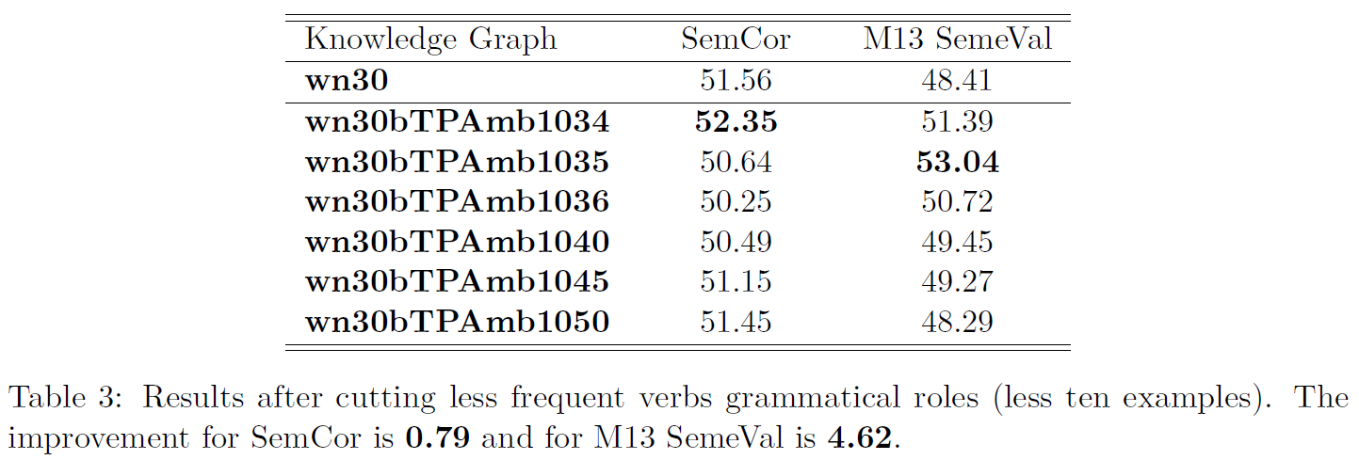
Results Text + Pseudo Corpus Reduced
WWE 2018 at GWC 2018, NTU, Singapore, 11.01.2018

Slide 24
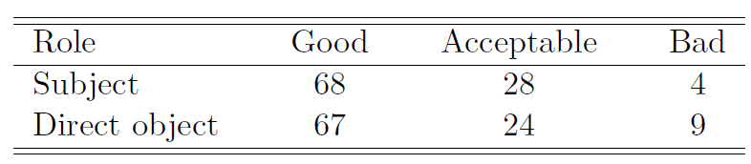
Manual Evaluation
The first 100 top-ranked subject and direct object relations were manually evaluated
The scale: good, acceptable, and bad
WWE 2018 at GWC 2018, NTU, Singapore, 11.01.2018

Slide 25
Conclusions
We proposed a mechanisim for learning of embeddings for grammatical roles of verbs in WordNet
These embeddings were used to rank potential relations between verb synsets and noun synsets
Two evaluations were done – KWSD and manual
The evaluations showed that highly ranked candidates are valuable
The approach might be applied to other relations
WWE 2018 at GWC 2018, NTU, Singapore, 11.01.2018

Slide 26
Future Work
We envisage to:
Learn representations of more types of arguments
Experiment with different algorithms for learning the embeddings over different contexts
Improve corpus annotation
Evaluate the grammatical role embeddings in other tasks: “If the baby does not thrive on raw milk, boil it.” (Jespersen, 1949), NNWSD
Use techniques similar to retrofitting to improve the results
Application to WordNet relations
WWE 2018 at GWC 2018, NTU, Singapore, 11.01.2018

