Slide 1
Computational Thinking Project
Evan Kale and Ben Onderick
Spring 2023

Slide 2
Problem Statement
Our problem deals with Airbnb prices and locations in New York City
It is hard to find something to compare prices, based on their location and price
We made a program that does this for people and shows a price distribution, to see if they are getting a good deal

Slide 3

Data Source
The data source we used was a file that we found on Kaggle, a free data gathering site
The data set has several columns of information, we chose to focus on just using the neighborhoods and the pricing information
Source: https://www.kaggle.com/datasets/dgomonov/new-york-city-airbnb-open-data?resource=download

Slide 4

Solution Approach
For our solution we broke down the data in terms of price
We separated the data into highest priced neighborhoods, and the lowest price neighborhoods
We then showed a price distribution for the data
We also show the average price per room in the whole city of New York City
With this solution, you can see the price average, based on a relatively expensive or inexpensive neighborhood

Slide 5
Solution Code- Utilities Module
In our utility's module, we imported multiple libraries, pandas, numpy and matplotlib
We used the pandas library to read in our data file
We used numpy to calculate some basic summary statistics for the data as whole, mean and median and others
Finally, we used the matplotlib to plot a price distribution in the form of a histogram

Slide 6
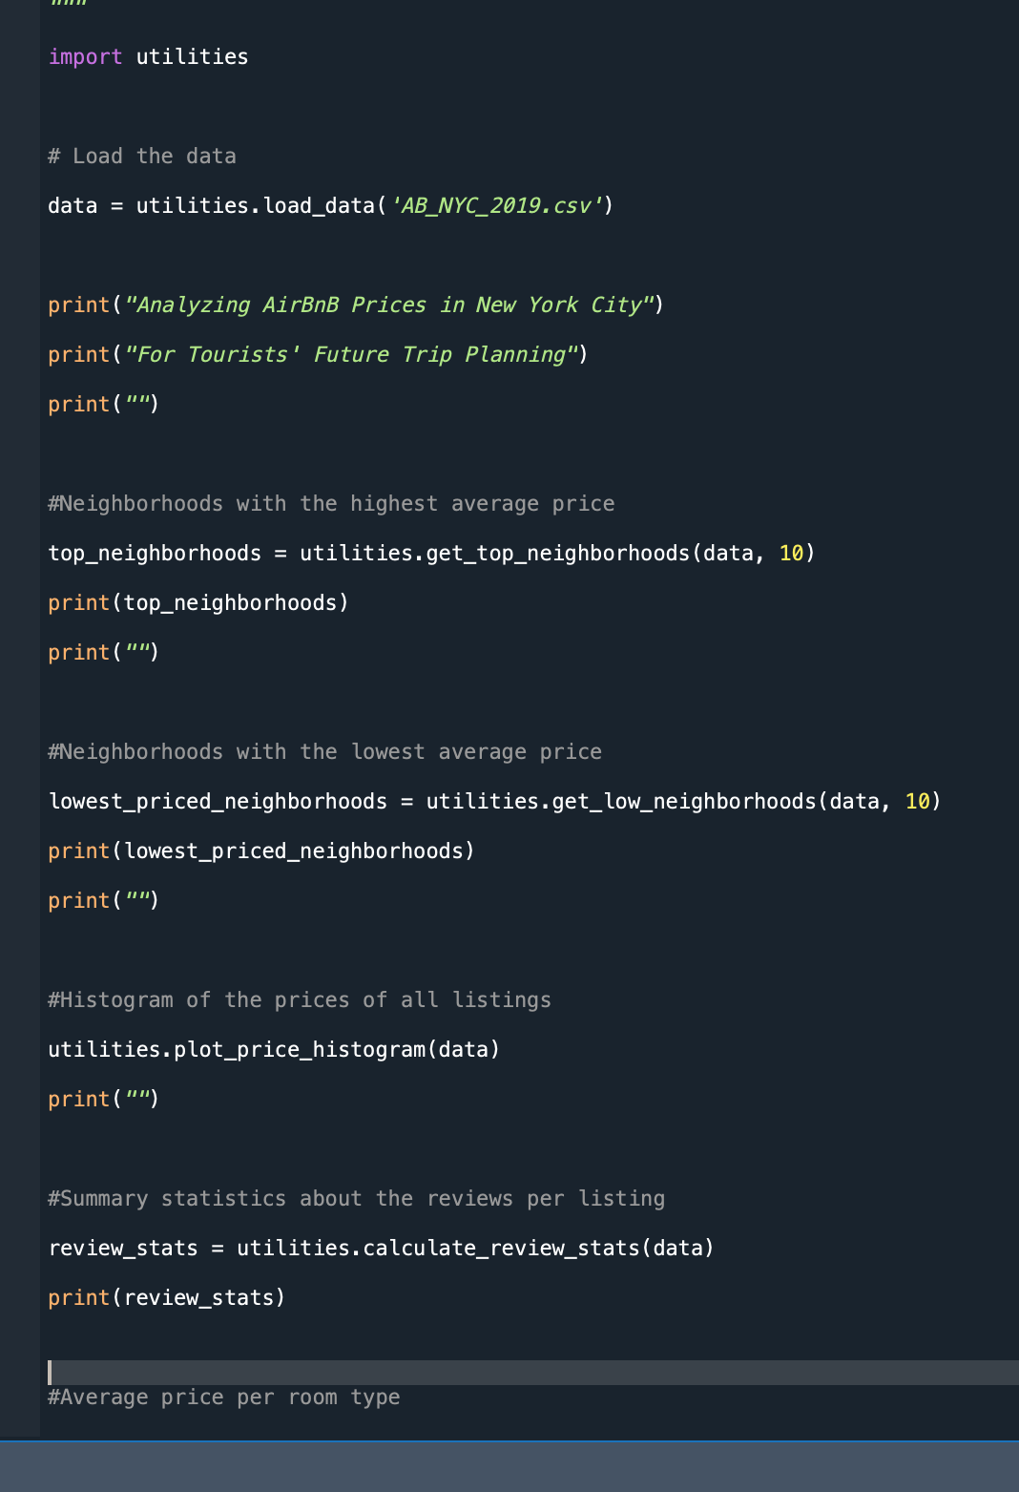
Solution Code- Main File
In the utilities file, we created a program for potential tourists to use to see if they were getting a good deal
In our main file, we called all of our functions that we implemented in the utilities module
We printed all the information calculated there, and printed out price distribution

Slide 7
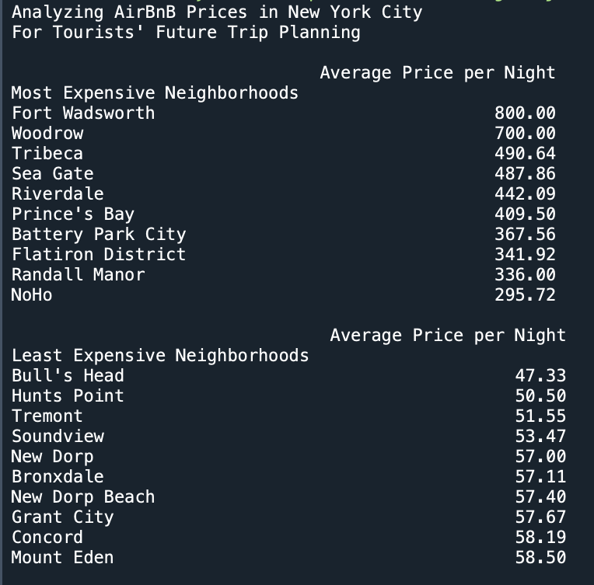
Output
Our output shows the most expensive neighborhoods for Airbnb’s in New York City on an average price per night basis
It also shows the cheapest average price per night according to the neighborhood

Slide 8
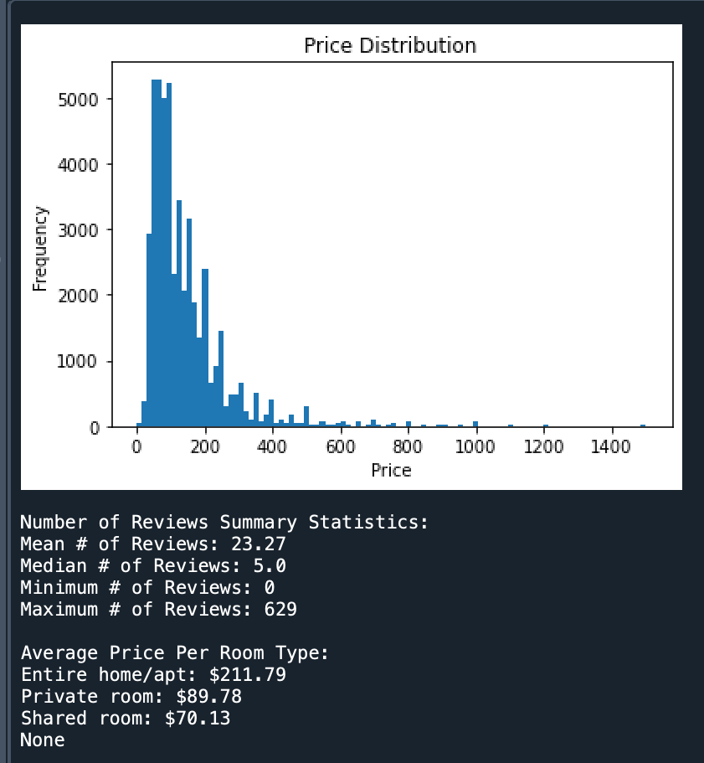
Output
Our Output also shows a price distribution based on the calculations
Summary statistics are also provided, showing the mean number of reviews, median number of reviews, the maximum and minimum number of reviews per neighborhood
It also shows pricing information regarding the type of Airbnb you get

Slide 9

Takeaway
The takeaway for this program and project is to be able to make good decisions while browsing for an Airbnb
By using the information provided, like the neighborhood, the price distributions and the price of various room types, people can get the best price for their travels

