Slide 1
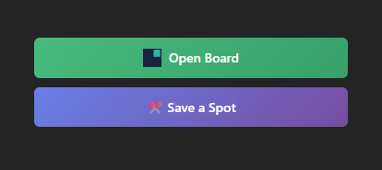
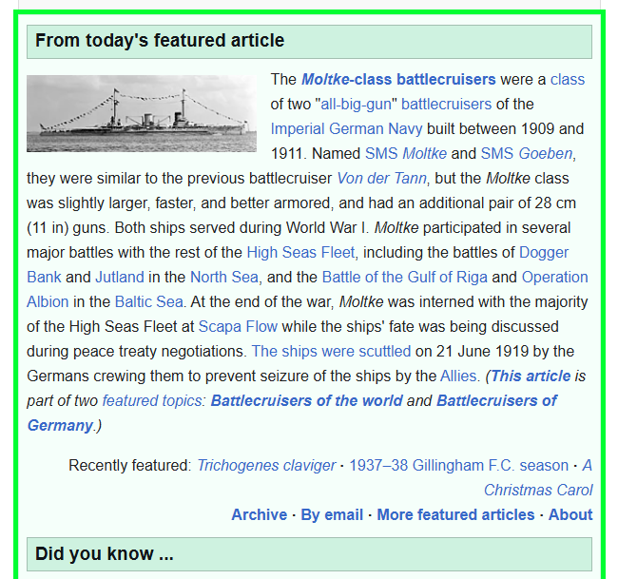
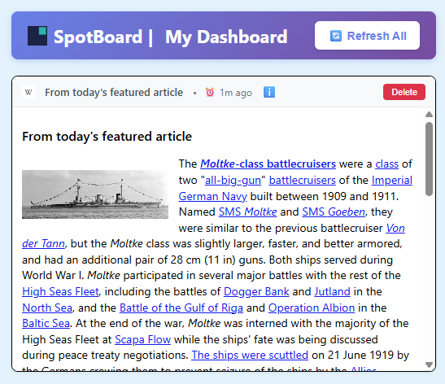
Click to save
Select your spots
On your board
Update when you like
SpotBoard
Save time
Save your spots!

