Slide 1

For Live Session Unit 4
Miguel Bonilla

Slide 2
R markdown file location
https://github.com/boneeyah/DS6306/blob/Ubuntu/Unit4%20markdown.Rmd

Slide 3
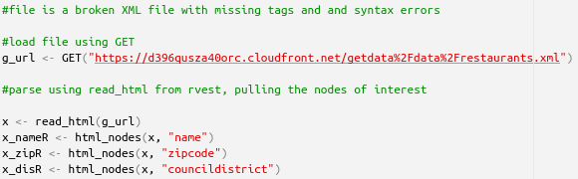
Part 1 – Restaurant data
The file is not proper XML, because tags for row_id and and location are not properly opened and closed. Therefore, the XML R package won't be able to parse the data.
Instead, we can use GET and httr packages to get the URL information and parse the data
Scrap the XML file for name, zipcode, and city council district.

Slide 4
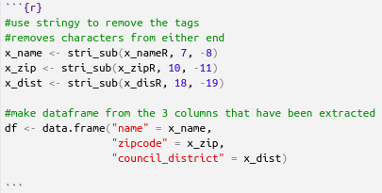
Part 1 – Restaurant data
Use stringy package to remove the tags from each string
Create new data frame
Scrap the XML file for name, zipcode, and city council district.
Make a data frame with those columns.

Slide 5
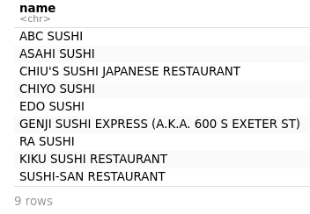
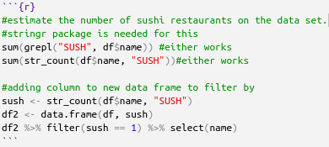
Part 1 – Restaurant data
We can answer this question by using grepl or str_count functions, searching through the restaurant names for "SUSH" or "SUSHI"
Additionally, we can get the names by adding a column to the data frame with the return string from str_count and filtering.
Are there any Sushi restaurants in Baltimore?
If so, can we estimate how many?

Slide 6
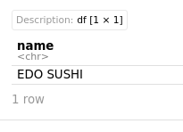
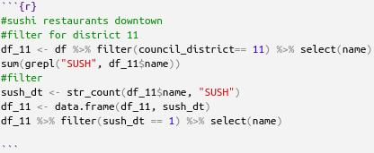
Part 1 – Restaurant data
Filter our data frame for council_district 11
Select name and use grepl or str_count
Additionally, we can get the name by adding the resulting string from str_count to our data frame and filtering
Are there any Sushi restaurants downtown?

Slide 7
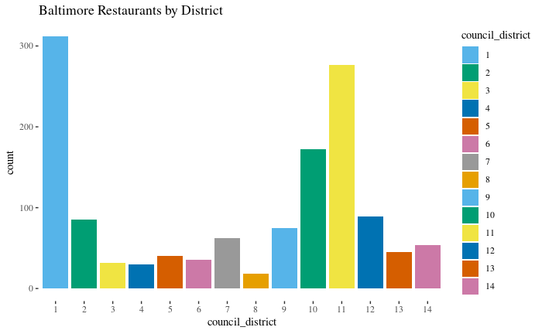
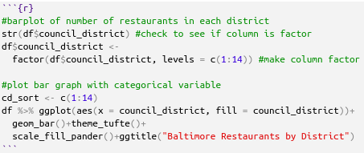
Part 1 – Restaurant data
Make a barplot of restaurants per each council.

Slide 8

Part 2– Freestyle
Tidycensus R Package
This package allows to connect to the Census.gov API
Need to request API key through http://api.census.gov/data/key_signup.html
After signing up, you receive your key and a link to activate it through your email
Install and load a package from the list, or another API.

Slide 9
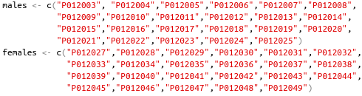
Part 2– Freestyle
How to use Tidycensus
To be able to load data, you first need to add your api key using census_api_key( ). After running the code, you get the option to save the key, so that you don't have to run it each time
One of the major functions used to pull data from the census with Tidycensus is get_decennial(geography = ,variables =, year = )
Arguments
geography: corresponds to the region the data is broken into (some of the options are "us", "region", "division", "state", "county", "zcta"
variables: These are the codes used in the census to identify different metrics, these vary by census and there are thousands. You can generate a table with the codes and descriptions for a given census by running load_variables(year, "sf1")
This package works well with the tidyverse packages, it has an option to generate data with coordinates that can be maped into regional maps using ggplot (and other packages).
However, that makes the downloaded data much larger, so it would be better to use with region, division, and state, rather than with counties or zip codes (zcta).

Slide 10
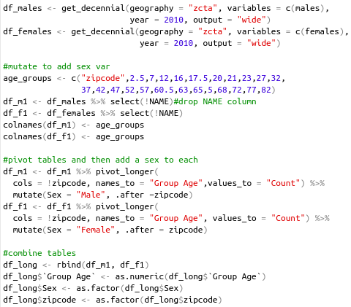
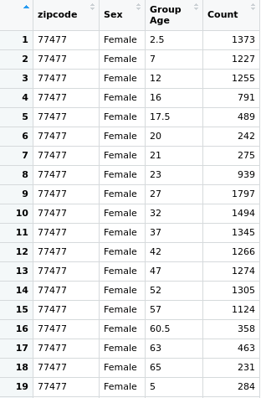
Part 2– Freestyle
Workflow:
Identify codes for variable of interest "sex by age", which has multiple codes broken up by age groups and sex.
Created two separate lists with all the vectors for each males and females
Change column names, pivot to get long form and mutate to add sex column
Combine tables into one data frame.
The combined dataframe has 1,523520 observations

Slide 11
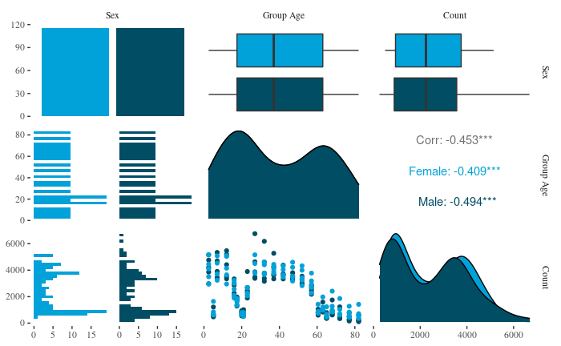
Part 2– EDA
Filtering for the 5 most populous zip codes.
The median number of males and females on the zip codes is similar, but there's more spread for the number of males.
There seem to be more males than females in the younger groups, but more females for the older groups.

Slide 12
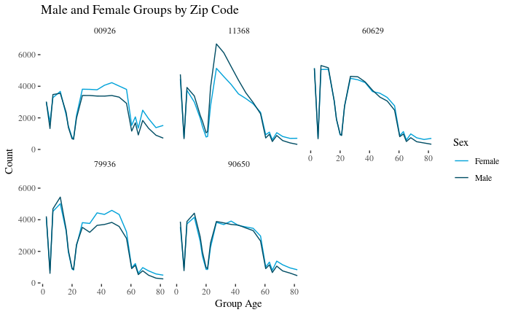
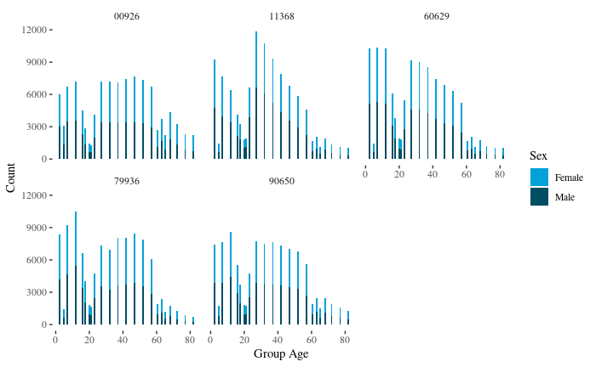
Part 2– EDA
This can be used to visualize how the male to female distribution changes for the different age groups.
I would have liked to have the option to pull data with groups of equal age widths, that would have helped better visualize trends in the relative size of the age groups.
We can see the differences in groups by zip code
Zip code 11368 has a larger proportion of males than females for the groups ranging from 20-50
60629 – Chicago
79936 – El Paso
11368 – Queens, NY
00926 – San Juan, PR
90650 – Los Angeles

Slide 13
Takeaways and questions
Takeaways
This was an extremely difficult assignment, the process of finding an API of interest, figuring out how to use it, and then how to get insight from that data was quite cumbersome.
I tried a couple of APIs at first, which took quite a bit of time, but the data I found from some of them wasn't particularly interesting in itself.
Questions
What are some recommended APIs to that are easier to start working with.

