Slide 1
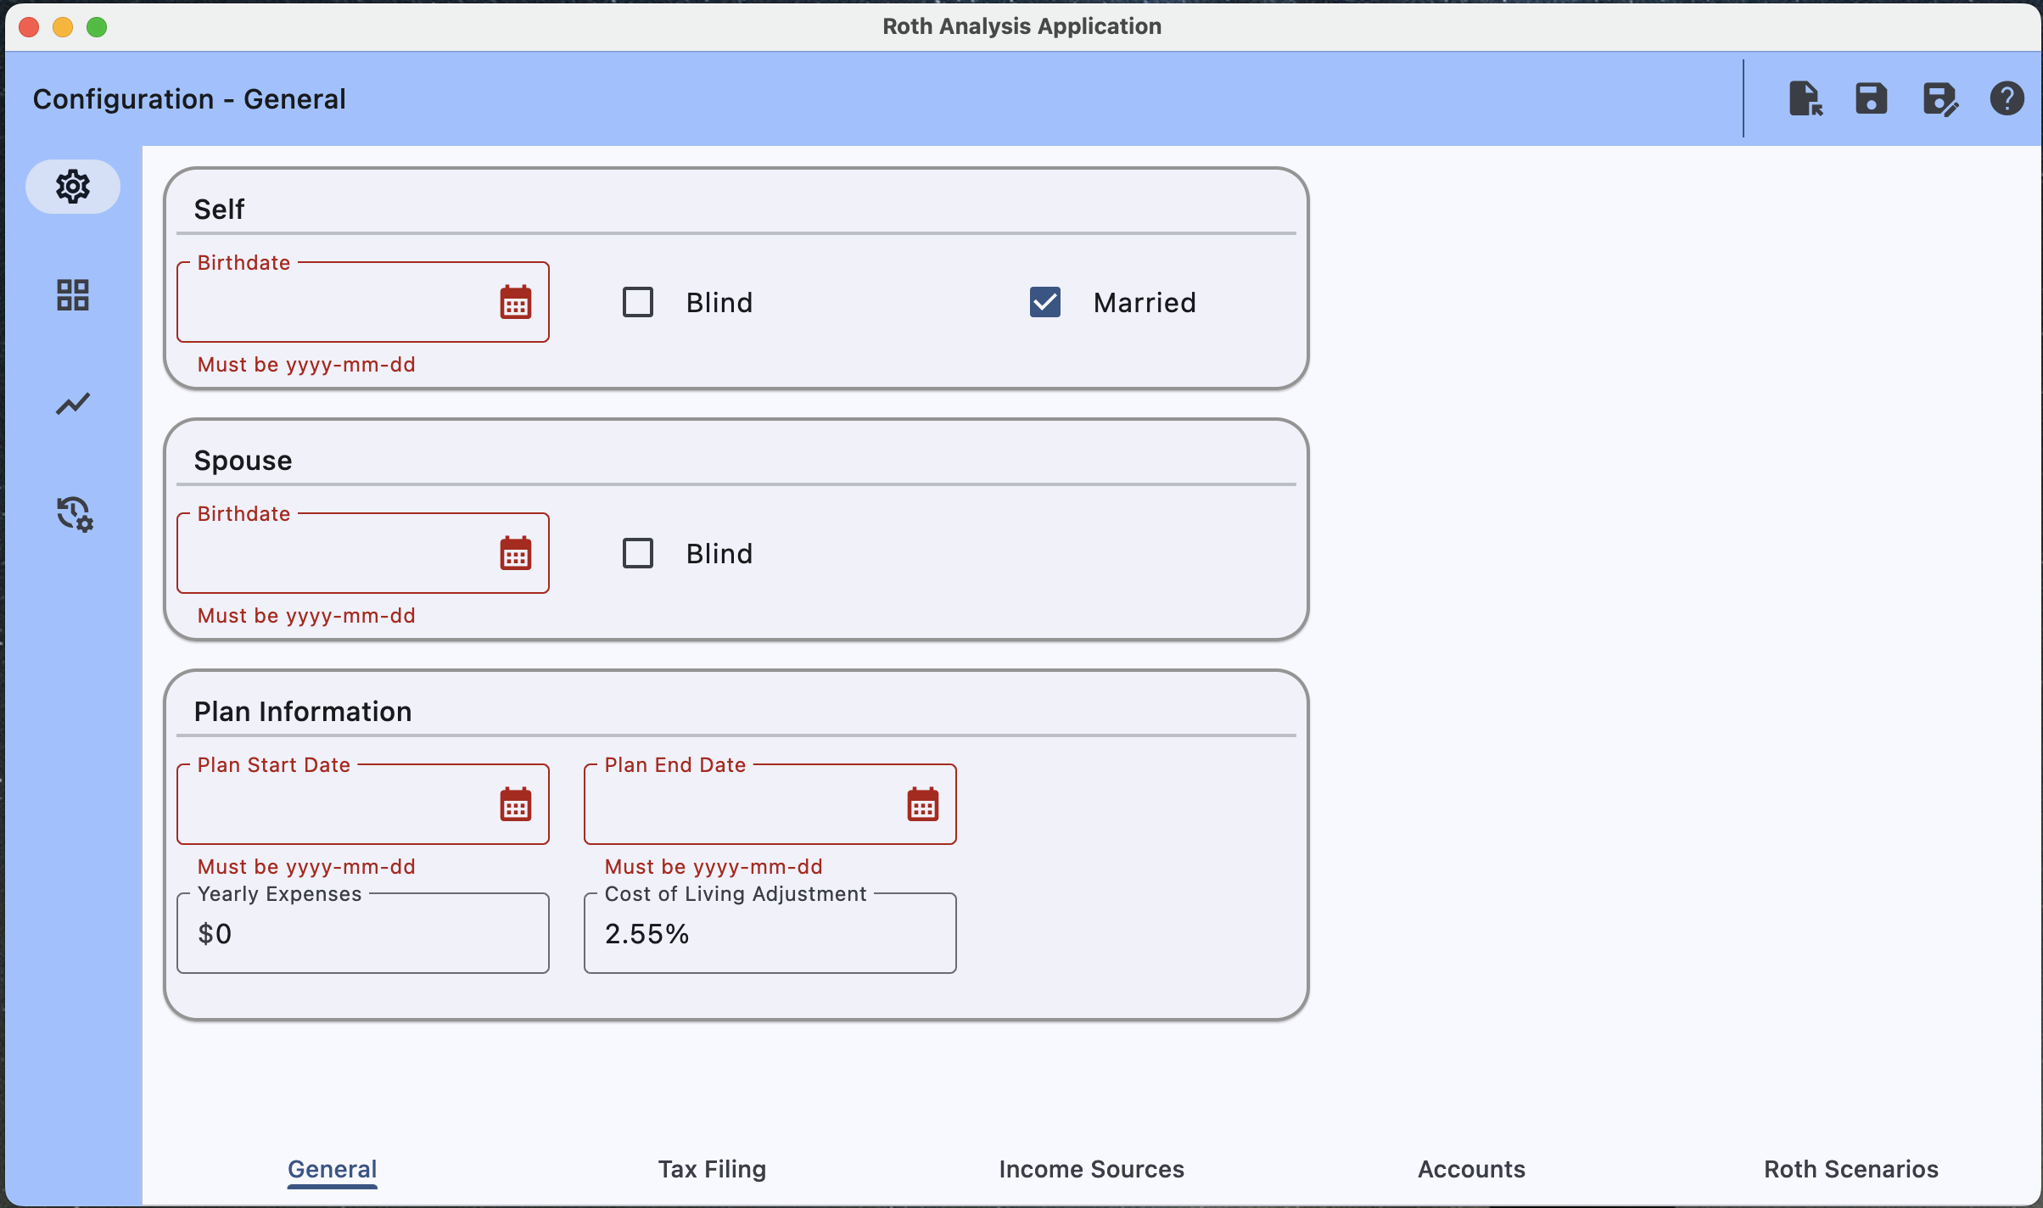
File Open,
File Save,
File Save-As
Help
Navigate to the Configuration Screens
Navigate to the Tabular Results
Navigate to the Chart Results
Navigate to the Transaction Log

Slide 2
Navigate to a particular Configuration Section

Slide 3
User Information
User’s Spouse Information (if married)
Overall Plan Information

Slide 4
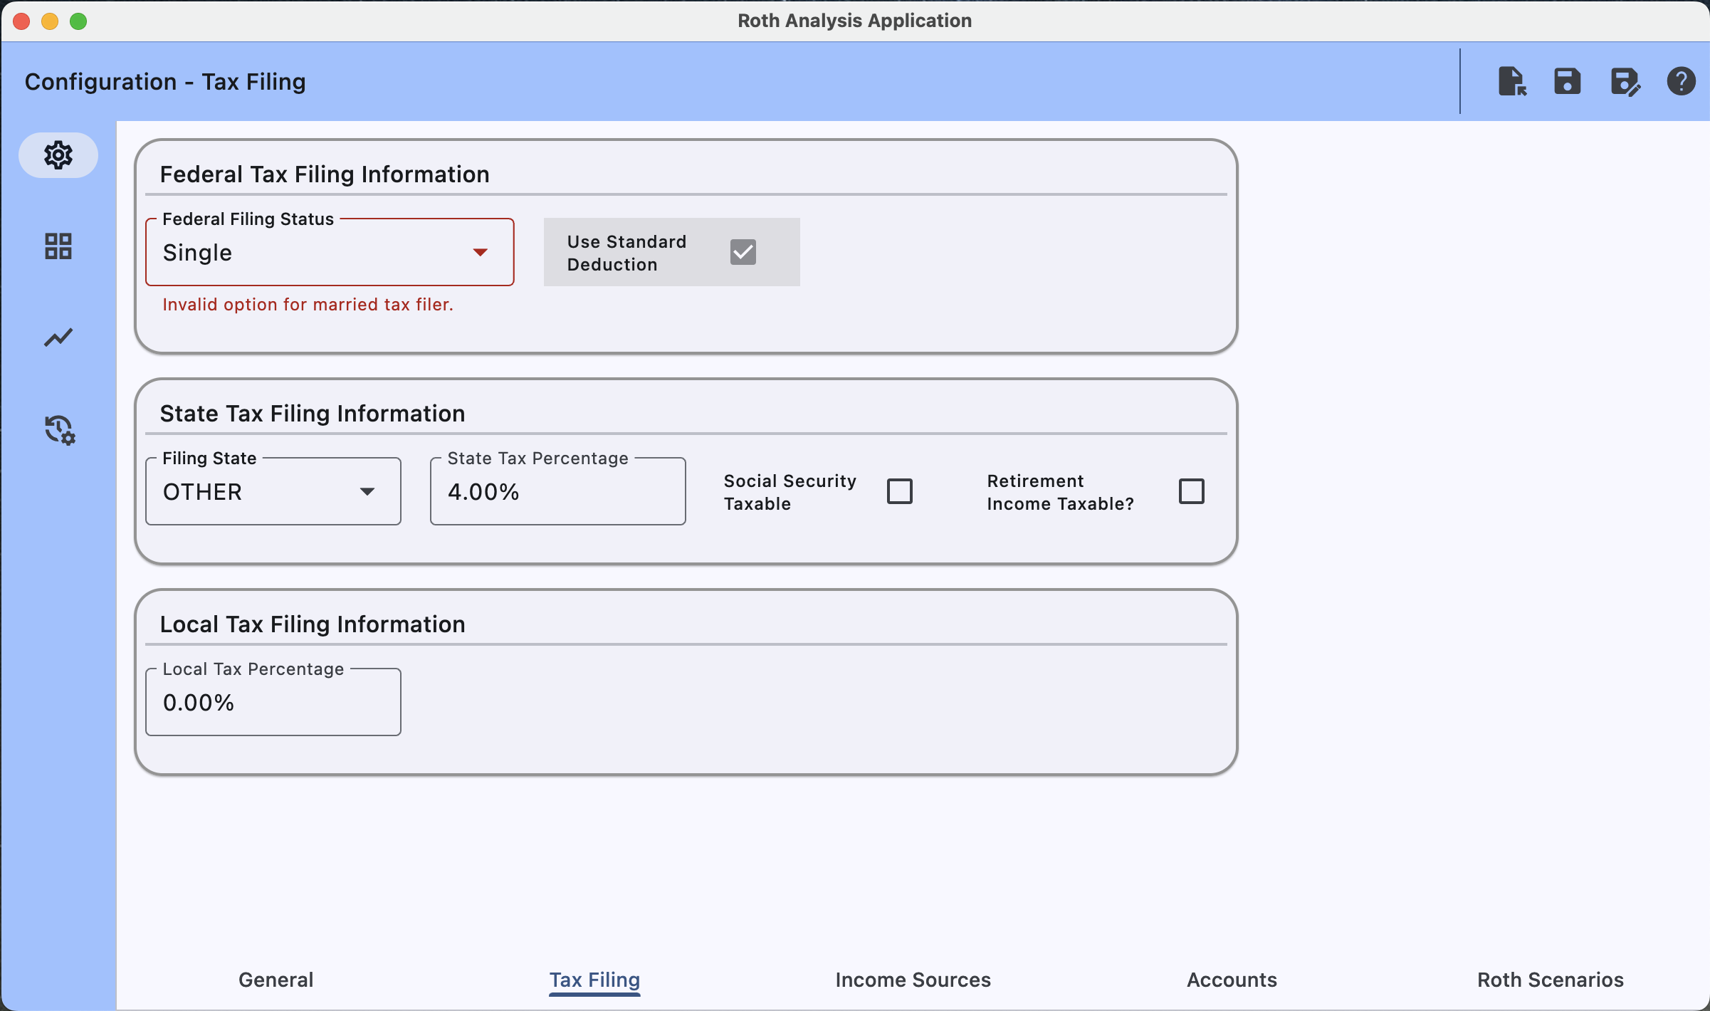
Needed to compute Federal Income tax.
Needed to compute State Income tax.
Needed to compute Local Income tax (id applicable).

Slide 5
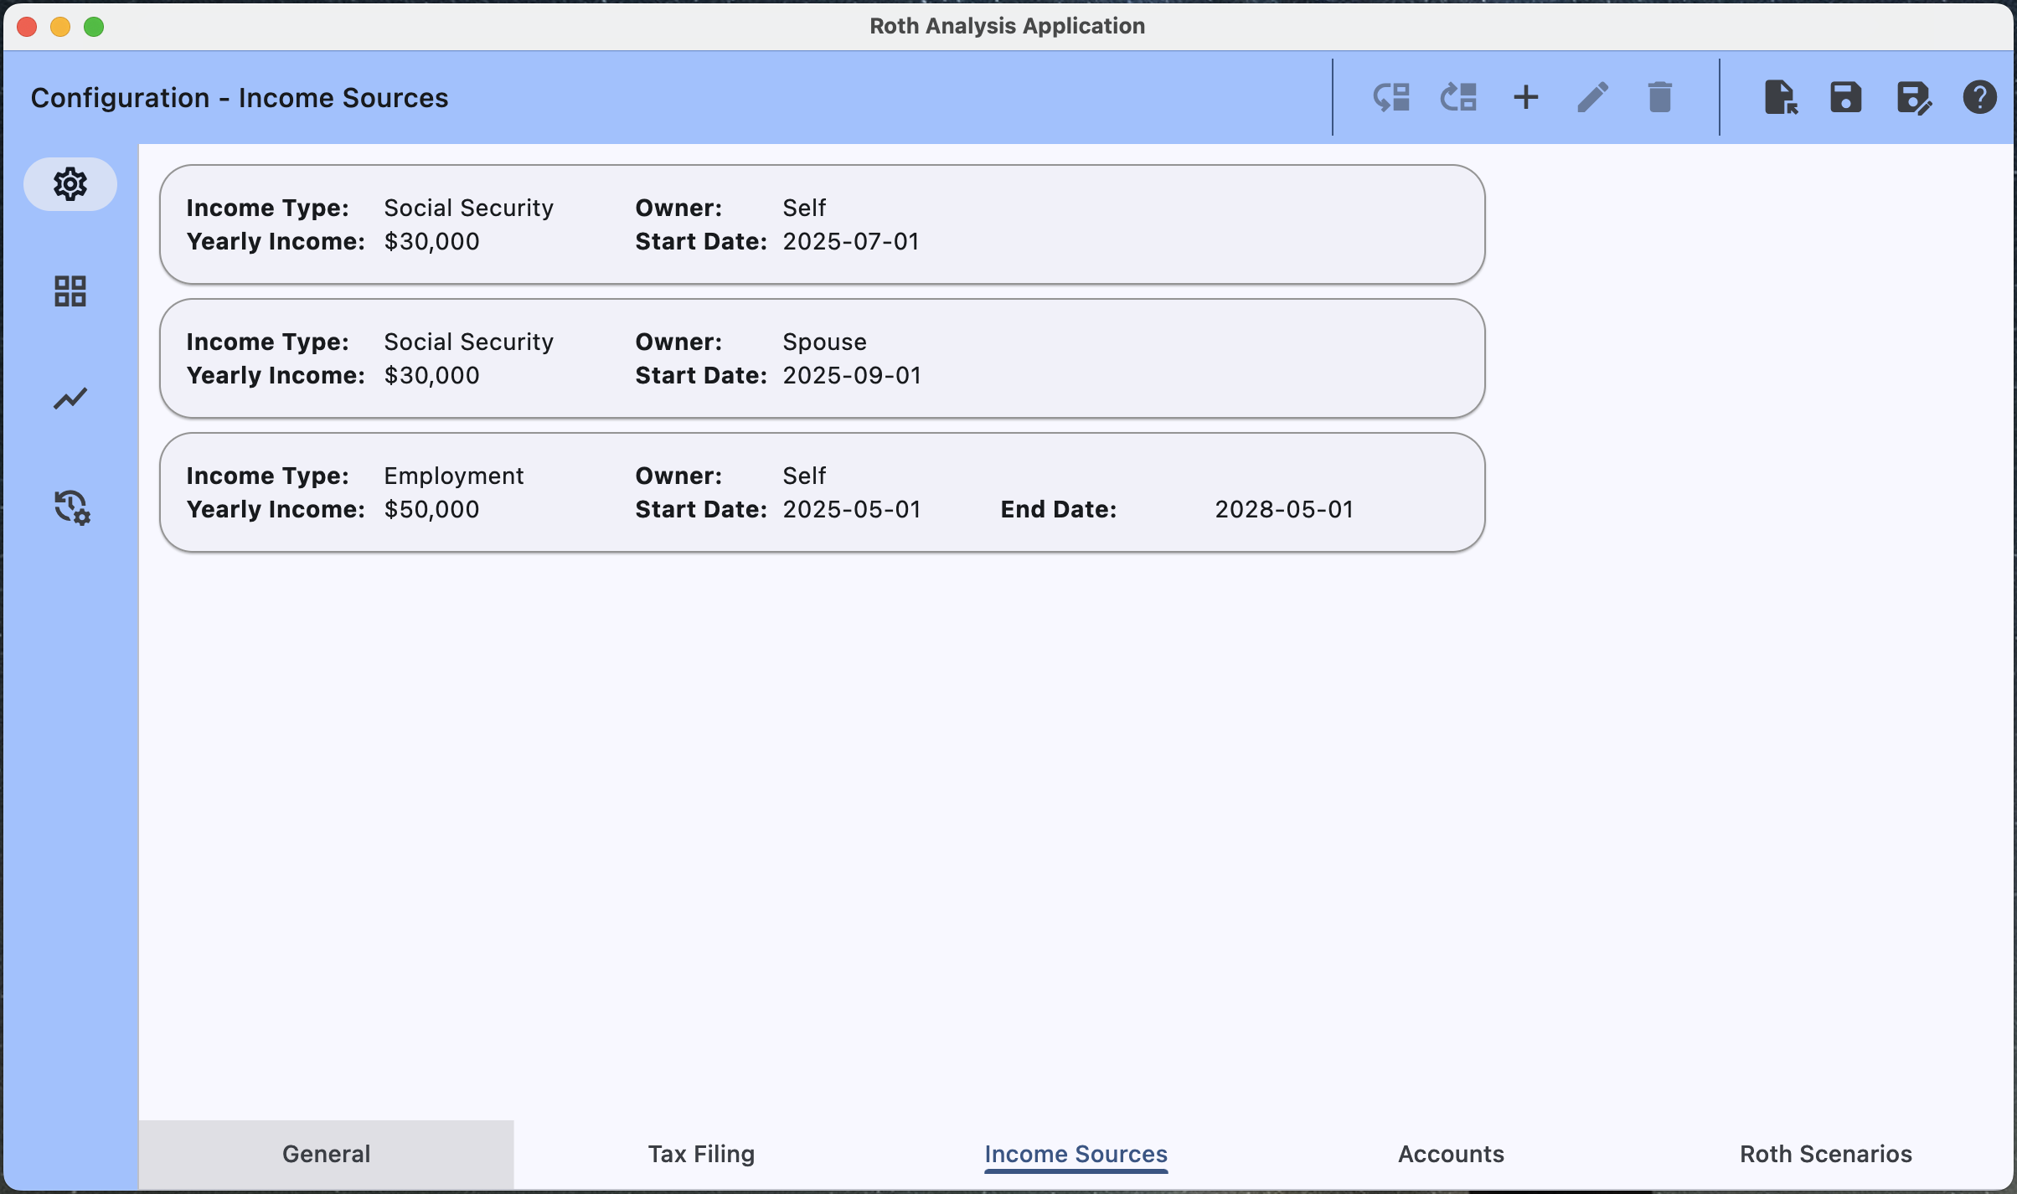
Move Item Down,
Move Item Up,
Add New Item
Edit Selected Item
Delete Selected Item
Represents one of N Income Streams
Income Type (Social Security, Regular Income, Self-Employment Income, Pension Income)
Owner (Self, Spouse),
Yearly Income
Start Date (of the Income Stream)
End Date (of the Income Stream)

Slide 6
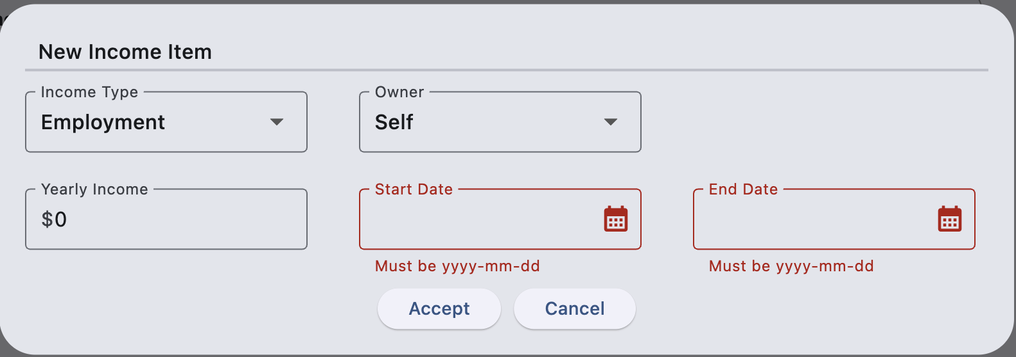

Slide 7
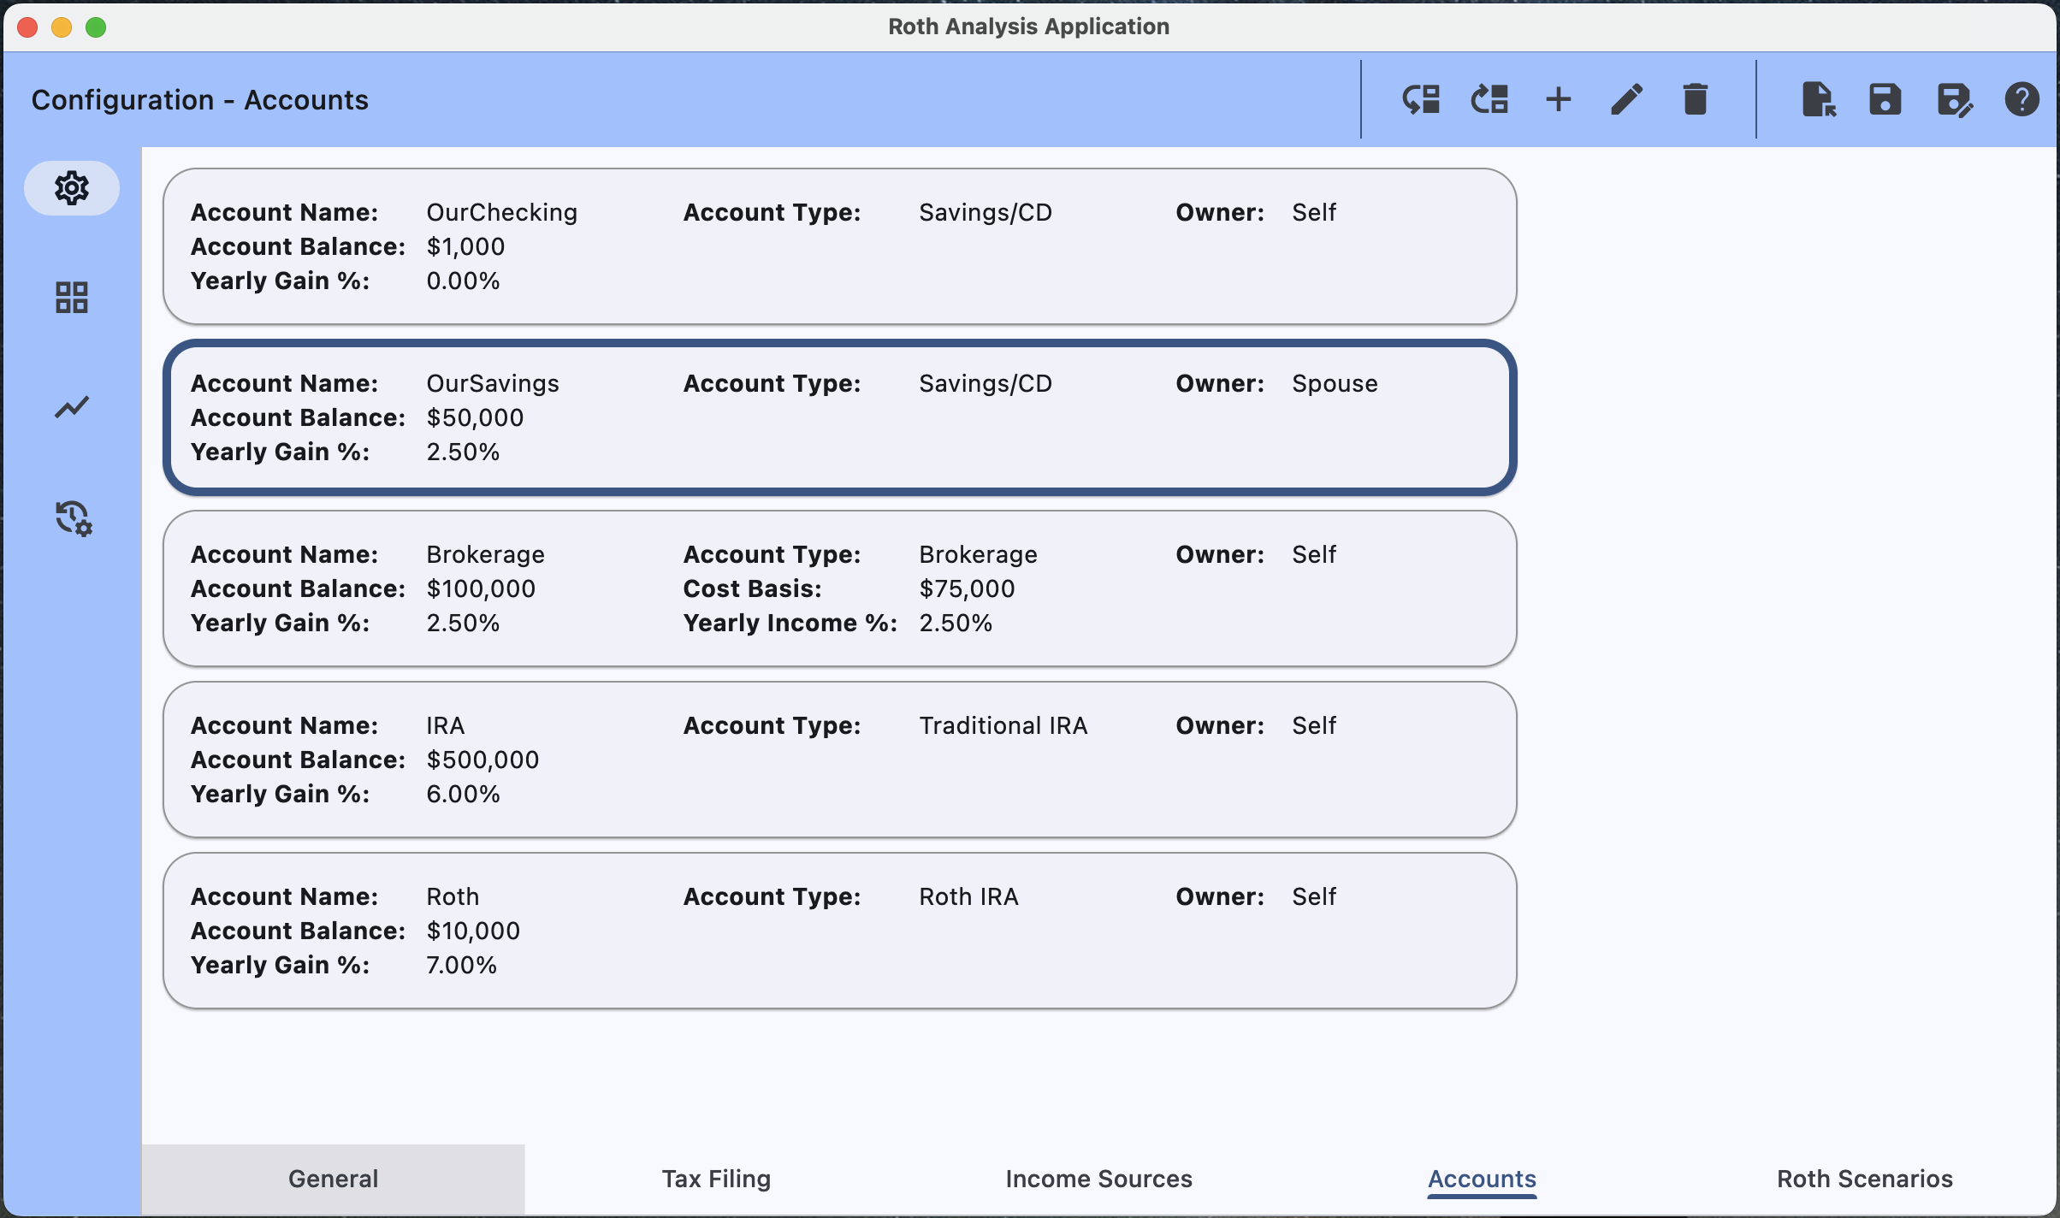
Move Item Down,
Move Item Up,
Add New Item
Edit Selected Item
Delete Selected Item
Represents one of N Investment Accounts
Account Name – Any meaningful text string less than 16 characters.
Income Type (Savings/CD, Brokerage, Traditional IRA, Roth IRA)
Owner (Self, Spouse),
Account Balance
Cost Basis
Yearly Gain Percentage
Yearly Income Percentage

Slide 8
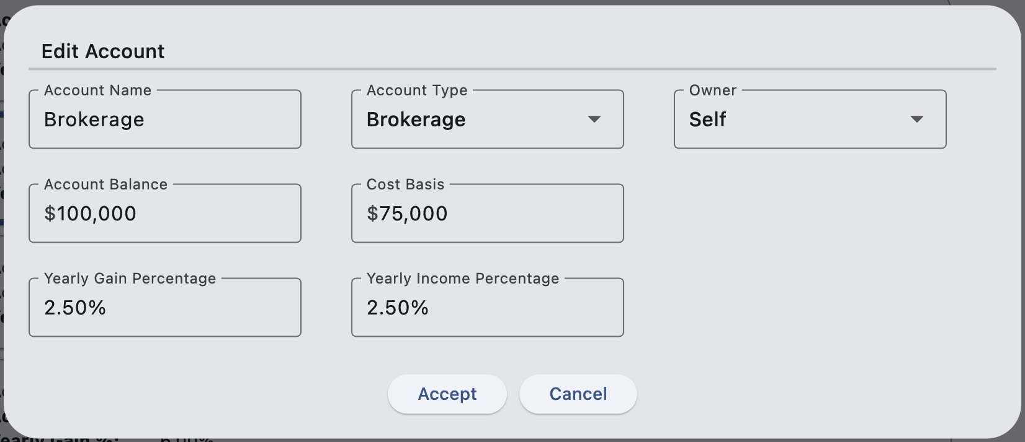

Slide 9
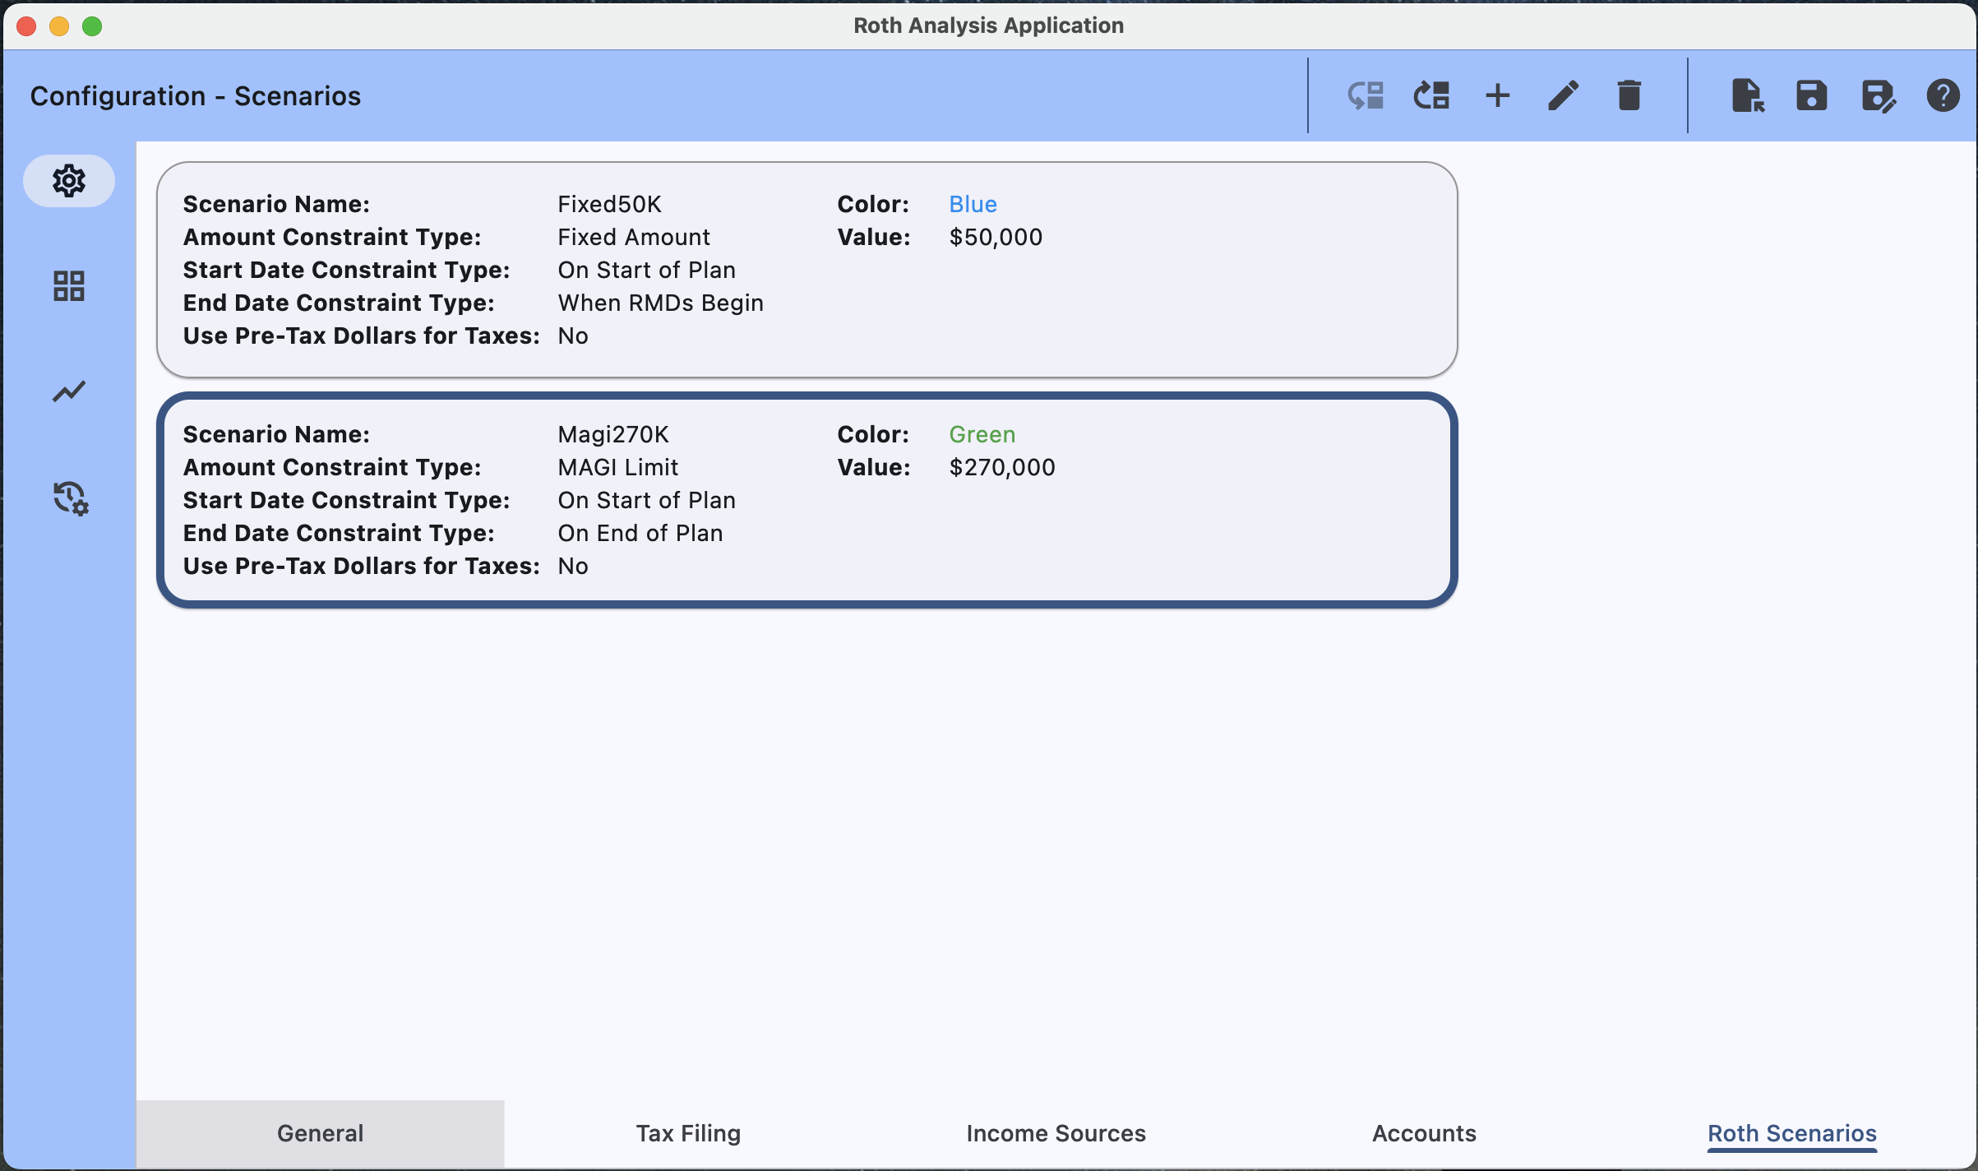
Move Item Down,
Move Item Up,
Add New Item
Edit Selected Item
Delete Selected Item
Represents one of N Conversion Scenarios to Analyze
Scenario Name – Any meaningful text string less than 16 characters.
Color – Color this scenario will be represented by in the comparison chart.
Amount Constraint (“Fixed Amount” or “MAGI Limited”)
Value - Fixed yearly dollar conversion amount or Yearly MAGI dollar amount to enforce.
Start Date Constraint (“On Start of Plan” or “On Fixed Date”)
End Date Constraint (“When RMDS begin”, “On Fixed Date”, “On Plan End”)
Use of Pre-Tax Dollars for Taxes

Slide 10
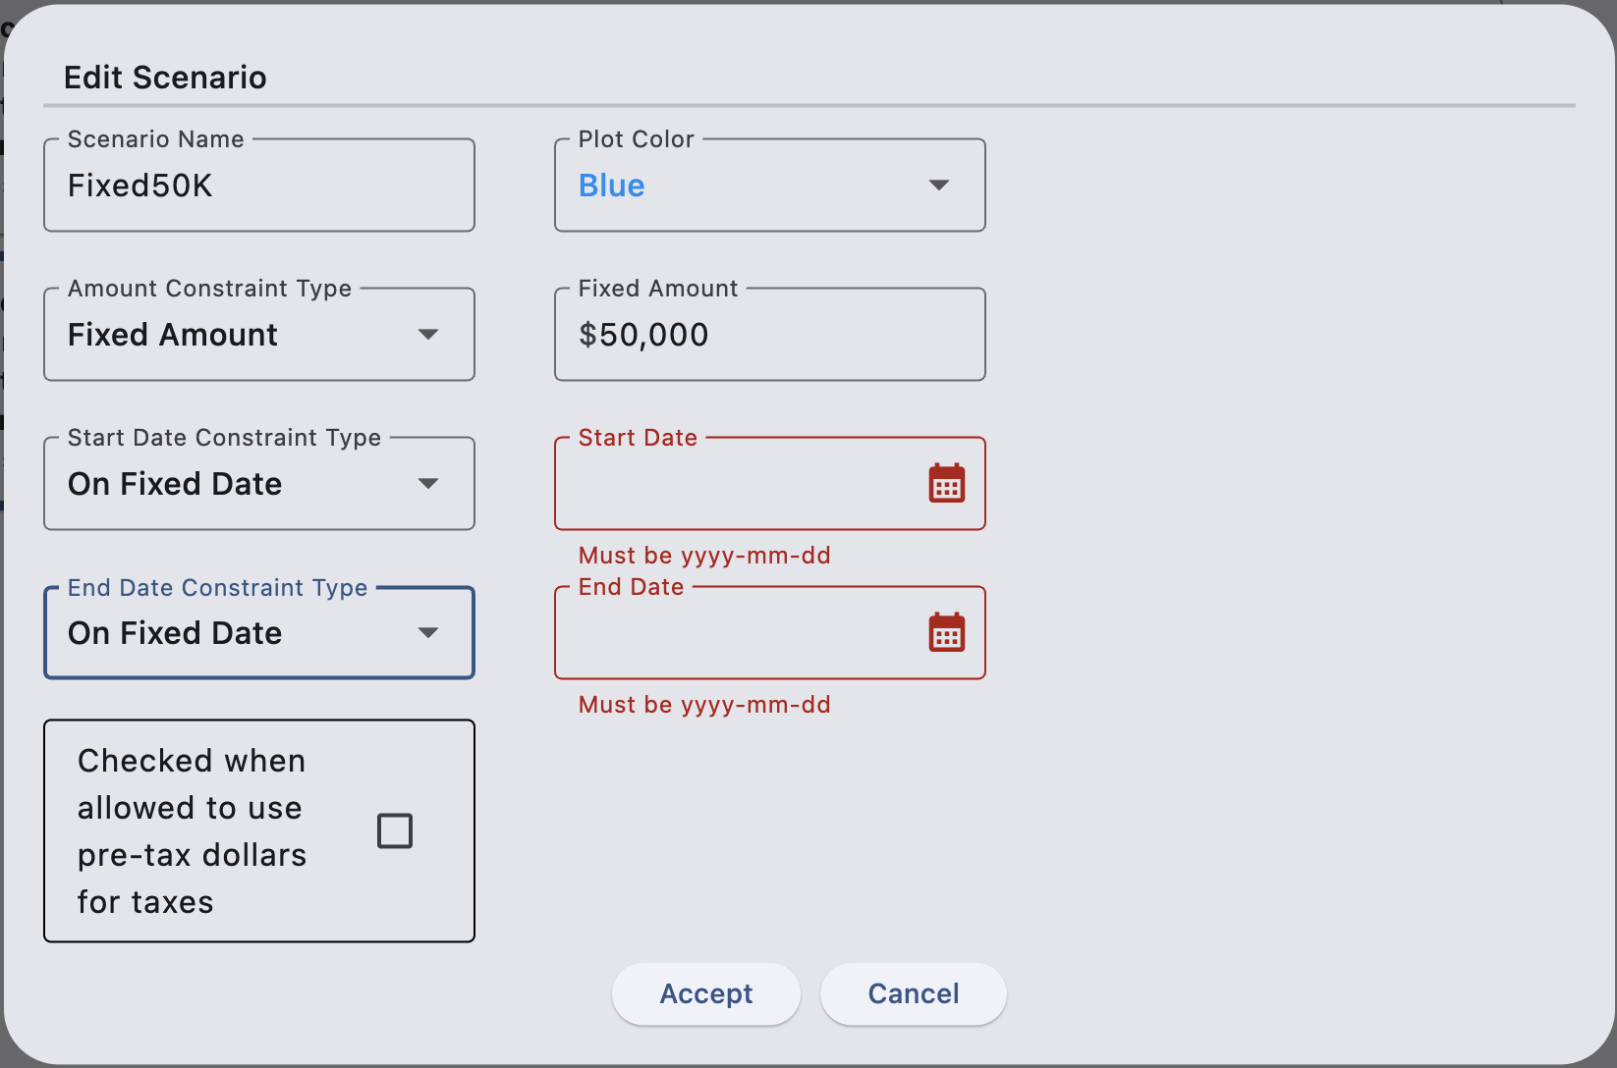

Slide 11
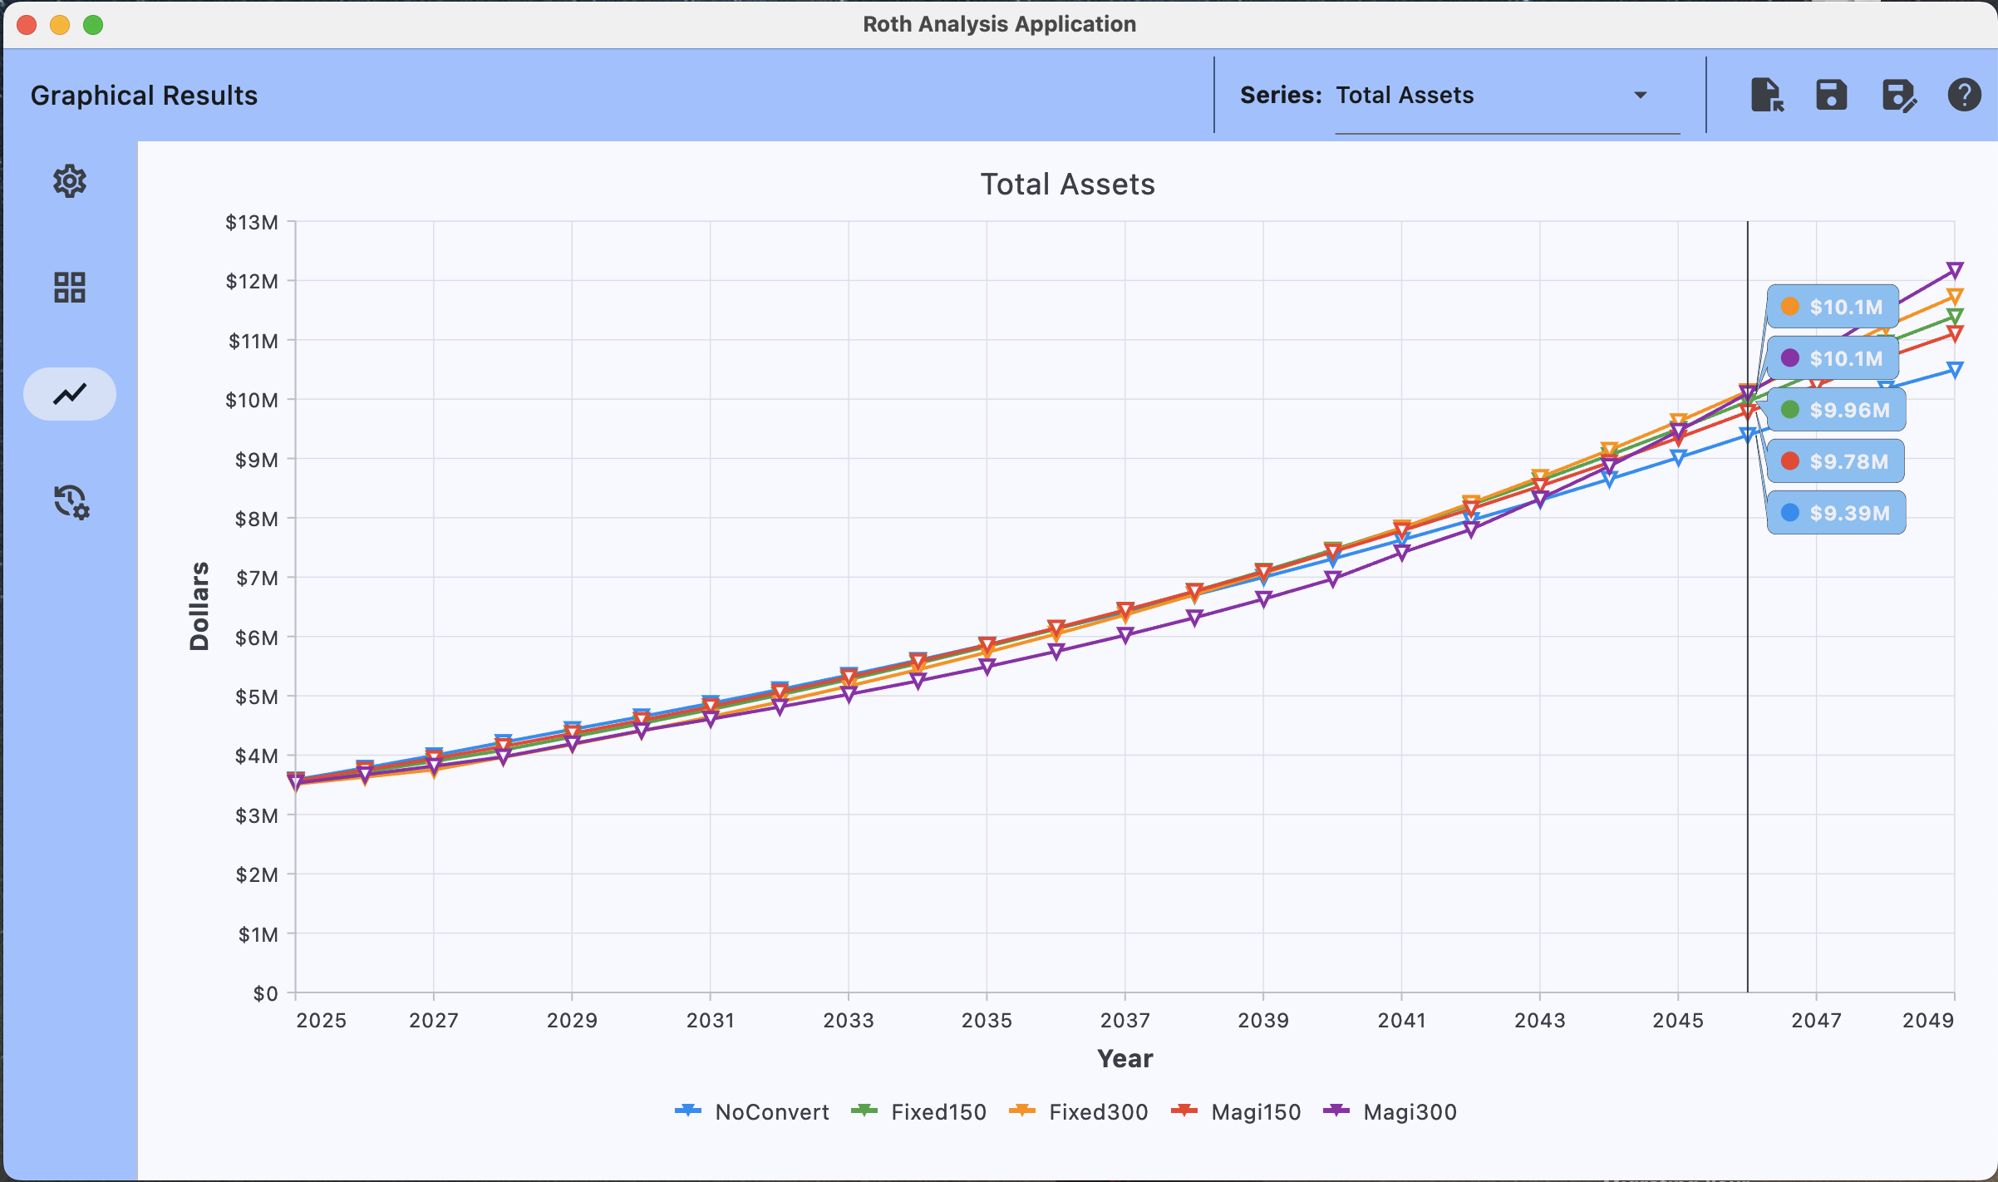
Dropdown to select what value is graphed
Plot of every scenarios result for easy comparison.
Trackbar display all value scenarios at a certain year. Enabled by holding down left mouse button.
Legend.

Slide 12
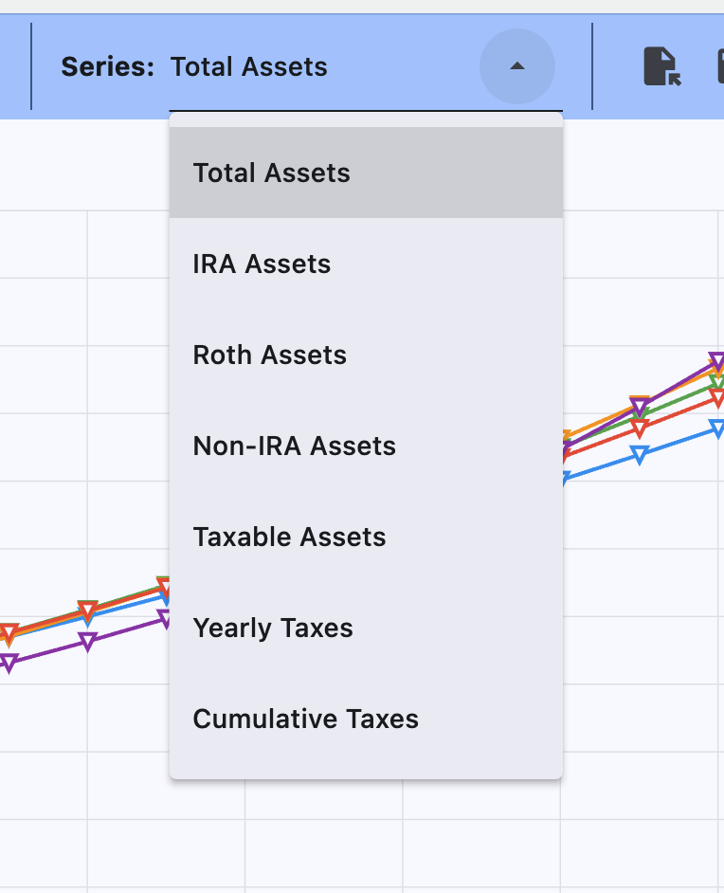

Slide 13
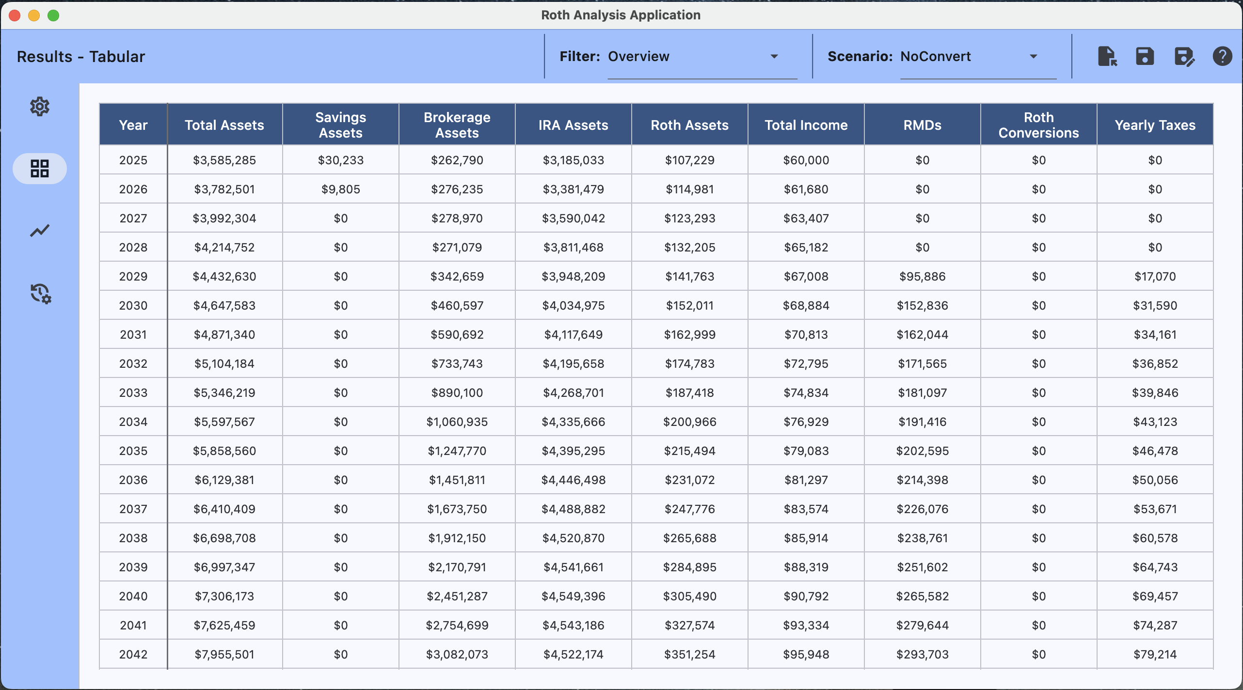
Dropdown to select what values are presented in the table.
Dropdown to select which scenarios' data is presented in the table.

Slide 14
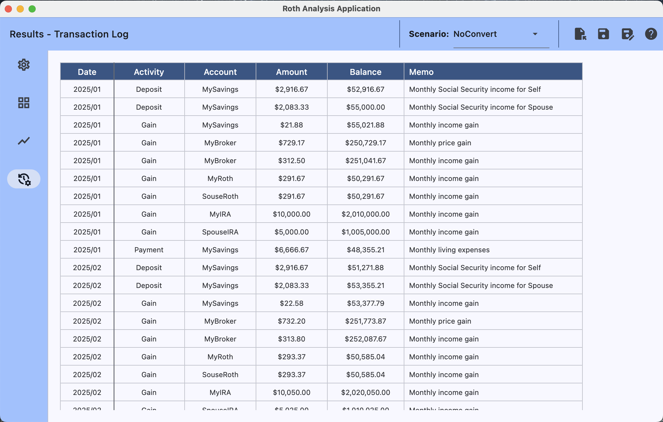
Dropdown to select which scenarios' data is presented in the table.

