Slide 1
Developing a minimal kernel with testing environment
Starting Point
Goals
Development
Results
Hüseyin Uslu

Slide 2
Starting point
Fast developing technology
Many alternatives
Users always expecting more and more performance
Benchmark Software

Slide 3
Goals
Hardware Performance Tests
CPU
  Floating Point
  Processing Capacity
Memory
  Access Time
  Corrupt Memory Banks
Disc
etc.

Slide 4
Need for a kernel
Effect of a operating system on performance tests
  Services
  Drivers
  Processes
Ensure equal conditions for similar configured computers
Enabling direct access of performance analyse codes to hardware
  Ring0
  Getting rid of operating system limitations
Benchmark Software based on a kernel

Slide 5
Test Environment
Kernel based platform for performance analysis code
No installation (live cd, USB sticks)
Parameter based tests
While a performance test, only vital kernel code runs
While a performance test, user input is blocked

Slide 6
Development Environment
Concurrent Development: Subversion
Compilers: GCC, NASM
Make system: MAKE
Debugger: GDB
Emulator: bochs, qemu, vmware
Bootloader: GRUB

Slide 7
Boot Loader
GNU GRUB
  Stable
  Widely used
  Supports different boot options
    CD
    Floppy
    USB drive

Slide 8
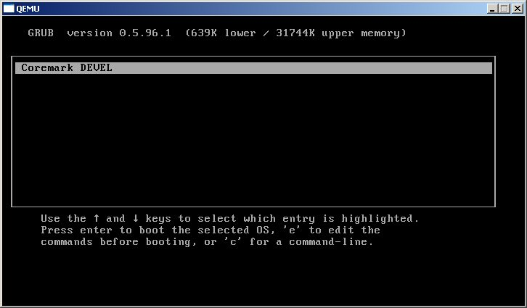
Bootloader - 2
boot.S (GRUB Multiboot Specification )
kernel.c - main() , entrance point for kernel

Slide 9
GDT
Global Descriptor Table (gtd.c)
  Memory Segments
  Access Privileges (ring0)
gdt_flush.asm
  kernel.c -> install_gdt() -> gdt_flush() [lgdt]

Slide 10
IDT
Interrupt Descriptor Tables
  Interrupts
  Exceptions
idt.c
  ISR definitions (ISR0 – ISR31)
  IRQ definitions (IRQ0, IRQ1…)
kernel.c-> install_idt()
  Relocating ISR & IRQs
  Matching handler fuctions for ISR & IRQs
  load_idt() [lidt]

Slide 11
Reprogramming the PIC
CPU Exceptions
  0-31 -> interrupt table 0 - 31
PIC ( hardware IRQs )
  Master (IRQ0 – IRQ7) -> interrupt table 8 - 15
  Slave (IRQ8 – IRQ15) -> interrupt table 112 - 120
Interrupt Table, location 8
  Double Fault Exception
  IRQ0, timer interrupt
Need reprogramming [pic.c – remap_pics()]
  0 Division By Zero Exception
  1 Debug Exception
  …
  7 No Coprocessor Exception
  8 Double Fault Exception
  9 Coprocessor Segment Overrun Exception
  10 Bad TSS Exception
  ..
  31 Reserved Exception
  32 IRQ0 Timer
  33 IRQ1 Keyboard
  …
  39 IRQ7 Parallel Port
  …
  47 IRQ15 Secondary IDE channel

Slide 12
Interrupt Handlers
Handler functions (irq_handler.c)
  Timer [timer_handler()]
  Keyboard [keyboard_handler()]

Slide 13
Exception Handlers
exception.c
  Fires on a CPU exception
    Name of exception
    Error code
    System status
    Register status
    Code Segment: Instruction Point (CS:IP)

Slide 14

Finding CPU (CPUID)
cpuid.asm, cpu_info.asm
  CPU Brand
  CPU Vendor
  CPU Features

Slide 15
Console Driver
User I/O (console.c, keyboard.c)
  User input
  Test results, reports

Slide 16
Timer
PIT [irq_handler.c, timer_handler()]
Realtime Clock (RTC) [time.c, read_system_time() ]
  Read current value from CMOS
Stop Timer [ start_time(), stop_time()
  Stop timer for performance analysis – 1ms sensivity

Slide 17
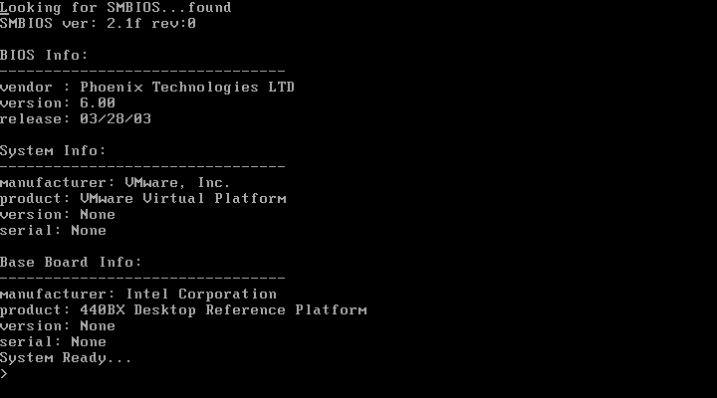
SMBIOS
Basic SMBIOS support [ smbios.c, read_smbios() ]
  Searches 000F0000h-000FFFFFh for SMBIOS signature
  Basic BIOS, system, motherboard info
Ongoing development

Slide 18
Makefile targets
Make
  Compile & link sources
Make image
  Disk image with GRUB
Make iso
  ISO image

Slide 19
Documentation
/doc folder under Subversion Repo.
  PIC, PIT, RTC…
  Compiling, Development Environment
  Technical topics, specifications

Slide 20
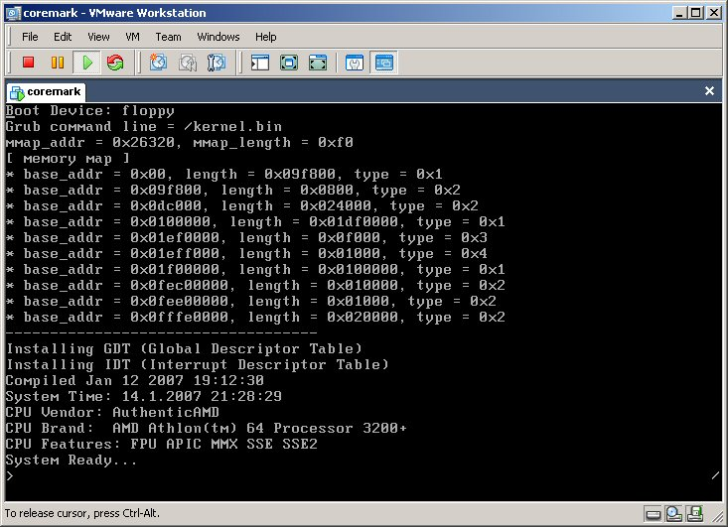
Result
Bootstrap
Vital kernel functions
Base platform for performance analysis

