Slide 1
Developing a minimal kernel providing test environment
Hüseyin Uslu
20194562

Slide 2
Goals
Kernel development
  Not a popular topic in Türkiye
  Our interest and motivation
  Willing to research on a non-popular topic in Türkiye

Slide 3
Deciding the purpose
General Purpose Kernel
  Time Limit ?
  Manpower limit ?
  Drivers ?
  Applications ?

Slide 4
Thinking minimalist
Minimalist Kernel
Specific Purpose
A kernel topic that satisfies a real need

Slide 5
Developing a minimal kernel providing test environment
kernel development
real need
minimalist
specific purpose

Slide 6
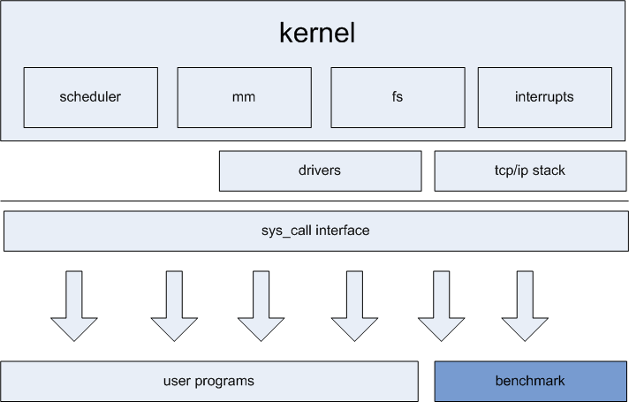
Current test environments

Slide 7
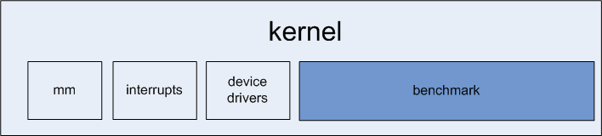
Our implementation
minimalistic
slightly affected test results
direct hardware access for benchmark code

Slide 8

Milestones
Milestone 1
  First semester
  Developing the kernel
  Stabilizing
Milestone 2
  Second semester
  Testing infastructure
  Test subsystems

Slide 9
Test Infrastructure
System configuration knowledge
  Boot
  Cpu
  Memory
  Time
  Additional

Slide 10
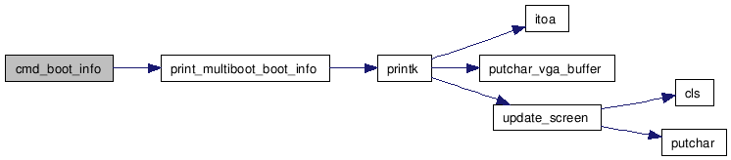
System Info - Boot

Slide 11
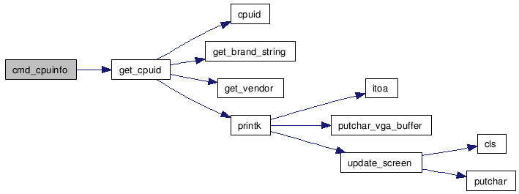
System Info - CPU

Slide 12
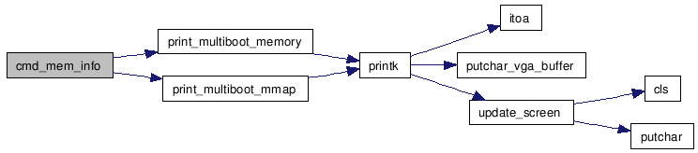
System Info - Memory

Slide 13
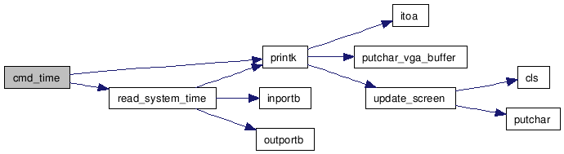
System Info - Time

Slide 14
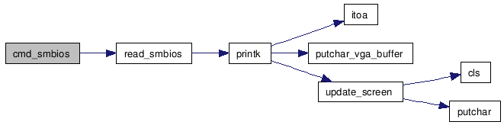
System Info – SMBIOS *(experimental)

Slide 15
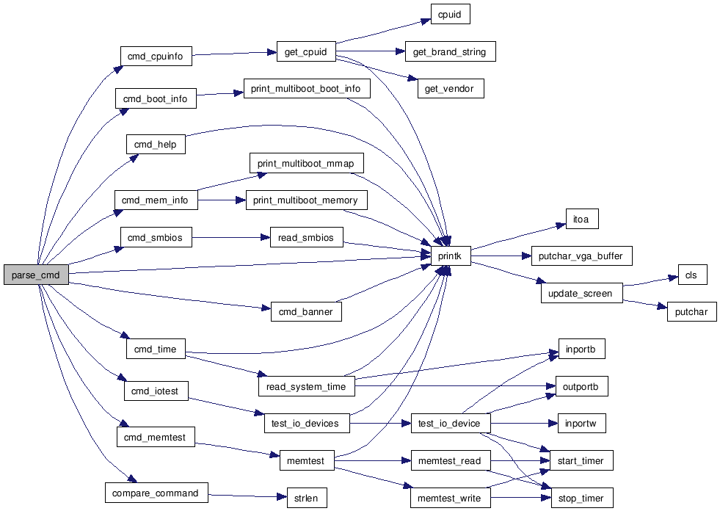
User interaction of test subsytem

Slide 16
Memory Testing - Goals
Testing the read/write duration
Same configurations == Same results ?
Slightly affected test function ?
Stable results

Slide 17
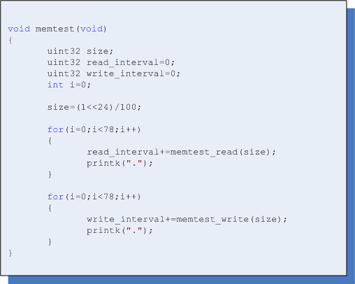
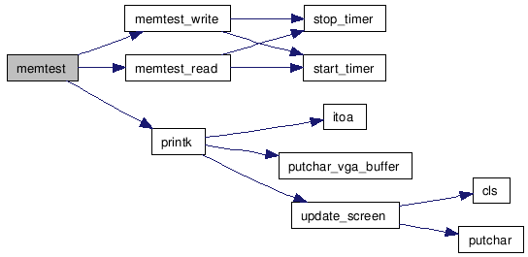
Memory Testing - Implementation
Stable results; n-Probes

Slide 18
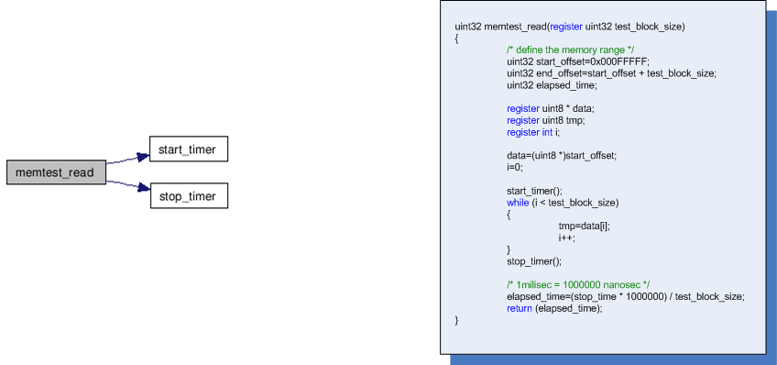
Read() Test
Slightly affected test function

Slide 19
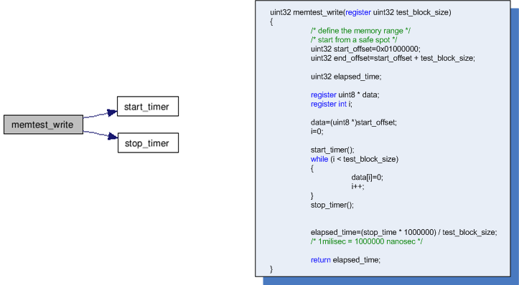
Write() Test
Slightly affected test function

Slide 20
Memory Test - Results
Testing the read/write duration
Same configurations = Same results
Slightly affected test function
Stable results

Slide 21
Memory Test - Deficiencies
Non-predicted cache effects
Cache-enabled results
Cache efficiency test

Slide 22
Cache Impact Workarounds
Caching effecting test results
Disable caching. How?
  Find largest cache size
    L2 or L3
  Use stepping on memory location to avoid cache hiting
    circulate memory location step+=max_cache_size

Slide 23
Disk I/O Test
Test read duration
  No write duration test. We don’t want user to explode his data!
Same configuration == Same results?
Slightly affected test function ?
Stable results

Slide 24
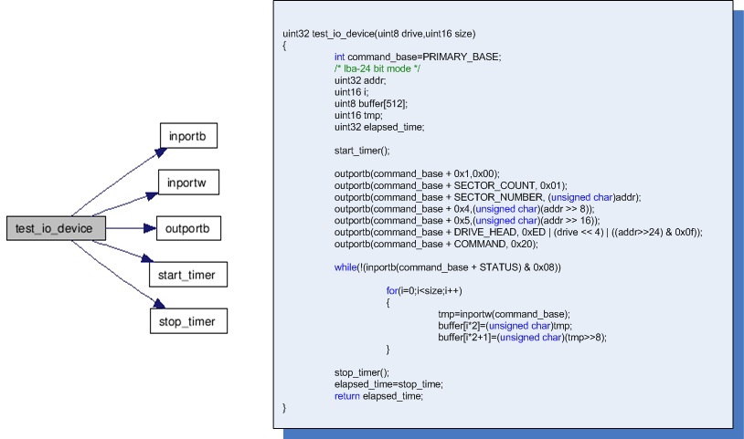
Disk I/O Test

Slide 25
Disk I/O - Current Problems
So many ATA specifications (1 to 7), SATA
Limited time = limited time of specifications implemented
Limited specifications implemented = Limited subsets of hardware supported for testing
Emulators optimizing the I/O timings, affecting the results

Slide 26
So far..
Kernel
Testing Infastructure
Tests

Slide 27
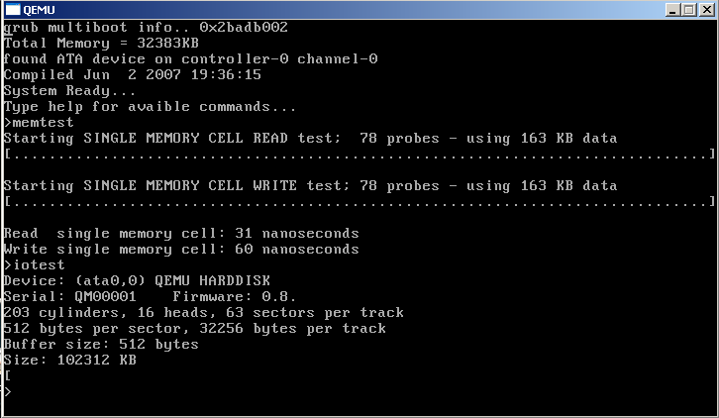
Thanks

