Slide 1
OLA RIDE INSIGHTS
By R. Boneys Dharan

Slide 2

Problem Statement:
The rise of ride-sharing platforms has transformed urban mobility, offering convenience and affordability to millions of users. OLA, a leading ride-hailing service, generates vast amounts of data related to ride bookings, driver availability, fare calculations, and customer preferences. However, deriving actionable insights from this data remains a challenge. To enhance operational efficiency, improve customer satisfaction, and optimize business strategies, this project focuses on analyzing OLA’s ride-sharing data.
Business Use Cases:
Identifying peak demand hours and optimizing driver allocation.
Analyzing customer behavior for personalized marketing strategies.
Understanding pricing patterns and surge pricing effectiveness.
Detecting anomalies or fraudulent activities in ride data.

Slide 3

Objective: To explore ola rides data, trying few SQL queries to better understand the data and gain valuable insights from visualization of data for the following cases
Identifying peak demand hours and optimizing driver allocation.
Analyzing customer behavior for personalized marketing strategies.
Understanding pricing patterns and surge pricing effectiveness.
Detecting anomalies or fraudulent activities in ride data.

Slide 4


Concepts Used:
Python
MySQL
Data Visualization
Data Extraction
Streamlit
Libraries Used:
Pandas
Streamlit
MySQL
Software Tools Used:
Visual Studio Code
MySQL workbench(optional)
Power Bi Desktop

Slide 5
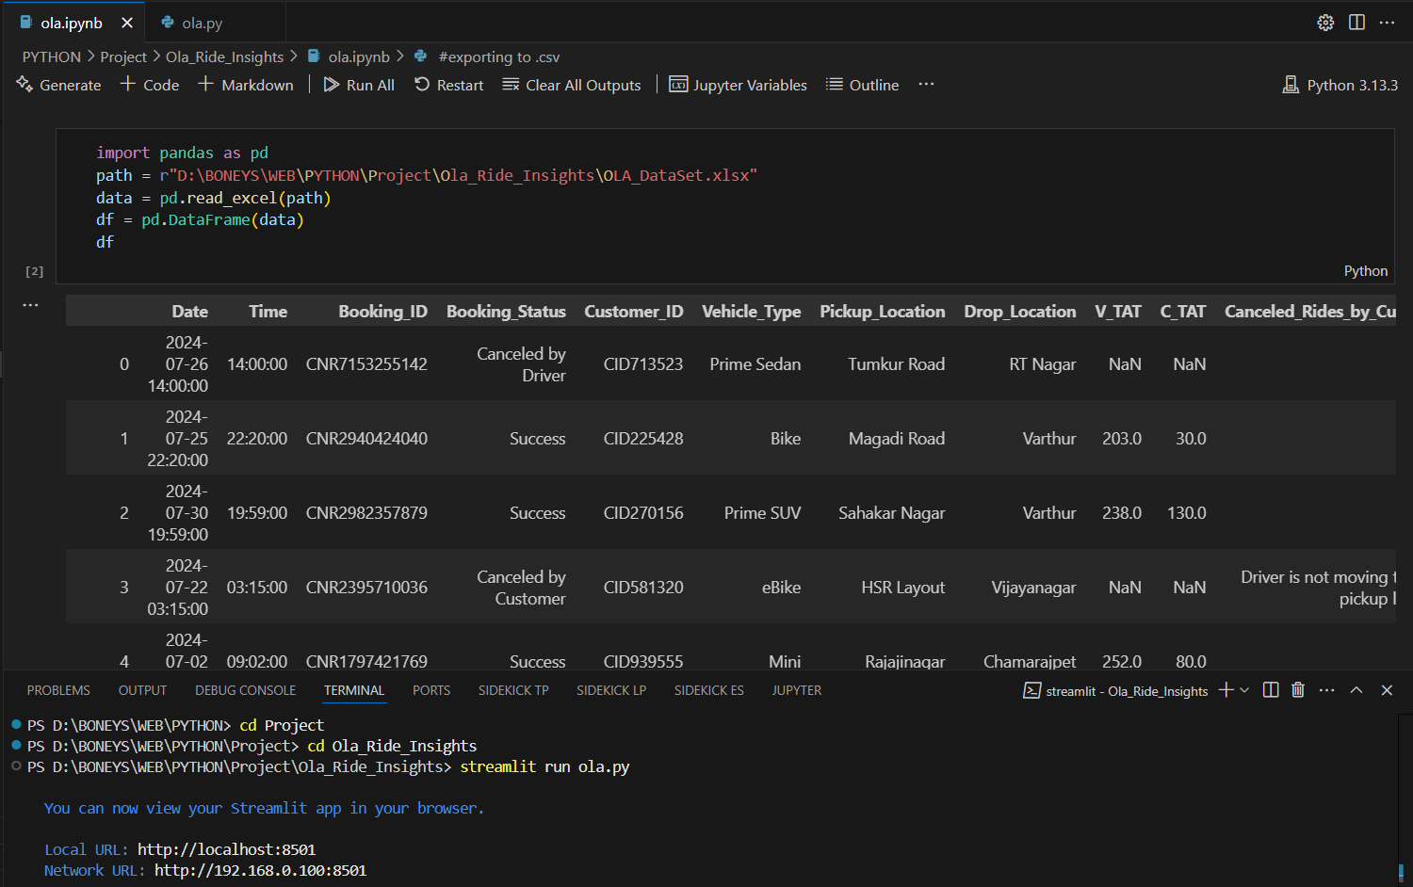
Data Extraction

Slide 6
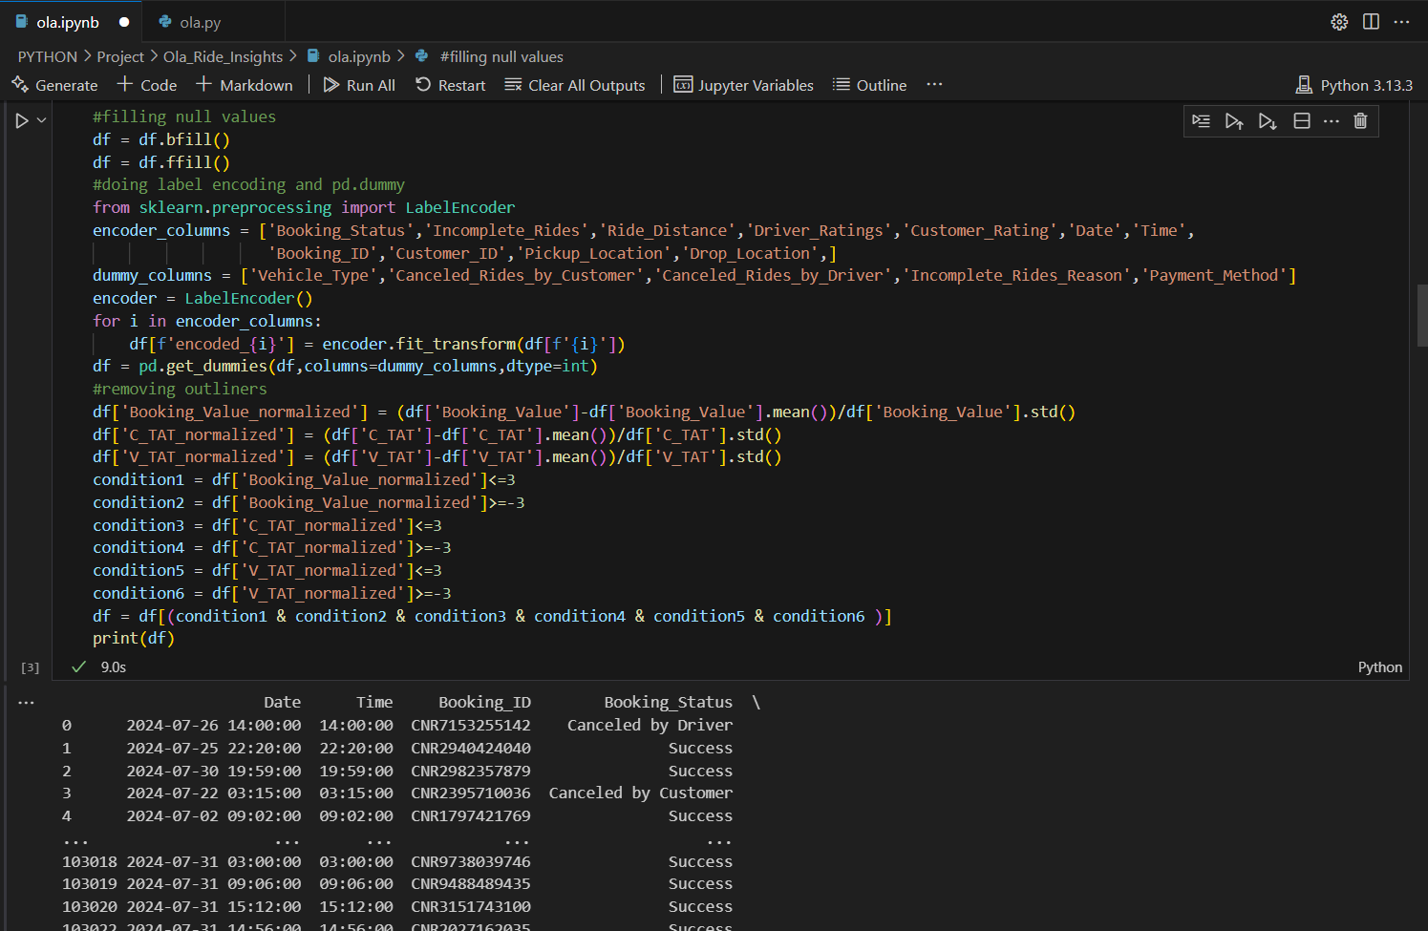
Data Cleaning

Slide 7
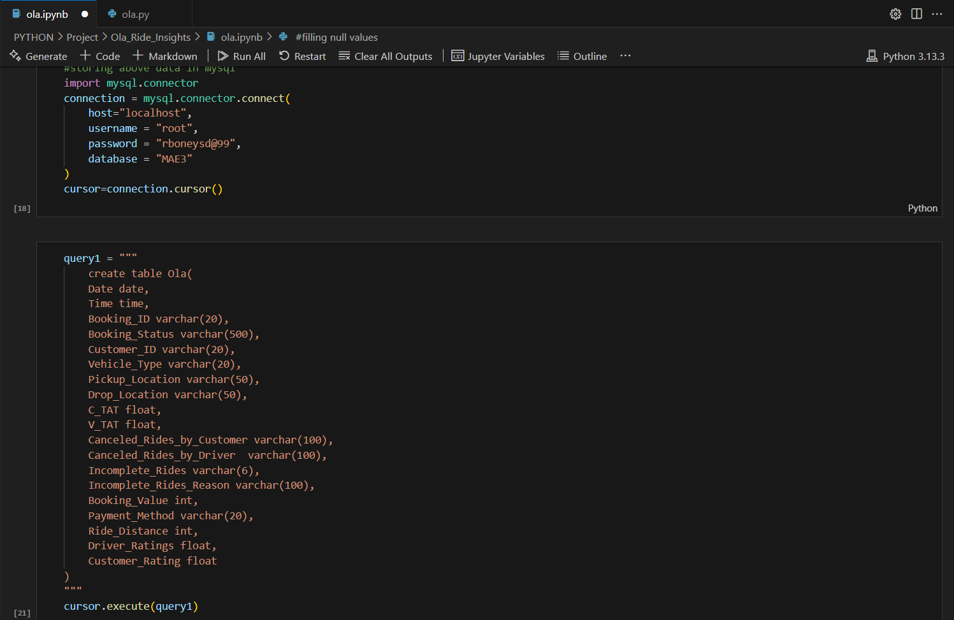
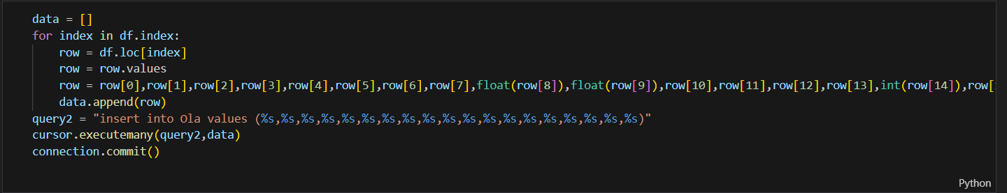
Data Storing in MySQL

Slide 8
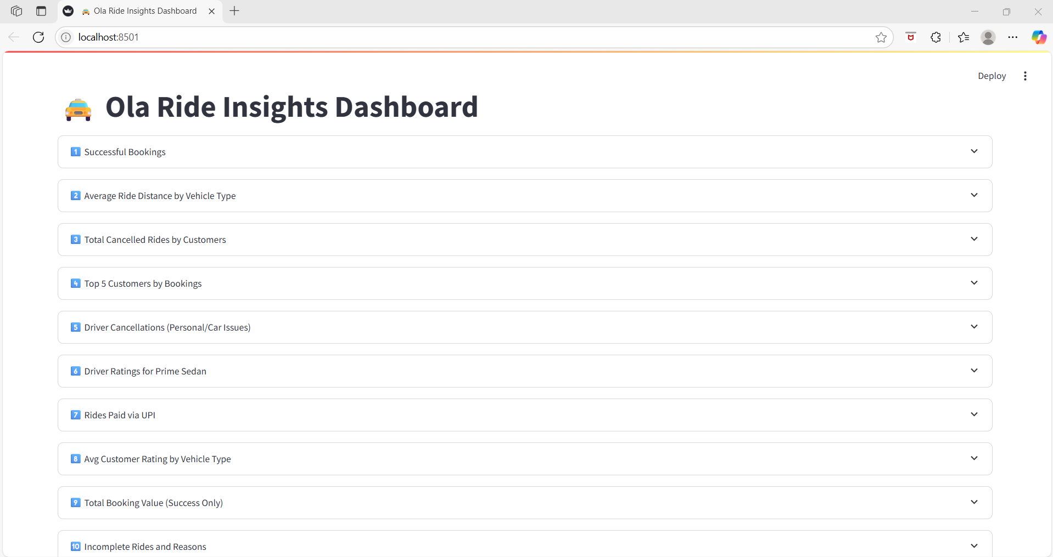
Streamlit Result:

Slide 9
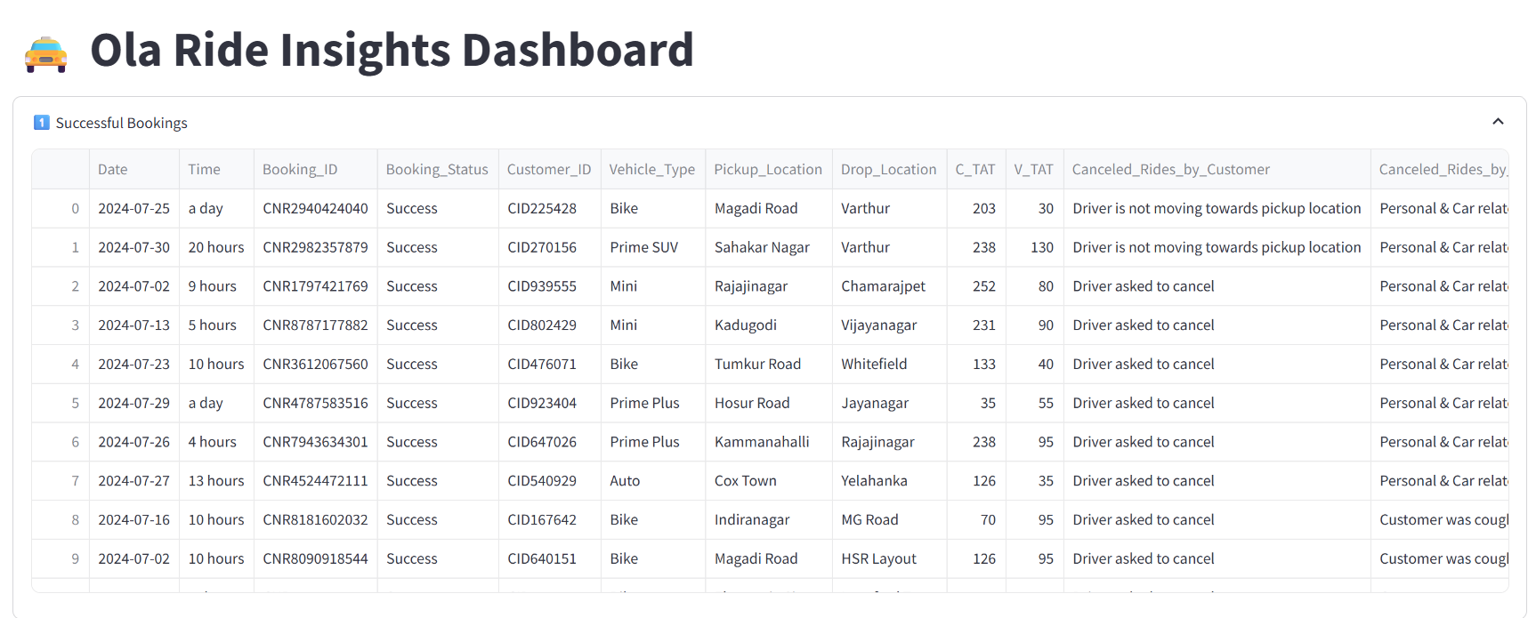
Queries to Examine:
1. Retrieve all successful bookings

Slide 10
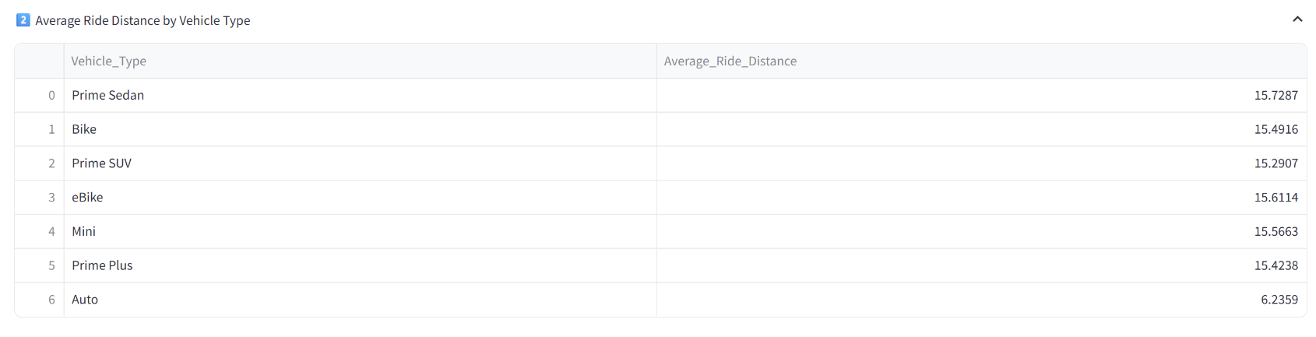
2. Find the average ride distance for each vehicle type

Slide 11
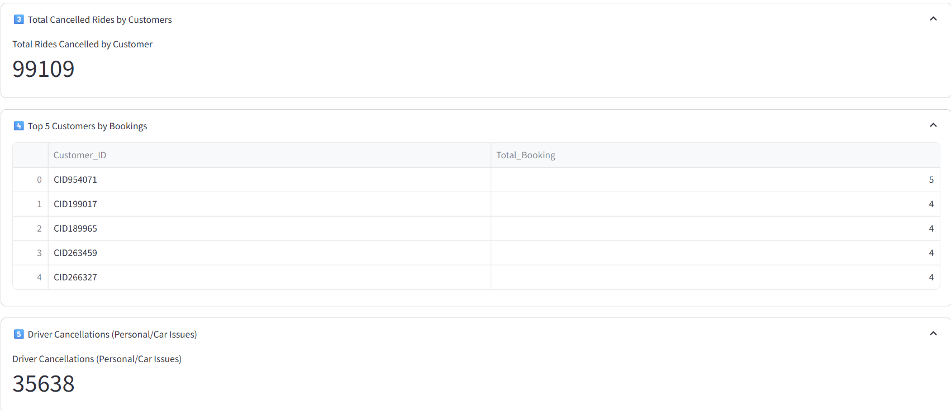
3. Get the total number of cancelled rides by customers:
4. List the top 5 customers who booked the highest number of rides:
5. Get the number of rides cancelled by drivers due to personal and car-related issues:

Slide 12
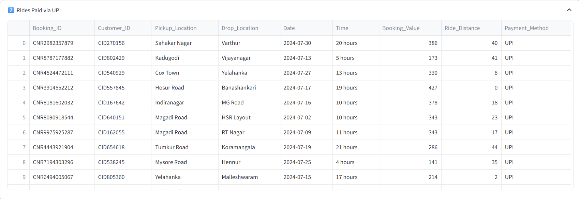
7. Retrieve all rides where payment was made using UPI:

Slide 13
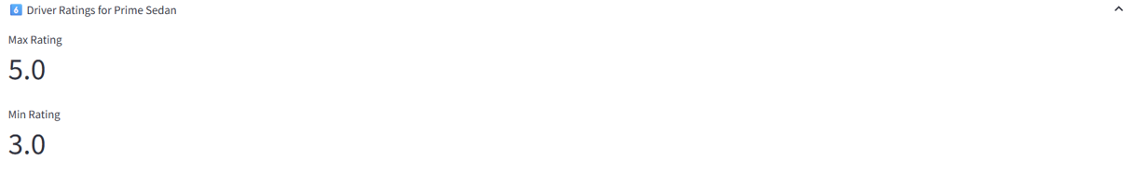
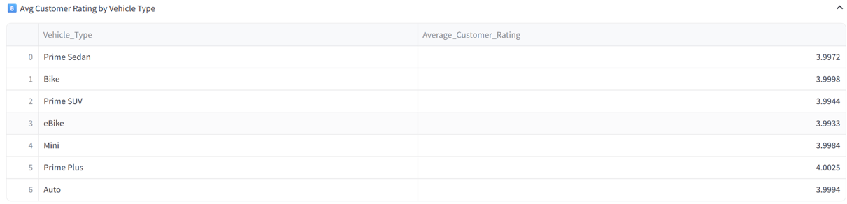
6. Find the maximum and minimum driver ratings for Prime Sedan bookings
8. Find the average customer rating per vehicle type

Slide 14
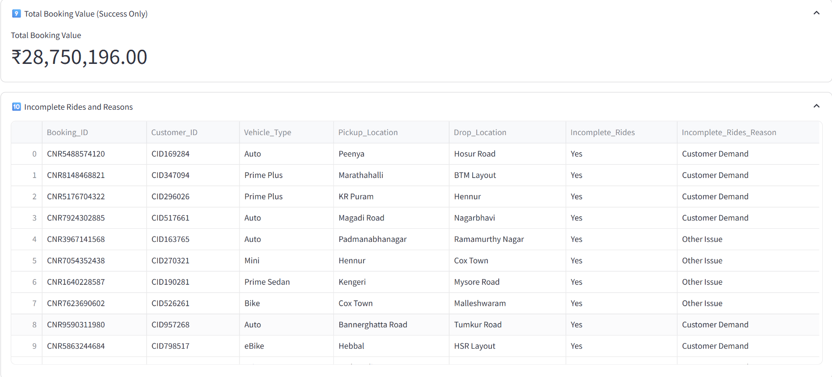
9. Calculate the total booking value of rides completed successfully
10. List all incomplete rides along with the reason

Slide 15
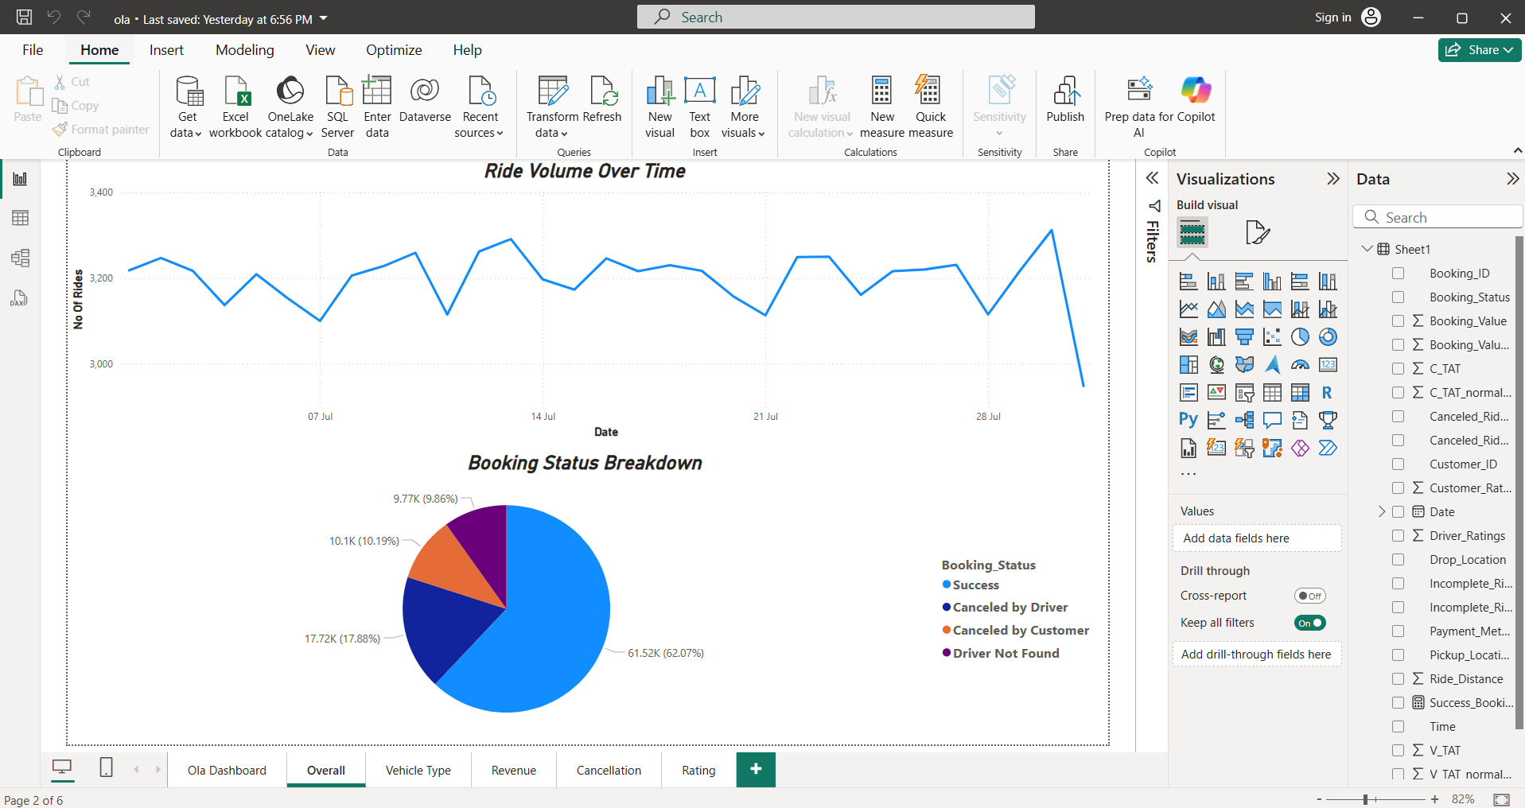
Result in Power Bi Desktop

Slide 16
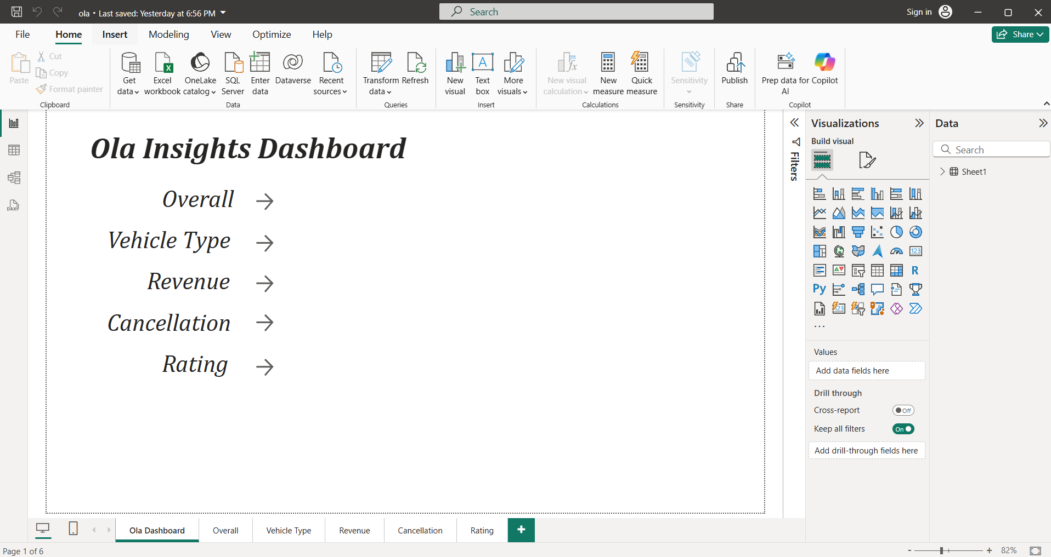
Dashboard:

Slide 17
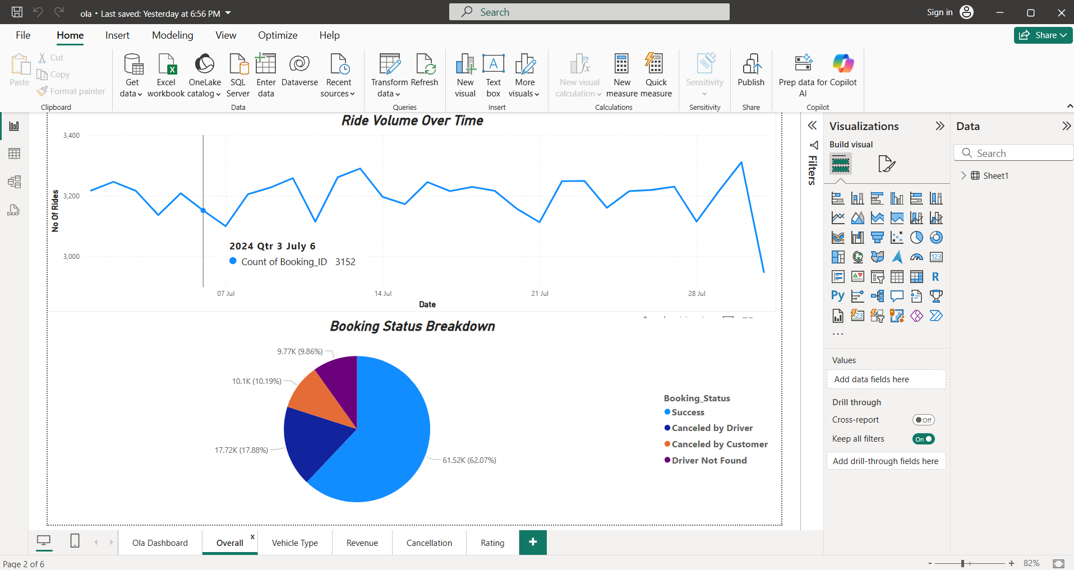
Identifying Peak Demand Hours and Optimizing Driver Allocation
Insights:
Ride volume is relatively stable, fluctuating between 3,000 to 3,400 daily rides throughout July.
A noticeable peak appears near the end of the month (around July 30–31), indicating a spike in ride demand.
Actions:
Deploy more drivers during end-of-month peaks or days showing higher than average ride volume.
Implement surge pricing strategies during predicted high-demand windows to balance supply-demand.

Slide 18
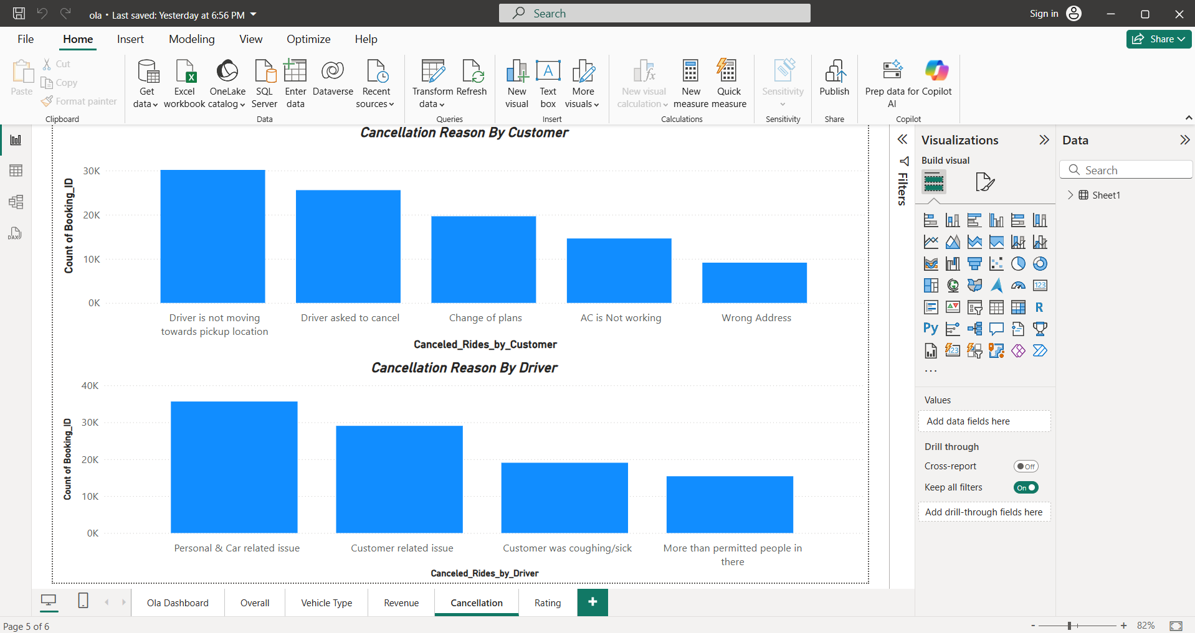
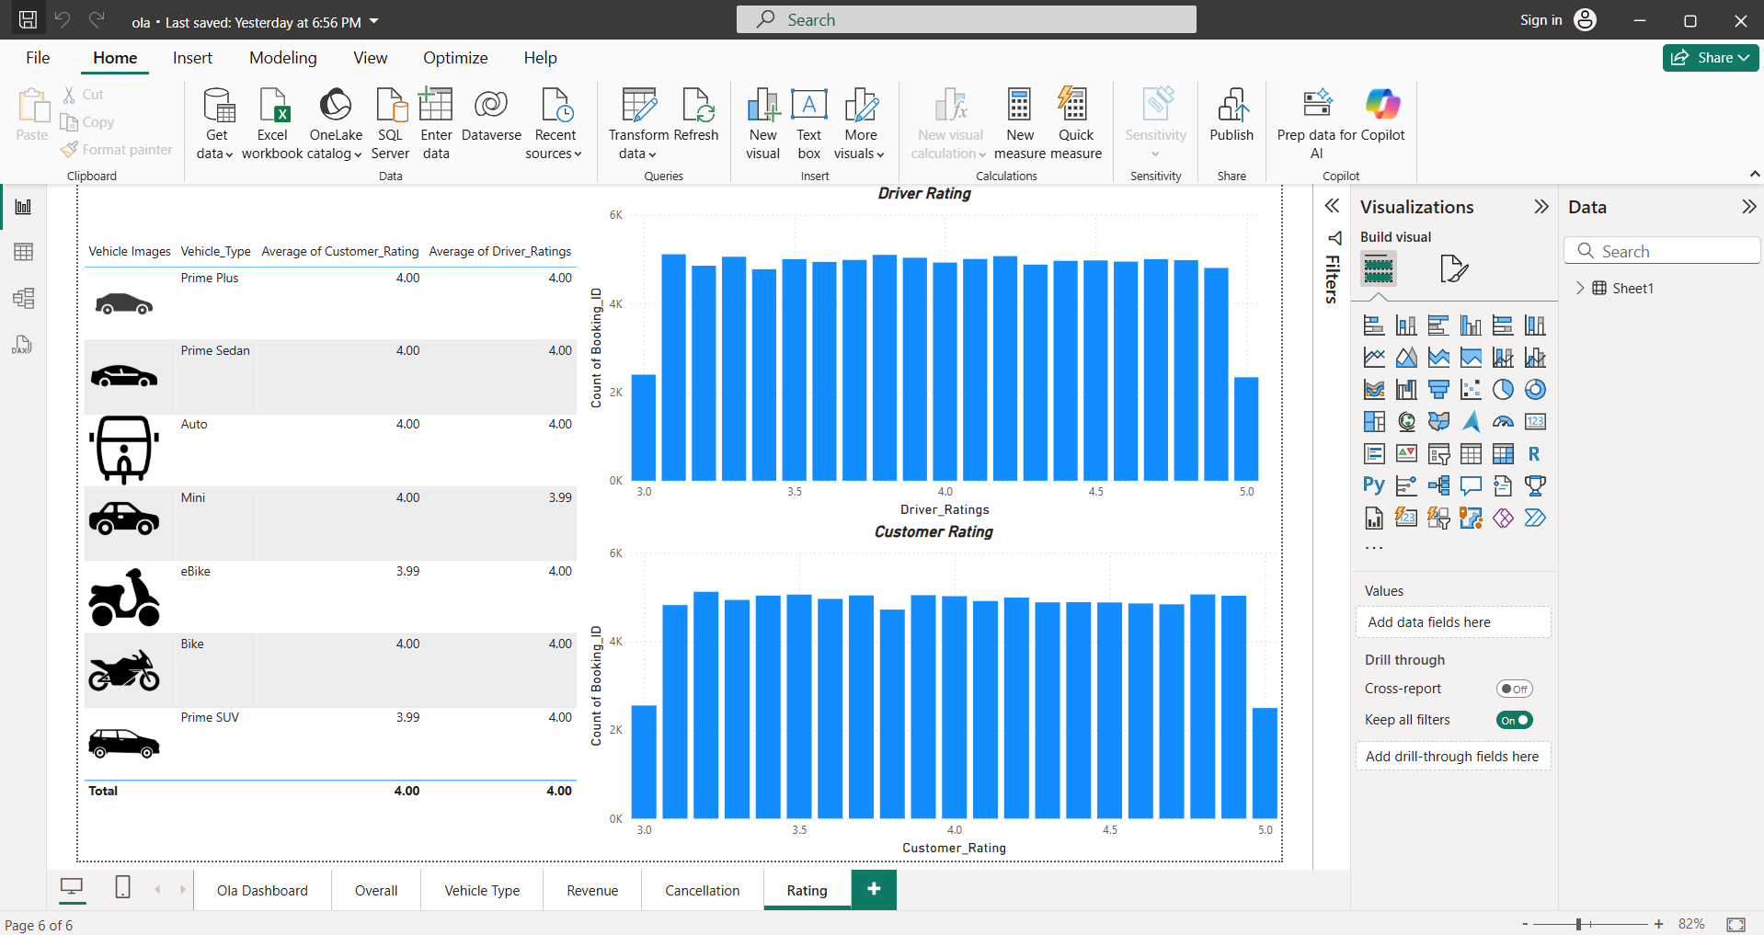
Detecting Anomalies or Fraudulent Activities in Ride Data:
Insights:
Driver and customer ratings are tightly clustered around 4.0, with occasional outliers (e.g., a spike at 3.0 or 5.0).
Cancellation reasons such as “More than permitted people” or “Customer coughing/sick” could be flagged for anomaly detection.
Actions:
Use outlier detection on rating distributions to flag potential fraud (e.g., bulk low ratings for specific vehicle types).
Monitor accounts with excessive cancellations for suspicious behavior — especially if reasons are inconsistent with norms.

Slide 19
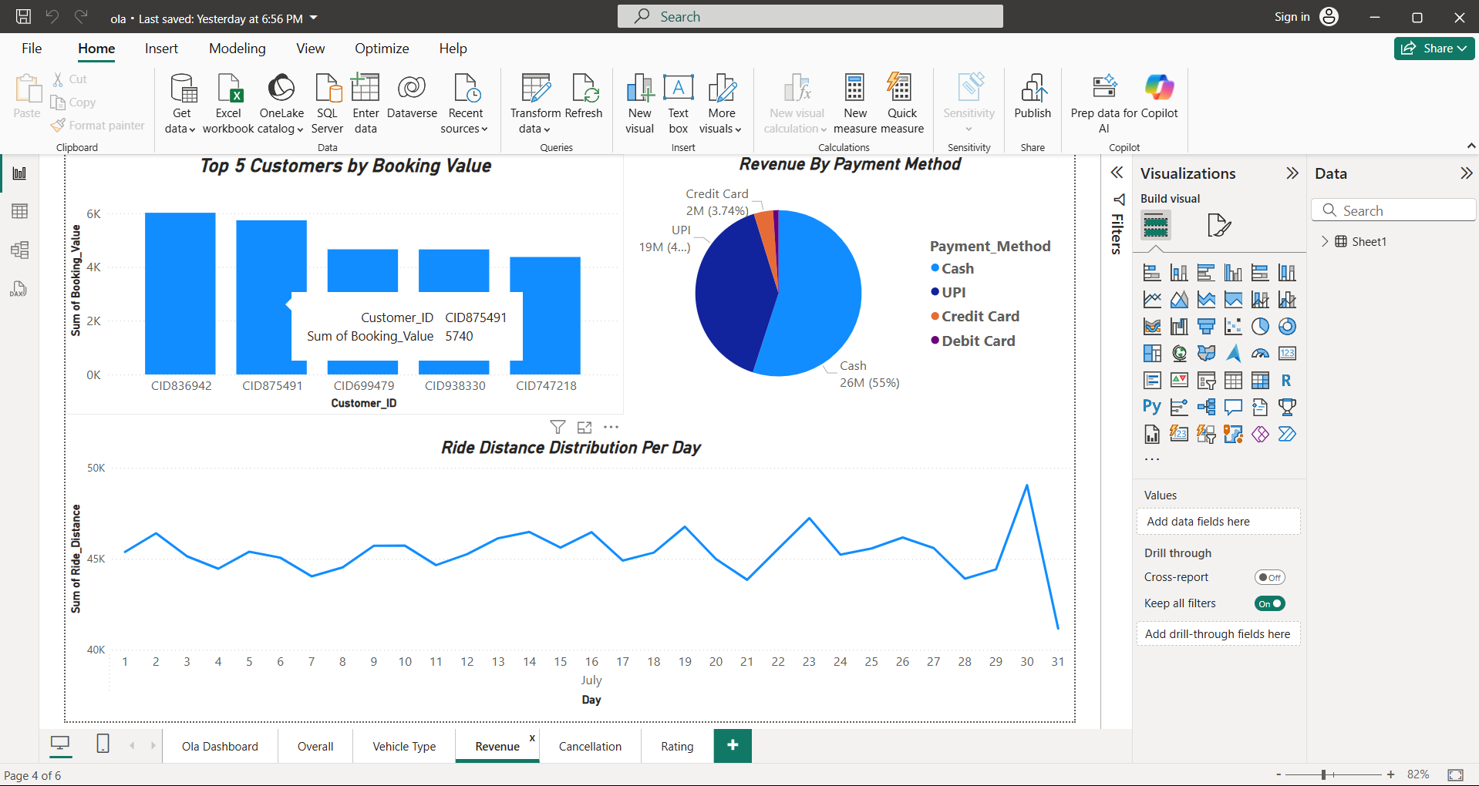
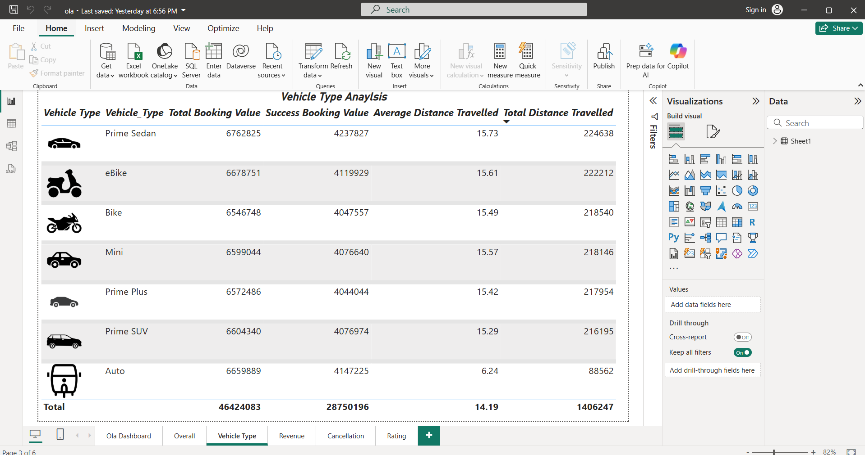
Understanding Pricing Patterns and Surge Pricing Effectiveness
Insights:
Most revenue is generated via Cash (55%) and UPI (40%), while Credit Card usage is very low.
Vehicles like Prime Sedan and eBike generate higher total booking values.
Actions:
Introduce or promote digital payment incentives (e.g., UPI cashback or credit card points).
Optimize surge pricing around high-demand vehicles like Prime Sedan and eBike during peak hours.

Slide 20
Analyzing Customer Behavior for Personalized Marketing Strategies
Insights:
Average customer rating is consistent across vehicle types (mostly 4.00), suggesting stable satisfaction.
Frequent cancellation reasons include “Driver not moving,” “Change of plans,” and “AC is not working.”
Actions:
Reward high-value customers with loyalty programs or targeted discounts.
Segment users based on cancellation reasons — for example, customers citing “AC not working” could be offered premium rides or vehicles with quality assurances.

Slide 21
Some Insights Based on Power Bi Output:
1. Ride Volume Over Time Insight:
Daily ride volume ranges between
3,000 and 3,400 rides.
There’s slight variability, with notable spikes on some days, e.g., around July 30–31.
Demand appears steady, indicating consistent usage.
2. Booking Status Breakdown Insight:
Success: ~62.07% (61.52K)
Canceled by Driver: ~17.88% (17.72K)
Canceled by Customer: ~10.19% (10.1K)
Driver Not Found: ~9.86% (9.77K)
While most rides complete successfully, nearly 38% are unsuccessful, signaling room for operational improvements.

Slide 22
3. Top 5 Vehicle Types by Ride Distance Insight:
Based on Total Distance Travelled:
Prime Sedan – 224,638
eBike – 222,212
Bike – 218,540
Mini – 218,146
Prime Plus – 217,954
These are the most travelled vehicle types, indicating their popularity or utility for longer commutes.
4. Average Customer Ratings by Vehicle Type Insight:
All vehicle types have ~4.00 average customer rating.
Customer satisfaction is consistent across vehicle types.

Slide 23
5. Canceled Rides Reasons Customer Cancellations:
Top Reasons:
"Driver is not moving towards pickup location"
"Driver asked to cancel"
"Change of plans"
Driver Cancellations:
Top Reasons:
"Personal & Car related issue"
"Customer related issue"
"Customer was coughing/sick"
Common causes are logistical delays and customer-driver communication issues.
6. Revenue by Payment Method Insight:
Cash: 26M (55%)
UPI: 19M (40%)
Credit Card: 2M (3.74%)
Debit Card: <1% (minimal)
Cash remains dominant; UPI is growing. Digital incentives could help shift behavior.

Slide 24
7. Top 5 Customers by Total Booking Value Insight: Based on Sum of Booking Value
CID836942 – ~6.1K
CID875491 – ~6K
CID699479 – ~4.7K
CID938330 – ~4.6K
CID747218 – ~4.5K
These customers are prime candidates for loyalty rewards.
8. Ride Distance Distribution Per Day
Visual: Line chart on "Revenue" tab Insight:
Daily ride distances fluctuate slightly, centered around 45,000 km.
Mild upward trend toward the end of the month.
Suggests increasing activity or longer trip lengths later in the month.

Slide 25
9. Driver Ratings Distribution Insight:
Ratings cluster between 3.5 to 4.9, with the majority around 4.0.
Consistently good driver performance across the board.
10. Customer vs. Driver Ratings Insight:
Both customer and driver ratings average around 4.0.
Distribution patterns are nearly identical, with some variance at low and high ends.
Ratings are mutually fair, implying a healthy ecosystem of service and feedback.

Slide 26

Conclusion: The Ola Ride Insights project successfully demonstrates the power of data-driven decision-making in the ride-sharing industry. Through extensive data cleaning, SQL querying, Power BI dashboard development, and a Streamlit-based application, we extracted actionable insights to improve operational efficiency and customer experience.
Key Takeaways:
Peak demand trends were identified, enabling smarter
driver allocation and reduced wait times.
Customer behavior analysis revealed opportunities for
personalized engagement and loyalty strategies.
Revenue patterns and ride data exposed potential
areas for surge pricing optimization and digital
payment incentives.
Cancellation and rating data highlighted service
and driver-customer dynamics.
Impact:
Enhanced business intelligence with interactive dashboards.
Informed marketing, pricing, and resource planning strategies.
strengthened foundation for anomaly detection and service reliability

Slide 27
THANK YOU

