Slide 1
Lab 5. Simple KVS SNU System Programming Assignment
Junghan Yoon
T-Netwoking Lab
Notes:
KVS = key value store
Redis, Memcached, etc.

Slide 2
What You Should Do
1. Implement a basic server
Use socket APIs
Use multiple threads
2. Implement a global hash table and rwlock
Multiple threads may access at the same time
Global hash table uses rwlock library
rwlock should support multiple concurrent readers when there is no writer
Reference for socket programming in C:
https://beej.us/guide/bgnet/
Reference for rwlock:
https://docs.oracle.com/cd/E37838_01/html/E61057/sync-124.html
https://www.ibm.com/docs/en/aix/7.3?topic=p-pthread-rwlock-rdlock-pthread-rwlock-tryrdlock-subroutines
https://docs.kernel.org/locking/locktypes.html

Slide 3
Background 1: Basic Server/Client

Slide 4



What is the Client-Server Model?
Definition: A distributed computing architecture where a client requests services, and a server provides them.
Structure: Typically involves multiple clients connecting to a centralized server.
Request for Service
Response

Slide 5
Programmer’s View
Internet client host
Internet server host
client
server
user code
sockets interface
(system calls)
TCP/IP
kernel code
TCP/IP
hardware interface
(interrupts)
Network
adapter
Network
adapter
Global IP Internet
Both client and server use socket interface!
Not only for TCP, but also for UDP
TCP? UDP?

Slide 6
TCP Socket Interface
2. Start client
1. Start server
Client
Server
getaddrinfo
getaddrinfo
socket
socket
bind
listen
Connection
request
connect
accept
3. Exchange data
Client / Server
Session
write
read
Await connection
request from
next client
read
write
4. Disconnect client
EOF
5. Drop client
close
read
close

Slide 7
System Calls for Basic Server
socket()
Makes a socket and allocates system resources for the socket
bind()
Binds IP address and port to the socket
listen()
Creates a connection queue to allow connections from clients
accept()
Retrieves a connection from the connection queue and returns a socket for an established connection
read() & write()
Next slide
close()
Close the socket and cleans up resources
Socket descriptor,
Socket structure for metadata
For this assignment, use 0.0.0.0
for binding server IP address
Listen, accept: only for TCP
TCP server has 2 sockets!
Notes:
For server,

Slide 8
System Calls for Basic Client
getaddrinfo() & freeaddrinfo()
Helper function for IP lookup
You may use gethostbyname() or gethostbyname_r()
socket()
Makes a socket and allocates system resources for the socket
bind()
Binds IP address and port to the socket
Usually not used in client
connect()
Creates a connection to the specified address:port (starts TCP handshake)
read() & write()
Next slide
close()
Close the socket and cleans up resources
Socket descriptor,
Socket structure for metadata
connect: for TCP
TCP client has 1 socket

Slide 9
System Calls for Socket Options
int setsockopt(int sockfd, int level, int optname, const void *optval, socklen_t optlen);
int getsockopt(int sockfd, int level, int optname, void *optval, socklen_t *optlen);
For address/port reuse and timeout setting
level: Specifies the protocol layer for the option
SOL_SOCKET : Socket layer (e.g., SO_REUSEADDR) ← use this
IPPROTO_TCP : TCP layer (e.g., TCP_NODELAY)
IPPROTO_IP : IP layer (e.g., IP_TTL)
optname: SO_REUSEADDR, SO_REUSEPORT, SO_RCVTIMEO
optval, optlen: different by optname.
SO_REUSEADDR, SO_REUSEPORT : int value, 1 means on / 0 means off
SO_RCVTIMEO : struct timeval to, set to.tv_sec = TIMEOUT;
You can check out its usage in skeleton code!

Slide 10
read()
ssize_t read(int fd, void *buf, size_t nbytes)
Returns
# of bytes read ( > 0)
-1 (error, you should check errno)
No bytes read
0 (closed by the peer)
errno == EAGAIN, EWOULDBLOCK
Nothing to read from the TCP socket recv buffer, try later
errno == EINTR
Failed due to interrupt, try again right now
errno == ECONNRESET
The peer abruptly reset the connection

Slide 11
write()
ssize_t write(int fd, void *buf, size_t nbytes)
Returns
# of bytes wrote ( > 0)
-1 (error, you should check errno)
No bytes wrote
errno == EAGAIN, EWOULDBLOCK
TCP socket send buffer is full, try later
errno == EINTR
Failed due to interrupt, try again right now
errno == ECONNRESET
The peer abruptly reset the connection
errno == EPIPE
The peer closed the connection (since SIGPIPE kills the process first, you will not see this error)

Slide 12
Background 2: Lock

Slide 13
Spin Lock vs. Mutex Lock
Spin Lock
Continuously checks if the lock is available while consuming CPU cycles (busy-waiting)
Optimized for short wait times and multi-core environments
Mutex Lock
Puts the waiting thread to sleep, releasing the CPU until the lock becomes available
Suitable for longer wait times or resource-intensive applications
Aspect | Spin Lock | Mutex Lock
Waiting | Busy-waiting (CPU is fully utilized) | Sleep-waiting (CPU is released)
Overhead | Low (no context switching) | High (context switching involved)
Use case | Short wait times | Long wait times
Multi-core | Effective in multi-core systems | Works well in both single/multi-core
Complexity | Simple | Relies on OS support

Slide 14
Mutex Lock
Protects shared data
Allows only one thread to access the critical section
What if most of the accesses are reads?
int shared_data = 0;
void *thread_function(void* arg) {
pthread_mutex_lock(&mutex); // acquire mutex lock
// critical section: access to the shared data
shared_data++;
printf("Thread %ld incremented data: %d\n",
(long)arg, shared_data);
pthread_mutex_unlock(&mutex); // release mutex lock
return NULL;
}

Slide 15
Many Readers & Few Writers
Contention necessary?
If there is no concurrent writer, multiple threads can concurrently read
int shared_data = 0;
void *writer_function(void* arg) {
pthread_mutex_lock(&mutex);
shared_data++;
printf("Writer %ld updated data: %d\n",
(long)arg, shared_data);
pthread_mutex_unlock(&mutex);
return NULL;
}
void *reader_function(void* arg) {
pthread_mutex_lock(&mutex);
printf("Reader %ld read data: %d\n",
(long)arg, shared_data);
pthread_mutex_unlock(&mutex);
return NULL;
}

Slide 16
RW Lock
A specialized lock that distinguishes between read and write access
RW lock is usually reader-priority (pthread_rwlockattr_setkind_np(3) - Linux manual page)
Allows concurrent multiple readers
Blocks writer when any readers exist (including pending readers)
When there is no more readers, wake up the oldest pending writer
Allows single writer only
Blocks other threads when writing
After finishing, wake up all pending readers
Aspect | Mutex Lock | Reader-Writer Lock
Concurrency | Only one thread (reader or writer) at a time | Multiple readers or a single writer
Performance | Suitable for low read-to-write ratio | Optimized for high read-to-write ratio
Complexity | Simpler | More complex
Starvation Risk | No starvation (single queue) | Writer starvation
Use Case | Any critical section | Scenarios with frequent reads and rare writes

Slide 17
FIFO RW Lock
accessing
pending
Allows concurrent multiple readers
Allows single writer only
Handle all accesses FIFO
dequeue
enqueue
r
r
r
w
w
w
r
w
r
r
sequential
concurrent
concurrent
Aspect | Reader-Priority RW Lock | FIFO RW Lock
Concurrency | Multiple readers or a single writer | Multiple readers or a single writer
Performance | Optimized for high read-to-write ratio | Balanced performance and fairness
Starvation Risk | Writer starvation | No starvation
Use Case | Scenarios with frequent reads and rare writes | Any scenarios
https://docs.kernel.org/locking/locktypes.html
ReentrantReadWriteLock (Java Platform SE 8 )
https://docs.rs/tokio/latest/tokio/sync/struct.RwLock.html

Slide 18
Signaling through Condition Variables
Example for waking up other threads using condition variables
Thread 1: pthread_cond_wait(&condvar, &mutex);
Thread 2: pthread_cond_signal(&condvar);
(or pthread_cond_broadcast(&condvar);)

Slide 19
Part 1: SKVS Server

Slide 20
SKVS Protocol
One connection per one client
Keep alive until typing empty line (\n) or EOF (Ctrl D)
Half-duplex
After sending request, wait for the response
Text based protocol
Key and value should be also text
Refer to the next slide
Server should be stateful
Key-value pairs should be accessible by other clients
Default service port: 8080
TCP Handshake
SKVS request msg
SKVS response msg
SKVS request msg
SKVS response msg
…
EOF (Ctrl D)
or
empty line
TCP Teardown

Slide 21
SKVS Protocol (cont.)
“_{s}”: a space character
“_{n}”: a newline character
Request Msg Format:
[CMD]_{s}[key]_{s}[value]_{n}
[CMD]_{s}[key]_{n}
Examples
CREATE_{s}hello_{s}world_{n}
READ_{s}hello_{n}
UPDATE_{s}hello_{s}snu_{n}
DELETE_{s}hello_{n}
QREAD_{s}hello_{n}
CMD: one of CREATE, READ, UPDATE, DELETE, QREAD
case-insensitive (e.g., rEAd, cReAtE are okay)
Key, value: string without _{s} nor _{n}
No binary, only text, case-sensitive
len(key) <= 32B, len(SKVS msg) <= 4096B
Response Msg Format:
CREATE_{s}OK_{n}
[value]_{n}
UPDATE_{s}OK_{n}
DELETE_{s}OK_{n}
COLLISION_{n}
NOT_{s}FOUND_{n}
INVALID_{s}CMD_{n}
INTERNAL_{s}ERR_{n}
EOF or empty line on client
Close the connection
Exit client program
Notes:
Message format is simple and parsing is not your part of assignment.
We’ll see skeleton later.

Slide 22
Example
“read jihoon yoo\n”
“INVALID CMD\n”
TCP Handshake
“READ jihoon\n”
“CREATE jihoon INTP\n”
“CUTE\n”
“CREATE OK\n”
“DELETE jihoooon\n”
“ReaD jihoon\n”
“NOT FOUND\n”
“INTP\n”
“DELETE jihoon\n”
“UpDATE jihoon CUTE\n”
“DELETE OK\n”
“UPDATE OK\n”
EOF (Ctrl D)
or
empty line
TCP Teardown
Notes:
When EOF or empty line is received, “client” should close connection.

Slide 23
Handling Errors
If SKVS request is in invalid format?
Responds “INVALID CMD\n”
If the length of SKVS msg > 4096
Reference client will prohibit this case
If the length of [key] > 32
Responds “INVALID CMD\n”
Received CREATE msg, but key-value pair already exists?
Responds “COLLISION\n”
Received READ/UPDATE/DELETE/QREAD msg, but no such key exists?
Responds “NOT FOUND\n”
If any internal error occurs, so cannot serve the request?
Responds “INTERNAL ERR\n”

Slide 24
SKVS Semantics
Client
SKVS main thread
Global HT should support thread-safe access to both read and write operations
Single listen queue
Use 10 worker threads
getaddrinfo
SKVS worker threads
getaddrinfo
socket
…
socket
bind
listen_fd
listen
Connection
request
connect
accept
Global
Hash Table
for Key-Value pairs
Client / Server
Session
write
read
read
write
close
EOF
read
close

Slide 25
Why Static 10 Threads? Any Other Ways for Concurrency?
What you have learned
accept(), read(), and write() are blocking..
What if dynamically fork() / pthread_create() for every clients?
(+) Easy to implement
(+) Easy to leverage multiple cores
Reality..
(--) Wastes system resources
(--) Poor performance due to creating processes or threads
(--) Poor performance due to context switching
Using fork() / pthread_create() for each request is inefficient (heavyweight)

Slide 26
Event-Driven Socket Programming (Out of Scope)
Set the sockets non-blocking
Use event-driven API (e.g., epoll)
Static threads to leverage multiple cores
Then,
(+) Best performance
Supports concurrency without context switching
Small number of threads
(--) Hard to implement using event-driven APIs
Workaround: Simply use static threads for this assignment! ☺

Slide 27
SKVS API
Helper API for parsing and processing the SKVS requests
struct skvs_ctx *skvs_init(size_t hash_size, int delay)
Initiates SKVS context
void skvs_destroy(struct skvs_ctx *ctx, int dump)
Destroys SKVS context
int skvs_serve(struct skvs_ctx *ctx, char *rbuf, size_t rlen, char *wbuf, size_t *wlen)
Writes a complete response to wbuf for the given SKVS request in rbuf
e.g., [value]\n, “INVALID CMD\n”, “CREATE OK\n”, “UPDATE OK\n”, “COLLISION\n”, …

Slide 28
Server Requirement
Your server should serve ~10 concurrent clients
Your server should interoperate with reference client
Reference server/client binaries will be provided
No support for Mac, windows (but, will work on WSL)
For usage, refer to the reference server/client

Slide 29
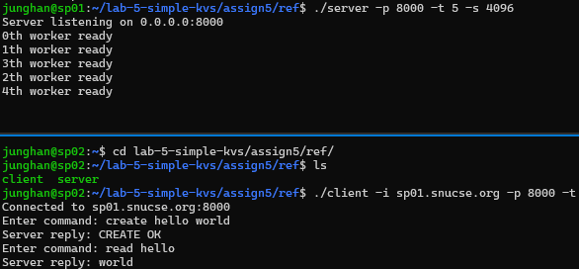
Usage Example for Interactive Mode (client w/ -t)
Interactive mode for your better understanding and testing
Try it using our reference client

Slide 30
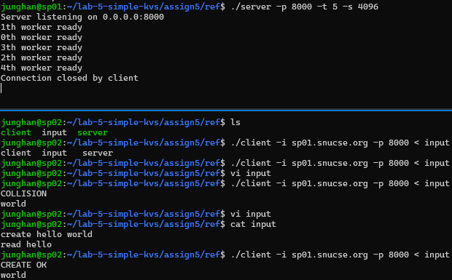
Usage Example for Silent Mode (client w/o -t)
On the client, SKVS responses will be printed out to stdout

Slide 31
Part 2: RW Lock

Slide 32

Lock
SKVS worker threads
Global
Hash Table
for Key-Value pairs
SKVS uses a global hash table
Any threads consistently access the key-value pair
Accesses to the hash table needs lock
But, lock contention leads to poor performance…
Fine-grained lock
For each bucket
Less contention compared to course-grained lock
Custom RW lock
Assumes many readers, few writers
Multiple readers are allowed at the same time
By default, read and write are handled in FIFO order
But, Quick read preempts pending accesses
…
Global
Hash Table
for Key-Value pairs
…
read
Global
Hash Table
for Key-Value pairs
…

Slide 33
Custom RW Lock: FIFO RW Lock + Quick read
Handle requests in FIFO by default
Readers can be concurrently handled
Writers should be sequentially handled
“Quick read” preempts pending accesses (prioritized read)
“Quick read” enqueued while processing concurrent read?
accessing
pending
dequeue
enqueue
r
r
r
w
w
w
r
w
r
r
q
sequential
concurrent
concurrent
Order in concurrent reads does not matter
Notes:
normal read / quick read

Slide 34
Custom RW Lock: FIFO RW Lock + Quick read (2)
Handle requests in FIFO by default
Readers can be concurrently handled
Writers should be sequentially handled
“Quick read” preempts pending accesses (prioritized read)
“Quick read” enqueued while processing sequential write?
accessing
pending
dequeue
enqueue
w
w
w
r
w
r
r
q
sequential
concurrent

Slide 35
rwlock.c
Combination of FIFO RW lock and Reader-priority RW lock
Not allowed to use pthread_rwlock API
Implement your own one in rwlock.c using pthread_mutex and pthread_cond API
int rwlock_init(rwlock_t *rw, int delay)
int rwlock_read_lock(rwlock_t *rw, int quick)
int rwlock_read_unlock(rwlock_t *rw)
int rwlock_write_lock(rwlock_t *rw)
int rwlock_write_unlock(rwlock_t *rw)
int rwlock_destroy(rwlock_t *rw)

Slide 36
hashtable.c
int hash_insert(hashtable_t *table, char *key, char *value)
Needs a write lock
Duplicates key and value
Fills node structure and inserts node to the table
Returns 0 if collision, 1 if inserted, -1 if any internal error
int hash_read(hashtable_t *table, char *key, char *dst, int quick)
Needs a read lock
Returns 0 if not found, 1 (and outputs to value) if found, -1 if any internal error
If found, copies the value to dst before releasing rlock
If quick set, should preempt pending accesses

Slide 37
hashtable.c
int hash_update(hashtable_t *table, char *key, char *value)
Needs a write lock
Duplicates value
Updates node->value to new one
Free old value
Returns 0 if not found, 1 if updated, -1 if any internal error
int hash_delete(hashtable_t *table, char *key)
Needs a write lock
Frees key and value
Evicts from the table
Returns 0 if not found, 1 if deleted, -1 if any internal error

Slide 38
Dumping Global Hash Table
Your SKVS server should dump the hash table using skvs_destroy(ctx, 1) before exit on SIGINT
Register SIGINT handler for dump

Slide 39
Requirements
Concurrent multiple readers’ access to the global hash table
Correct RW lock semantic (FIFO + reader-priority)
Print the entries in the global hash table using hash_dump()
Do not modify this function

Slide 40
Debugging and Testing

Slide 41
Reference Binaries for self-checking
Reference server/client binaries will be provided
No support for Mac, windows
For any ambiguities, please refer to the reference server/client
You may use TRACE_PRINT() and DEBUG_PRINT() for debugging
CFLAGS += -DTRACE
CFLAGS += -DDEBUG

Slide 42
Self-testing for Write Lock
Before testing, check below
Implement server/client first with robust read/write
Your server must be ready for concurrency first
./server –d 5
sleep(5) in rwlock_write_unlock(), rwlock_read_unlock()
Example test scenario
Send “CREATE hello 1\n” on client 1
It will hold a write lock for 5 seconds
Send “CREATE hello 2\n” on client 2
Check whether client 2 gets stuck
Send “CREATE hello 3\n” on client 3
Check whether client 3 gets stuck
Send “CREATE hello 4\n” on client 4
Check whether client 4 gets stuck
After 5 seconds…
Check whether client 1 receives “CREATE OK\n”
After 5 seconds…
Check whether client 2 receives “COLLISION\n”
After 5 seconds…
Check whether client 3 receives “COLLISION\n”
After 5 seconds…
Check whether client 4 receives “COLLISION\n”

Slide 43
Self-testing for Read Lock
Before testing, check below
Implement server/client first with robust read/write
Your server must be ready for concurrency first
./server –d 5
sleep(5) in rwlock_write_unlock(), rwlock_read_unlock()
Example test scenario
Send “CREATE hello world\n” on client 1
It will hold a write lock for 5 seconds
Send “READ hello\n” on client 2
Check whether client 2 gets stuck
Send “READ hello\n” on client 3
Check whether client 3 gets stuck
Send “READ hello\n” on client 4
Check whether client 4 gets stuck
After 5 seconds…
Check whether client 1 receives “CREATE OK\n”
After 5 seconds…
Check whether client 2 receives “world\n”
Check whether client 3 receives “world\n”
Check whether client 4 receives “world\n”
simultaneously

Slide 44
Self-testing for FIFO Scenario
Before testing, check below
Implement server/client first with robust read/write
Your server must be ready for concurrency first
./server –d 5
sleep(5) in rwlock_write_unlock(), rwlock_read_unlock()
Example test scenario
Send “CREATE hello world\n” on client 1
It will hold a write lock for 5 seconds
Send “DELETE bye\n” on client 2
Check whether client 2 gets stuck
Send “READ hello\n” on client 3
Check whether client 3 gets stuck
Send “UPDATE hello snu\n” on client 4
Check whether client 4 gets stuck
Send “DELETE hello\n” on client 5
Check whether client 5 gets stuck
Send “READ hello\n” on client 6
Check whether client 6 gets stuck
After 5 seconds…
Check whether client 1 receives “CREATE OK\n”
Check whether client 2 receives “NOT FOUND\n” (why?)
After 5 seconds…
Check whether client 3 receives “world\n”
After 5 seconds…
Check whether client 4 receives “UPDATE OK\n”
After 5 seconds…
Check whether client 5 receives “DELETE OK\n”
After 5 seconds…
Check whether client 6 receives “NOT FOUND\n”

Slide 45
Self-testing for Quick Read Scenario
Before testing, check below
Implement server/client first with robust read/write
Your server must be ready for concurrency first
./server –d 5
sleep(5) in rwlock_write_unlock(), rwlock_read_unlock()
Example test scenario
Send “CREATE hello world\n” on client 1
It will hold a write lock for 5 seconds
Send “DELETE bye\n” on client 2
Check whether client 2 gets stuck
Send “READ hello\n” on client 3
Check whether client 3 gets stuck
Send “UPDATE hello snu\n” on client 4
Check whether client 4 gets stuck
Send “DELETE hello\n” on client 5
Check whether client 5 gets stuck
Send “QREAD hello\n” on client 6
Check whether client 6 gets stuck
After 5 seconds…
Check whether client 1 receives “CREATE OK\n”
Check whether client 2 receives “NOT FOUND\n” (why?)
After 5 seconds…
Check whether client 3 receives “world\n”
Check whether client 6 receives “world\n”
After 5 seconds…
Check whether client 4 receives “UPDATE OK\n”
After 5 seconds…
Check whether client 5 receives “DELETE OK\n”

Slide 46
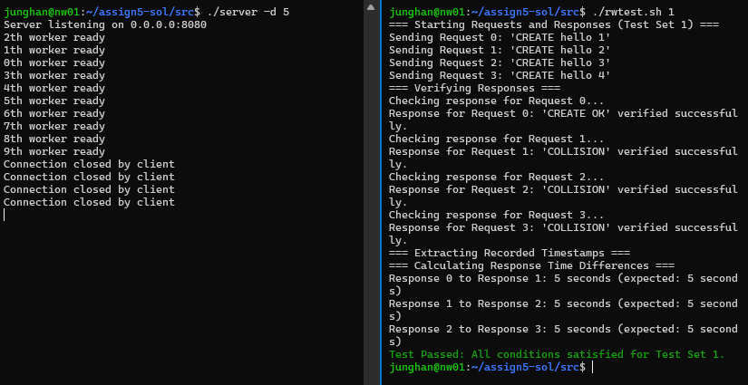
Automated Self-testing
Run your server with delay 5 first, and run rwlock.sh on another terminal
There are 5 default tests, but you can extend them for more complex test cases
To run rwlock.sh, you need to install timestamp. It’s already installed in VM.
If you want to run in your local environment, “sudo apt install moreutils”

Slide 47
Guidelines

Slide 48
Notice
Do not change the name and the prototype of the skeleton code
You are allowed to modify server.c, hashtable.c, and rwlock.c
Do not modify header files, skvslib.c
Submit honor code agreement along with your source code
Carefully read slides, readme, and header files
What to submit
A tarball named 202512345_assign5 including server.c hashtable.c rwlock.c NoAI.docs.
cd assign5/src
make submit ID=202412345
Replace 202512345 to your student ID without dash

Slide 49
Deadline
Deadline: ~ 2025. 12. 18 22:00
0 Points if deadline is missed
0 Points for copying
Contact
Please use Classum for normal Q&A.
If you need to contact TA via Email, please attach [LAB 5] as a prefix of title.
Notes:
As it’s my first time to do TA, I’m gonna be strict. So please don’t violate these rules.

Slide 50
Criteria
build (10)
single create test (5)
single read test (5)
single update test (5)
single delete test (5)
concurrency test (10)
write lock test (10)
read lock test (10)
fine-grained lock test (10)
complex scenario test (15)
complex scenario test including quick read (15)

Slide 51
Q&A

