Slide 1
Distributed Programming with Golang and Kotlin

Slide 2
Contents
Kotlin – An Introduction
Concurrency with Kotlin
ktor – Kotlin Framework for Client – Server Applications
Project: Chat Application with multiple Clients
Encountered Issues
Reflection

Slide 3

Kotlin – An Introduction
Unveiled in 2011
Designed by JetBrains
New Language for Java Virtual Machine
First Stable Release in 2016
Kickstarter: Primary Programming Language for Android

Slide 4
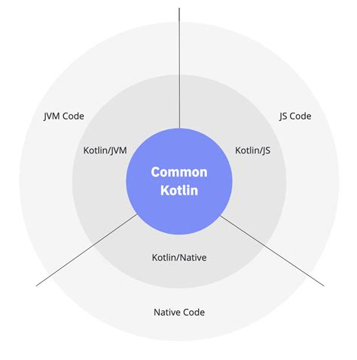
Kotlin – An Introduction
Support for Multiple Paradigms (Object-Oriented, Functional, Procedural)
Multiple Targets with Library and Framework Interoperability
Statically Typed
Null-Safety
Garbage Collection

Slide 5
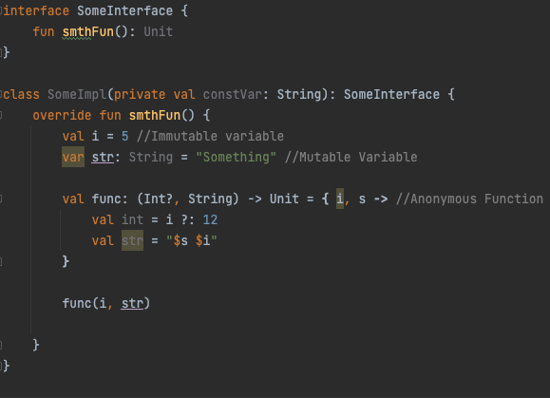
Kotlin Basics

Slide 6
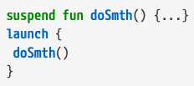
Concurrency in KOtlin
Coroutines as platform independent model
suspend: function only callable in Coroutine
launch: start coroutine

Slide 7
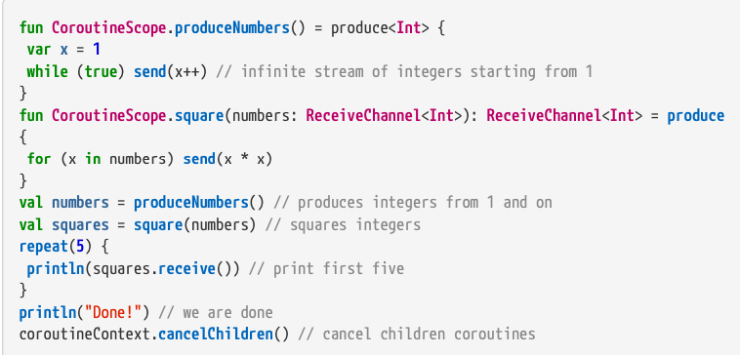
Concurrency in Kotlin
Communication with Channels
Typical Pattern: Pipelining

Slide 8
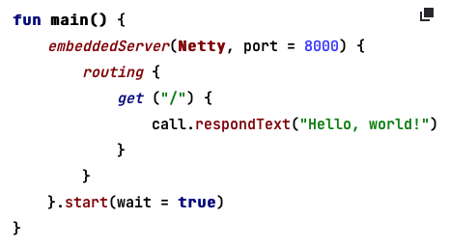
ktor
Framework for Developing Client-Server Application
Async Functionality with Coroutines
Adding Features to Application with ktor-Module

Slide 9
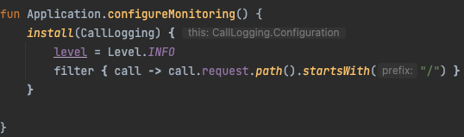
Ktor
install: Add CallLogging module
Code-Block: Configure module

Slide 10
Project – Chat Application
Creating new users with username and password for JWT authentication
Creating and adding users to chat groups
Sending messages to chat groups
Automatically receiving of new messages

Slide 11
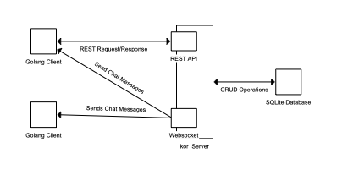
Project - Architecture
Clients in Golang
Backend-Server in Kotlin
Communication with REST-API and WebSockets
SQLite for data persistence

Slide 12
Project - Demo

Slide 13
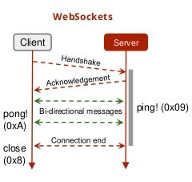
Encountered Issues
Websockets with ktor WebSocket Module
Ping-Pong-Mechanism to keep connection alive
Manual Implementation required

Slide 14
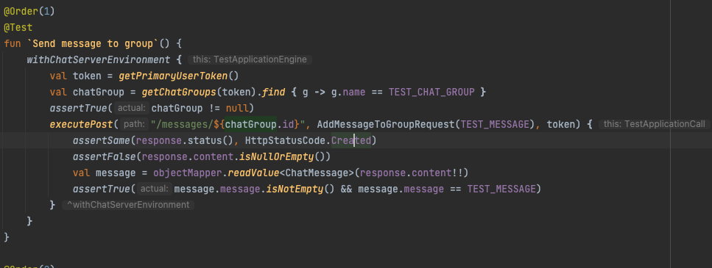
Encountered Issues
Creation of Units Tests
Clean State for each test
Dependent on previous operations

Slide 15
Reflection
Similar Concurrency Models → Easy Switch between languages
Established and maintained Frameworks for both languages
Rising popularity in Developer Community for support
-→ Position of languages interchangeable
→ Kotlin preferred due familiarity

