Slide 1
Hospital Emergency-Room Triage System
Prioritize the ones who need it most. Seconds matter.

Slide 2
What is Triage?
Rapid Urgency Assessment
You check them the second they walk in. Severity decides how fast they get care.
Treatment Priority & Resource Allocation
Staff, beds, and gear go where the real threats are. Nothing more, nothing less.
Save Lives First
The sickest get care first. Everything else follows from that.

Slide 3
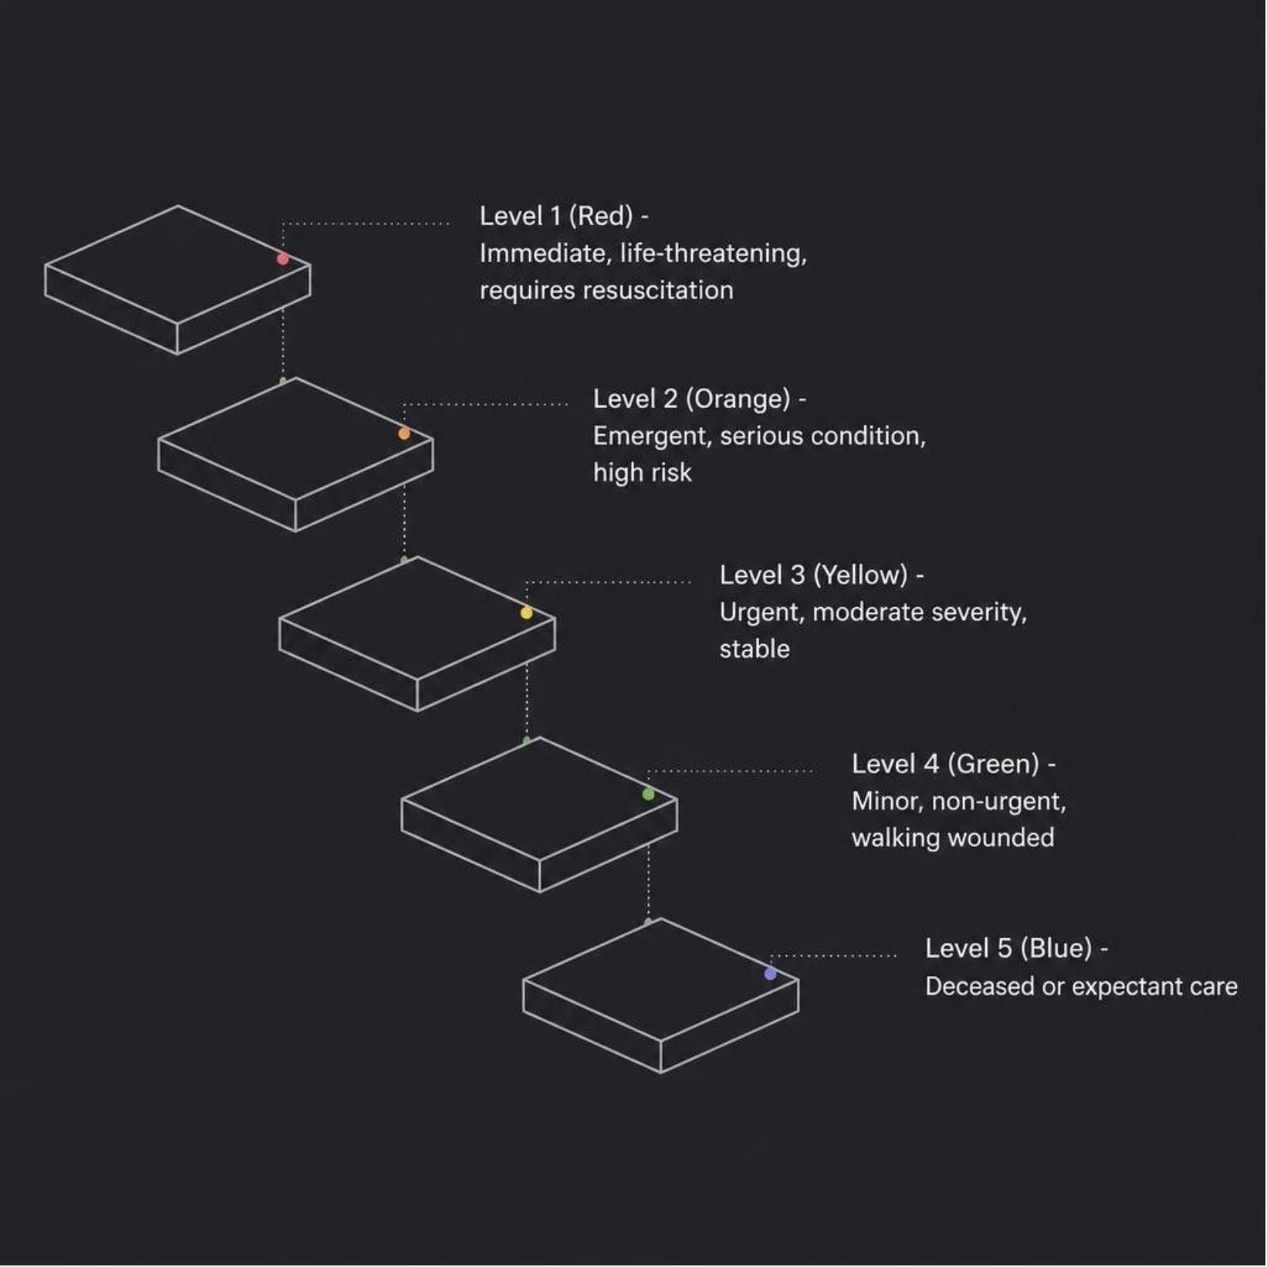
The Five-Level Triage Scale
Level 1 — Red
Level 2 — Orange
Immediate · Resuscitation required
Emergent · High risk, serious
Level 3 — Yellow
Level 4 — Green
Urgent · Moderate severity, stable
Minor · Non-urgent, ambulatory
Level 5 — Blue
Deceased or expectant care

Slide 4
Level 1: Immediate Care
🔴 LIFE-THREATENING — ACT NOW
Altered Mental Status
Unresponsive or out of it. Protect the airway. Check the brain. Now.
Severe Respiratory Compromise
Can't breathe or about to stop. Secure the airway. No delay.
Hemodynamic Instability
Shock, massive bleed, or arrest. Resuscitate. Pressors if needed. Move.
Severe Trauma & Burns
Multi-system damage, penetrating wounds, or big burns with system failure.

Slide 5
Level 2 & 3: Emergent & Urgent
🟠 LEVEL 2 — EMERGENT
🟡 LEVEL 3 — URGENT
High-Risk Presentations
Stable but Time-Sensitive
Chest pain with cardiac risk factors or ST changes
Moderate trauma with possible fractures or internal injury
Acute abdominal pain suggesting surgical emergency
Altered consciousness — stroke, seizure, metabolic crisis
Minor trauma — sprains, lacerations, extremity injuries
Stable vital signs with moderate complaint severity
Chronic condition exacerbation — asthma, COPD, CHF
Fever without systemic signs of sepsis
Provider contact within 30 minutes. Watch for any drop to Level 2.
Seen by a provider within 15 minutes. Keep eyes on them the whole time.

Slide 6
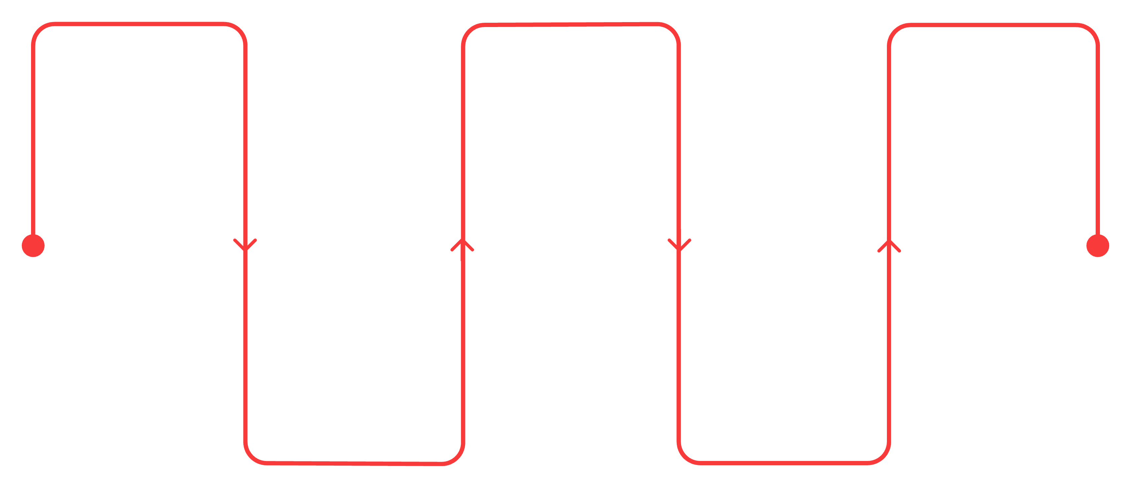
Triage Assessment Process
Assess ABCs
Focused Exam
Document & Reassess
Airway, breathing, circulation
Targeted physical assessment
Record findings and repeat checks
Obtain Vitals
Assign Acuity
Vitals and brief history
Determine level and area
Don't skip steps. Conditions change. Write it down. Check again.

Slide 7
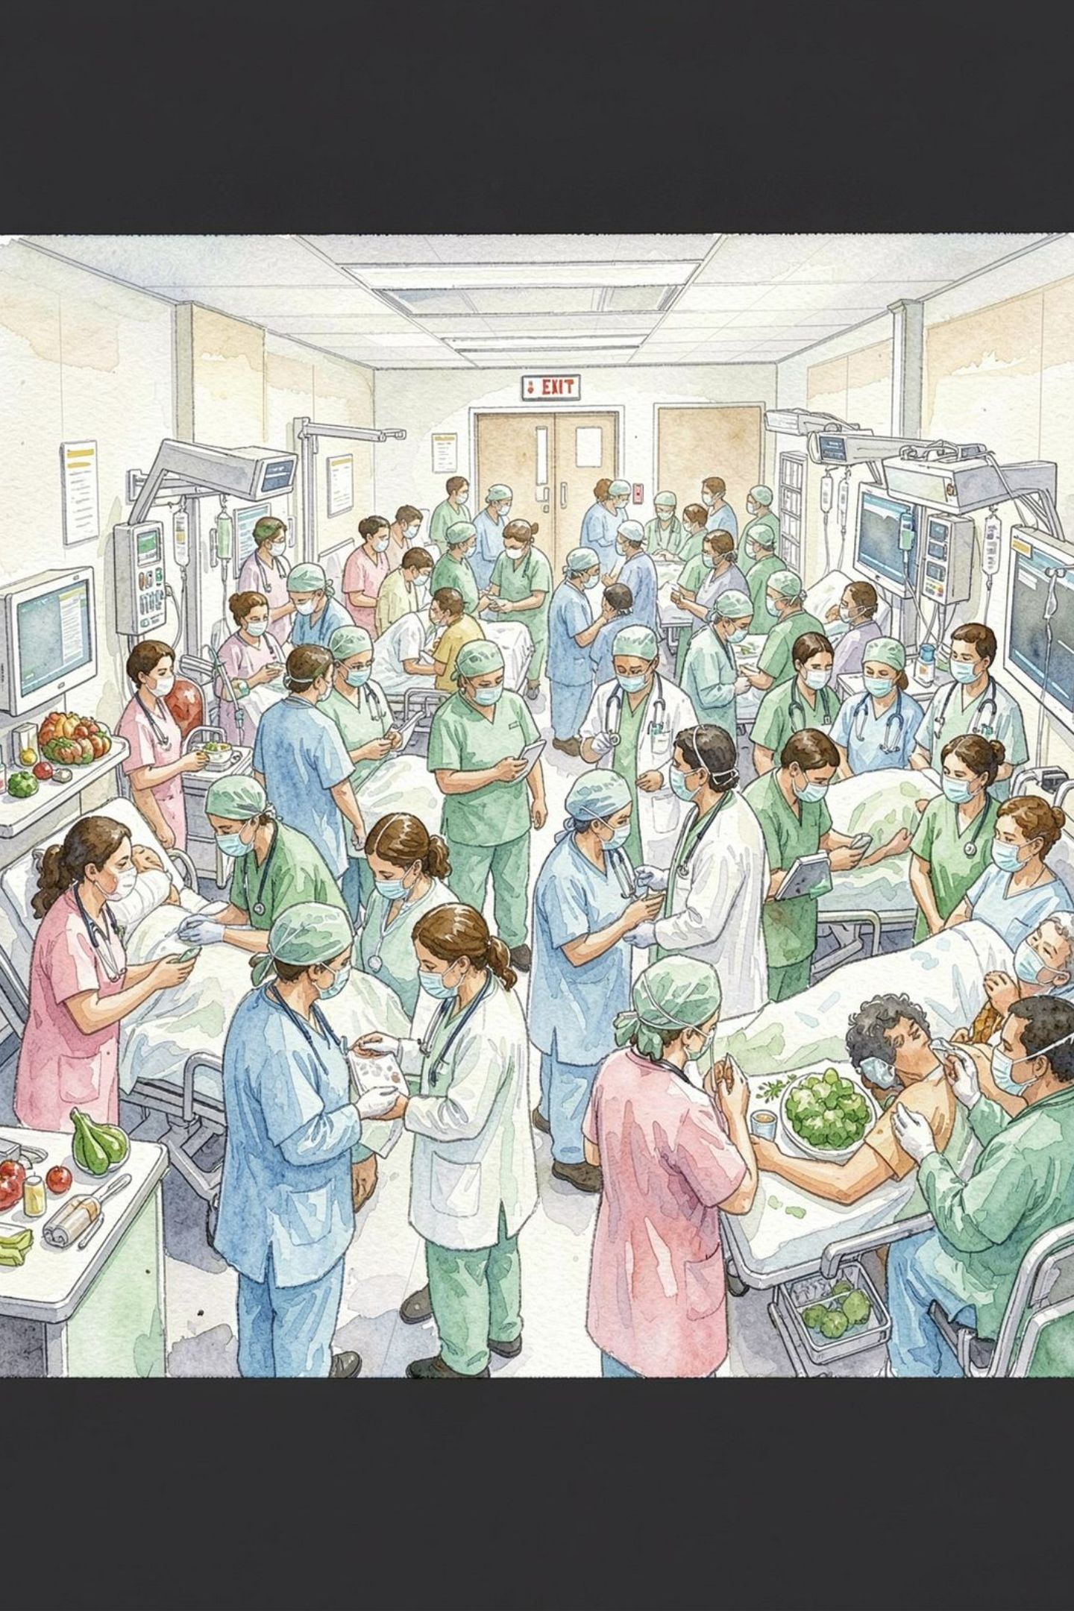
Key Challenges in ER Triage
Volume Surge
Peak hours crush the clock. Undertriage risk goes up fast.
Subjective Judgment
Different nurses, different calls. Borderline Level 2/3 cases take the hit.
Patient & Family Pressure
They'll push. Stay objective. The protocol doesn't care about volume.
Dynamic Reassessment
A Level 3 can become a Level 1. Reassess or miss it.

Slide 8

Best Practices for Effective Triage
Standardized Protocols
Ongoing Training & Validation
Technology Integration
Clear Communication
Use ESI, CTAS, or MTS the same way every time. Consistency saves lives.
Monitors, EHR, decision tools. Faster assessment, fewer mistakes.
Tell them straight. Less panic. Better compliance.
Drill it. Review cases. Keep the skill sharp.
Triage is discipline. Follow the protocol. Trust the process.

