Slide 1
Validation System for PeerGFS-Based Active-Active NAS DR
Production-Grade Multi-Site DR Validation and Demonstration Plan
Leading Point
2026

Slide 2
Overview | Validation Objectives & Expected Outcomes | 3
System Configuration | Components and Architecture | 4
Data Design | Validation Data Composition | 5
Data Generation Strategy (1) | Data Structure and Distribution Strategy | 6
Data Generation Strategy (2) | Synthetic Workload Generation Strategy | 7
Data Generation Strategy (3) | Real-World File-Based Workload Configuration and Validation | 8
Validation Scenarios | Core Validation Scenario Framework & Workflow | 9
Scenario 1 | Baseline Performance Measurement & Initial Replication Validation | 10
Scenario 2 | Near Real-Time Replication Validation | 11
Scenario 3 | Delta-Level Replication Validation | 12
Scenario 4 | Active-Active File Services Validation | 13
Scenario 5 | WAN Environment Performance Validation | 14
Scenario 6 | Failure Scenario | 15
Scenario 7 | Recovery Scenario | 16
Conclusion | Summary of Validation Results & Expected Effects | 17
CONTENTS

Slide 3
Validation Objectives & Expected Outcomes
Traditional NAS-based DR environments commonly face limitations such as WAN performance degradation, extended RPO windows, repeated retransmission of large files, and underutilized passive DR sites.
This validation plan is designed to evaluate whether PeerGFS can support production-scale Active-Active NAS DR environments.
Near Real-Time Active-Active DR Validation
Delta-Level Replication Efficiency Validation
WAN Environment Validation
Failure Recovery and Data Consistency Validation
Validation of near real-time data synchronization and bi-directional Active-Active operations
Validation of a changed data transfer architecture designed to minimize network utilization by transmitting only modified data blocks
Validation of synchronization stability under high-latency and packet-loss network conditions
Validation of automatic re-synchronization and data integrity during failure and recovery scenarios
Key Validation Areas
Validation Area | Expected Outcome | Validation Method
Near Real-Time Replication Performance | Measurement of actual replication latency between file modification and DR site synchronization | Timestamp-Based Synchronization Latency Calculation
Delta-Level Replication | Verification of efficient transfer of changed data only | Comparison of transferred data volume after partial file modification
Active-Active File Services | Verification of stable bi-directional operations and data consistency during concurrent workloads | Validation of data consistency after concurrent file creation and modification across both Main and DR sites
WAN Replication Stability | Measurement of replication performance under degraded network conditions | Linux tc-based simulation of latency, packet loss, and bandwidth constraints
Failure Recovery and Data Consistency | Verification of automatic re-synchronization and data consistency after failure recovery | Post-recovery data consistency comparison

Slide 4
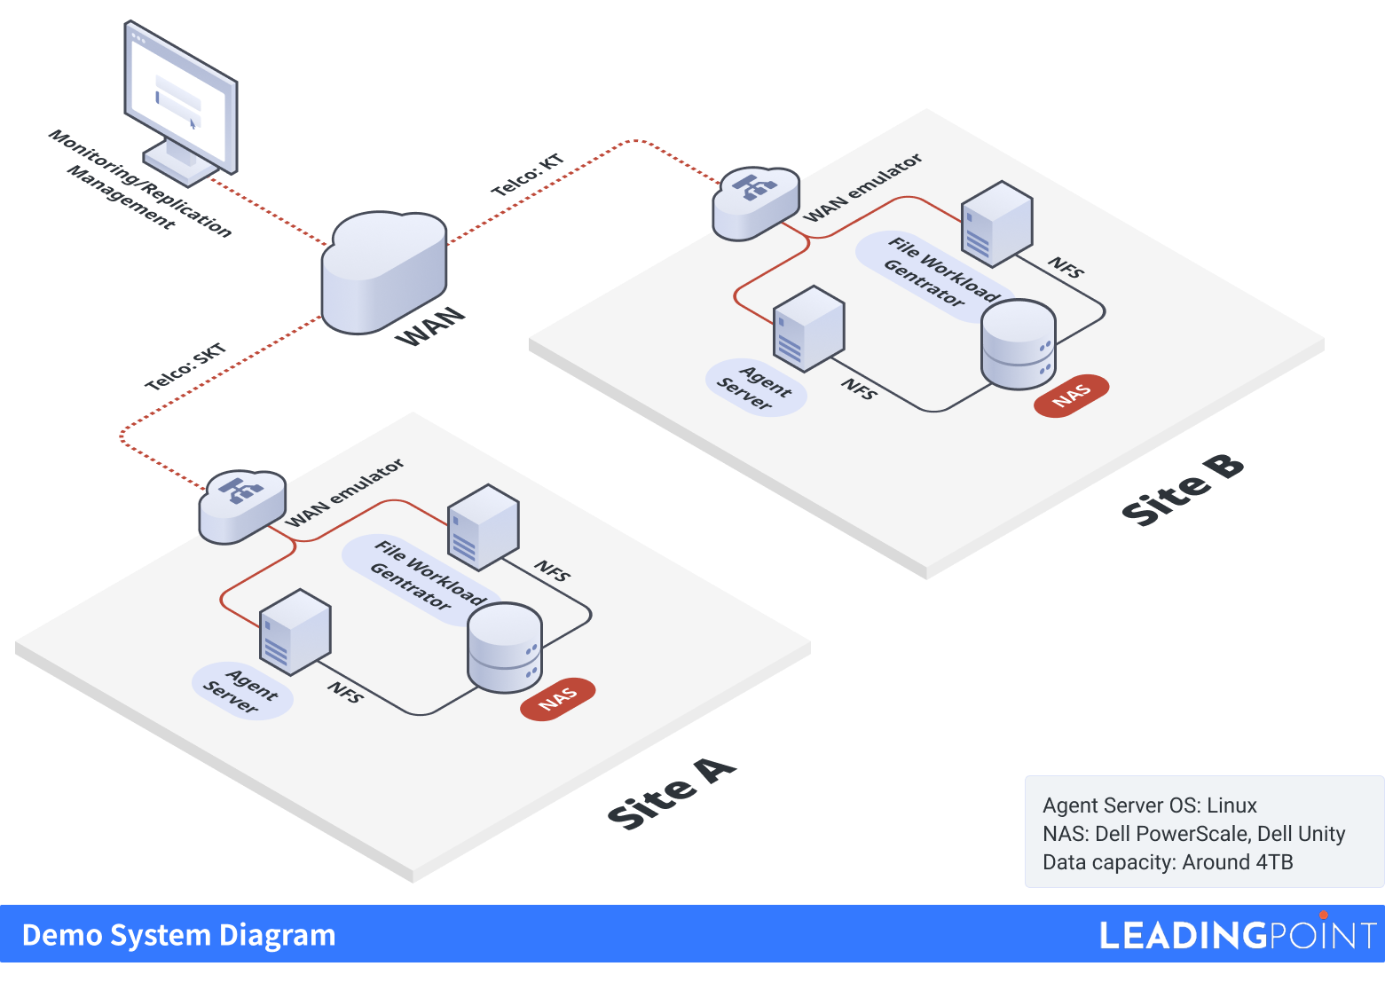
Validation Environment and Architecture
The validation environment has been designed to closely emulate a real-world production deployment in order to validate real-time replication, WAN performance, failure recovery, and data consistency in an Active-Active NAS DR architecture.
Component | Role
NAS | Production-grade file storage environment
Linux Server | NFS mounting and real-time file change generation/validation
PeerGFS Agent | Real-time file change detection and Delta-Level Replication
Peer Management Center | Replication status monitoring, job management, and operational visibility
WAN Network | Simulation of latency, packet loss, bandwidth constraints, and unstable WAN conditions
Server Specifications
CPU: 8 Core or higher Memory: 32GB or more Disk: SSD 50GB or more NIC: 10Gbps OS: Linux (Ubuntu/RHEL-based Linux OS)
Notes
SSD-based configuration for high-throughput replication performance validation Linux environment optimized for large-scale file processing and replication validation 10Gbps NIC configuration for high-throughput WAN replication testing

Slide 5
Validation Dataset Design & Workload Configuration
The validation dataset is configured to reflect various file sizes and access patterns encountered in actual production environments. It is designed to validate multi-file processing workloads, large file replication, continuous file modifications, and real-time data synchronization characteristics within WAN environments. In addition, the validation is based on datasets reflecting actual NAS operational environments, including Office documents, images, and backup files.
File Composition (Total 1,324,000 files / Total 10TB)
File Types | Count | Scope
Extra Small File (500KB) | 1,000,000 | File and Directory Processing Performance, Concurrent File Changes, IOPS Load
Small File (5MB) | 300,000 | Standard Business File Synchronization Patterns
Medium File (100MB) | 20,000 | Throughput Verification
Large File (500MB) | 3,000 | WAN Bandwidth Utilization
Extra Large File (1GB) | 1,000 | Large File Transfer Integrity & Stability
Design Objective
Large Volume of Small Files | Performance Degradation during Bulk File Creation / Handling Concurrent Multi-file Updates / Processing Delays in Large Multi-file Environments
A Subset of Medium/Large Files | WAN Bandwidth Utilization / Throughput Stability in WAN Environments / Large-scale Transfer Reliability
Data Composition | 99% Synthetic Data (fallocate-based) + 1% Actual Files (Sample Replication & Modification of PDF, JPG, TXT, etc.)

Slide 6
Verification Data Generation Strategy & Storage Structure
The verification environment consists of approximately 10TB of data and over 1.32 million files. To minimize processing bottlenecks and file system stress in large-scale environments, directory distribution and I/O optimization strategies have been implemented.
Core Principles
Directory Structure
Data Composition | 99% Synthetic Data + 1% Actual Files
Initial Data | No initial network-based synchronization for the total 10TB of data Physical migration (Seeding) used to replicate actual production environments Real-time replication verification performed only for delta changes after initial setup
Directory Distribution Strategy | Prevention of processing bottlenecks caused by single directory congestion Maintenance of file system performance in large-scale small file environments Workload optimization for parallel file creation and scanning
bash
/data
├── small/ (00~63, 64 Directories)
│ └── 500KB × 1,000,000
├── medium/ (00~31, 32 Directories)
│ └── 5MB × 300,000
├── large/ (00~15, 16 Directories)
│ └── 100MB × 20,000
└── xlarge/
├── 500MB × 3,000
└── 1GB × 1,000
File System Optimization
Feature | Purpose
noatime | Reduces unnecessary file system write operations
nodiratime | Minimizes directory access overhead
Directory Sharding | Prevents concentrated file access bottlenecks
SSD-based Storage | Optimizes I/O for large-scale small file environments
Linux inotify | Supports real-time file change detection

Slide 7
Synthetic Workload Generation Strategy
Large-scale verification data was generated using a synthetic approach to optimize creation time and storage efficiency. Small-file workloads were generated based on random data to emulate realistic large-scale file processing environments, while large-scale files utilized fallocate-based allocation for rapid generation and Delta-Level Replication validation.
Small File
(500KB x 1,000,000)
Medium File
(5MB x 300,000)
Large/XLarge File
(500MB / 1GB)
Delta-Level Replication Validation Considerations
Avoid full re-generation of large-scale files
Workload configuration based on partial file overwrites
Data design structured to verify that only changed data (delta changes) are transmitted
Implementation of modification patterns that maintain original file sizes
Strategies for
Production-Grade Realism
Reflecting file size distributions that emulate actual production environments
Inclusion of high-frequency multi-file workloads
Application of modification patterns based on partial overwrites
Inclusion of large-scale transfer workloads within WAN environments
Verification Objectives
Large-scale multi-file workload generation
Replication of large-scale small file environments
Verification of concurrent file creation and modification workloads
Generation Methodology
Random data generation via /dev/urandom
Parallel creation using GNU parallel
Implementation of 64-directory sharding
Verification Objectives
Replication of standard business file operation patterns
Establishment of a mixed workload environment
Generation Methodology
Random data-based generation
Implementation of 32-directory sharding
Parallel generation to accelerate dataset creation
Verification Objectives
Validation of WAN throughput
Validation of large-scale file transfer stability
Establishment of a baseline for Delta-Level Replication validation
Generation Methodology
Rapid space allocation using fallocate
Applying entropy via partial random overwrites
Ensuring efficiency in generation time and storage utilization

Slide 8



Real-World File-Based Workload Configuration and Validation
Recognizing that synthetic data alone cannot fully replicate the file diversity and modification patterns of actual production environments, we have incorporated real-world business files (e.g., PDF, JPG, TXT, Office documents). By applying partial overwrite-based modification patterns, we have established a workload that reflects realistic enterprise NAS operational environments.
Real-World File Workload Configuration
Partial Overwrite-Based Modification Strategy
Post-Generation Verification Procedures
Objectives
Integration of actual business file patterns
Inclusion of diverse binary structures
Replication of application-driven file operation behaviors
Objectives
Validation of Delta-Level Replication capabilities
Verification of full-file retransmission prevention
Simulation of real-world file modification patterns
Verification Items | Objectives
Total Capacity Check | Verification of the target dataset (10TB)
File Count Verification | Validation of the workload scale
File Integrity Verification | Verification of file integrity
Sampling Verification | Confirmation of successful and accurate data generation
Included File Types
PDF / JPG / TXT / Office document samples
Principles
Maintenance of original file size
Modification of selected portions of files only
Application of overwrite-based delta changes
Generation Methodology
Sample file replication
Modification via partial random overwrites
Applying diverse file modification patterns
Data Integrity Verification
Execution of sampling-based file integrity verification
Validation of data health and identification of potential corruption
Establishment of the baseline dataset for subsequent DR recovery scenarios
Linkage to Delta-Level Replication Validation
By implementing partial overwrite-based modification patterns on real-world business files, the environment is configured to validate whether only changed data (delta changes) are transmitted at a realistic workload level.

Slide 9
Key Validation Scenario Framework
Performance Baseline |  | Key Verification Points
Performance Baseline | 1. Baseline Measurement | Identify maximum system performance prior to PeerGFS implementation; establish benchmarks
 | 2. Initial Replication | Measure initial data loading performance and reference replication performance for select datasets
Near Real-Time Replication Validation | 3. Near Real-Time Replication | Measure Replication Latency and End-to-End (E2E) time; validate Low RPO capabilities
 | 4. Delta-Level Replication | Verify that only changed data (delta changes) is transmitted
Active-Active Operations | 5. Active-Active File Services | Ensure stable bi-directional operations and data consistency during concurrent multi-site workloads
 | 6. WAN Condition Test | Validate replication stability under degraded WAN conditions (high latency/packet loss)
Failure & Consistency | 7. Failure Scenario | Confirm automatic re-replication and data consistency after restoration
 | 8. Recovery Scenario | Confirm automatic re-synchronization and data consistency after restoration

Slide 10
1. Baseline Performance Measurement & 2. Initial Replication Validation
In this stage, we measure the system’s baseline performance prior to Peer GFS implementation, establishing a benchmark for all subsequent validation results. To emulate production-grade environments, the initial large-scale dataset is established via physical seeding, allowing the validation to focus specifically on the replication performance of subsequent delta changes.
1. Baseline Performance Measurement
Measurement Area | Objective | Tool
Network Throughput | Identify maximum transmittable bandwidth | iperf3
Network Latency | Establish baseline for network latency | ping / iperf3
NAS IOPS | Establish benchmarks for small-file processing performance | fio
Storage Throughput | Measure large-scale I/O processing performance | fio
I/O Latency | Establish baseline for storage response times | fio
2. Initial Synchronization Validation
The core objective of this validation is to evaluate real-time replication and Delta-Level Replication performance for operational data changes, rather than the initial full-data replication.
Initial Replication Strategy
Physical Seeding: Applied to the large-scale initial dataset (10TB)
Bypassing Network-Based Full Replication: Initial full-data replication over the network is excluded to reflect real-world migration patterns
Focus on Delta-Level Synchronization: Validation is centered on the near real-time replication performance of modified data following the initial baseline setup
The following scenario measures Replication Latency—the actual time elapsed between file modification and its successful replication to the DR site.

Slide 11
3. Near Real-Time Replication Validation
This scenario validates the delay between file modification events and replication completion at the DR site during continuous workload execution. The objective is to measure near real-time replication responsiveness and low-RPO operational capability.
Verification Objectives
Measurement Metrics
Test Procedures
Measurement of actual replication latency between file modification and DR site replication.
Validation of near real-time replication capabilities.
Validation of Low RPO (Recovery Point Objective) environments.
Verification of continuous near real-time replication stability under sustained enterprise NAS workloads.
Measurement Metrics | Description
Sync Detection Time | Time elapsed to detect file modifications
Transfer Start Delay | Latency before the data transfer process initiates
End-to-End Replication Time | Total time from initial file creation/modification to completion on the DR site
Sync Stability | Performance consistency and reliability under repetitive workload stress
Generate a file in the Main NAS environment.
Record the creation timestamp (START).
Record the timestamp when the file is first detected in the DR environment (DETECT).
Verify completion based on file size and data integrity validation.
Calculate the time difference (Latency) between the recorded timestamps.
Script Example (Bash)
Workflow
Expected Outcomes
bash
# 1. Generate file and record start time (Main Server)
START=$(date +%s.%N)
dd if=/dev/urandom of=/data/test/file_1 bs=1M count=10
echo $START > /tmp/start_time.txt
# 2. Record detection time on DR server
while [ ! -f /data/test/file_1 ]; do sleep 0.1; done
DETECT=$(date +%s.%N)
# 3. Verify sync completion via file size
while true; do
size=$(stat -c%s /data/test/file_1)
if [ "$size" -eq 10485760 ]; then break; fi
done
END=$(date +%s.%N)
# 4. Calculate results
echo "Sync Latency : $(echo "$DETECT - $START" | bc) seconds"
echo "E2E Total Time : $(echo "$END - $START" | bc) seconds"
File Creation
Sub-second replication latency for standard enterprise NAS workloads.
Confirmation of near real-time DR operational feasibility.
Validation of sustained real-time replication without performance degradation.
Successful verification of Low RPO environment requirements.
Modification (Creation) Detection
PeerGFS Replication
DR Replication Completion

Slide 12
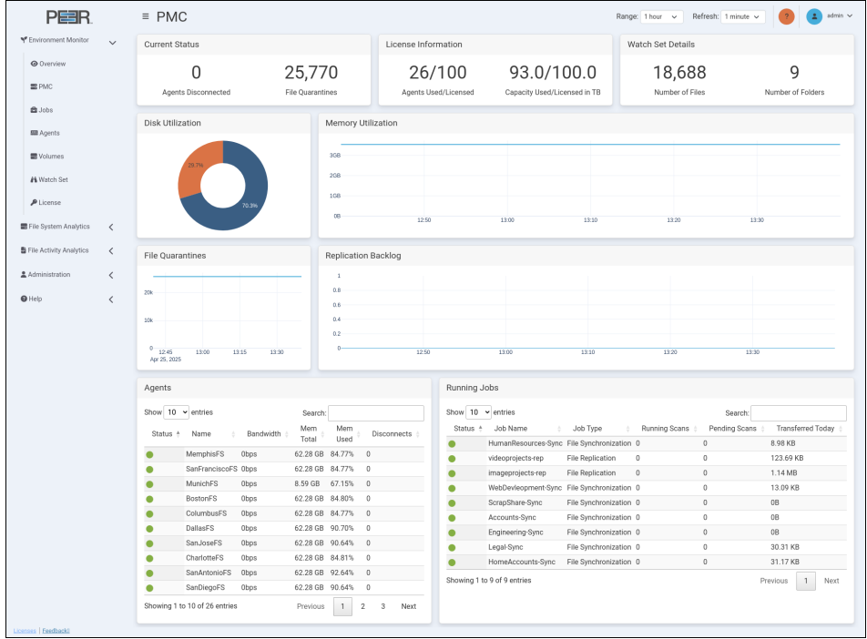
4. Delta-Level Replication Validation
This scenario evaluates the efficiency of PeerGFS Delta-Level Replication by verifying that only modified data is replicated instead of retransmitting entire files. The goal is to validate WAN bandwidth efficiency and replication performance optimization within enterprise NAS environments.
Verification Objectives
Test Principles
Test Procedures
Verify delta-level replication behavior: Confirm that only modified data is replicated.
Validate minimization of network utilization: Ensure efficient use of bandwidth.
Assess replication efficiency in WAN environments: Measure the effectiveness of delta-level replication over high-latency networks.
Evaluate enterprise NAS workload optimization: Validate replication performance for large-scale file operations.
Principle | Description
Partial Overwrite | Modifying only a specific portion of the file
Maintain File Size | Prohibiting full-file regeneration to isolate the measurement of delta changes
Delta-Level Replication Validation | Confirming that only modified data is identified and replicated
Transfer Size Measurement | Conducting a comparative analysis of the actual data volume transmitted
Generate a 100MB baseline file
Perform a 10MB (10%) partial overwrite on the file
Monitor the Peer Management Center to track real-time replication metrics
Conduct a comparative analysis of the actual transmission volume vs. total file size
Validate synchronization completion and data integrity on the DR site via checksum
Workflow
Expected Validation Outcomes
Verify via Peer Management Center
File Modification (10%)
Successful replication of modified data only, without full-file retransmission
Significant reduction in network utilization, particularly advantageous for WAN environments
Confirmed operation of Delta-Level Replication: Validation that for a 100MB file modification, only the modified ~10MB data is replicated instead of retransmitting the full 100MB file
Modification Detection
PeerGFS Real-Time Replication (Delta-Level Only)
Delta ReplicationCompletion

Slide 13
5. Active-Active File Services Validation
Traditional DR environments often suffer from low resource efficiency because the DR site remains in a passive operational state. This scenario validates the Active-Active File Services architecture, where both the Main and DR sites remain operational while maintaining data consistency and replication stability during concurrent bi-directional file operations.
Validation Objectives
Test Configuration
Test Procedures
Validation of simultaneous operations at both Main and DR sites
Verification of conflict-free bi-directional synchronization for file creation and modification
Assessment of DR site feasibility for active production workloads
Validation of sustained near real-time synchronization and data consistency
Main Site | DR Site
File Creation/Modification | File Creation/Modification
Active | Active
↔ Bi-directional | ↔ Bi-directional
Concurrent File Activities: Simultaneously create and modify files on both the Main and DR servers
Cross-Site Modification: Perform separate file modifications on each site to induce bi-directional traffic
Replication Monitoring: Verify the status and completion of bi-directional replication through the Peer Management Center
Consistency Audit: Compare final file lists and data consistency between both sites
Measurement Metrics
Expected Outcomes
Metric | Description
Bi-directional Replication | Success rate of simultaneous two-way Replication
Replication Latency | Time elapsed for modifications to be reflected across both sites
Data Consistency | Verification of final data consistency across both sites
Continuous Operation | Maintenance of stable Active-Active states under sustained load
Proven feasibility of bi-directional Active-Active operations, maximizing resource utilization at the DR site
Validation of conflict-free, near real-time Replication during simultaneous multi-site updates
Confirmed data integrity across all nodes, validating the robustness of the Peer GFS-based architecture

Slide 14
6. WAN Environment Performance Test
In real-world DR deployments, various WAN constraints such as latency, packet loss, and limited bandwidth are common. This scenario validates whether PeerGFS maintains real-time replication stability and WAN transfer efficiency even under degraded network conditions.
Verification Objectives
WAN Simulation Phases
Measure real-time replication performance changes under WAN conditions.
Validation of response capabilities in high-latency scenarios.
Assessment of stability in environments with packet loss.
Verification of transmission efficiency under bandwidth-constrained conditions.
We utilize Linux tc (Traffic Control) to emulate realistic WAN conditions across the following phases.
Phase | Condition | Objective
Baseline | No constraints | Establish baseline performance benchmarks
Latency | 50ms delay | Validate performance in high-latency (long-distance) environments
Packet Loss | 1% loss | Verify retransmission efficiency and replication stability
Bandwidth Limit | 100Mbps | Evaluate transfer efficiency under constrained bandwidth
Measurement Metrics
Expected Outcomes
Metric | Description
Transfer Speed | Fluctuations in throughput under WAN constraints
Replication Latency | Changes in end-to-end synchronization delay
Transferred Data | Total data volume transmitted via Delta Replication
Active Transfer | Monitoring of concurrent transfer threads and system status
Maintenance of stable synchronization even under severe WAN conditions
Confirmed efficiency in bandwidth-limited environments, maximizing available throughput
Validation of retransmission robustness in packet loss environments without session drops
Proven feasibility for long-distance DR deployments through resilient transport protocols

Slide 15
7. Failure Scenario
This scenario evaluates the system's ability to maintain operations at the DR site during a Main site outage. The goal is to verify service continuity and confirm that the DR site can support production workloads independently without data loss.
Verification Objectives
Test Procedures
Verification Items
Expected Outcomes
Validation of system response during a Main site failure
Verification of DR site standalone operational capabilities
Assessment of data loss during the failure event
Validation of Business Continuity (BCP)
Forced Shutdown: Execute a forced shutdown of the Main server
Standalone DR Operations: Continue production workloads exclusively on the DR server
Active File Modification: Perform file creation and modifications directly on the DR site
Service Audit: Verify service availability and identify any potential data loss
Item | Description
DR Continuous Operation | Feasibility of standalone DR operations
Data Loss | Presence of data loss at the point of failure
Sync Status | Synchronization state at the moment of failure
Service Availability | Ability to sustain services without interruption
Seamless operation at the DR site during Main site failure
Zero or minimal data loss confirmed through PeerGFS real-time replication architecture
Validation of Active-Active DR robustness for business continuity

Slide 16
8. Recovery Scenario
This scenario validates the automatic restoration process once the Main site is recovered. It focuses on the system's ability to automatically re-synchronize changes made during the downtime and ensure perfect data integrity.
Verification Objectives
Test Procedures
Verification Items
Expected Outcomes
Verification of automatic re-replication after Main site recovery
Validation of delta change application for the period of failure
Assessment of post-recovery data consistency
Validation of stable operational failback
Main Site Restoration: Bring the Main server back online
Auto Re-Replication Monitoring: Monitor PeerGFS for automatic replication resumption
Delta Reflection: Verify that modifications made on the DR site during downtime are applied to the Main site
Consistency Audit: Compare final data consistency between Main and DR sites
Item | Description
Auto Re-Synchronization | Capability to resume sync without manual intervention
Recovery Time | Time required to complete the re-synchronization process
Data Consistency | Post-recovery integrity check using checksums
Missing Changes | Verification that all changes from the downtime are reflected
Zero-touch automatic re-replication without manual intervention
Successful reflection of all delta changes made during the outage
Perfect data consistency maintained across both sites after recovery
Stable and reliable operational failback confirmed

Slide 17
Summary of Validation Results & Expected Effects
This validation goes beyond simple file replication tests; it is designed to prove that a PeerGFS-based Active-Active NAS DR architecture is fully capable of stable, production-grade operations. The results comprehensively demonstrate the feasibility of real-time replication, WAN optimization, and multi-site data consistency.
Core Validation Summary
Expected Effects
Validation Item | Key Findings & Verification
Near Real-Time Sync | Achievement of near real-time synchronization performance
Delta Replication | Maximized WAN efficiency through block-level delta transfers
Active-Active | Proven feasibility of bi-directional active operations at both sites
WAN Validation | Sustained synchronization stability under degraded network conditions
Failure & Recovery | Confirmed service continuity and automatic zero-touch recovery
Operational Aspect
Maximization of DR Site Resource Utilization: Transitions the DR site from a passive to an Active-Active state, improving overall infrastructure efficiency
Continuous Near Real-Time Replication DR Environment: Establishes a highly responsive disaster recovery architecture based on Low RPO
Technical Aspect
WAN Environment Optimization: Overcomes network constraints PeerGFS replication architecture
Significant Bandwidth Savings: Reduces network overhead via Delta-Level Replication
Guaranteed Data Consistency: Ensures real-time data consistency across all sites
Business Aspect
Minimized Failure Response Time: Achieves rapid recovery and minimizes the impact of system outages
Enhanced Service Continuity: Ensures uninterrupted business operations through robust failover capabilities
Reduced Operational Risk: Mitigates the risk of data loss and downtime in enterprise-scale environments

